Slide 1
Evaluating Washington, D.C. as a Disability-Friendly City
Capstone Project
Is the city Compliant or
Complicit???
Asher Scott
Data 205
CRN 33155
Professor Perine
2026
Spring Semester

Slide 2
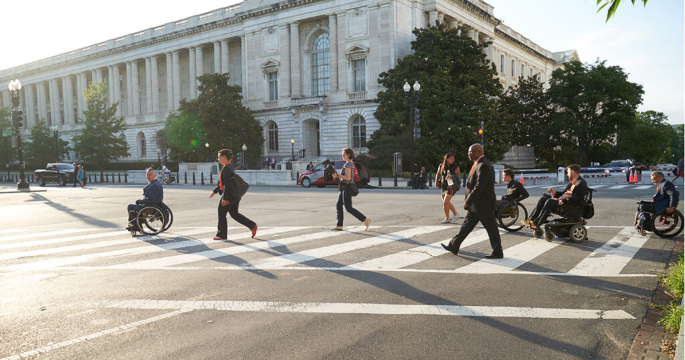
The vision
Project Outline
Definition: A disability friendly city means accessible sidewalks, ramps, bus stops, and crossings.
Four parts:
Who disabled residents are and where they live.
Infrastructure compliance.
Distance to barriers and transit.
Grades for each ward.

Slide 3

Cleaning
The vision
Used 10 datasets from D.C. Open Data Portal.
34,000+ curb ramps, 24,000 sidewalk records.
Cleaning took 40% of my time.
Used pandas, geopandas, QGIS.
Example: 479 barrier text strings → 11 categories → high/medium/low impact.
No valid analysis without preprocessing.

Slide 4
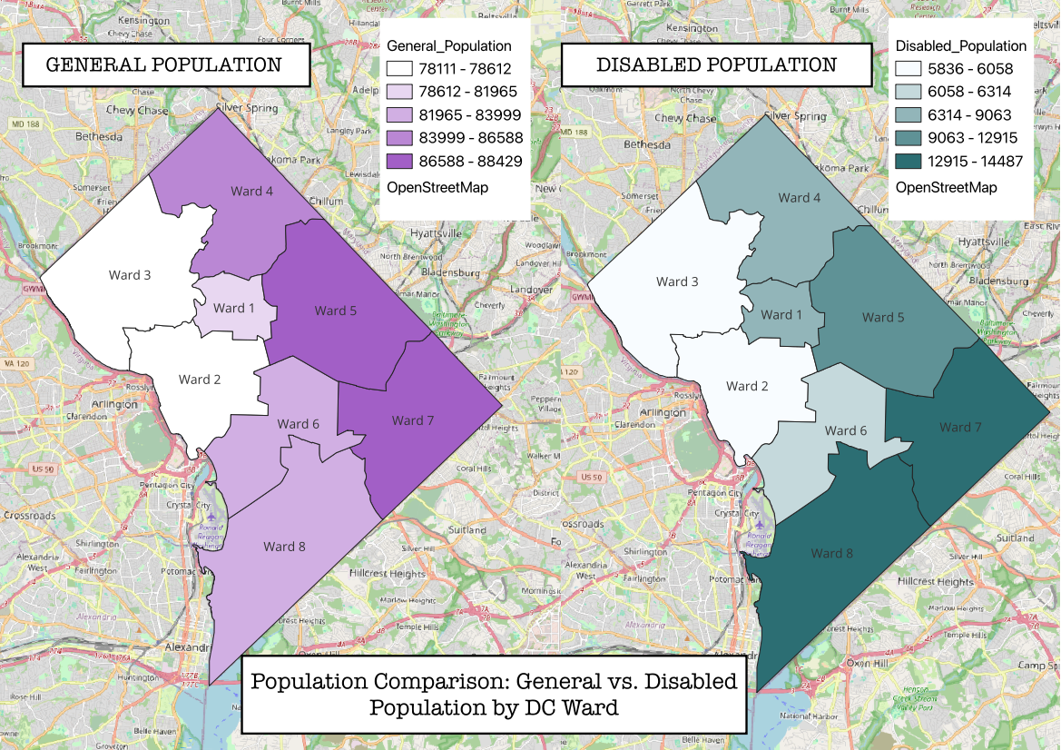
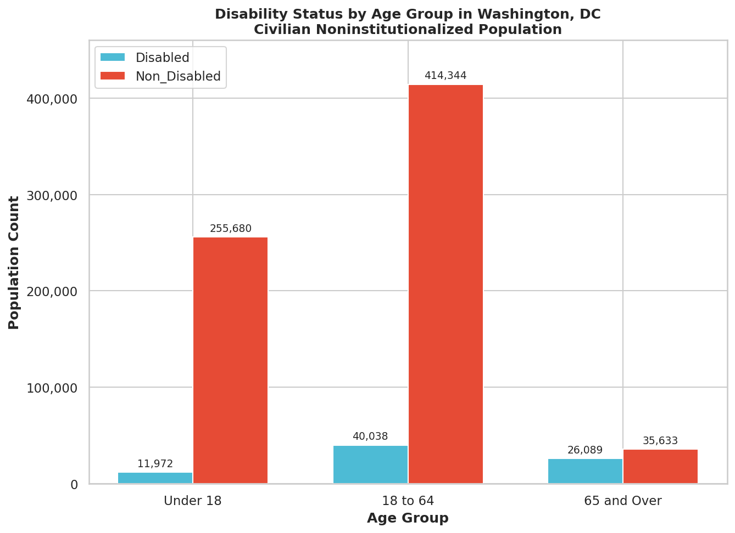
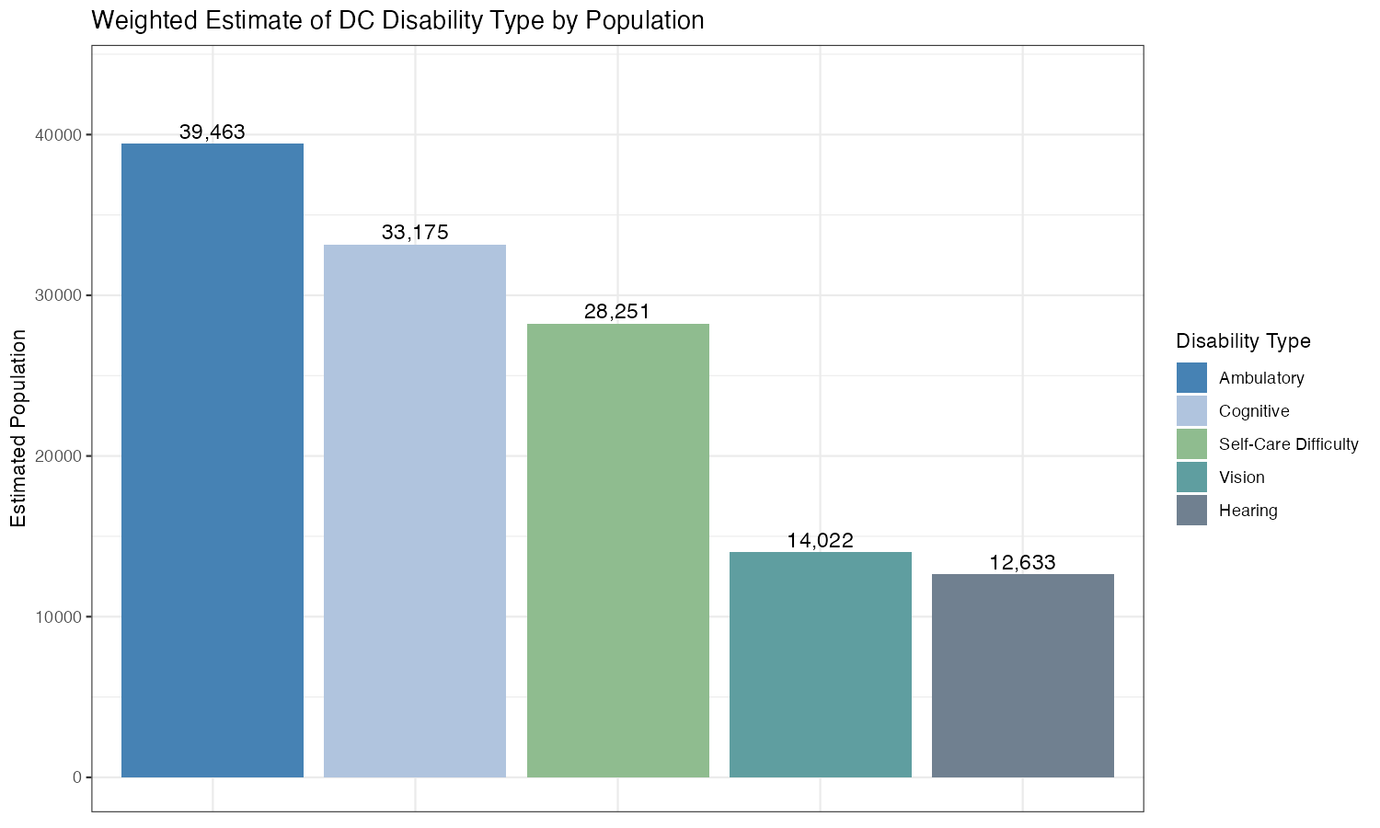
Disability Population by Age and Type
Characteristics
Disability is not evenly distributed.
Under 18: 4.5%
18–64: 8.8%
65+: 42.3% (nearly half of seniors)
Most common: ambulatory disabilities (40,000 residents).
Ramps and sidewalks directly affect this group.

Slide 5
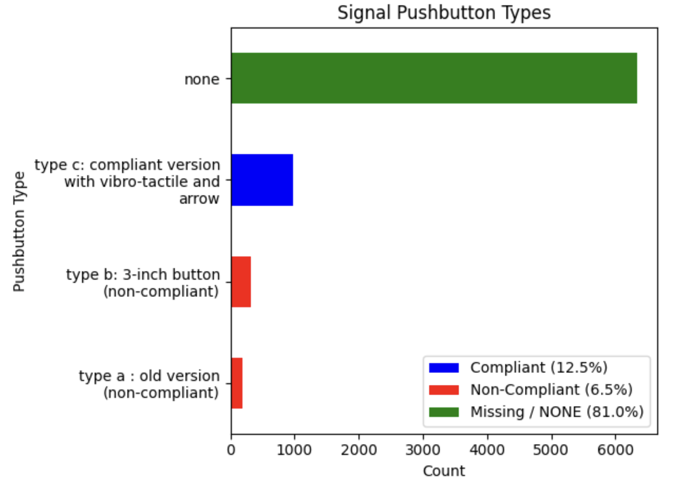
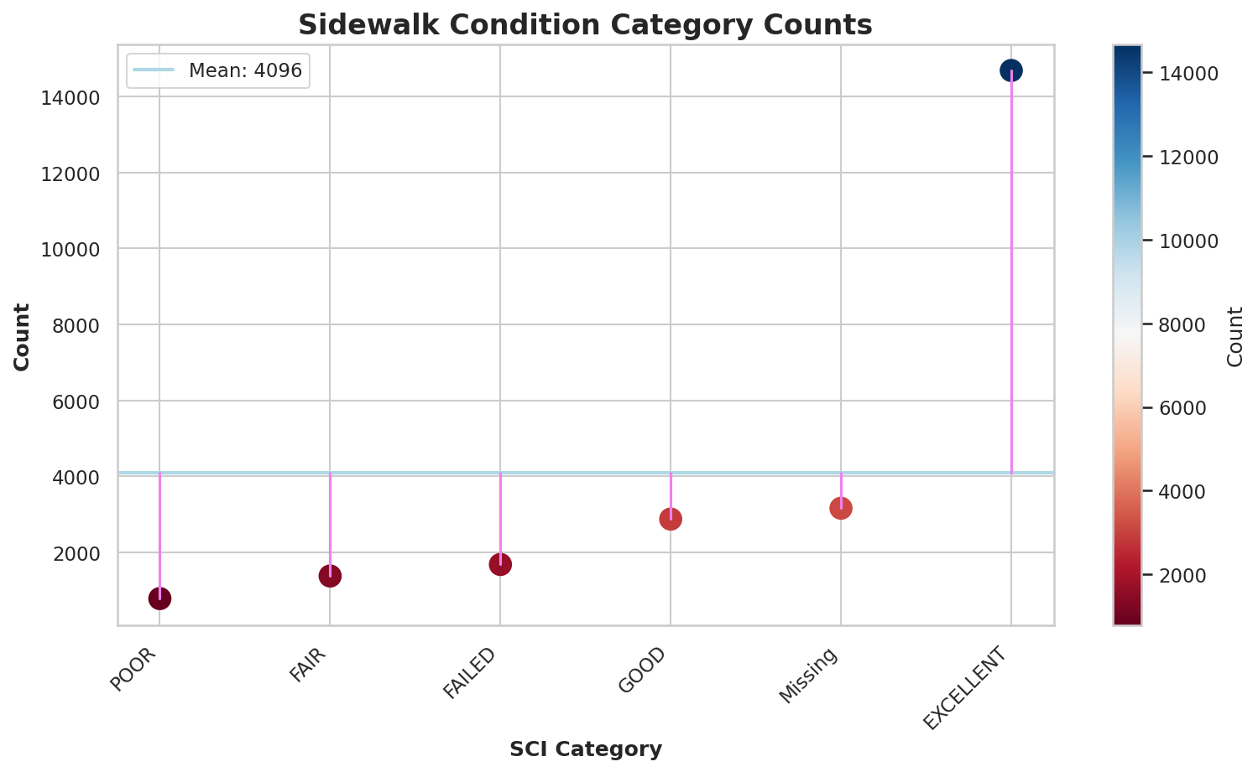
Infrastructure
Sidewalks: Excellent (14,000), but Good only 3,200.
Missing: 3,500. Failed: 1,800.
Signals: Type A (noncompliant), Type B (noncompliant), Type C (compliant).
About 50% of signals are noncompliant.
81% of areas lack an audible crosswalk.
Comparisons Part 1 – Sidewalks and Signals

Slide 6
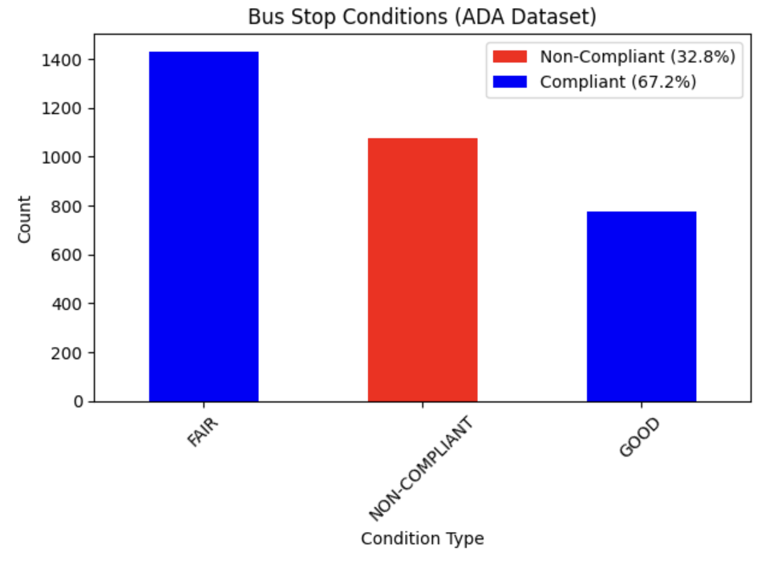
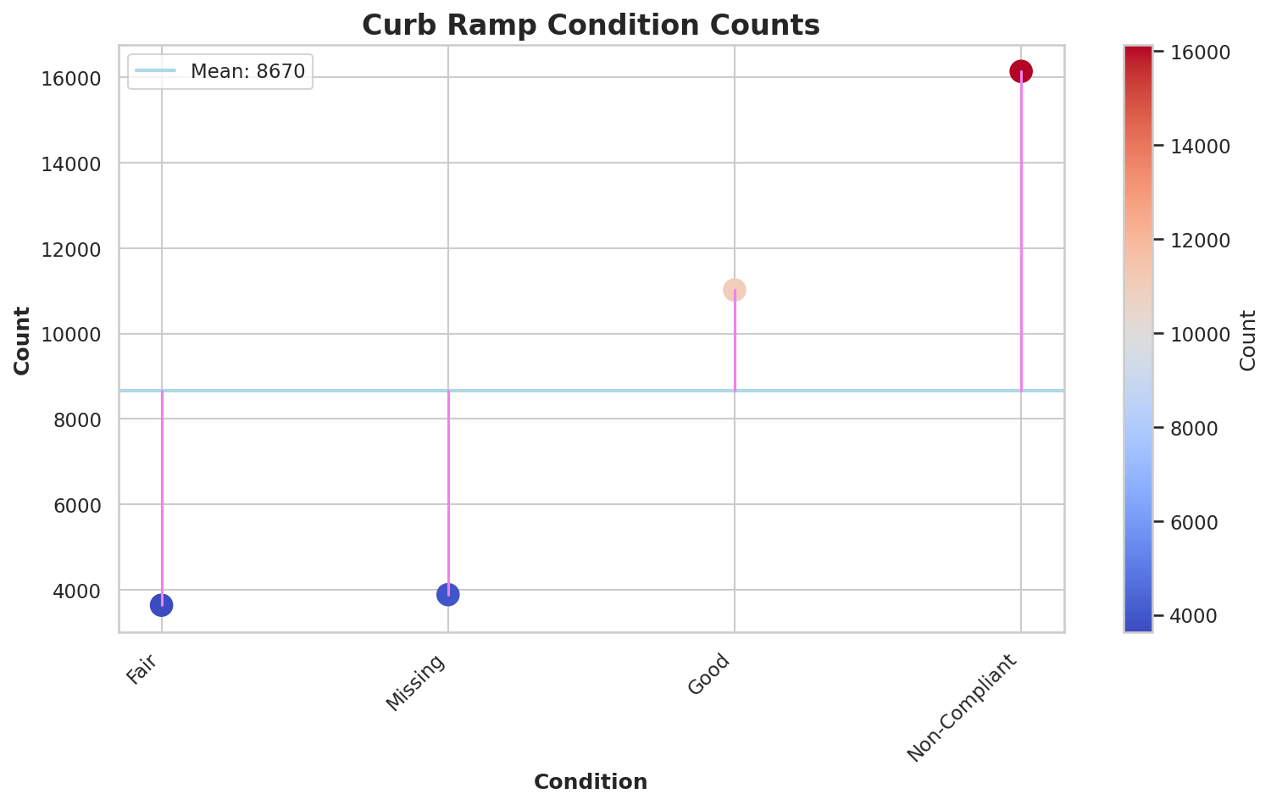
Infrastructure
Curb ramps: Noncompliant (16,000) > Good (11,000).
Fair and missing: ~8,600 each.
Bus stops: 67.2% compliant, 32.8% noncompliant.
Fair: 14,200, Good: 7,800, Noncompliant: 10,800.
Sidewalks and ramps are the worst. Signals and bus stops are slightly better but still have gaps.
Comparisons Part 2 – Curb Ramps and Bus Stops

Slide 7
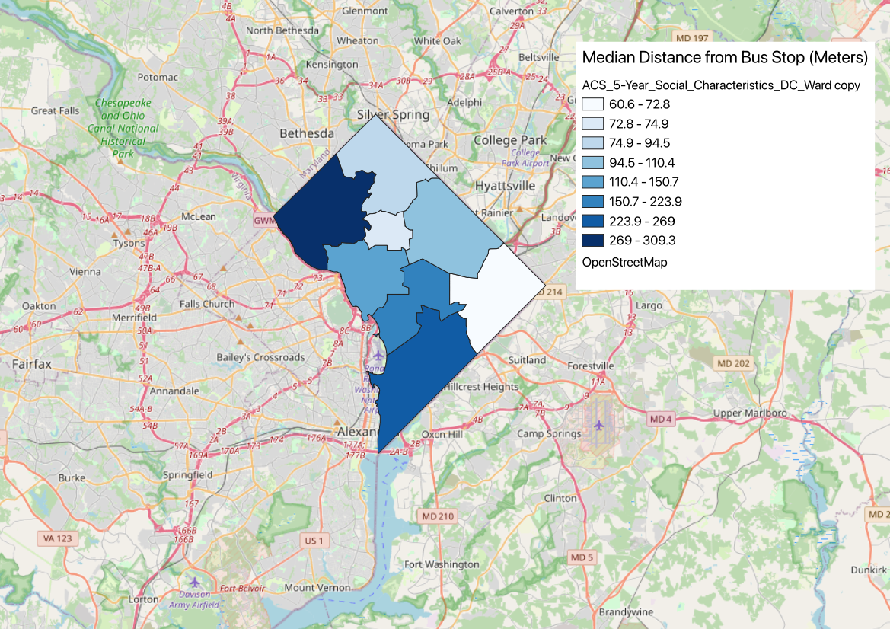
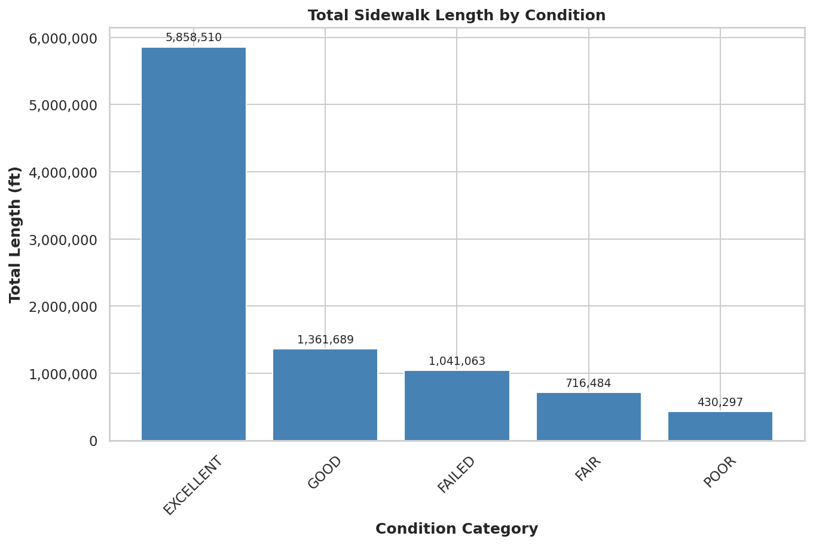
Distance
D
Calculated distance to nearest ADA bus stop
Based on ward centroids
Distances range: ~60m to 300m+
Large variation in accessibility
Metro access even more limited
Median distance: 1,038 meters (~0.6 miles)
Distance to Transit and Sidewalk Conditions

Slide 8
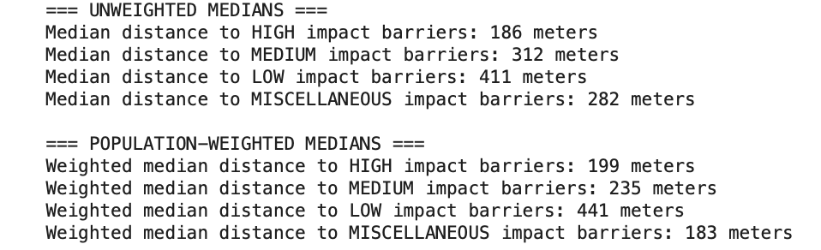
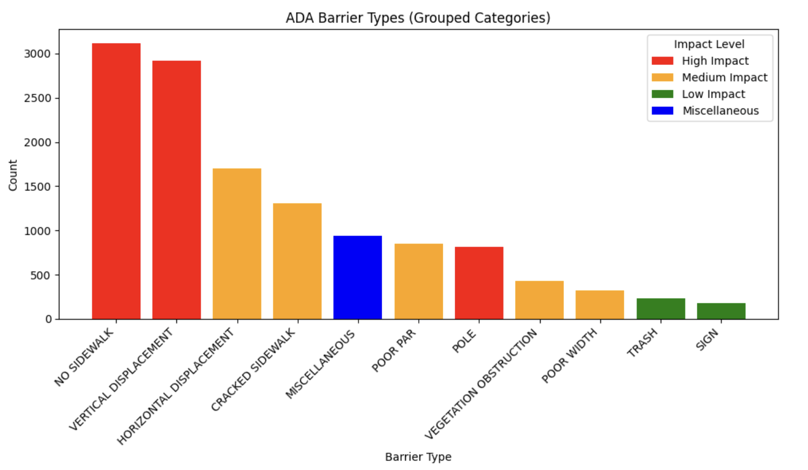
Distance
Barrier Distance by Type and Impact Level
Median distance to nearest barrier: 160 meters.
Most common high impact barriers:
No sidewalk: 3,100
Vertical displacement: 2,900
Population-weighted median to high impact barrier: 199 meters.
You can't go a couple blocks without a failed asset.

Slide 9
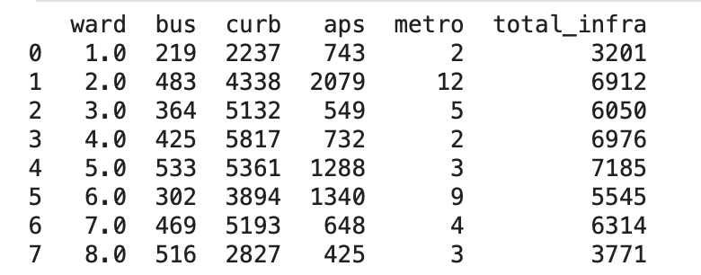
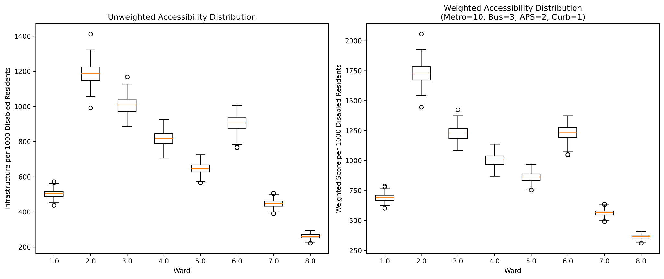
Infrastructure
Per Ward Findings – Weighted Infrastructure Scores
Weights by mobility importance:
Bus stops: 3
Curb ramps: 1
APS signals: 2
Metro stations: 10
Per 1,000 disabled residents:
Ward 2 highest: 1,724
Ward 8 lowest: 362
Ward 8 has the largest disabled population but <1/4 infrastructure per capita.
Not just compliance. It's distribution.

Slide 10
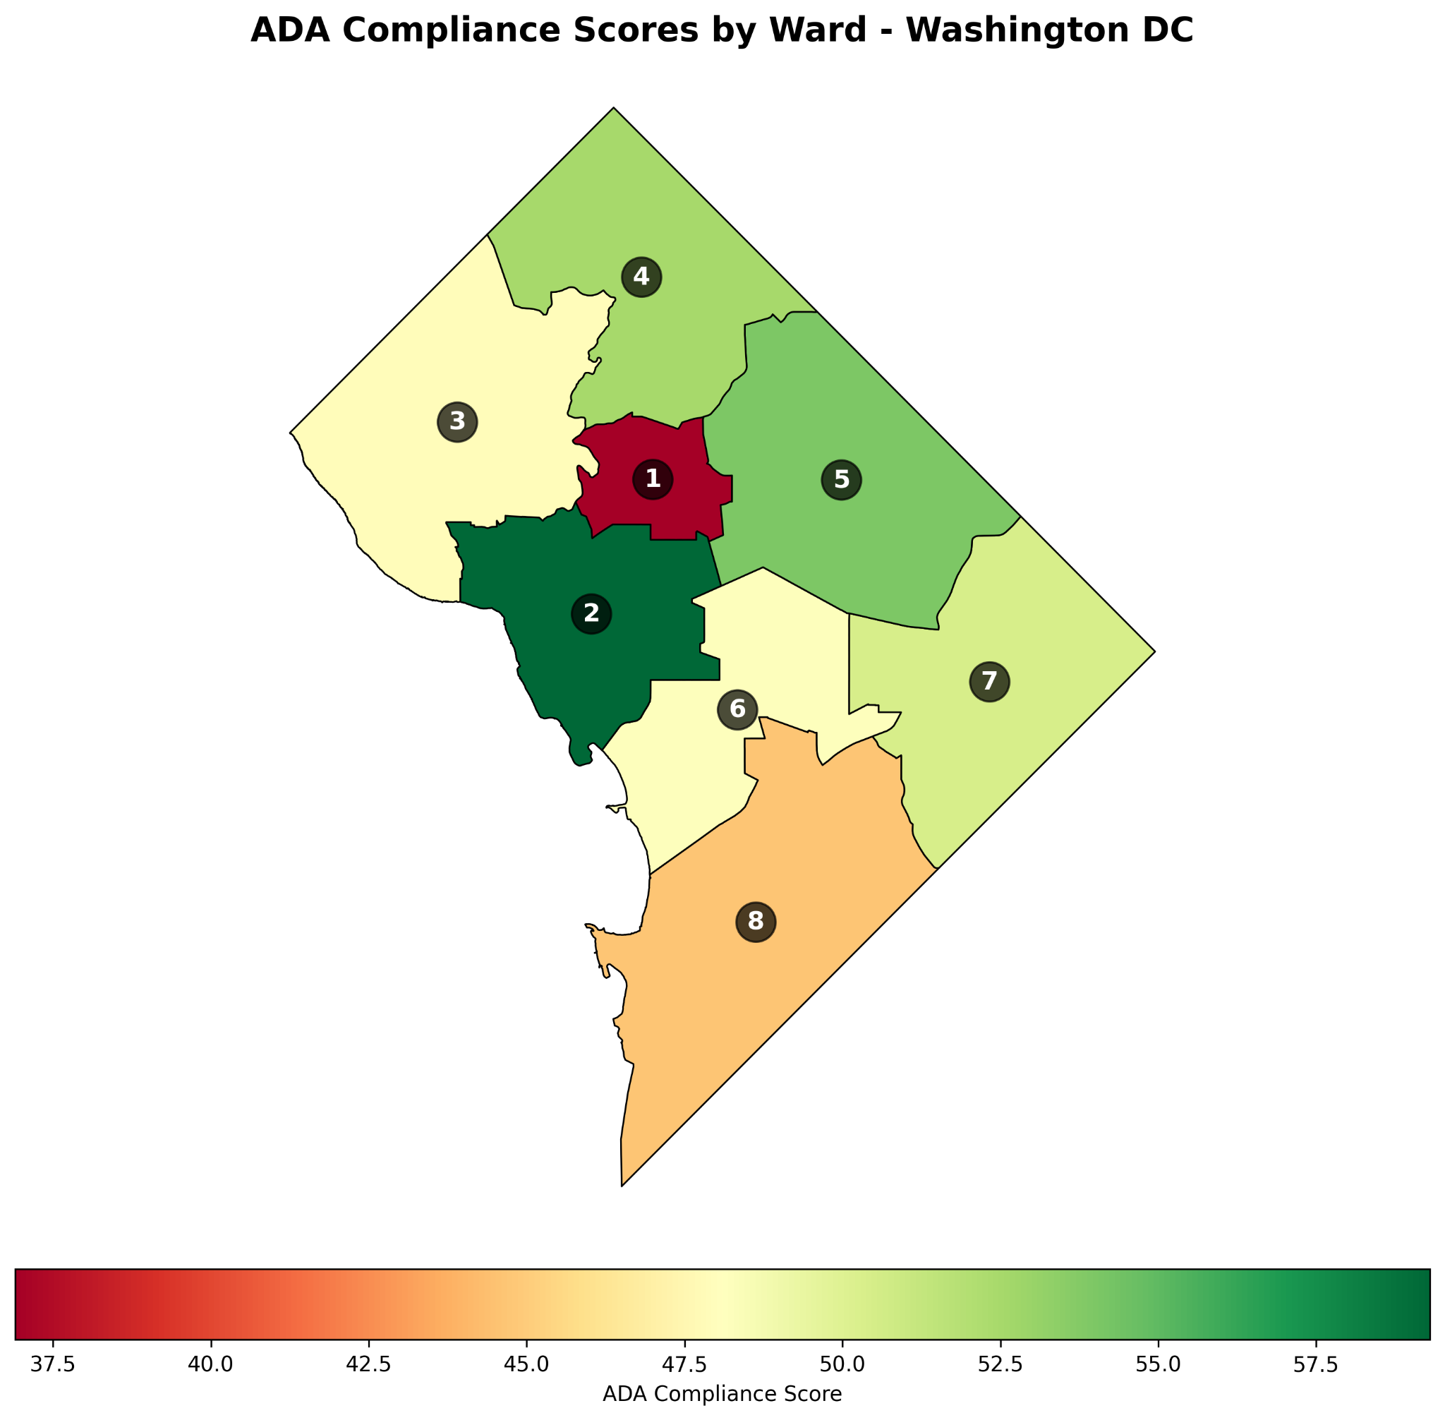
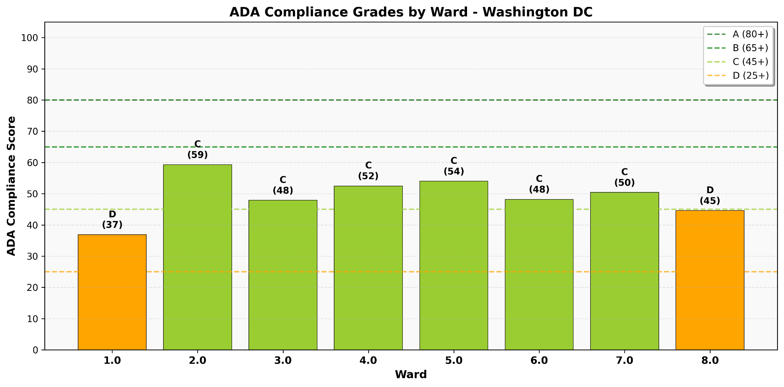
Grade
Grading scale: A=80+, B=65–79, C=45–64, D=25–44, F=<25.
Ward 2 highest: 59.3 (C)
Ward 1 lowest: 36.9 (D)
No ward scored above 60. No Bs or As.
ADA Compliance Scores by Ward

Slide 11
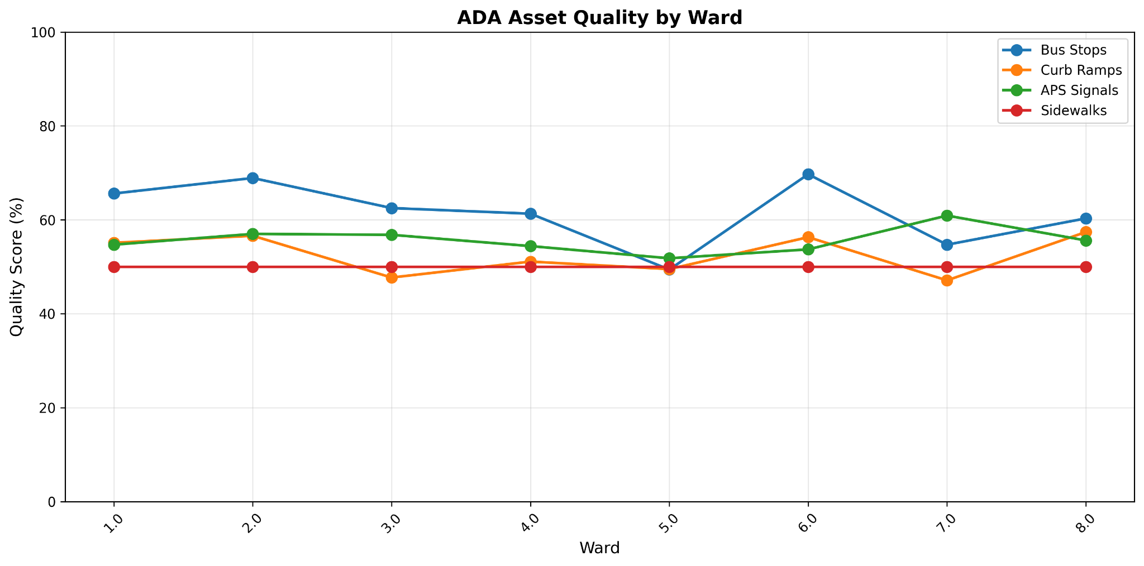
Grade
ADA Asset-Level Breakdown
Average ward grade: 49.23 (C range). Best: Ward 2 (59.30, C). Worst: Ward 1 (36.90, D)
Grade distribution: 6 wards (75%) received a C; 2 wards (25%) received a D
Ward 2: Highest bus stop compliance (66%), but only 58% curb ramps and 56% sidewalks
Ward 8: Lowest curb ramp compliance (45%) and lowest APS signal compliance (51%)
Key takeaway: No single ward performed well across all four asset types

Slide 12

The vision
What Did I Officially Find? My Conclusions
Based on everything you've seen: Is D.C. disability friendly?
My answer: No.
D.C. has systems, plans, and inventories.
But infrastructure is not up to ADA regulation.
Ramps noncompliant. Sidewalks failed. Hundreds of audible crosswalks missing.
Gap between policy and reality is wide.

Slide 13
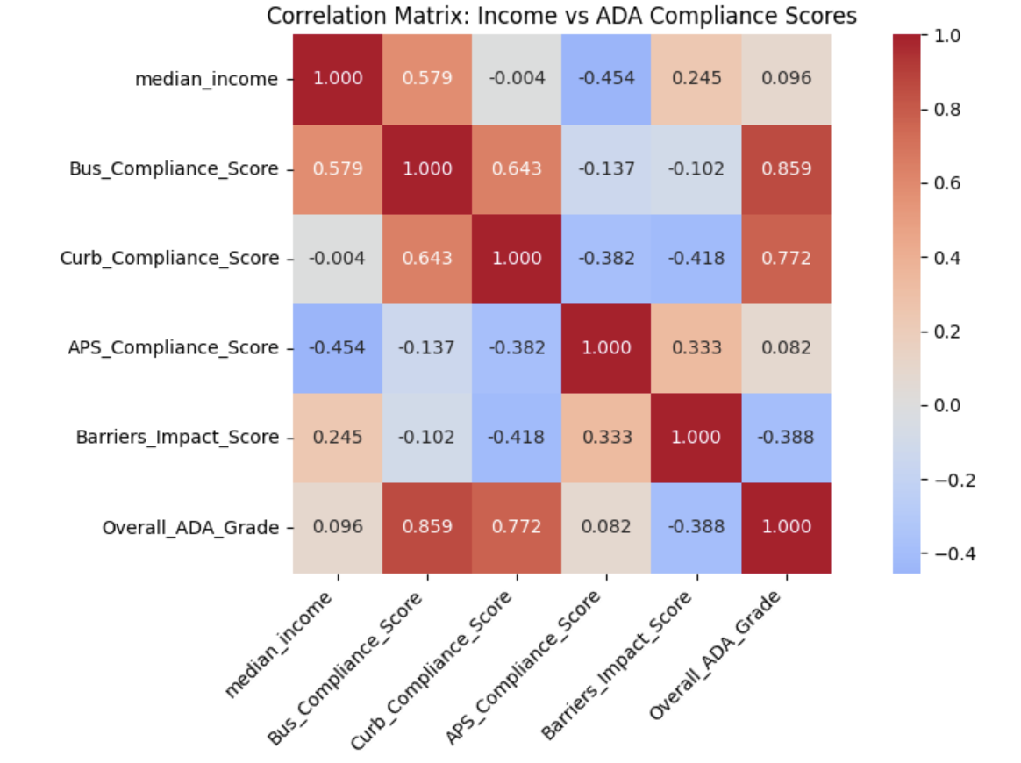
Characteristics
Correlations with Median Household Income
Bus stop compliance: moderate positive (0.579) – wealth helps.
Curb ramps: almost none (-0.004).
APS signals: moderate negative (-0.454).
Overall ADA grade: very weak (0.096).
Takeaway: Income predicts some assets, not others.
Overall compliance is nearly independent of wealth.

Slide 14
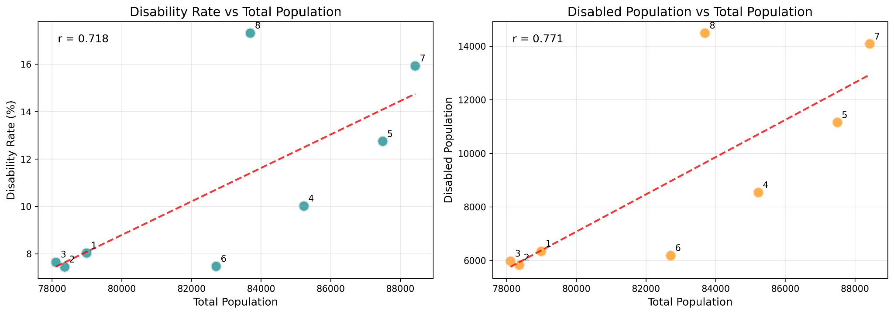
Characteristics
Bus quality vs. disabled population: negative (-0.717, p=0.045).
More disabled residents = worse bus stops.
Same for total population (-0.763).
Other assets: no significant correlations.
Example: Ward 2 (low disability, high bus quality). Ward 8 (high disability, low bus quality).
Overall, next to now difference in population types
Correlations with Disability/Total Population

Slide 15
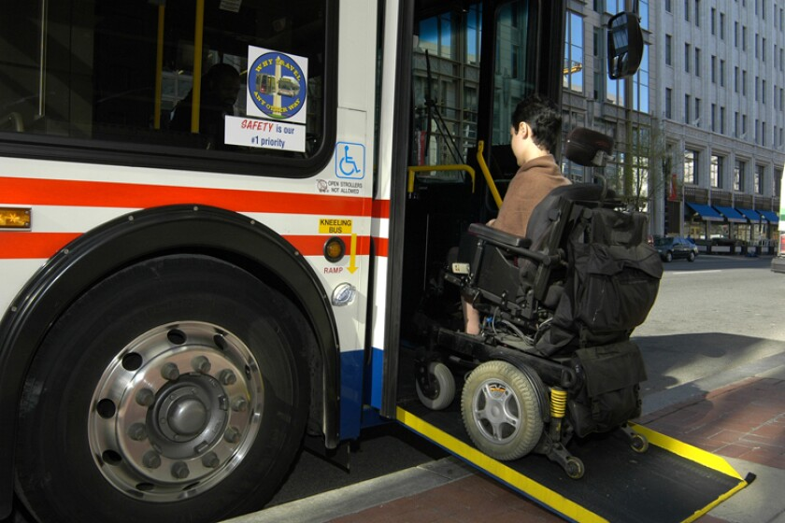
The vision
Limitations and Acknowledgments
Limitations: laptop failed last 3 weeks.
No precise disability location data (CDC privacy) → used ward centroids.
Sidewalk scores ~50% for every ward (possible missing data).
Only 8 wards → interpret p-values cautiously.
Acknowledgments: classmates, friends, family, Professor Perine.

