Slide 1
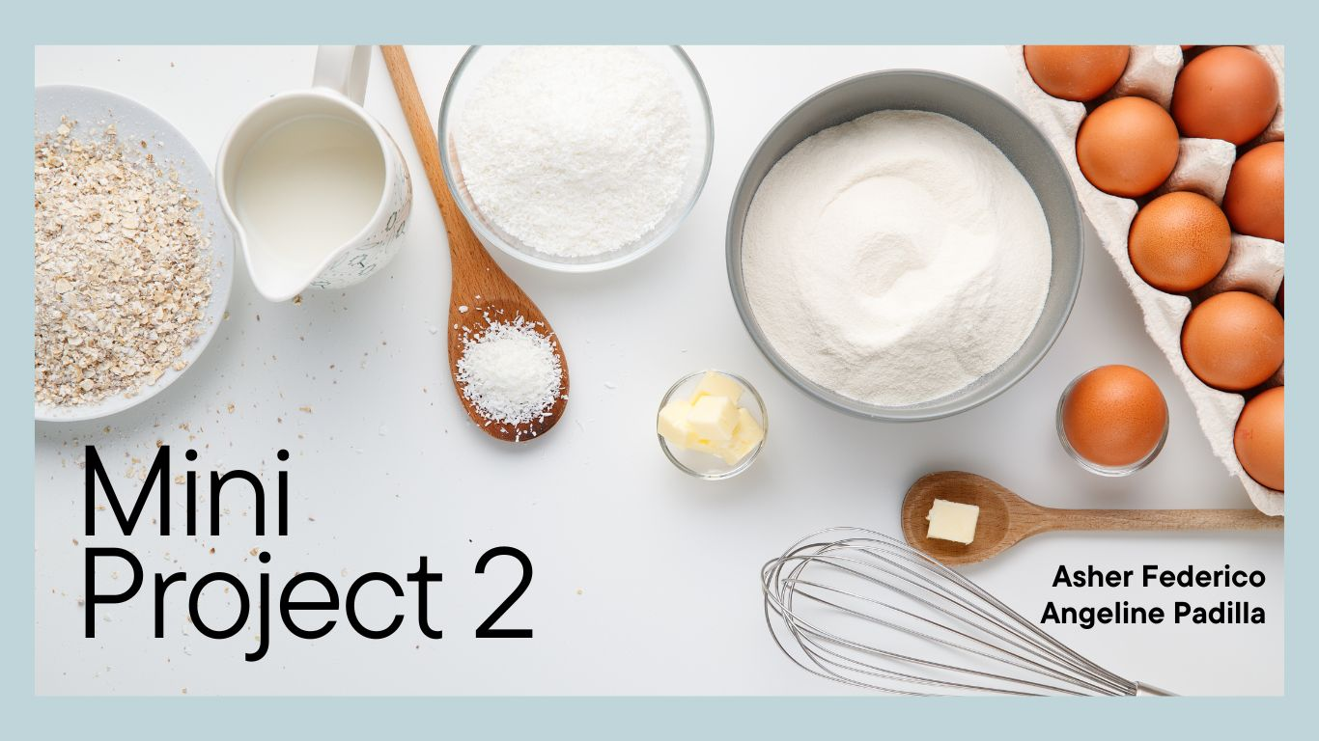

Slide 2
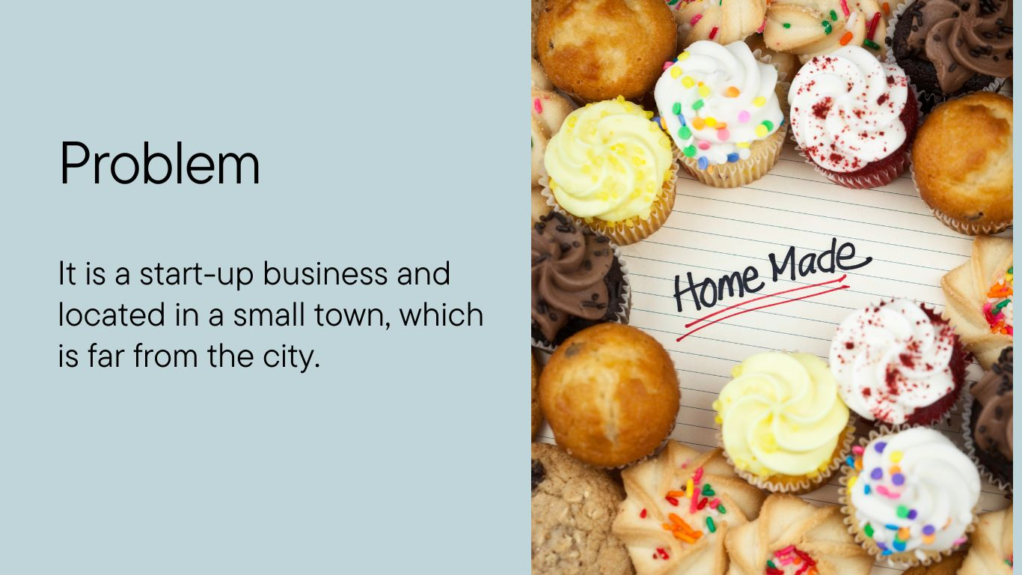

Slide 3
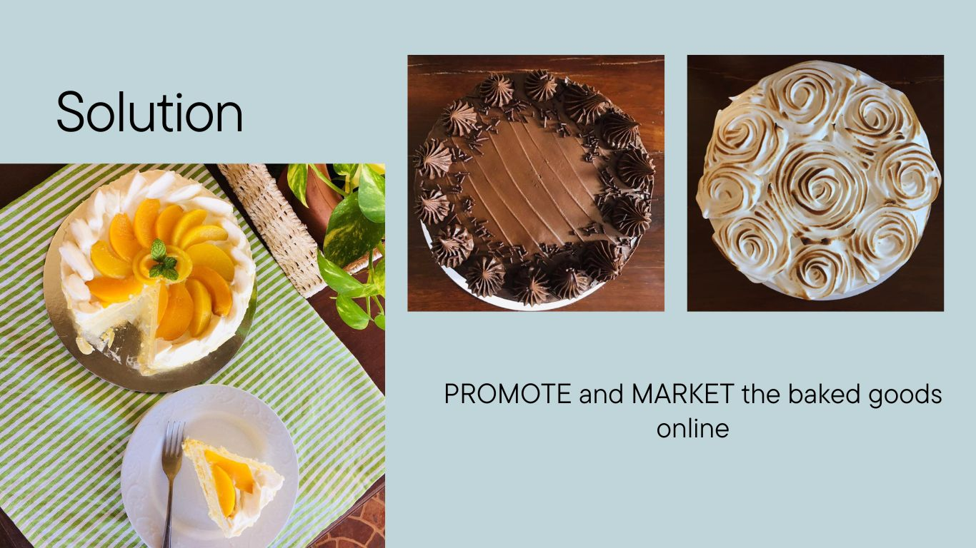

Slide 4
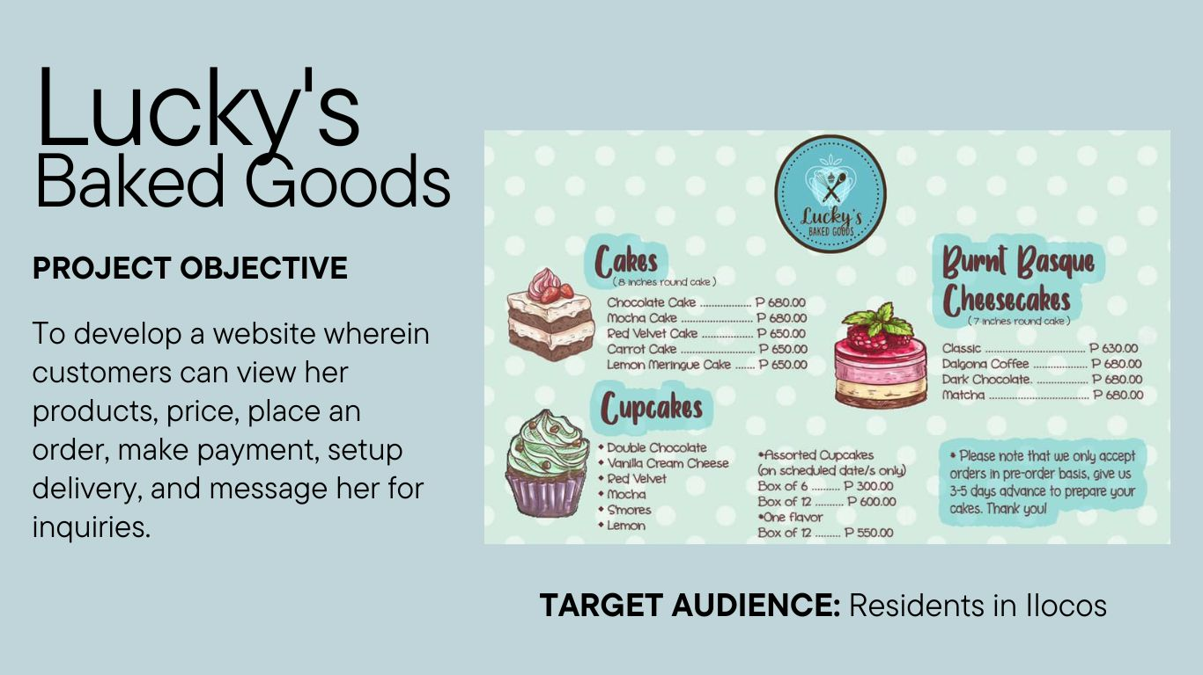

Slide 5





MENU
All Recipes
Baking Tools
Baking Tips
Videos
Story
Login
IMAGE HERE
IMAGE HERE
IMAGE HERE
IMAGE HERE
My Favorite
Blueberry Cake
My Favorite
Blueberry Cake
My Favorite
Blueberry Cake
My Favorite
Blueberry Cake
We are a home-based bakery that makes delicious cakes, cheesecakes, cupcakes, bread and cookies!
About
MEET LUCKY
PRIVACY DISCLOSURE
FAQS
Let’s connect
FACEBOOK
INSTAGRAM
© All Rights Reserved, 2023
WIREFRAME

Slide 6
Homepage
Home
Hero
Our Products
Customer Reviews
MENU
Cakes
Cheesecakes
Cupcakes
Bread
Cookies
Story
Meet Lucky
FAQs
Privacy Disclosure
Login
All Recipes
Baking Tools
Baking Tips
Videos
Cart
SITEMAP
THANK YOU!

