Slide 1


Slide 2
Cloud Computing Introduction
Eucalyptus Education Services Revision B

Slide 3
Module Topics
Cloud computing definition
Cloud computing models
Cloud computing vs. virtualization
Notes:
This module introduces generic cloud concepts and terminology. The next module specifically introduces the Eucalyptus cloud.

Slide 4
Traditional IT Deployment Model
In a traditional model, the user must work through the IT department to provision a server.
This is a multi-stage process that has inherent delays.
Can take days, weeks, or even months
User requests server
no
Negotiate business case
Approved?
yes
Negotiate resource configuration
IT available?
no
Wait
yes
Server provisioned
Notes:
Approvals and deployments depend on humans and therefore have the potential for delays. Deployment can take days, weeks, or even months.

Slide 5
Cloud Computing Deployment Model
In a cloud computing model the user can self-provision servers that fall within predefined IT resource policies.
This model eliminates many of the inherent delays in the traditional deployment model.
Deployment time reduced to minutes
IT defines resource policies
User requests server
Within policies?
no
yes
Server provisioned
Notes:
The cloud itself, not the IT department, checks to see if the request is within policies. Because humans are less involved there is no potential for delay.

Slide 6
Cloud Computing Definition
Industry surveys indicate that the desire to move to cloud computing is widespread. So what is cloud computing?
National Institute of Standards and Technology (NIST) definition: “. . . a model for enabling ubiquitous, convenient, on-demand network access to a shared pool of configurable computing resources . . . that can be rapidly provisioned and released with minimal management effort or service provider interaction.”
Notes:
http://csrc.nist.gov/publications/drafts/800-145/Draft-SP-800-145_cloud-definition.pdf
Most IT surveys in the last three years put cloud and virtualization among the top goals for most companies.
So what is cloud computing? Seems like every company says that they have a cloud today, but do they? Are they just cloud-washing?
NIST offers a broad definition covering all aspects of cloud computing.
More detail on the following pages.

Slide 7
Five Essential Cloud Characteristics
According to NIST:
On-demand self-service
Broad network access
Resource pooling
Rapid elasticity
Measured service
Notes:
These five characteristics are discussed on the next slides.

Slide 8
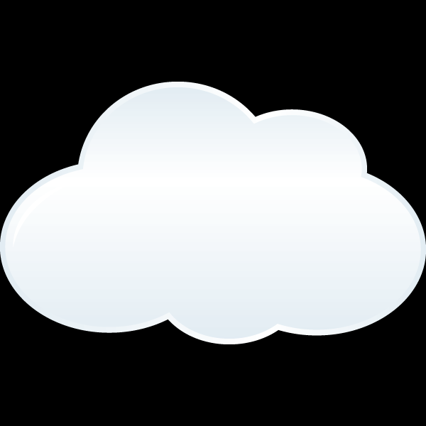
On-Demand Self-Service
A consumer can unilaterally provision computing capabilities as needed without requiring human interaction with the (IT service) provider.
Typically using a browser
User requests server
Server provisioned
Notes:
Because browsers are ubiquitous across many devices.

Slide 9
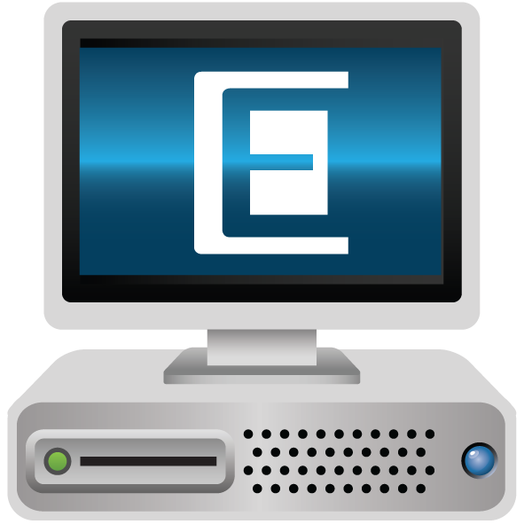



Broad Network Access
Cloud computing resources are available over the network and accessed through standard mechanisms that promote use by heterogeneous platforms.
Often through a browser using XML, SOAP, HTML over HTTP

Slide 10
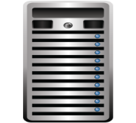
Resource Pooling
Computing resources are pooled to serve multiple consumers.
Servers can be efficiently managed as a unit.
Consumers share the cost of the pooled resources.
cloud
Notes:
Resource pooling means no more individual servers which form silos of individual compute resources. A cloud environment is a pool of servers that are managed and function as a unit. It is referred to as a cloud because users are typically not aware of which server is providing their resources.

Slide 11
Rapid Elasticity
The ability to quickly and dynamically provision and de-provision physical resources.
scale out limit
resource usage
cloud
Notes:
Rapid elasticity in this case refers to the ability to provision server resources as needed and then de-provision those same server resources when they are no longer needed. While resource usage might change in the private cloud, the amount of physical resources available in the private cloud are fixed at any given time. This leads to the possibility of running out of private cloud resources.
What are the options if you run out of private cloud resources? You can add more resources to the private cloud, configure quotas that prevent users from consuming the available resources, or make use public cloud resources to augment the private cloud resources as needed.

Slide 12

Measured Service
Cloud resources can be monitored, controlled, and reported, providing transparency for both the provider and consumer of the utilized service.
Useful for:
Chargeback
Change control
Capacity planning
Security
Compliance
Auditing
Notes:
It is important to know who is using the cloud, how many resources they are consuming, and what they might owe if usage costs are being assessed. Monitoring is also important for other reasons as well. For example, monitoring is helpful in the areas of configuration change control, capacity planning and forecasting, security, compliance, and auditing.

Slide 13
Cloud Computing Models
A service model defines what type of service the cloud provides to users.
There are three cloud service models.
Software as a service (SaaS)
Platform as a service (PaaS)
Infrastructure as a service (IaaS)
A deployment model defines where the physical servers are deployed and who manages them.
There are three cloud deployment models.
Public
Private
Hybrid
Notes:
Service models and deployment models are discussed in the following slides.

Slide 14
Software as a Service
SaaS provides applications to users.
Cloud provider maintains the application code and user data.
Provides storage/backup of the user’s application data
SaaS provides limited user management of the application or infrastructure.
Submit change and enhancement requests to vendor
SaaS is simple and quick to implement.
Examples: Salesforce.com, Google Docs
Notes:
Some simple configuration options might be available that allow a corporation to determine which application features are visible to the corporate users.

Slide 15
Platform as a Service
PaaS provides a software development environment to users including:
Software development tools
Necessary CPU, memory, storage, and network resources
Developers are limited to the languages and tools provided by the PaaS provider.
Application portability is not guaranteed.
Examples: Microsoft Azure, Google App Engine

Slide 16
Infrastructure as a Service
IaaS provides raw compute resources to users.
CPU cycles, memory space, storage space, network connectivity
Choice of operating systems, applications
The user manages and controls everything except the underlying physical hardware and network resources.
IaaS offers extreme flexibility and fast self-deployment.
Examples: Amazon Web Services, Eucalyptus

Slide 17
Public Clouds
The cloud infrastructure is made available to the general public but is owned by the organization selling cloud services.
Infrastructure costs are shared across customers.
Economies of scale due to size
Data security and location must be considered.
Compliance with industry or national regulations
company
users
public cloud
Notes:
Data security and location might be an issue depending on a number of factors, including the type and sensitivity of the data, and the industry and national laws concerning the data. For example, some countries do not allow personal data to reside on servers outside of the country.

Slide 18
Private Clouds
The infrastructure is operated solely for an organization.
Provide the self-service convenience and elasticity of public clouds
Organization maintains control over applications and data
Organization has complete control over the security of data in storage and in transit
company
users
private cloud

Slide 19

Hybrid Clouds
Two or more clouds bound together by technology that enables data and application portability between them
Utilizes the of cost benefits of a public cloud
When needed, locate and protect confidential data in private cloud
Enhances business continuity/disaster recovery options
users
company
hybrid cloud
public cloud
private cloud
Notes:
To enable hybrid operation the two clouds typically have to use shared APIs, and those APIs must work on objects that function in nearly identical ways.

Slide 20
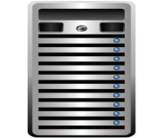




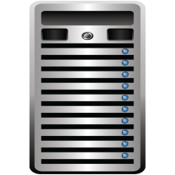




Virtual Machine
A set of files including configuration, virtual hard disk, others…
Interacts with a software layer called the hypervisor
Abstracts the underlying physical resources
Interacts with a configuration file to present virtual hardware to guest operating systems
Software installs on the virtual hard disk
Operating system
Applications
Provide services just like physical hosts
virtual machines
physical machine
CPU

Slide 21
Virtualization Benefits
Better physical host resource utilization (consolidation)
Guest operating systems and applications remain isolated
Dramatic cost reductions in:
Capital expenses (host hardware, switches, cabling, etc.)
Operating expenses (power, administration costs, etc.)
Increased flexibility in the datacenter
Better workload mobility
Lifecycle management not tied to hardware refresh cycles
Enhanced business continuity/disaster recovery capabilities

Slide 22
Virtualization and Cloud Computing
Cloud computing leverages virtualization but is not virtualization.
Virtualization provides the ability to run multiple, isolated virtual machines on a single physical host.
Cloud computing provides self-service billable provisioning, QoS guarantees, and private secure inter-VM networks to each authenticated user.
cloud computing
virtualization
hardware
layers of control
Notes:
Eucalyptus offers more than just plain virtualization and virtual machines.
While virtualization provides isolated access, it does not associate this access with an authenticated user for security and charging purposes. Operating system virtualization and hypervisors provides unauthenticated isolation of CPUs and memories, but not a private inter-VM network and not per-allocation persistent storage.
Clouds also provide a way for a cloud administrator to define either Service Level Agreements (SLAs) or Quality-of-Service (QoS) specifications that categorize the quality of access (and the resulting charging rate) individual users will experience. In plain virtualization, the notion of QoS or SLA is not exported to the end user as a way of enabling self-service provisioning.
Eucalyptus allows users to provisions and unprovision virtual machines through a standard API. However, it decides where to place the virtual machines in the pool of resources.
Eucalyptus automatically assigns IP addresses and controls IP subnets, VLANs, security firewalls in order to isolate and protect virtual machines according to user-defined policies.
Eucalyptus provides two different types of storage abstractions (S3 and dynamic block volumes).
Eucalyptus maintains user and group access controls.

Slide 23
Differences Between Virtualization and Cloud Computing
 | Traditional Virtualization | AWS Compatible Cloud Computing
VM Location | on a specific host | on any host in an availability zone
VM Storage | always persistent | ephemeral or persistent
Deploying VM Resources | customizable across a broad range of sizes | standard sizes (Small, Medium, Large, etc.)
Changing VM Resources | resize existing VM | launch new instance
Time to Provision | minutes to hours | minutes
VM Failure Recovery Method | attempt to recover failed VM | discard and start new instance
Notes:
AWS compatible clouds offer both ephemeral and persistent instances. EC2-backed instances are ephemeral but can have attached persistent storage in the form of EBS volumes. EBS-backed instances are persistent just like traditional virtual machines.

Slide 24
Summary
Five essential characteristics of cloud computing
On-demand self-service
Broad network access
Resource pooling
Rapid elasticity
Measured service
Cloud computing models
Service models: SaaS, PaaS, and IaaS
Deployment models: public, private, and hybrid
Cloud computing leverages virtualization, but they are distinct technology areas.

Slide 25
End of Module

