Slide 1


Slide 2
Eucalyptus IAM
Eucalyptus Education Services Revision C

Slide 3
Module Topics
Eucalyptus Identity and Access Management (EIAM) concepts
LDAP integration
Accounts, users, groups, and resources
Security credentials
Eucalyptus resource names
IAM access control policies
Quotas
Managing accounts, groups, and users
Creating, viewing, and deleting accounts
Creating, viewing, and deleting groups
Creating, viewing, and deleting users

Slide 4
EIAM Concepts and Terminology

Slide 5
Eucalyptus IAM
Eucalyptus Identity and Access Management (EIAM):
Is an authentication, authorization, and resource accounting system
Manages user identities
Enforces access controls over resources
Reports can be generated from resource accounting information
Based on AWS IAM organizational model and authorization scheme
Eucalyptus added extensions that support:
Resource quotas
More granular resource access control
Notes:
More about quotas and access policies later in this module.

Slide 6
LDAP and AD Integration
EIAM optionally integrates with LDAP or Active Directory
For more information, see the Eucalyptus Administration Guide at http://www.eucalyptus.com/docs.
Eucalyptus without LDAP/AD
Eucalyptus with LDAP/AD
Cloud Controller
Cloud Controller
LDAP/AD
DB
DB
accounts, users, groups, certificates, permissions, keys, policies
certificates, permissions, keys, policies
accounts, users, groups
Notes:
By default, all cloud account, user, and group configuration information is stored in the Cloud Controller database. However, to simplify integration with other datacenter applications and management tools, cloud account, user, and group configuration information can be moved to LDAP or Active Directory.
If you configure LDAP or AD, then Eucalyptus management of accounts, users, and groups is no longer supported. Admin users remain in Eucalyptus and are managed by Eucalyptus. Only normal users are imported from LDAP/AD. Currently there is no way to map individual users from LDAP to Eucalyptus accounts. You can only map LDAP groups (with users) to Eucalyptus accounts.
Create the LDAP Integration Configuration (LIC) file using /usr/sbin/euca-lictool --password <LDAP_password> --out example.lic. Then edit the file with your LDAP information. Then run /usr/sbin/euca-modify-property -f authentication.ldap_integration_configuration=<lic_filename.lic> to install and activate LDAP. Example LIC file at /usr/share/eucalyptus/lic_template.

Slide 7
EIAM Accounts
An account includes users, groups, and resources.
Accounts represent organizational divisions.
Examples: eng, sales, marketing
Accounts are the primary unit for resource usage accounting.
Accounts are a separate namespace for users, groups, security groups, and key pairs
Groups are used to assign resource access controls to a set of users.
account
group
group
user
user
user
user
user
user
VM
resources
Notes:
An account includes the account name itself, and the users and groups that are created as part of the account. Accounts are created to represent departments or divisions within a company. For example, you might have an eng account for users in the engineering department and a sales account for users in the sales department. The only account that exists by default after installation is the eucalyptus account. Other accounts would need to be created.
Each account is a separate namespace so a user named steve could appear in more than one account and yet be completely different users. The same is true for group names, security groups, and keypairs.
An account can also be assigned permissions to access specific resources. Any permissions created for users or groups within the account don't apply to the account itself.

Slide 8
Account Users
account
Accounts include users.
A user:
Is an individual person
Interacts with the cloud
Is associated with a single account
Has a unique name within the account
Case insensitive
Has unique security credentials
Can belong to multiple groups
group
group
user
user
user
user
user
VM
resources
Notes:
People access the cloud as users in an account. It is users who access images to launch instances that consume such resources as elastic IP addresses, security groups, and EBS volumes. The only user account that exists by default after installation is the admin user in the eucalyptus account. Other users in other accounts would have to be created.
A user can belong to a group. A group can be used to assign access permissions to multiple users at one time. A user can actually belong to multiple groups. Later this module will describe how to evaluate a user’s permissions if they belong to multiple groups with differing permissions.

Slide 9
Accounts and Resources
Accounts also include resources.
A resource is an entity with which users interact.
image, security group, address, availability zone, instance, key pair, volume, snapshot, vmtype
A resource has friendly name and a Eucalyptus resource name (ERN).
ERNs are explained later in the module.
account
group
group
user
user
user
user
user
user
VM
resources
Notes:
Resources include images, security groups, addresses, availability zones, instances, keypairs, volumes, snapshots, vmtypes.
Resources have two types of names. A friendly name is a short, human readable name. Eucalyptus Resource Names (ERNs) are much longer names used by the software. Friendly names can generally be used as command-line arguments whereas ERNs must be used in access control policies.
There is more about ERNs and access control policies later in the module.

Slide 10
Special Identities
The eucalyptus account is created at installation.
The admin user is created at installation.
Any user (including admin) in this account is a cloud administrator.
Have complete cloud privileges
All new accounts automatically have an admin user.
Is only an account administrator
Only privileges over account resources
The admin users cannot be deleted.
eucalyptus
new_acct
creates
admin
admin
group
group
user1
user1
user2
user2
user3
user3
resources
resources
Notes:
As mentioned before, the only account and user that exist after installation is the eucalyptus account with its admin user. The eucalyptus account is unique in that every user created in the eucalyptus account has full access to the resources in the system. These users are often referred to as system admins or cloud admins. You cannot remove eucalyptus account from the system.
By default, only users in the eucalyptus account can create new accounts.
Each new account has a user named admin created automatically. The admin of an account has full control of the resources owned by the account. You cannot remove the admin user from an account. The admin can permit resource access by other users (or groups) in the account by using IAM policies.

Slide 11
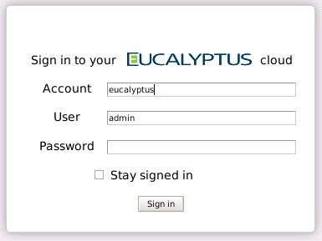
Login Profile
A login profile consists of a login name and password.
A login profile is required for any user to access the Administrator Console.
Notes:
The Administrator Console is a Web-based administrative GUI for the cloud. To log in to the Administrator Console requires an account name, user name, and the user’s password. A login name and password are known as a login profile.

Slide 12
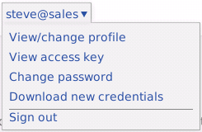
Downloading Credentials
Users can create and download their own credentials once logged into the Administrator Console.
By default, new users do not have credentials.
Notes:
A user has limited capabilities in the Administrator Console and in the cloud until an IAM policy provides them the permissions to perform more actions. While users use the Administrator Console to download their credentials or change their passwords, the Administrator Console is primarily a cloud administrator’s tool and not a user’s tool. For day-to-day operations, users would use tools like the Eucalyptus User Console or euca2ools.
Each account has its own credentials. The credentials of the admin user in each account are the credentials of the account itself.
By default, a user has no security credentials other than their password, but their password does allow them to log in to the Administrator Console and download the rest of their credentials. However, even after downloading credentials they still have very limited set of permissions in cloud. Users must be assigned IAM policies which provide them with the additional permissions to perform actions within the cloud.

Slide 13
Eucalyptus Resource Names
arn:aws:<vendor>:<region>:<namespace>:<relative-id>
Eucalyptus Resource Name (ERN) is the name format used to uniquely identify cloud resources, users, and groups.
arn – Amazon resource name; used in ERNs for AWS compatibility
aws – Amazon Web Services compatible
vendor – identifies the service (for example, ec2, s3, iam)
region – specifies the region of a resource (not used in Eucalyptus)
namespace – specifies the name space of a resource
relative-id – specifies the ID within the service and the namespace
Seen or used in the:
Administrator Console
Command-line outputs
EIAM access control policies
Notes:
To understand IAM policies which are discussed later in the module, you have to understand Eucalyptus Resource Names (ERNs) first.
All resources in the cloud are identified by a unique ERN. An ERN consists of six colon separated fields. ERNs are compatible in format with the AWS Amazon Resource Name (ARN). In fact, the first field in an ERN is actually the text arn followed by the text aws in the second field. This was done specifically to maintain AWS compatibility.
The last three fields progressively provide more detail about the resource. For example, the vendor field describes which service the resource is part of. There are three possible services; ec2, s3, and iam. The namespace field varies but is specific to the type of service. There specific examples of different types of ERNs in the next slides.
You will see ERNs displays in a number of places. They appear in the Administrator Console , in the output of euca2ools commands, and are used extensively in IAM policies.

Slide 14
IAM and S3 ERN Examples
IAM service ERN examples
Pattern:
arn:aws:iam::<account_id>:[user|group]/<optional path>/<user_or_group_name>
Examples:
arn:aws:iam::eucalyptus:user/steve
arn:aws:iam::eng:user/*
arn:aws:iam::sales:group/west/salesteam
S3 service ERN examples
Pattern:
arn:aws:s3:::<bucket_name>[/<key_name>]
Examples:
arn:aws:s3:::acme_bucket/emi-1234abcd
arn:aws:s3:::acme_bucket/*
Notes:
In the iam service ERNs, the account_id field for users is the account name or the account ID number of the account the user belongs to and not the user’s name or account number. The Administrator Console will display the account name rather than the account ID number. However, displays only the account ID number. In the case of groups, the account_id is the group name or the ID number of the group.
The group salesteam in the example above includes an optional path named sales. Optional paths for users and groups are discussed later in the module.

Slide 15
EC2 ERN Examples
Eucalyptus EC2 resource type extensions provide more granularity than AWS in access control policies.
AWS only supports the * wildcard in access control policy statements.
EC2 service ERN examples
Pattern:
arn:aws:ec2::<account_ID>:<resource_type>/<resource_ID>
Account ID is optional, and can limit resource access to an account.
Examples:
arn:aws:ec2:::vmtype/m1.small
arn:aws:ec2::marketing:image/emi-af45e531
The following resource types are supported.
image, securitygroup, address, availabilityzone, instance, keypair, volume, snapshot, vmtype
Notes:
AWS does not allow anything but wildcards in EC2 resource ARNs used in IAM access policies. This means that in Amazon IAM you cannot constrain users to specific resources. Eucalyptus has extended resource ERNs to include specific resources.
The account_ID field may be blank or contain an account name. If the field is blank then all accounts are implied. If an account name is included then it limits the meaning to just that account. For example, using the ERN shown above, all accounts could be restricted from using a VMtype of m1.small if you were to write a policy to do so using the ERN shown above. Likewise, using the ERN shown above, you could restrict just the users in the marketing account from using the EMI identified as emi-af45d531.
The Eucalyptus EC2 service includes support for many different types of resources, called namespaces in ERN terminology. They are listed above.
For an address resource types, either a specific IP address or a hyphen-separated IP address range is supported.

Slide 16
Access Control Policies and Quotas

Slide 17
Access Control Policy Overview
By default, a user has very limited access to resources.
A cloud or account administrator creates access control policies.
A policy is a document that provides a formal statement of one or more permissions allowing or disallowing access to resources.
Access control policies can be assigned to a user or a group of users.
A user or group might be assigned more than one policy.
Notes:
Now that you are familiar with ERNs, you can begin to learn about IAM policies.
By default, a user has a very limited set of permissions in the cloud. For convenience, Eucalyptus grants the following default access to regular users:
Users can download their credentials using the Administrator Console.
Users can list themselves (euare-userlistbypath)
Users can get their own attributes (euare-usergetattributes)
Users can get information about themselves (euare-usergetinfo)
Users can list their own accounts (euare-accountlist)
To do anything more the user will have to be granted permissions through an IAM policy. Be default, the account admin can create and assign policies to users and groups. A policy is a text document that describes what a user or group can or cannot do in the cloud.
Only policies that define resource quotas are assigned at the account level. Resource quotas are covered later in the module.

Slide 18


Policies, Users, Groups
POLICY
POLICY
permission
permission
permission
permission
permission
permission
permission
permission
Notes:
A permission can be added to a policy document. A policy document can contain one or more permissions. There might be multiple policies in the cloud.
A permission policy can be assigned to a user or group. Permission policies on accounts are untested by Eucalyptus.
Two or more policies can be assigned to a user or group. How to evaluate this condition is described later in the module.

Slide 19
Policy Language
Policies are written in JavaScript Object Notation (JSON) format.
A text-based data interchange format.
Compatible with the AWS IAM policy language
A policy can contain one or more permission statements.
Each statement specifies a permission on a resource.
{
"Version":"2008-10-17",
"Statement":[{
"Sid":"1",
"Effect":"Allow",
"Action":"*",
"Resource":"*"
}]
}
Notes:
A permission statement specifies whether to “Allow” or “Deny” (effect) a list of actions to be performed on a list of resources, under some conditions. Conditions are optional.
The policy statement above, for example, allows all actions on any resource. Note the use of wildcards in the Action and Resource elements.
The Version is the access policy language version. This is an optional element, and the date is based on the Eucalyptus cloud.
The Statement is the main element for a statement. It can include multiple elements. The Statement element contains an array of individual statements. Each individual statement is a distinct JSON block enclosed in curly braces { }. For example; "Statement":[{...},{...},{...}]. Each statement is enclosed in curly braces and is separated by a comma.

Slide 20
Policy Statements
Component | Meaning
Sid | Optional statement ID, must be unique within the policy
Effect | Decision that applies to the resource; either Allow or Deny
Action or NotAction | User-specific commands on the resource, for example ec2:RunInstances.There are ec2:*, s3:*, and iam:* actions.
Resource or NotResource | Resource effected, specified as an ARN, for example arn:aws:s3:::user1_bucket/centos.img. There are ec2:*, s3:*, and iam:* resources.
Condition | Additional constraints on the permission, for example DateGreaterThan or ec2:ExpirationTime
Notes:
The statement ID is optional. If it is used, each statement must have a unique ID. The ID can be a string of alpha-numeric characters.
The Effect is always Allow or Deny in IAM permission policies. Later you will look at resource quota policies and they extend this element to include Limit.
The Action element describes which service action or actions the policy statement allows or denies. Using the NotAction element is useful if you want to make an exception to a list of actions. The following example refers to all actions other than the EC2 RunInstances commands; “NotAction":"ec2:RunInstances”. You would use this in a policy with "Effect":"Deny" to keep users from accessing any other actions.
EC2 service actions (ec2:*) allow users to work with instances, images, volumes, snapshots, and IP addresses. S3 service actions (s3:*) allows a user to work with buckets. IAM serivce actions (iam:*) allow a user to work with accounts, users, groups, credentials, and access control policies.
For a list of EC2 service actions see Actions at http://docs.amazonwebservices.com/AWSEC2/latest/APIReference/Welcome.html?r=400. For a list of S3 service actions, see the section about the S3 SOAP API Reference at http://docs.amazonwebservices.com/AmazonS3/latest/API/APISoap.html. For more information about IAM service actions, see AWS Identity and Access Management API Reference at http://awsdocs.s3.amazonaws.com/IAM/latest/iam-api.pdf.
A Resource element describes with resource the policy statement applies to. The NotResource element is useful if you want to make an exception to a list of resources, similar to the previous NotAction description.
The Condition element is the most complex part of the policy statement. It is referred to as the condition block, because although it has a single Condition element. However, it can contain multiple conditions and each condition can contain multiple key-value pairs. When creating a condition block, you specify the name of each condition, and at least one key-value pair for each condition

Slide 21
Sample Policy (1)
The following specifies permission to launch instances with only an m1.small vmtype:
{
"Version":"2008-10-17",
"Statement":[{
"Sid":"2",
"Effect":"Allow",
"Action":"ec2:RunInstances",
"Resource":[
"arn:aws:ec2:::vmtype/m1.small“,
"arn:aws:ec2:::image/*", "arn:aws:ec2:::securitygroup/*", "arn:aws:ec2:::keypair/*", "arn:aws:ec2:::availabilityzone/*", ]
}]
}
Notes:
In this example the policy would allow the launch of instances using only the vmtype m1.small. Whose would be limited by this policy would depend on which user or group the policy was applied to. Notice that if the vmtype was change to the wildcard character then the user or group would be able to use any vmtype to launch an instance.

Slide 22
Sample Policy (2)
The following example restricts an instance running time to 24 hours using an additional condition:
{
"Version":"2008-10-17",
"Statement":[{
"Sid":"3",
"Effect":"Allow",
"Action":"ec2:RunInstances",
"Resource":"*",
"Condition":{
“NumericEquals”:{
“ec2:KeepAlive”:”1440”
}
}
}]
}
Notes:
This example includes a condition block. The user or group would be able to launch an instance using any resources, but with the condition that the instance only run for 24 hours. 1440 minutes is 24 hours.
The ec2:KeepAlive and ec2:ExpirationTime in IAM are Eucalyptus extension to AWS. If multiple values apply to a user, the longer value is used. For examples of each, see the Administration Guide at http://www.eucalyptus.com/docs.

Slide 23
Sample Policy (3)
The following example allows a user to run instances and describe things:
{
"Statement": [{
"Sid": "Stmt1313605116084",
"Action": [
"ec2:AllocateAddress",
"ec2:AssociateAddress",
"ec2:AttachVolume",
"ec2:Authorize*",
"ec2:CreateKeyPair",
"ec2:CreateSecurityGroup",
"ec2:CreateSnapshot",
"ec2:CreateVolume",
"ec2:DeleteKeyPair",
"ec2:DeleteSecurityGroup",
"ec2:DeleteSnapshot",
"ec2:DeleteVolume",
"ec2:Describe*",
"ec2:DetachVolume",
"ec2:DisassociateAddress",
"ec2:GetConsoleOutput",
"ec2:RunInstances",
"ec2:TerminateInstances"
"ec2:ReleaseAddress"
],
"Effect": "Allow",
"Resource": "*"
} ]
}
Notes:
This example policy would allow the user or group to perform quite a number of different EC2 operations. The user or group could run and terminate instances, manage IP addresses, manage security groups, and manage EBS volumes and snapshots.
For more detail about policies, and more examples of policies, see Administration Guide at http://www.eucalyptus.com/resources/docs.

Slide 24
Paths and Policy Scope
An optional path is useful to identify organizational differences between users or groups in the same account.
Steve and Janet are both in sales, but in different customer segments.
arn:aws:iam::sales:user/commercial/steve
arn:aws:iam::sales:user/government/janet
Paths are useful to control the scope of permissions in policies.
An administrator could be given permission to manage only the user and groups in commercial sales.
{
"Statement":[{
"Effect":"Allow",
"Action":"iam:*",
"Resource":["arn:aws:iam::sales:group/commercial/*",
"arn:aws:iam::sales:user/commercial/*"]
}]
}
Notes:
Paths are useful for at least two reasons. First, it provides a useful way to categorize users and groups within an account in a way that is easy to see onscreen. In the example above both Steve and Janet are members of the sales account. However, they sell to different customer segments. This can be easily noted on the screen by placing them in different paths where the path names indicate which customer segment they sell to.
Second, paths provide a way to limit the scope of permissions given to administrators for resources. In the example above, the administrator with this policy would have permissions to manage users and groups only in the west geography of the sales account.

Slide 25
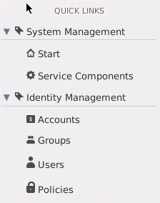
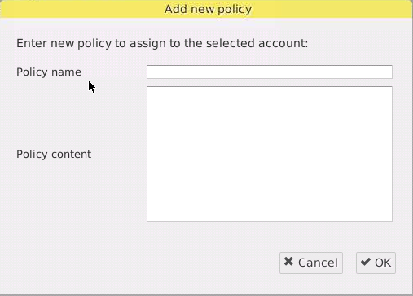

Creating Policies - Administrator Console
You can create policies from the Accounts, Groups, and Users main panel.
Provide a name and enter the policy in JSON format.
Notes:
To create a new policy using the Administrator Console , you would select either Accounts, Groups, or Users in the QUICK LINKS panel. On the main panel you would then select an account, group, or user and then click the Add policy button. The Add new policy window will open and provide text boxes to enter the policy name and enter the policy itself using JSON-formatted text.

Slide 26
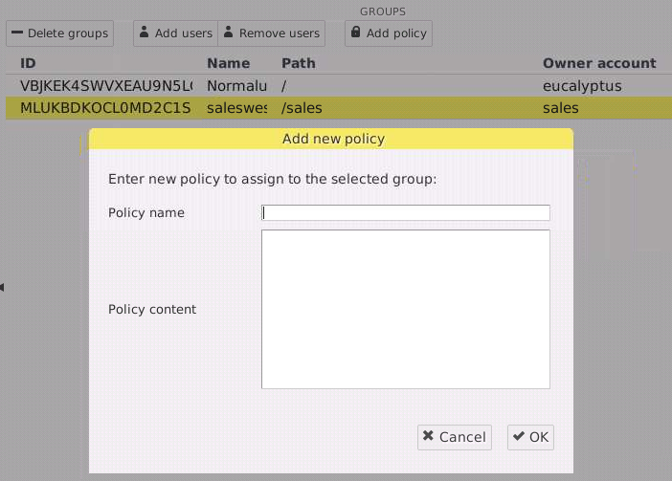
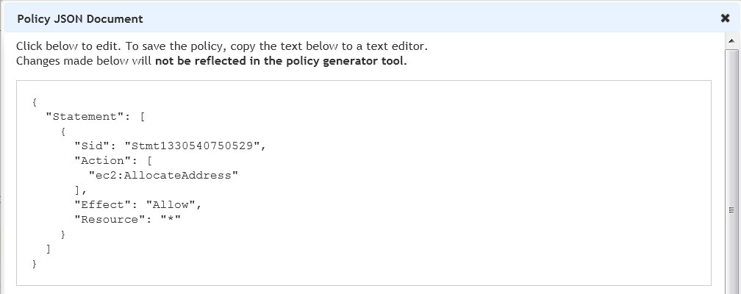
Amazon Policy Generator
Amazon provides a policy generation tool.
Creates JSON-formatted policy statements
Compatible with Eucalyptus IAM
Copy/paste from the tool to the Administrator Console
copy/paste
Notes:
It is also possible to create a policy by using the online Amazon Policy Generator Web page in conjunction with the Administrator Console. The Amazon tool allows you to build a policy using radio buttons and drop-down menus. The JSON-formatted policy generated by the Amazon tool can be copied and pasted into the Administrator Console, often with no additional edits.

Slide 27
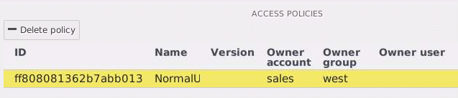
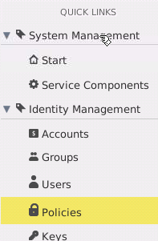
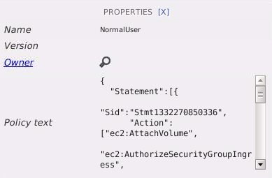
Viewing Policies - Administrator Console
You can view policies from the Policies QUICK LINK.
Notes:
You can view policies by using Policies in the Administrator Console QUICK LINKS panel. Once you select Policies, a list of the cloud’s current policies appears in the main window. Select a policy and its content appears on the right-side of the Web browser window. Notice that you can also delete a policy using the Delete policy button once you select a policy from the list.

Slide 28
Managing Policies – Command Line
Starting with Eucalyptus 3.0, there is a new set of command-line commands.
Begin with the prefix euare-.
The euare- commands are used to manage EIAM functionality.
Policy management
Account management
Group management
User management
Just looking at policy management here
Notes:
You can also manage policies from the command line. Eucalyptus 3 introduced a new set of command-line tools to manage IAM functionality, including policy management. The new set of command-line tools all begin with the prefix euare-. This next section will only look at those euare- commands that deal with policy management.

Slide 29
Group Policies
Create a group policy.
euare-groupaddpolicy -g <group_name> -p <policy_name> -e [Allow|Deny] –a <actions> -r <resources> -o
List the names of policies associated with a group.
euare-grouplistpolicies –g <group_name> <--delegate=account_name>
Display the content of a single, named policy.
euare-groupgetpolicy –g <group_name> -p <policy_name> <--delegate=account_name>
Delete an group policy.
euare-groupdelpolicy –g <group_name> -p <policy_name> <--delegate=account_name>
Notes:
The next two slides only describe group and user policy management commands because account policies are implemented to create resource quotas, and resource quotas have not been discussed yet.
The euare-groupaddpolicy command builds a policy from the command line and adds it to a group. It can only be run by a user with administrative privilege on the account that owns the group. (There is no --delegate option for this command.) For example, the command euare-groupaddpolicy -g west -e Allow -a "*" -r "*" -p allowall –o would allow members of the group west to perform any action on any resource. The quotes around the wildcard characters are required. The final –o option would print the policy to the screen so that the user can see the policy that was added to the group.
Policies can also be uploaded from an external file using the command euare-groupuploadpolicy –g group_name –p policy_name –f policy_file.txt --delegate=account_name. The --delegate option allows a cloud administrator to perform this action not on the eucalyptus account, but on the account named in the delegate option. A cloud administrator is a user in the eucalyptus account. The --delegate option is common across many, but not all, commands.
The euare-grouplistpolicies command lists the names of a policies associated with a group in an account. This command can be run by the administrator of the account, or if using the --delegate option, by a cloud administrator. If run by a cloud administrator, it would display the polices associated with the group in the account listed in the --delegate option. While not shown above, the content of the policies is also displayed if the –v option is included. There are additional options to limit the number of policies displayed on the screen and to paginate the display results. For more information, see the online help page for the command.
The euare-groupgetpolicy command displays the contents of the named policy associated with the named group, but has no pagination options. This command can be run by the administrator of the account, or if using the --delegate option, by a cloud administrator. If run by a cloud administrator, it would display the polices associated with the group in the account listed in the --delegate option.
The euare-groupdelpolicy command deletes the named policy from the named group. This command can be run by the administrator of the account, or if using the --delegate option, by a cloud administrator. If run by a cloud administrator, it would delete the polices associated with the group in the account listed in the --delegate option.

Slide 30
User Policies
Create a user policy.
euare-useraddpolicy –u <user_name> -p <policy_name> -e [Allow|Deny|Limit] –a <actions> -r <resources> -o
List policy names associated with a user.
euare-userlistpolicies –u <user_name> <--delegate=account_name>
Display the content of a single, named user policy.
euare-usergetpolicy –u <user_name> -p <policy_name> <--delegate=account_name>
Delete an user policy.
euare-userdelpolicy –u <user_name> -p <policy_name> <--delegate=account_name>
Notes:
The euare-useraddpolicy command builds a policy statement and adds it to a user. It can only be run by a user with administrative privilege on the account. There is no --delegate option for this command. For example, the command euare-groupaddpolicy –u steve -e Allow -a "*" -r "*" -p allowall –o would allow steve to perform any action on any resource. The quotes around the wildcard characters are required. Notice that there is also a Limit argument for the –e option. Limit arguments are used in quota policies rather than permission policies. The final –o option with print the policy content to the screen.
Policies can also be uploaded from an external file using the command euare-useruploadpolicy –u user_name –p policy_name –f policy_file.txt --delegate=account_name. If run by a cloud administrator, the policy would be uploaded to the account named in the --delegate option.
The euare-userlistpolicies command lists the names of a policies associated with a user. This command can be run by the administrator of the account, or if using the --delegate option, by a cloud administrator. If run by a cloud administrator, it would display the polices associated with the user in the account listed in the --delegate option. While not shown above, the content is of the policies is also displayed if the –v option is included. There are additional options to limit the number of policies displayed on the screen and to paginate the display results. For more information, see the online help page for the command.
The euare-usergetpolicy –command displays the contents of the named policy associated with the named user, but has no pagination options. This command can be run by the administrator of the account, or if using the --delegate option, by a cloud administrator. If run by a cloud administrator, it would display the polices associated with the user in the account listed in the --delegate option.
The euare-userdelpolicy command deletes the named policy from the named user. This command can be run by the administrator of the account, or if using the --delegate option, by a cloud administrator. If run by a cloud administrator, it would delete the polices associated with the user in the account listed in the --delegate option.

Slide 31
Delegate Option
sales
admin
# euare-userlistpolicies –u janet
SUCCESS
jason
janet
eucalyptus
admin
# euare-userlistpolicies –u janet
FAILURE
steve
# euare-userlistpolicies –u janet
--delegate=sales
SUCCESS
bodie
Notes:
The delegate option can only be used by cloud administrators. It is used by cloud administrators in the eucalyptus account to view and edit information associated with accounts.

Slide 32
Access Management Controls
Resource access control is available on two levels.
Resource-level – Buckets and images have built-in permissions used to control access across all accounts.
Policy-level – Policies can be used to control access to all resources within each account.
Permissions | Attached To | Scope | Service | Set By
S3 bucket ACL | specific resource | across accounts | S3 | S3curl.pl
S3 image permission | specific resource | across accounts | EC2 | euca-upload-bundle --acl
IAM | users/groups | inside account | all | policies
Notes:
Access to S3 resources is controlled by API calls. Both buckets and the objects in buckets have access control ACLs. They define which Eucalyptus accounts or groups are granted access along with the type of access. Bucket ACLs are completely independent of Object ACLs and can be set using S3curl.pl. When a request is received against a resource, the S3 service checks the corresponding ACL to verify that the requester has the necessary access permissions. When you create a bucket or an object, the S3 service creates a default ACL that grants the resource owner full control over the resource. S3 supports adding predefined ACLs for image permissions. Each predefined ACL has set of grantees and permissions. You specify a predefined ACL in your HTTP request header and S3 adds the corresponding predefined grants to the resource’s ACL.
Image permissions in the Walrus buckets are controlled by using the --acl option of the euca-upload-bundle command. The syntax is:
--acl acl
where valid values for acl are public-read and aws-exec-read. The default is aws-exec-read.
The aws-exec-read gives read permission when used by the admin to upload images ensures that everyone can see the image. The same permission when used by a normal user only permits the user to see the image.

Slide 33
Permissions Evaluation
Permission evaluation must consider both levels.
If user is a cloud administrator, access is granted.
If user is an account administrator, access is granted to within the account.
If normal user denied at resource-level, access is denied.
If normal user allowed at resource-level, evaluate all IAM policies in effect for the user.
If there is no policy match, access is denied (implicit deny).
If user is specifically denied, access is denied.
If user is specifically granted, access is granted.
If user is specifically granted and denied, access is denied.
Notes:
Assuming that the per-resource control allows access, the most permissive policy prevails.

Slide 34
Quota Policies
Eucalyptus 3 introduced quota enforcement to resource usage by extending the AWS IAM language.
Effect in a policy statement can now be set to Limit.
If the Effect is Limit, it is a quota statement and not a permission statement.
A quota statement also has Action and Resource fields.
Used to match specific requests
All quotas include the condition NumericLessThanEquals
Actual quota type and the value are specified using special quota keys listed in the condition.
Notes:
There are no quota limits in a public cloud as they would be contrary to the business goals of the public cloud owner. A public cloud’s revenue stream is based on users using the cloud’s resources. The more resources the users use, the more money the public cloud provider makes. Also, from a individual user’s perspective, the public cloud’s resources might appear unlimited.
A private cloud is different in that there are limits on the physical resources. Because resources are more limited in the private cloud, the ability to enforce resource quotas on users makes more sense. For this reason Eucalyptus extended the Amazon IAM API to include resource quotas.
There are no default quotas. Cloud administrators are not bound by any quotas. Account admins are only bound by account quotas set by the cloud administrator. Account admins can see their quotas but not change them. Users are bound by all quotas in affect for them.
The policy statement Effect was extended to include Limit along with the normal Allow and Deny keywords. Where Limit appears as the Effect, it is a quota statement and not a permissions statement. While condition blocks are optional in permission statements, they are required in quota statements. However, the only condition will always be NumericLessThanEquals. The condition block will include the actual quota type and settings.

Slide 35
Quota Example
This quota statement, attached to a user, would limit the user to running a maximum of 16 instances at a time.
{
"Version":"2008-10-17",
"Statement":[{
"Sid":"4",
"Effect":“Limit",
"Action":"ec2:RunInstances",
"Resource":"*",
"Condition":{
“NumericLessThanEquals”:{
“ec2:quota-vminstancenumber”:”16”
}
}
}]
}
condition type
quota key
Notes:
In the example above the account or individual user would be limited to running only 16 instances at a time. Whether this limit applies to an account or an individual user would depend on which the quota policy is attached to.

Slide 36
Quota Keys (1)
Keyname | Description | Scope
s3:quota-bucketnumber | Number of S3 buckets | account and user
s3:quota-bucketobjectnumber | Number of objects in each bucket | account and user
s3:quota-bucketsize | Size of bucket in MB | account and user
s3:quota-buckettotalsize | Total size of all buckets in MB | account and user
ec2:quota-addressnumber | Number of elastic IPs | account and user
ec2:quota-imagenumber | Number of EC2 images | account and user
Notes:
The next two slides describe the types of quotas that are available. The keyname is the value that is entered into the condition block in the quota policy. The scope determines whether the quota can be applied to both an account and an individual user, or just to an account.

Slide 37
Quota Keys (2)
Keyname | Description | Scope
ec2:quota-snapshotnumber | Number of EC2 snapshots | account and user
ec2:quota-vminstancenumber | Number of EC2 instances | account and user
ec2:quota-volumenumber | Number of EC2 volumes | account and user
ec2:quota-volumetotalsize | Number of total volume size in GB | account and user
iam:quota-groupnumber | Number of IAM groups | account only
iam:quota-usernumber | Number of IAM users | account only

Slide 38
Quota Rules
Quotas can be attached to both users and accounts.
Some quota keys only apply to accounts.
Account quotas are attached to the admin user of the account
Quotas attached to groups will take no effect.
POLICY
quota
quota
quota
account
quota
Notes:
Quota policies are only valid when they are attached to a user or an account. Quotas policies attached to groups will have no effect. How to evaluate conflicting quotas is describe later in the module.

Slide 39
Quota Evaluation
A user might be affected by multiple quota limits.
If the user is a cloud administrator, there are no limits.
If the user is an account administrator, reject any request that exceeds an account-level quota.
If the user is a normal user, reject any request that exceeds any account or user-level quota.
Note that cloud properties supersede quotas
Example: The cloud property walrus.storagemaxbucketsizeinmb sets a hard limit that the quota s3:quota-bucketsize cannot change.
Notes:
A user might be affected by multiple quota policies with different values. The slide above describes how to evaluate those policies to determine what limits actually would apply to a user. System properties are the ultimate limit for users. They cannot exceed those even if a quota limit is higher. Beyond this, the most restrictive quota limit would apply.
For example, if the system property walrus.storagemaxbucketsizeinmb was set at 20GB, no user could exceed that size no matter what s3:quota-bucketsize policy was set. However, the s3:quota-bucketsize policy could limit the user to a value less than 20GB. If the s3:quota-bucketsize policy was set in multiple places, the smallest value would limit the user.

Slide 40
Account Policies (Quotas)
Upload an account quota policy from a text file.
euare-accountuploadpolicy –a <account_name> -p <policy_name> -f <policy_filename>
List all quota policies associated with an account.
euare-accountlistpolicies –a <account_name>
Display the content of a single, named account quota policy.
euare-accountgetpolicy –a <account_name> -p <policy_name>
Delete an account quota policy.
euare-accountdelpolicy –a <account_name> -p <policy_name>
Notes:
Quota policies can be set on an account or on an individual user. None of the commands on this slide include a --delegate option.
Policies can be uploaded from an external file using the command euare-accountuploadpolicy.
The euare-accountlistpolicies command lists the names of a policies associated with an account. There are additional options to limit the number of policies displayed on the screen and to paginate the display results. For more information, see the online help page for the command.
The euare-accountgetpolicy command displays the contents of the named policy associated with the named account, but has no pagination options.
The euare-accountdelpolicy command delete the named policy from the named account.

Slide 41
Summary
Eucalyptus includes AWS-based Identity and Access Management.
Used to manage accounts, users, groups, and resource controls
Accounts are the primary unit for resource usage accounting and centrally control all the resources under their umbrellas.
Users in the eucalyptus account are given cloud administrator permissions.
Eucalyptus Resource Name (ERN) is the name format used to uniquely identify cloud resources, users, and groups.
A policy is a document that provides a formal statement of one or more permissions allowing of disallowing user or group access to resources.
Eucalyptus includes resource quotas for accounts and users.

Slide 42
Managing Accounts, Groups, and Users

Slide 43
Managing Accounts, Groups, Users
This section describes management operations on:
Accounts
Groups
Users
It covers management from the Administrator Console and command line.
It is not exhaustive, but does include the most common operations.
For more information, see the Eucalyptus Command Line Interface Reference Guide at http://www.eucalyptus.com/docs.
Notes:
The last section of this module described IAM concepts and how to manage policies from the command line and Administrator Console. This section will describe how to manage accounts, groups, and users from the command line and the Administrator Console. This sections covers common operations but not all operations that are possible. Additional help is available in the online Eucalyptus documentation at http://www.eucalyptus.com/docs.

Slide 44
Adding Accounts
There are two main methods by which a new account can be added to the cloud
User-initiated
User requests a new account through the Administrator Console
Assumes the “user” will be likely be the admin of the account
Administrator-initiated
Administrator creates a new account without a user request
Notes:
There are two different ways that a new account can be added to the cloud. A user could open the Administrator Console and use it to request a new account. The cloud administrator would review the request and either approve or deny the request. In the other method, a cloud administrator can create a new account for a user and then tell the user how to connect to the cloud and log in as that user. The next slides describe both methods.

Slide 45

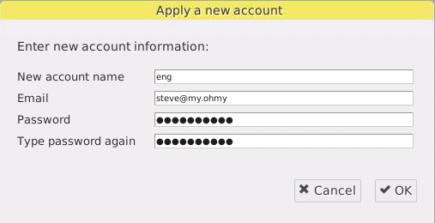
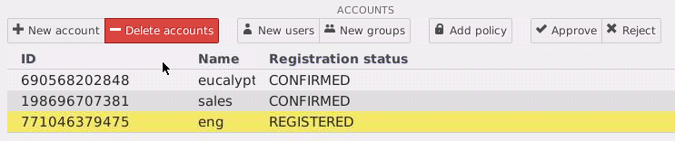
User-Initiated
The user uses the Administrator Console to request a new account.
Email is sent to the cloud administrator.
Administrator approves or denies
Cloud administrator manually approves the account
Email is sent back to user with URL to log in and finalize the account.
Notes:
In this method the user uses the Administrator Console to request a new account from the cloud administrator. The cloud administrator could either see the request via email or notice the pending request in the Administrator Console. Either way, the cloud administrator would either approve or deny the request in the Administrator Console. An email is sent to the user with either the denial or with the information about how to access the cloud and log in.
Approved accounts are listed with a registration status of CONFIRMED in the Administrator Console. Pending account requests are listed with a status of REGISTERED in the Administrator Console.
To confirm an account from the command line use euare-usermod --delegate account -u admin --reg-status=confirmed. To view the registration status using the command line use euare-usergetattributes --delegate <account_name> -u admin --show-extra.

Slide 46
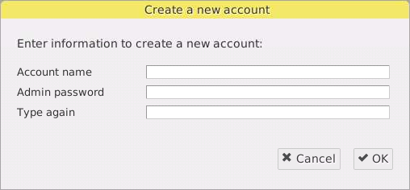
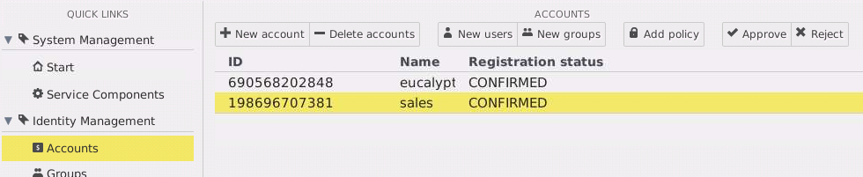
Administrator-Initiated
Accounts can be created from the Administrator Console or command line.
# euare-accountcreate –a <account_name>
Notes:
To create an account requires the user to be a cloud administrator. Accounts can be created using either the Administrator Consoleor the command line. Both are illustrated in the slide above.
To create and account in the Administrator Console select Accounts in the QUICK LINKs panel and click the New account button. Once you fill out the form the new account is created. When you create a new account using the Administrator Console you will need to supply the password for the admin user of the account. When you do this at the command line, you will have to run one command to create the account and another to set the password for the admin user.
When you add a new account, you cannot specify a specific path for the admin user for the account. To specify a path other than the default /, once the account is created got to the Administrator Console and select the admin user and change the path in the PROPERTIES panel.

Slide 47
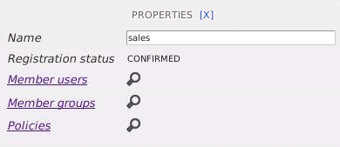
Viewing Accounts
Accounts can be viewed and searched from the Administrator Console or command line.
list users, groups, and polices in the account
# euare-accountlist
# euare-accountgetsummary <--delegate=account_name>
Notes:
You can view account using both the Administrator Console and the command line. Using both is illustrated above.
To view accounts in the Administrator Console select Accounts in the QUICK LINKS panel and the list of existing account appears in the main panel. You can click any account to get additional information about that account including member users, member groups, and attached policies.
The euare-accountlist command returns the names of all the accounts. There is no --delegate option for this command.
The euare-accountgetsummary command returns the number of groups and users in an account, but does not list the group names or user names.
The --delegate option can only be run by a cloud administrator (user in the eucalyptus account). It allows the user to display information about accounts other than the eucalyptus account.

Slide 48
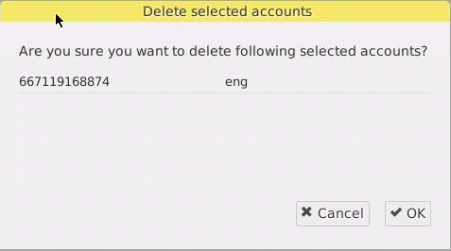
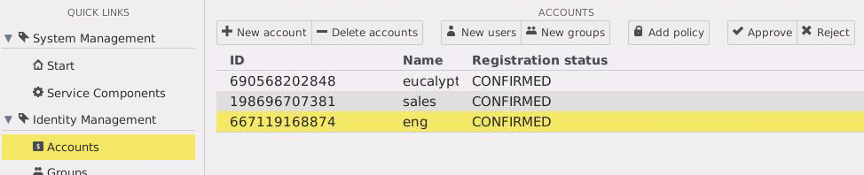
Deleting Accounts
Accounts can be deleted from the Administrator Console or the command line.
# euare-accountdel <–r> –a <account_name>
Notes:
This slide illustrates how to delete an account from both the Administrator Console and the command line.
To delete an account from the Administrator Console select Accounts in the QUICK LINKS panel, select the account you wish to delete, and click the Delete accounts button. Once you confirm the operation the account and all users, keys, certificates, passwords, and groups in the accounts will be deleted.
From the command line you can use the euare-accountdel command to delete an account. If you want to recursively delete all the users, keys, certificates, passwords, and groups use the –r option.

Slide 49
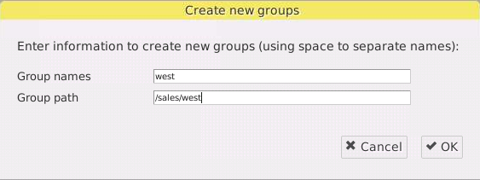
Adding Groups
Groups can be added to an account using the Administrator Console or command line.
# euare-groupcreate –g <group_name> <–p path> <--delegate=account_name>
Notes:
Groups can be added to an account using either the Administrator Console or the command line.
To add a group to an account from the Administrator Console select Accounts, select the account in the list, and click the New groups button. Provide the group name and an optional path. If no path is given it will default to /.
This command can be run by the administrator of the account, or if using the --delegate option, by a cloud administrator. If run by a cloud administrator, the group would be created in the account listed in the –-delegate option.
The –p argument is optional and will default to / if not included.

Slide 50
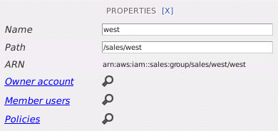
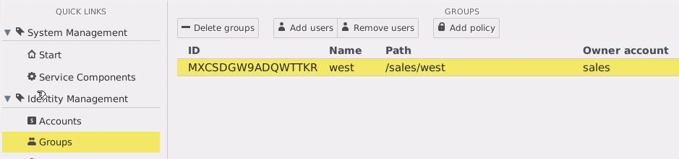
Viewing Groups
Groups can be viewed using the Administrator Console or command line.
list account owner, users, and polices
# euare-grouplistbypath <–p path_prefix> <--delegate=account_name>
# euare-grouplistusers –g <group_name> <--delegate=account_name>
# euare-grouplistpolicies –g <group_name> <--delegate=account_name>
Notes:
You can view groups using either the Administrator Console or the command line.
To view all groups in the cloud from the Administrator Console select Groups in the QUICK LINKS panel and the list of groups appears in the main panel.
The euare-grouplistbypath command lists the groups in an account. The euare-grouplistusers lists the users in a group. The euare-grouplistpolicies lists the policies associated with a group. These commands can be run by the administrator of the account, or if using the --delegate option, by a cloud administrator.
If euare-grouplistbypath is run by a cloud administrator, the groups listed would be those in the account listed in the --delegate option. If euare-grouplistusers is run by a cloud administrator, the group whose users are listed would be a group in the account listed in the --delegate option. If euare-grouplistpolicies is run by a cloud administrator, the group whose policies are listed would be a group in the account listed in the --delegate option.
The –p argument is optional and will default to / if not included. This option can be used to filter the list to only those groups with the path_prefix.
For all thses commands there are additional options to limit the number of groups displayed on the screen and to paginate the display results. For more information, see the online help page for the command.

Slide 51
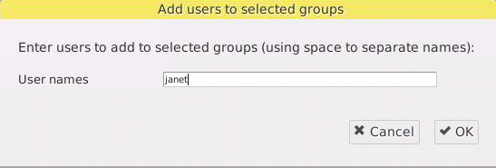
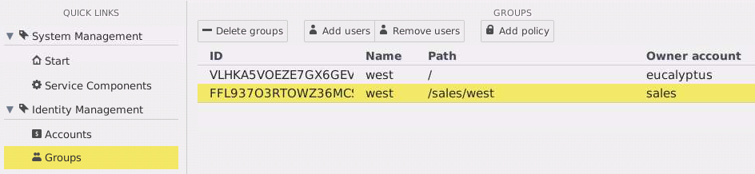
Adding Users to Groups
Users can be added to a group using the Administrator Console or command line.
# euare-groupadduser –u <user_name> –g <group_name> <--delegate=account_name>
Notes:
Users can be added to groups in an account using either the Administrator Console or the command line.
To add users to a group in the Administrator Console select Groups in the QUICK LINKS panel, select the group from the list in the main panel, then click the Add users button to add a user.
The euare-groupadduser command add a user to the named group. The command can be run by the administrator of the account, or if using the --delegate option, by a cloud administrator. If the command is run by a cloud administrator, the group to which a user was added would be a group in the account listed in the --delegate option.

Slide 52
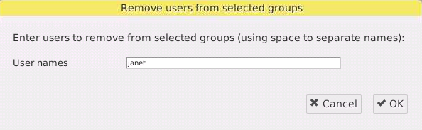
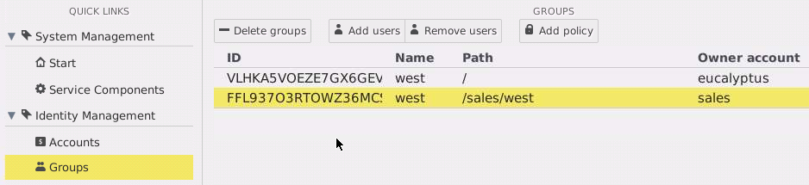
Removing Users from Groups
Users can be removed from a group using the Administrator Console or command line.
# euare-groupremoveuser –u <user_name> –g <group_name> <--delegate=account_name>
Notes:
Users can be removed from a group using either the Administrator Console or the command line.
To remove a user from a group from the Administrator Console, select Groups in the QUICK LINKS panel, select the group in the main panel, then click the Remove users button.
The euare-groupremoveuser command removes a user from the named group. The command can be run by the administrator of the account, or if using the --delegate option, by a cloud administrator. If the command is run by a cloud administrator, the group to which a user is removed would be a group in the account listed in the --delegate option.

Slide 53
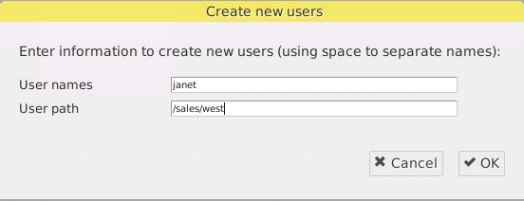
Adding Users to an Account
Users can be added to an account from the Administrator Console or command line.
# euare-usercreate -u <user_name> <-g group_name> <-p path> <--delegate=account_name>
Notes:
Users can be added to accounts in the cloud using either the Administrator Console or the command line.
To add user from the Administrator Console select Accounts in the QUICK LINKS panel, select the account you wish to add the user to, and then click the New users button. Once you complete the form the user is added.
The euare-usercreate command creates a new user in an account. This command can be run by the administrator of the account, or if using the --delegate option, by a cloud administrator. If run by a cloud administrator, the user would be created in the account listed in the –-delegate option.
The user can optionally be added to an existing group using the –g option, but the group must exist.
The path defaults to / if not specified.
Neither the Administrator Console nor this command creatse a user password, certificate, or keys. These must be created using additional steps shown in the next two slides.

Slide 54
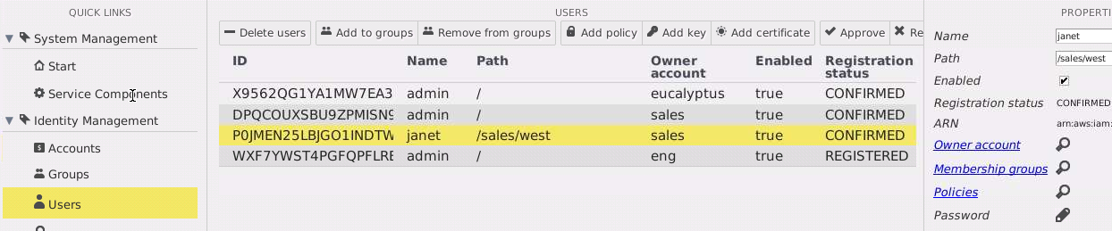
User Password and Credentials (1)
To create an initial login password, click the Password icon.
To create access keys and a certificate:
Click Add key and OK
Click Add certificate, copy/paste the certificate content, and click OK
Or just have the user log in and download their credentials
Keys and a certificate are automatically generated in response to a download credential request in the Administrator Console.
Notes:
Once a user has been created in an account, the will still need a log in password for the Administrator Console and will also require a certificate and keys to work with euca2ools or tools like Hybridfox.
This slide describes how to create a user login password, access keys, and a certificate when using the Administrator Console.
To create an initial password that will allow the user to log in to the Administrator Console, select the user in the Administrator Console and then click the Password icon shown above. When prompted, enter the user’s initial password. When the user first logs in to the Administrator Console they will use this password but will be prompted to change their password to something new.
While the Administrator Console will create access keys for the user, the Administrator Console will not create a certificate for the user. For certificates, the Administrator Console expects you to copy and paste an existing certificate in to the Add certificate dialog box. If there is no pre-existing credential and you would like the cloud to generate a certificate for the user, then user the command line euare-usercreatecert command rather than the Administrator Console.

Slide 55
User Password and Credentials (2)
To create an initial login password
euare-useraddloginprofile –u <user_name> –p <password> <--delegate=account_name>
To create access keys
euare-useraddkey –u <user_name> <--delegate=account_name>
To create a certificate
euare-usercreatecert –u <user_name> <--delegate=account_name>
Notes:
This slide discusses how to create a user login password, access keys, and a certificate when using the command line.
The euare-useraddloginprofile is used to create a login password for a user account. This command can be run by the administrator of the account, or if using the --delegate option, by a cloud administrator. If run by a cloud administrator, the password would be created for the user in the account listed in the –-delegate option.
The euare-useraddkey is used to create access keys for a user account. This command can be run by the administrator of the account, or if using the --delegate option, by a cloud administrator. If run by a cloud administrator, the access keys would be created for the user in the account listed in the –-delegate option.
While not shown on the previous slide, the –k option can be added to the euare-usercreate command and it would generate access keys for the user at the time the user is created.
The euare-usercreatecert is used to create a certificate for a user. This command can be run by the administrator of the account, or if using the --delegate option, by a cloud administrator. If run by a cloud administrator, the certificate would be created for the user in the account listed in the –-delegate option.
There are other commands to list, modify, and delete a user login password, access keys, and certificate. They include euare-usergetloginprofile, euare-usermodloginprofile, euare-userdelloginprofile, euare-userlistkeys, euare-usermodkey, euare-userdelkey, euare-userlistcerts, euare-usermodcert, and euare-userdelcert. See the online Eucalyptus documentation at http://www.eucalyptus.com/eucalyptus-cloud/documentation or command help pages for more information.

Slide 56
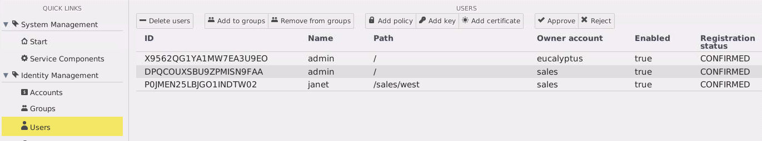
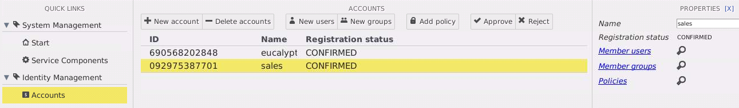
Viewing Users
View users from all accounts.
View users from a specific account.
# euare-userlistbypath <-p path_prefix> <--delegate=account_name>
Notes:
Existing users can be viewed from either the Administrator Console or the command line. From the Administrator Console you can list all users in all accounts by selecting Users in the QUICK LINKS panel. To view users in a specific account you can select Accounts in the QUICK LINKS panel, then select an account, and click the search icon next to Member users.
The euare-userlistbypath command lists the users in an account. This command can be run by the administrator of the account, or if using the --delegate option, by a cloud administrator. If euare-userlistbypath is run by a cloud administrator, the users listed would be those in the account listed in the --delegate option.
The –p argument is optional and will default to / if not included. This option can be used to filter the list to only those users with the path_prefix.
There are additional options to limit the number of users displayed on the screen and to paginate the display results. For more information, see the online help page for the command.

Slide 57
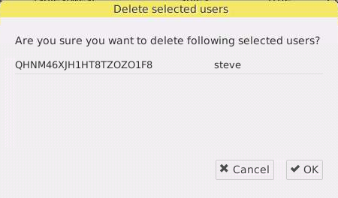
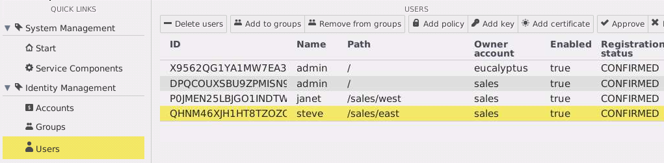
Deleting Users
Users from any account can be viewed or deleted.
# euare-userdel <–r> –u <user_name> <--delegate=account_name>
Notes:
You can also delete users using either the Administrator Console or the command line. To delete a user from the Administrator Console select Users from the QUICK LINKS panel, select the user to delete from the list, and then click the Delete users button.
From the command line use the euare-userdel command to delete a user. The -r option recursively removes the user’s credentials, policies, and login profile, and also removes the user from any groups. There is also a –p preview option that shows what the command would do, but without actually doing it.

Slide 58
Summary
Accounts, groups, and users can be managed from the Administrator Console or the command line.
The euare-* commands are used at the command line.
A user can initiate account creation or a cloud administrator can create an account.
Creating a user account does not automatically create a login profile (password), access keys, or certificate for the user.
A password must be manually created by an administrator.
Credentials can be manually created by an administrator, or are created when a user attempts to download their credentials.

Slide 59
Hands-On (1)
Managing Eucalyptus Accounts, Users, and Groups
Add a new administrative user in the eucalyptus account
Log in and test the new administrative user
Create a non-administrative user
Log in as a non-administrative user

Slide 60
Hands-On (2)
Managing Eucalyptus Policies
Test default permissions for a normal user using the Administrator Console
Test default permissions for a normal user using euca2ools
Create a policy and assign it to a group
Test the new policy’s operation with a normal user

Slide 61
End of Module

