Slide 1


Slide 2
Eucalyptus User Console
Eucalyptus Education Services Revision C

Slide 3
Module Topics
Eucalyptus User Console introduction
Installing and configuring the User Console
Starting the User Console
Managing key pairs
Starting, listing, and stopping instances
Listing images
Managing security groups
Managing elastic IP addresses
Managing volumes
Managing snapshots

Slide 4


Eucalyptus User Console
Is an easy-to-use Web-based user interface
Manages images, instances, key pairs, addresses, volumes, snapshots, security groups
Installed as a service accessed by https://<IP_address_where_console_installed>:<port>
Users will need an account name, login name, and password.
User Console service
Cloud Controller
Notes:
Firefox is the officially supported browser, but Internet Explorer, Chrome, and Safari should work too.
The User Console does not require Flash and works with HTML5.
The server supports 150 concurrent users.
The port number of 8888 can be changed in the User Console’s configuration file.

Slide 5
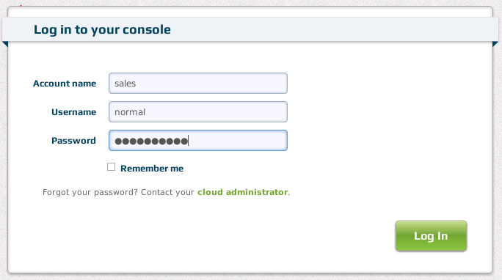
User Console Log In
Enter your account name, username, and password to log in.
opens the Administrator Console, for changing your password

Slide 6
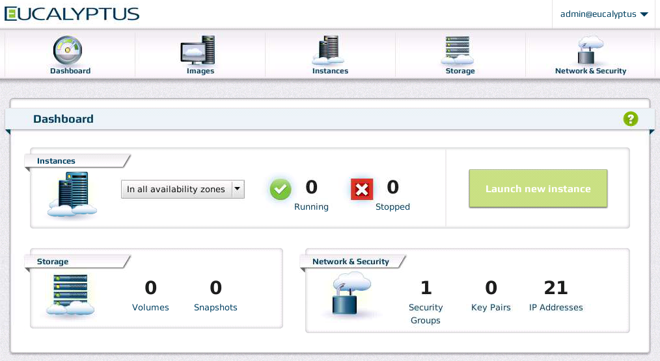
User Console Dashboard
main navigation panel
user@account
log out
links to manage images, instances, volumes, snapshots, security groups, key pairs, and IP addresses
Notes:
The Dashboard is the initial screen when you log in to the User Console. You use the Dashboard to navigate to other screens. The Dashboard also quickly provides information about the status of instances, storage, and network and security resources.

Slide 7
Installing the User Console
Install on any host with access to Cloud Controller and users.
Installation on Cloud Controller is OK as long as users have access and there are sufficient machine resources
Installation requires the installation of the Eucalyptus release and EPEL repo files
Installation of the User Console
yum install http://downloads.eucalyptus.com/software/eucalyptus/3.2/ \ centos/6/x86_64/eucalyptus-release-3.2.noarch.rpm
yum install http://downloads.eucalyptus.com/software/eucalyptus/3.2/ \ centos/6/x86_64/epel-release-6.noarch.rpm
yum install eucalyptus-console

Slide 8
Configuring the User Console
The User Console must be configured for your cloud.
The configuration file is /etc/eucalyptus-console/console.ini.
In the [server] section, configure:
Cloud Controller IP address
clchost: <cloud_controller_IP_address>
Port service will run on
uiport: <port_number>
Administrator Console Portal URL
support.url: <URL_of_Administrator_Console>
Other configuration parameters include custom SSL keys, locale, session timeouts, polling frequencies, and others.
For more information, see the Eucalyptus User Console Guide at http://www.eucalyptus.com/docs.
Notes:
The User Console configuration file is located at /etc/eucalyptus-console/console.ini. The file contains not only configuration parameters, but also information about the parameters and guidance about changing their values.
The Cloud Administration Portal URL simply provides the user a link to the Administrator Console so that the user can change their password.
The Cloud Administration Portal URL (support.url:) setting determines where the user will be taken when they click the link “Forgot your password? Contact your cloud administrator. “ on the main login screen. Selecting this link will open the Eucalyptus Administrator Console and allow the user to change their password.

Slide 9
Configuring vmtypes
The User Console must be manually configured to match the vmtypes configuration of your cloud.
The following default values in the User Console .ini file match the default values of the cloud.
[instance_type]
m1.small.cpu: 1
m1.small.mem: 128
m1.small.disk: 2
c1.medium.cpu: 2
c1.medium.mem: 128
c1.medium.disk: 5
m1.large.cpu: 2
m1.large.mem: 512
m1.large.disk: 10
m1.xlarge.cpu: 2
m1.xlarge.mem: 1024
m1.xlarge.disk: 10
c1.xlarge.cpu: 4
c1.xlarge.mem: 2048
c1.xlarge.disk: 10
automatic configuration is planned for the 3.3 release
Notes:
The vmtypes, and how to change them in your cloud, are covered in the Instance and Image Management module of the Design, Build, Manage course.

Slide 10
Starting the User Console
Start the User Console once the console.ini file has been configured.
Restart the User Console if the console.ini file has been changed.
Refresh your browser window too.
service eucalyptus-console start
service eucalyptus-console restart
Notes:
If you make changes to the console.ini configuration file, then restart the User Console service using service eucalyptus-console restart.

Slide 11
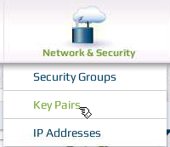
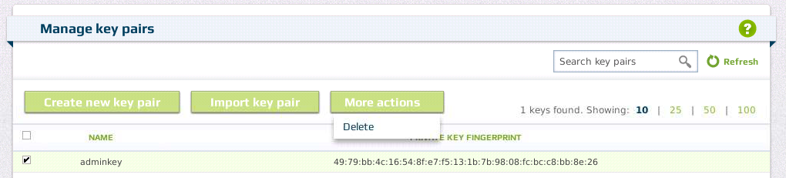
Managing Key Pairs
Public/private key pairs can be managed by the Eucalyptus User Console.
Create keys
View keys
Delete keys
Notes:
Users can also manage their public and private key pairs using the Eucalyptus User Console.

Slide 12

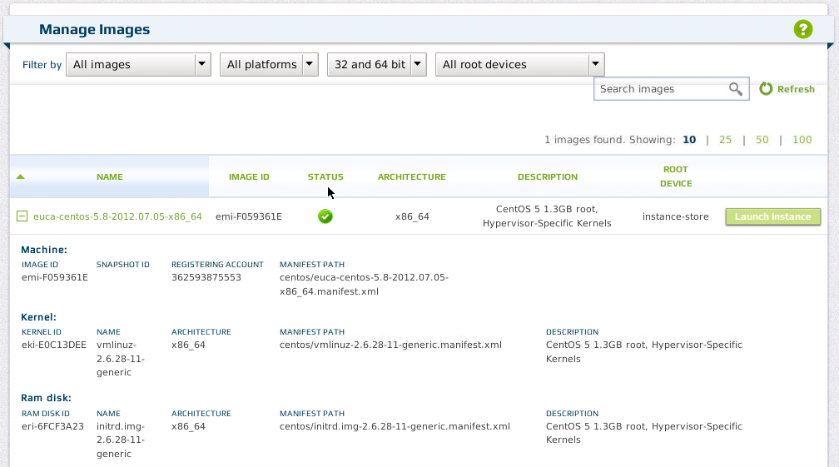
Listing Images
expand/contract to view more image information
expanded information for the selected EMI
Notes:
The view is currently expanded so that for the EMI you can see both more EMI information and information about the bundled EKI and ERI.

Slide 13

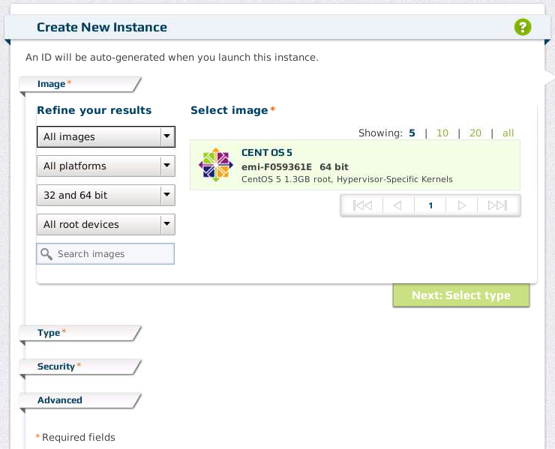
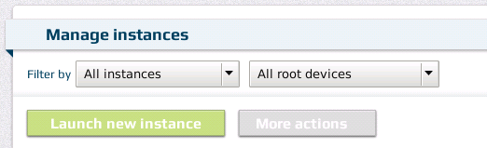
Starting an Instance
Notes:
It is also possible to launch new instances using the Eucalyptus User Console.
In the Create New Instance window, you make a series of choices in order to launch an instance. The choices are listed below:
Image section - Select your EMI image. Several filters exist to find the exact EMI you want. Filters include:
All images
Images owned by me
All platforms
Linux
Windows
32 and 64 bit
32 bit
64 bit
All root devices
Instance-store root device
EBS root device
Type section
Select one of the five vmtypes
Select the number of instances to launch
Select a specific availability zone or let the cloud pick the availability zone
Security section
Select a key pair
Select a security group
At this point you are offers the choice to launch the instance or continue on to the Advanced section where you can make additional choices.
Advanced section
Manually enter user data that will be made available to the instance when it boots
Browse to a file that contains user data that will be made available to the instance when it boots
Choose a specific EKI with which to launch the EMI
Choose a specific ERI with which to launch the EMI
Choose to launch the instance with only a private IP address and not public IP address
At this point you may launch the instance.
If at any time you want to go back and change your selections before you launch the instance, you may by clicking the appropriate section title. Clicking the section title reopens the section and allows you to change your selections.

Slide 14
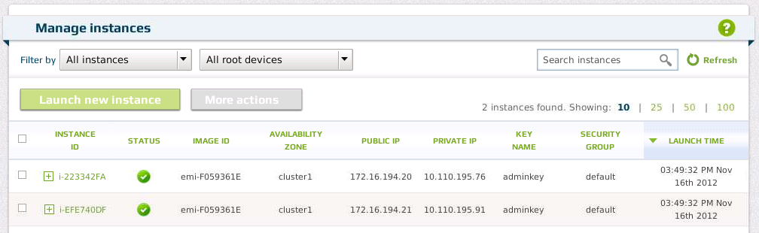
Listing Instances
expand instance for more information

Slide 15
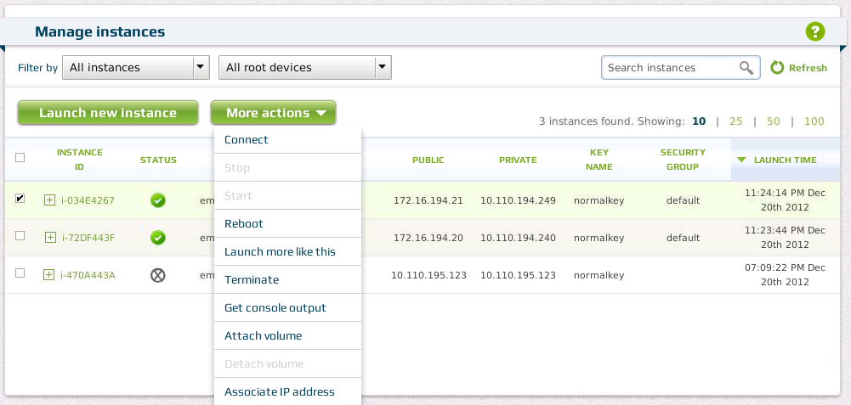
Controlling an Instance
Instance store or EBS-backed instances can be rebooted or terminated.
Notes:
Ephemeral data is not lost during a reboot. Some versions of hypervisors might not reconnect an EBS volume to the instance and manual intervention might be necessary.
EBS-backed images can also be suspended and resumed. EBS-backed images are covered in a later module.

Slide 16
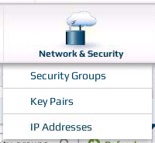
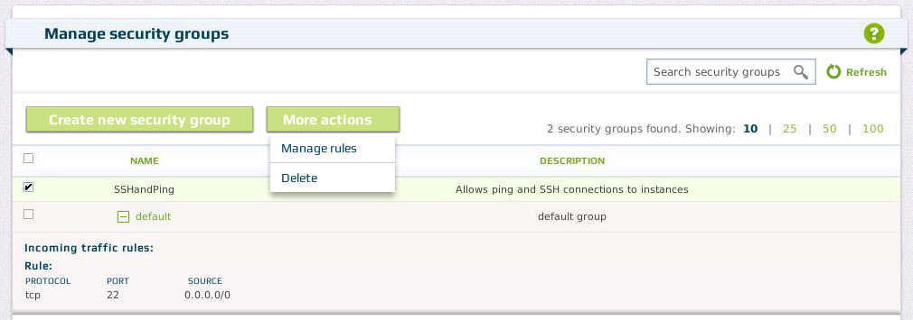
Managing Security Groups
Notes:
The Eucalyptus User Console also allows users to manage their security groups. Users can list their security groups, add or delete a security group, and authorize or de-authorize outside connection access.
Clicking the Create new security group button opens a window that allows you to name a group and then add one or more rules to it.
The security group SSHandPing was added by a user. Notice that it was selected, which then allows the user to click the More actions button and choose to either manage the security group’s rules or delete the security group.

Slide 17
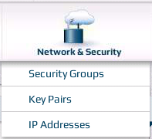
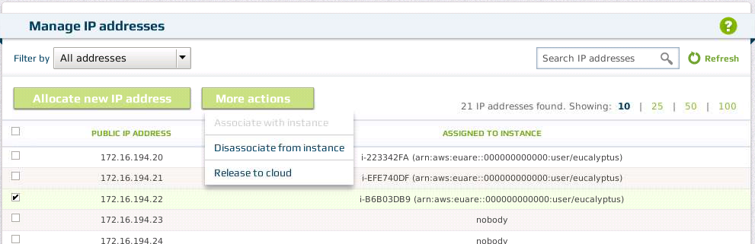
Managing Elastic IP Addresses
Notes:
The Eucalyptus User Console can also be used to manage elastic IP addresses in the same way that euca2ools can be used.

Slide 18
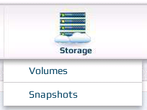
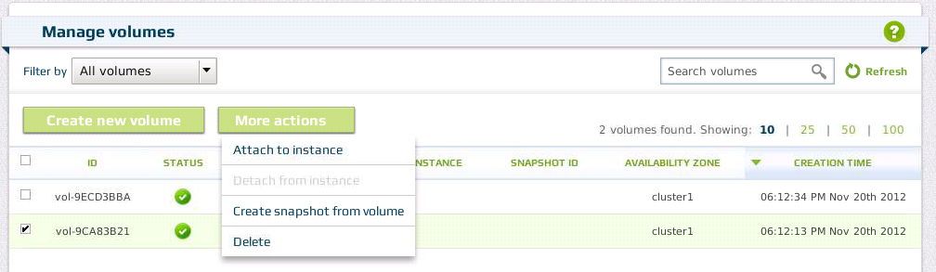
Managing Volumes
Notes:
The Eucalyptus User Console provides the same volume management functionality that euca2ools does.

Slide 19
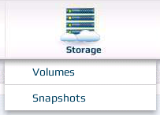
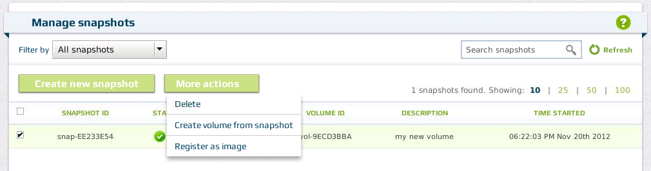
Managing Snapshots
Notes:
The Eucalyptus User Console provides the same snapshot functionality that euca2ools does.

Slide 20
Summary
The Eucalyptus User Console is a graphical user interface that manages:
Instances
Security groups
Elastic IP addresses
Volumes
Snapshots
The main User Console configuration file is /etc/eucalyptus-console/console.ini.
Start and stop the User Console with service eucalyptus-console start/stop.

Slide 21
Hands-On (1)
Using the Eucalyptus User Console
Install and configure the Eucalyptus User Console
Log in to the User Console
Create a key pair
Launch an instance
Connect to a running instance
Terminate an instance
Create a security group
Modify a security group
Delete a security group

Slide 22
Hands-On (2)
Reserve an elastic IP address
Assign an elastic IP address
Unassign an elastic IP address
Create a storage volume
Attach a volume to an instance
Detach a volume from an instance
Snapshot a volume
Create a volume from a snapshot
Delete a volume and snapshot

Slide 23
End of Module

