Slide 1


Slide 2
Monitoring the Cloud
Eucalyptus Education Services Revision C

Slide 3
Module Topics
Eucalyptus Dashboard usage report types
Generating usage reports
Viewing usage reports
Understanding usage report values
Saving usage reports

Slide 4
Dashboard Usage Reports
The Eucalyptus Dashboard reports cloud resource usage over a user-specified date range.
Six types of usage reports are available.
Instance usage reports
S3 usage reports
Volume usage reports
Snapshot usage reports
Elastic-IP usage reports
Capacity reports

Slide 5
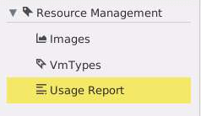
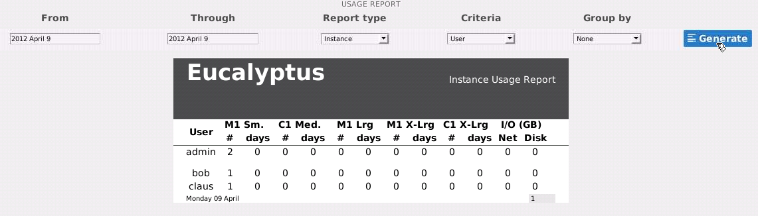
Generating Usage Reports
Only cloud administrators
Click Usage Report.
Select the date range, type of report, sort criteria, and how to group the report output.
Click Generate.
Notes:
When you select a range of dates for the report, the report is inclusive of the starting and ending dates.
The Report type is a drop-down menu that include Instance, Storage, and S3 choices.
Criteria is a drop-down menu whose choices depend on the type of report selected. Later slides list all the available choices in a flowchart format. Criteria is used to sort the data in the report.
Group by is drop-down menu whose choices depend on the type of report and the criteria selected. Group by is used to organize the sorted data in different ways. For example, a list of data sorted by users could be further organized so that all the users are listed by their account, or by the availability zone in which they operate.

Slide 6
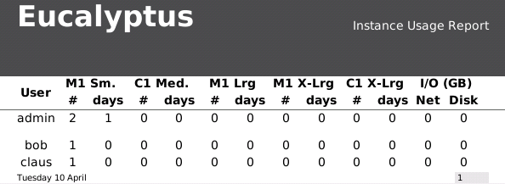
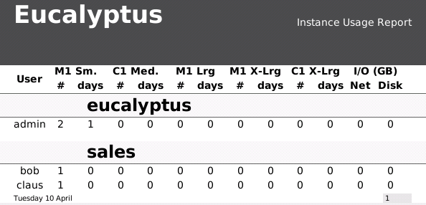
Instance Report Examples
Criteria: User
Group by: None
-just a list of users
Criteria: User
Group by: Account
-a list of users further grouped by accounts
Notes:
In the example above the user admin in the eucalyptus account has had two instances running for at least one day. Together, those instances have generated less than 1GB of either network or disk I/O. The users bob and claus in the sales account have had one instance each running for less than a day. Neither of the instances have generated 1GB of network or disk I/O up to this point in time.

Slide 7
Instance Report Options
Instance
Report type
Criteria
User
Account
Cluster
Availability Zone
None
Account
Cluster
Availability Zone
None
Cluster
Availability Zone
Group by
None
Availability Zone
None
Notes:
Because instances run in an availability zone and are controlled by a Cluster Controller, instance usage can be reported by user, account, cluster (Cluster Controller), and availability zone.
If Instance and Account are selected, then the Group by menu has only selections for None, Cluster, and Availability Zone.
If Instance and Cluster are selected, then the Group by menu has only selections for None and Availability Zone.
If Instance and Availability Zone are selected, then the Group by menu on has a selection of None.

Slide 8
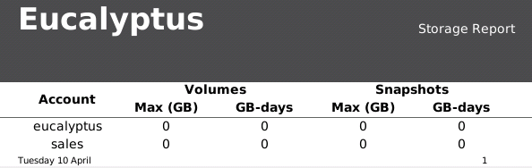
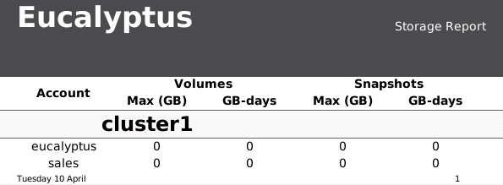
Storage Report Examples
Criteria: Account
Group by: None
-just a list of accounts
*GB-days = [number of days allocated] x [number of GBs allocated].
Criteria: Account
Group by: Availability Zone
-a list of accounts further grouped by the availability zone name
Notes:
The report contains values for Max (GB) and GB-days. Max (GB) reports the maximum number of GB that was deployed during the report period. GB-days refers to [number of days allocated] x [number of GBs allocated]. Bear in mind that number of days and GB can be fractional, and it adds them all up. You could have 80 volumes of 100MB, each allocated for 3 hours, and the result would be 1 GB-Day (0.1*80*/(24/3)).
In the output above the users in the eucalyptus account consumed less than 1GB of storage controller space for less than 1 day for both volumes and snapshots. The same is true for the users in the sales account.

Slide 9
Storage Report Options
Storage
Report type
Criteria
User
Account
Cluster
Availability Zone
None
Account
Cluster
Availability Zone
None
Cluster
Availability Zone
Group by
None
Availability Zone
None
Notes:
Because volumes and snapshots are associated with a cluster controller and created within an availability zone, volume and snapshot usage can be reported by user, account, cluster (controller), and availability zone.
If Storage and Account are selected, then the Group by menu has only selections for None, Cluster, and Availability Zone.
If Storage and Cluster are selected, then the Group by menu has only selections for None and Availability Zone.
If Storage and Availability Zone are selected, then the Group by menu only has a selection of None.

Slide 10
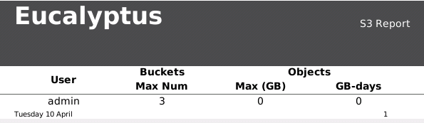
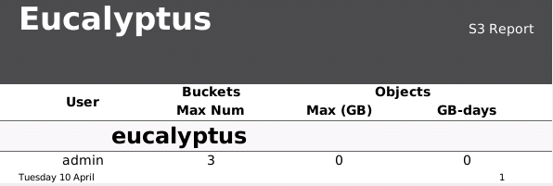
S3 Report Examples
Criteria: User
Group by: None
-just a list of users
*GB-days = [number of days allocated] x [number of GBs allocated].
Criteria: User
Group by: Account
-a list of users further grouped by account
Notes:
The report contains values for Max Num, Max (GB), and GB-days. Max Num reports the maximum number of buckets deployed during the report period. Max (GB) reports the maximum number of GBs that were deployed during the report period. GB-days refers to [number of days allocated] x [number of GBs allocated]. Bear in mind that number of days and GBs can be fractional, and it adds them all up. You could have 80 buckets of 100MB, each allocated for 3 hours, and the result would be 1 GB-Day (0.1*80*/(24/3)).
In the output above the user admin in the eucalyptus account owned a maximum of 3 buckets during the report period. Those buckets consumed less than 1GB of space for less than 1 day.

Slide 11
S3 Report Options
S3
Report type
Criteria
User
Account
None
Account
Group by
None
Notes:
Because Walrus buckets are a cloud-wide resource, and not associated with a specific cluster controller or availability zone, Walrus usage is reported only by user and account.
If S3 and User are selected, then the Group by menu has only selections for None and Account.
If S3 and Account are selected, then the Group by menu has only selections for None.

Slide 12
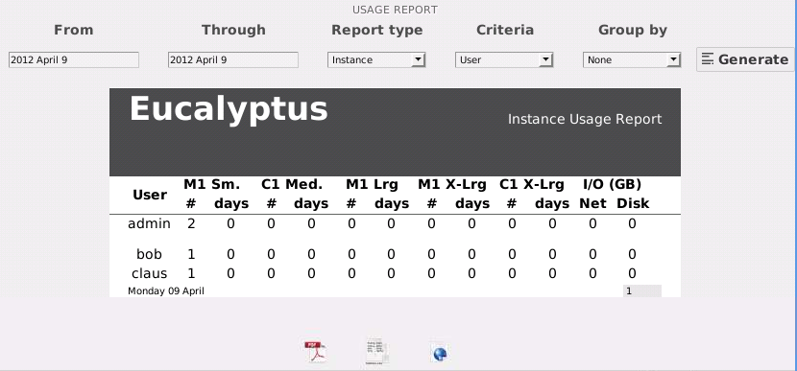
Saving Usage Reports
Reports can be saved to PDF, CSV, and HTML files.
PDF
CSV
HTML
Notes:
Reports can be saved to files in different formats. This makes it possible to view reports, or further process reports, using external utilities. CSV means comma-separated value and is a popular format used to input data into spreadsheet programs.

Slide 13
Summary
The Eucalyptus Dashboard reports about cloud resource usage over a user-specified time period.
Sixtypes of reports are available; instance reports, S3 reports, volume reports, snapshot reports, Elastic-IP reports, and Capacity reports.
Reports can be sorted by different criteria.
Reports can be viewed in the Dashboard, or saved to PDF, CSV, or HTML files for viewing, or processing by, in other programs.

Slide 14
End of Module

