Slide 1


Slide 2
Eucalyptus High Availability
Eucalyptus Education Services Revision C

Slide 3
Module Topics
Eucalyptus HA features
HA and redundancy
Service redundancy
Infrastructure redundancy
Storage redundancy
Service states
Arbitrator operation
HA deployment requirements
HA configuration

Slide 4
Eucalyptus High Availability
Eucalyptus HA provides:
A highly-available cloud service.
Not highly-available applications (instances)
Automatic monitoring of system health, including detection of service faults
Automated failover of redundant services
Administrator tools for interrogating the service health and access to service state information
Administrator Console, euca-describe-services, euca-describe-arbitrators
Ability to remove individual component services from operation without disrupting service, assuming services are redundant
Administrator Console, euca-modify-service
Support for restoring/replacing a component service after a total-loss failure (for example, disk failure, host combustion)
Notes:
Eucalyptus HA provides highly-available cloud services and not highly-available instances and applications. HA protects the Web services running on the Eucalyptus cloud components using redundancy. Each redundant pair has an service that is actively responding to service requests and one server that is not responding to service requests. Each service in a pair monitors the other service for faults. If a fault occurs on the active service then the redundant server assumes control.
Eucalyptus HA also includes administrator tools for monitoring service health and status. Tools that can be used include the Administrator Console and the command-line administrator tools in /usr/sbin on the Cloud Controllers. You cannot only query for state information, but change state as well. This allows you to take a server out of service for maintenance without interrupting the service. You can also bring a server back online to restore redundancy.

Slide 5
HA and Redundancy
High availability is provided by a combination of:
Eucalyptus service redundancy
Cloud Controller, Walrus, Cluster Controller, Storage Controller, VMware Broker
Environmental redundancy
Underlying server, network, storage, power, and cooling redundancy
Operational support
Maintaining proper configuration and operation
Notes:
Redundant services are the foundation of Eucalyptus HA, but other types of redundancy are important too. The Eucalyptus services depend on the underlying servers, network, storage, power, and cooling too. For a truly high availability environment all these components should be redundant. Its also important that your operational processes support the HA environment. Servers should be properly maintained and monitored to ensure that redundancy is maintained at all times. For example, if a service was to fail and go unnoticed, the failure of its partner service most likely would interrupt cloud operation.

Slide 6
Service Redundancy
Eucalyptus HA provides high availability for the cloud and cluster-layer components.
CLC
CLC
Walrus
Walrus
CC
CC
SC
SC
CC
CC
SC
SC
Node Controller
Node Controller
VM
VM
VM
VM
VM
VM
Node Controller
SAN
Node Controller
VM
VM
VM
VM
VM
VM
Node Controller
Node Controller
VM
VM
VM
VM
VM
VM
Notes:
This illustration depicts the redundant cloud servers and services. While not shown above because the diagram would be too complicated, the VMware Broker service is also redundant. The VMware Broker service would run on the Cluster Controller hosts.
Node Controllers are not redundant within the same cluster. If a Node Controller fails, the instances that it is running will fail. For this reason you should architect applications for availability. For example, you could ensure that a running applications runs instances in two separate clusters. If a Node Controller in one cluster fails, it would not affect instances running in another cluster.

Slide 7


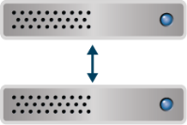

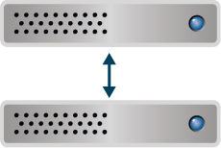
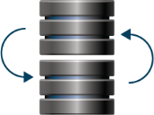

High Availability in Action
Node Controllers
SAN Storage Arrays
Cluster Controller HA
VM
VM
VM
VM
VM
VM
Cloud Controller HA
Storage Controller HA
NAS
Self-Service GUI
Node Controllers
SAN Storage Arrays
Walrus Storage HA
Cluster Controller HA
VM
VM
VM
VM
VM
VM
Programmatic Cloud Access
Storage Controller HA
NAS
Notes:
Eucalyptus HA can maintain cloud operation during multiple failures as long as both services in a service pair do not simultaneously fail and the service is accessible through a network interface.

Slide 8
Network Redundancy
(users)
Hosts supporting HA should be configured with redundant networks and components.
Each host should have one extra NIC for each functional NIC.
NICs should be bonded but connected to separate physical networks.
switch
switch
N1
N2
N1
N2
Cluster ControllerA
Cluster ControllerB
N3
N4
N3
N4
switch
switch
CC example
(instances)
Notes:
The physical hosts supporting Eucalyptus HA should be configured with redundant network connections so that there is no single point of failure. To support failover capability, configure the underlying NICs in to a bond and then connect each NIC in the bond to a separate network infrastructure. In this way the services on the host are insulated from both NIC failure and infrastructure failures. The illustration in this slide is of the Cluster Controller, but the same type of configuration should also be done for the other Eucalyptus components.

Slide 9
Storage Redundancy
Storage for the Walrus and Storage Controllers must be redundant.
Consider storage path redundancy too.
SC
SC
Walrus
Walrus
switch
switch
switch
switch
ctlr
ctlr
RAID
Notes:
Storage should not be a single point of failure for the Walrus or Storage Controllers. Eucalyptus requires a supported SAN for Eucalyptus HA. Make sure that you have redundant paths to the SAN and that the SAN uses RAID technology to protect the data from disk failure.
Walrus storage is protected by Distributed Replicated Block Device (DRBD) software running in the Linux kernel. DRBD is described in the next slides.

Slide 10
Walrus Storage
Walrus HA requires storage disks configured in a cluster.
Walrus leverages kernel-based DRBD software to maintain cluster consistency.
The enabled Walrus writes updates to both disks.
At failure, the disabled Walrus is enabled and takes over the cluster.
Walrus (enabled)
Walrus (disabled)
switch
switch
Notes:
DRBD is open-source software that has been in the mainline Linux kernel since 2.6.33. It allows the configuration of a master-slave storage cluster that uses the network to maintain consistency between the two storage devices. The master-slave roles can be reversed as necessary. It allows the master to read from its own storage but send writes to both the master and slave storage. In case the master fails, the slave takes over the role of master and the storage cluster continues to operate.

Slide 11
DRBD Operation
DRBD is network-based mirroring (RAID 1).
DRBD in the kernel intercepts disk writes and replicates them to the other Walrus using the network interface.
Writes are synchronous.
For more information, see www.drbd.org.
Walrus
Walrus
DRBD
TCP/IP
TCP/IP
DRBD
HBA
NIC
NIC
HBA
switch
Notes:
This slide illustrates how DRBD in the kernel is able to intercept write requests to the disk and send write requests to both the local storage and to the TCP/IP driver for transport to the slave system. DRBD uses synchronous writes in Eucalyptus HA to ensure that the write is committed to the remote disk on the slave before the master Walrus flushes the data from its write buffer. This helps to ensure consistency between the clustered Walrus disks. However, synchronous writes do limit the physical distance between the two Walrus systems.
To provide more clarity in the diagram, the redundant NICs and networks were removed.
Starting with drbd-0.7-plus up to 16 TB per DRBD device is suported.

Slide 12
DRBD Metadata
Walrus
Walrus
DRBD creates a metadata area on the Walrus disk to help ensure data consistency in the cluster.
Consumes less than 5MB even on a 150GB storage area
DRBD
TCP/IP
TCP/IP
DRBD
HBA
NIC
NIC
HBA
switch
consistency
metadata
metadata
Notes:
Because DRBD is a clustered storage solution, it requires a way to maintain state information and ensure that data on both sets of storage is consistent. One method that DRBD uses to accomplish this is the use of metadata on each storage device. The metadata is small and take up only a few MBs of space. The online DRBD documentation at http://www.drbd.org/docs/about/ provides a formula for calculating the size of metadata based on the size of the replicated storage.

Slide 13
Service States
Individual cloud and cluster services that are paired are best described as enabled and disabled.
View using the Administrator Console or euca-describe-services
State | Operational | In Use | Description
ENABLED | yes | yes | Service is operating correctly and is selected for processing requests
DISABLED | yes | no | Service is operating correctly but is not selected for processing requests
NOTREADY | no | no | Service is failing to operate correctly
BROKEN | no | no | Service is not contactable by the system
STOPPED | n/a | no | Service has been stopped by an administrator
Notes:
These are the five possible state for redundant services in the cloud. The normal operational states for all service pairs are ENABLED and DISABLED.
There is a illustration later in this module that shows the output of the euca-describe-services command. This command displays service states on your screen. Service state information is also available in the Eucalyptus Administrator Console.

Slide 14
Cloud Availability
The cloud is available if:
The cloud has an enabled Cloud Controller.
The cloud has an enabled Walrus.
The availability zone has an enabled Cluster Controller.
The availability zone has an enabled Storage Controller.
VMware hypervisors have an enabled VMware Broker.
The user-facing service has one reachable Arbitrator per host.
If you configure Arbitrators
Notes:
These are the conditions under which the cloud is considered to be available. All but the last condition should be easy to understand at this point in the course. However, the module has not yet described Arbitrators. They are described starting on the next slide.

Slide 15

Arbitrators
An optional service that monitors user network connectivity.
Configured on Cloud Controllers, Walruses, and Cluster Controllers
Uses ICMP echo messages to periodically test reachability to an external IP address.
If the Arbitrator has reachability out, users should have reachability in.
Choose IP addresses that best approximate user locations.
Viewing Arbitrator information
euca-describe-arbitrators, euca-describe-properties | grep arbitrator
CLC
NIC
router2
arbitrator
ping
Notes:
The redundant service pairs monitor each other to determine if they are functional or not. However, having a functional service is only useful if it can be reached by the users that need the service. Testing user reachability is the purpose of the Arbitrator services.
Arbitrators are an optional but recommended configuration for Eucalyptus HA. They should be configured on the user-facing cloud components including the Cloud Controllers, Walruses, and the Cluster Controllers. Each Arbitrator tests for user reachability by send ICMP echo requests (a ping –c 1) to the IP address of a network device. The network devices that are chosen should approximates the users’ locations. Because users could be connecting from multiple networks to different network interfaces on the Eucalyptus hosts, it is recommended to configure a separate Arbitrator to test network reachability to each network through each NIC where users might be.

Slide 16
Arbitrators Example
company router 1
company router 2
company router 1
company router 2
company router 1
company router 2
Arbitrator
Arbitrator
Arbitrator
Arbitrator
Arbitrator
Arbitrator
Cloud Controller
Walrus
Cluster Controller
Configure multiple Arbitrators to test all NICs and paths to public networks
If all Arbitrators registered on a host fail, failover occurs.
Arbitrators are register with the host, not a service.
All services running on host with use the Arbitrator(s).
Notes:
Is this example, the cloud architect determined that if the Cloud Controllers, Walruses, and the Cluster Controllers could reach company routers 1 and 2, then cloud users should be able to reach the cloud services.
It might take multiple Arbitrators running on a host to test all NICs and networks Only three Arbitrators may be configured on a Cluster Controller, but more Arbitrators can be configured on Cloud Controllers and Walrus.
Failover from one host to another not only occurs if its Web service fails, but also if all the Arbitrators on the host running the service fail to connect to their assigned IP addresses. After 10 ping failure the arbitrator will consider the address unreachable. If all arbitrators fail in 10 seconds a failover will occur.
You can view arbitrator configuration and status using either the command line or the Eucalyptus Administrator Console.

Slide 17
Eucalyptus HA Requirements
Eucalyptus HA requirements are similar to a regular Eucalyptus deployment, with the following additional considerations:
Install each pair of services on separate hosts.
Cloud Controller, Walrus, Cluster Controller, Storage Controller, VMware Broker
The services must be installed on physical hosts.
Service pairs must have network connectivity.
Walrus hosts must mirror storage using DRBD.
Storage controller services must use a supported SAN array.
No local or NFS, only NetApp, Equallogic, EMC drivers
Configure DNS round-robin support for Cloud Controller and Walrus hosts
Notes:
Installing Eucalyptus HA is not difficult. It mostly consists of installing the software twice, once on each host in the service pair. Once the software has been installed on all hosts, you just register each service as you normally would. The first service in a pair that is registered becomes the initial primary host and is enabled. The second service in a pair that is registered becomes the secondary host and is disabled. It is disabled because during its initial checks it becomes aware that an enabled services already is running. Make sure that a firewall does not block services from each other as they send heartbeat packets to each other.
Any special installation requirements are listed in the slide above.

Slide 18
Example Configurations (1)
Full physical host redundancy
CLC
CLC
Walrus
Walrus
CC
CC
SC
SC
CC
CC
SC
SC
Node Controller
Node Controller
VM
VM
VM
VM
VM
VM
Node Controller
SAN
Node Controller
VM
VM
VM
VM
VM
VM
Node Controller
Node Controller
VM
VM
VM
VM
VM
VM
Notes:
Eucalyptus HA can be configured for full host redundancy or partial host redundant. The illustration above is the recommended full physical host redundancy. In this configuration each separate cloud service runs on its own dedicated physical machine.

Slide 19
Example Configurations (2)
Partial physical host redundancy
CLC
Walrus
CLC
Walrus
CC
SC
CC
SC
CC
SC
CC
SC
Node Controller
Node Controller
*It is recommended to put all services on separate hosts.
VM
VM
VM
VM
VM
VM
Node Controller
SAN
Node Controller
VM
VM
VM
VM
VM
VM
Node Controller
Node Controller
VM
VM
VM
VM
VM
VM
Notes:
The illustration depicts partial physical host redundancy. In this example the Cloud Controller and Walrus share a physical host, as do the Cluster Controller and Storage Controller. If any host fails and disrupts the two services running on that host, those two services are still available on the redundant host.

Slide 20
Installation and Configuration
Install Eucalyptus software on redundant (secondary) hosts.
Use the same installation instructions used on the primary hosts.
Configure the /etc/eucalyptus/eucalyptus.conf on the redundant hosts.
Use the same configuration used on the primary hosts.
Remember: The Node Controllers are not redundant.
Notes:
Use the same software installation instructions to install both the primary and secondary host in each service pair. Make sure that each host in a service pair has the same eucalyptus.conf configuration.

Slide 21
Starting the Cloud-Layer Components
Initialize only the database on the first Cloud Controller.
It becomes the primary server.
euca_conf -–initialize
Start the Cloud Controller services on both hosts.
Start the host with the initialized database first.
service eucalyptus-cloud start
Start the Walrus services on both hosts.
service eucalyptus-cloud start
Notes:
Only the first Cloud Controller in a pair needs to be manually initialized using the euca_conf command shown above. Once the first Cloud Controller has had its database initialized, you can start it as well as the second Cloud Controller. Once the Cloud Controllers are running, start the Walruses. If the Walrus is installed on the same host as the Cloud Controller, it would be started when the Cloud Controller is started and a separate command is not necessary.

Slide 22
Starting the Cluster Components
Start the Cluster Controller services on both hosts.
service eucalyptus-cc start
Start the Storage Controller services on both hosts.
service eucalyptus-cloud start
Start the VMware Broker on both hosts, only for VMware clusters.
service eucalyptus-cloud start
Start the Node Controllers in each cluster.
service eucalyptus-nc start
While there might be multiple Node Controllers, they are not redundant.
Repeat the startup for each cluster in the cloud.
Notes:
The remaining services must be started on the remaining host pairs. If the Storage Controller is installed on the same host as the Cloud Controller, it would be started when the Cloud Controller is started and a separate command is not necessary. If the VMware Broker is installed on the same host as the Cloud Controller, it would be started when the Cloud Controller is started and a separate command is not necessary.
Remember that the Node Controller services are not redundant but must still be started.

Slide 23
Register the Secondary Cloud Controller
The first Cloud Controller is automatically registered during installation and initialization and is ENABLED.
Register the second Cloud Controller with the first Cloud Controller.
It will automatically start in a DISABLED state.
euca_conf --register-cloud --component <unique_CLC2_name> --partition eucalyptus --host <CLC2_public_IP_address>
The partition name must be eucalyptus.
Choose a unique name for the second Cloud Controller component name.
For example, clc-hostB.
Notes:
The first Cloud Controller to be started is not redundant so it automatically become the initial primary server. Once the second Cloud Controller is started it should be registered with the primary Cloud Controller. Because this is the second Cloud Controller to be registered in the cloud, it will automatically become the secondary and run in a DISABLED state.
Because the Cloud Controller is not really part of a partition, the --partition option should be given the special argument eucalyptus. You can choose your own name for the --component option as long as it is unique and readily identifies the Cloud Controller for you when you see it later on.

Slide 24
Register the Walrus Services
Register the first Walrus with the primary Cloud Controller.
It will automatically start in an ENABLED state.
euca_conf --register-walrus --component <Walrus1_unique_name> --partition walrus --host <Walrus1_public_IP_address>
Choose a unique component name for the first Walrus.
For example, walrus-hostC.
Register the second Walrus with the primary Cloud Controller.
It will automatically start in a DISABLED state.
euca_conf --register-walrus --component <Walrus2_unique_name> --partition walrus --host <Walrus2_public_IP_address>
Choose a unique component name for the second Walrus.
For example, walrus-hostD.
Notes:
Once you have the Cloud Controllers registered, you must register the Walruses with the primary Cloud Controller. Because the Walruses are not part of a cluster, the --partition option should be given the special argument walrus. You can choose your own name for the --component option as long as both Walruses are given unique names and they readily identify the Walruses for you when you see them later on.

Slide 25
Register the Cluster Controllers
Register the first Cluster Controller with the primary Cloud Controller.
It will automatically start in an ENABLED state.
euca_conf --register-cluster --component <CC1_unique_name> --partition <cluster_name> --host <CC1_public_IP_address>
Choose a unique component name for the first Cluster Controller.
For example, cc-hostE.
Register the second Cluster Controller with the primary Cloud Controller.
It will automatically start in a DISABLED state.
euca_conf --register-cluster --component <CC2_unique_name> --partition <cluster_name> --host <CC2_public_IP_address>
Choose a unique component name for the second Cluster Controller.
For example, cc-hostF.
Notes:
Next you will register the Cluster Controllers with your primary Cloud Controller. You can choose your own name for the --component option as long as both Cluster Controllers are given unique names and they readily identify the Cluster Controllers for you when you see them later on. You name your cluster when you choose the argument for the --partition option. You should choose a name that describes you cluster. For example, the name could describe the clusters location, purpose, or performance characteristics.
You would have to repeat these steps for each cluster in the cloud.

Slide 26
Register the VMware Brokers
Register the first VMware Broker with the primary Cloud Controller.
It will automatically start in an ENABLED state.
euca_conf --register-vmwarebroker --component <VB1_unique_name> --partition <cluster_name> --host <VB1_public_IP_address>
Choose a unique component name for the first VMware Broker.
For example, vb-hostE.
Register the second VMware Broker with the primary Cloud Controller.
It will automatically start in a DISABLED state.
euca_conf --register-vmwarebroker --component <VB2_unique_name> --partition <cluster_name> --host <VB2_public_IP_address>
Choose a unique component name for the second VMware Broker.
For example, vb-hostF.
Notes:
Next you will register the VMware Brokers with your primary Cloud Controller, assuming that you will be running the VMware hypervisor in one of your clusters. You can choose your own name for the --component option as long as both VMware Brokers are given unique names and they readily identify the VMware Brokers for you when you see them later on. The name for the --partition option should be the same as the name of the cluster the VMware Brokers will run in.
You would have to repeat these steps for each cluster in the cloud that will run the VMware hypervisor.

Slide 27
Register the Storage Controllers
Register the first Storage Controller with the primary Cloud Controller.
It will automatically start in an ENABLED state.
euca_conf --register-sc --component <SC1_unique_name> --partition <cluster_name> --host <SC1_public_IP_address>
Choose a unique component name for the first storage controller.
For example, sc-hostG.
Register the second Storage Controller with the primary Cloud Controller.
It will automatically start in a DISABLED state.
euca_conf --register-sc --component <SC2_unique_name> --partition <cluster_name> --host <SC2_public_IP_address>
Choose a unique component name for the second Storage Controller.
For example, sc-hostH.
Notes:
Next you will register the Storage Controllers with your primary Cloud Controller. You can choose your own name for the --component option as long as both Storage Controllers are given unique names and they readily identify the Storage Controllers for you when you see them later on. The name for the --partition option should be the same as the name of the cluster the Storage Controllers will run in.
You would have to repeat these steps for each cluster in the cloud.

Slide 28
Register the Node Controllers
Register the Node Controllers with the primary Cluster Controller in each cluster.
euca_conf --register-nodes=<“NC1_IP NC2_IP NC3_IP …”>
Repeat for each cluster.
Notes:
Lastly, you will need to register the Node Controllers in each cluster with the primary Cluster Controller in each cluster. While individual Node Controllers are not redundant in each cluster, there are typically multiple Node Controller hosts in each cluster.

Slide 29
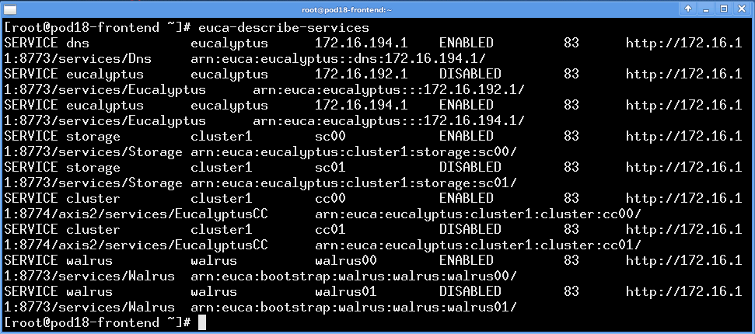
View Service States
euca-describe-services displays service states
Notes:
The service state information can be displayed from the command line using the euca-describe-services command. The most useful information in this display are the service names, component names, and service states. For example, one of the Cloud Controller services is reported as the SERVICE eucalyptus, with a component name of 172.16.194.1, and is in an ENABLED state. As another example, one of the Walrus services is reported as the SERVICE walrus, with a component name of walrus00, and is in an ENABLED state.
To change a service state use the syntax euca-modify-service –s STATE component_name. For example, euca-modify-service –s disable walrus00.
Service state information is also available in the Eucalyptus Administrator Console.

Slide 30
Register the Arbitrators
Register the arbitrators on the hosts with public-facing services.
Cloud Controller, Walrus, and Cluster Controller hosts
euca_conf --register-arbitrator --component <arb_unique_name> --partition <arb_unique_name> --host <host_public_IP_address>
Choose a unique component name for each arbitrator.
For example, euca_conf --register-arbitrator --component arb01 --partition arb01 --host 172.16.160.1.
The component and partition names should be the same.
The host should be the name or public IP address of the Cloud Controller, Walrus, or Cluster Controller host.
Repeat for each arbitrator on each host.
Notes:
The euca_conf command is also used to register arbitrators on the public-facing hosts. The –component and –partition options should have the same argument. For example, you could name your Arbitrators something a simple as arb00, arb01, and so on. Or you could name your Arbitrators after the host they run on. For example, the Arbitrators on the Cloud Controllers could be name arb0clc0 and arb0clc1. The IP address in the --host option is the IP address of the NIC on the Eucalyptus host and not the IP address of the external network device that the Arbitrator will ping.
Remember that Eucalyptus recommends configuring an Arbitrator to test each NIC/network used to reach a public-facing cloud service.

Slide 31
Configure Arbitrators
Each arbitrator must be configured with an IP address to ping
To configure this IP address for a Cloud Controller or Walrus use:
euca-modify-property -p <arbitrator_name>.arbitrator.gatewayhost=<address_to_ping>
For example, euca-modify-property –p arb01.arbitrator.gatewayhost=172.205.188.11.
To configure this IP address for a Cluster Controller:
Modify the CC_ARBITRATORS=“” entry in the /etc/eucalyptus/eucalyptus.conf file
Enter up to three, space-separated IP addresses
Notes:
The process to configure the IP address that the Arbitrator will ping is different depending on whether you are configuring Arbitrators on the Cloud Controller and Walrus or the Cluster Controller. For the cloud controller and Walrus the IP address is configured by setting system properties. For the Cluster Controller the IP address is configured using the eucalyptus.conf file.

Slide 32
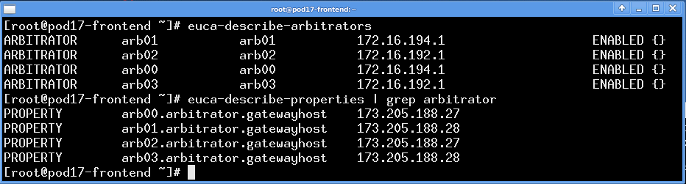
View Arbitrators
euca-describe-arbitrators lists arbitrators and states
euca-describe-properties lists the addresses that the arbitrators use to test reachability
Notes:
It takes two different command line commands to view Arbitrator configuration. The euca-describe-arbitrators command displays the arbitrator name, the IP address of the NIC it is associated with, and whether it is enabled or not. The euca-describe-properties command displays the arbitrator name and the IP address that it is configured to ping.
In the example above, the IP addresses 172.16.194.1 and 172.16.192.1 are the network interfaces on the hosts where the arbitrators are running. Note that the arbitrators are all ENABLED. The IP addresses 173.205.188.27 and 173.205.188.28 are the IP addresses that are being used by the arbitrators to test reachability.
Arbitrator state can also be seen in the Eucalyptus Administrator Console.

Slide 33
Loading and Using DRBD
DRBD is implemented as a loadable kernel module.
Load the kernel module to start the DRBD configuration.
modprobe drbd
Walrus service is configured to use DRBD by:
Modifying /etc/eucalyptus/eucalyptus.conf
CLOUD_OPTS="-Dwalrus.storage.manager=DRBDStorageManager“
euca-modify-property -p walrus.blockdevice=/dev/drbd1*
euca-modify-property -p walrus.resource=r0*
* /dev/drbd1 and r0 are defined in the Eucalyptus DRBD configuration file (described in a later slide).
Notes:
DRBD is a loadable kernel module although it is not loaded until it is configured on the system. To manually load it for configuration use the Linux modprobe command. Once it has been configured it will automatically load at startup. There is a drbd startup script in the /etc/init.d directory that will reconfigure DRBD at each startup.
DRBD is used to replicate its storage across two Walrus hosts which means that Walrus must be configured to know about and use DRBD. This is accomplished by configuration settings in the eucalyptus.conf file and in the Cloud Controller properties settings.

Slide 34
Walrus and DRBD Devices
Walrus write operation with DRBD and Linux devices.
r0 is a replicated resource
/dev/drbd1 is a DRBD device
/dev/sdb1 is the Linux device
Access to disk
Walrus service
r0
/dev/drbd1
/dev/drbd1
/dev/sdb1
/dev/sdb1
data
data

Slide 35
DRBD Configuration Files
The master DRBD configuration file must reference the Eucalyptus DRBD configuration file.
The Eucalyptus DRBD configuration file defines the replication information.
Walrus hostnames
Walrus IP addresses and ports
Storage devices – DRBD device and backing devices
DRBD metadata location
Synchronization type and rate
/etc/drbd.conf
include “/etc/eucalyptus/drbd.conf”;
Notes:
DRBD automatically references the master configuration file /etc/drbd.conf. The master configuration file allows the use of include statements to point to other site specific configuration files. The Eucalyptus site specific file is /etc/eucalyptus/drbd.conf. It is this site specific file that contains all the DRBD configuration for Eucalyptus.

Slide 36
Eucalyptus DRBD File
The file defines a replicated DRBD resource named r0.
Walrus writes to /dev/drbd1 which in turn writes to /dev/sdb1 on each Walrus host.
DRBD uses port 7789.
DRBD metadata is kept internally on /dev/sdb1.
/etc/eucalyptus/drbd.conf
resource r0 {
on pod01-frontend {
device /dev/drbd1;
disk /dev/sdb1;
address 172.16.150.1:7789;
meta-disk internal;
}
on pod02-frontend {
device /dev/drbd1;
disk /dev/sdb1;
address 172.16.152.1:7789;
meta-disk internal;
}
Notes:
This is just the main section of the /etc/eucalyptus/drbd.conf file. Other smaller sections of the file define the type of replication between the Walrus hosts (synchronous), the maximum replication rate (40MB/s), and other DRBD parameters. See the online DRBD documentation at http://www.drbd.org/docs/about/ for more information about DRBD operation, parameters, and commands.

Slide 37
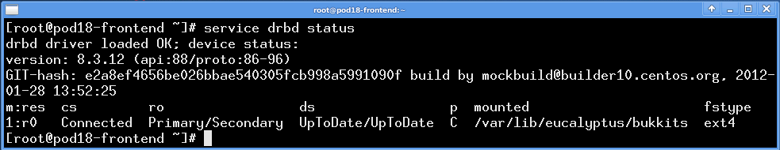
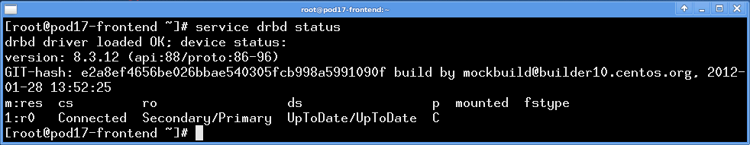
View DRBD State
service drbd status displays DRBD state information
Shown from primary and secondary Walrus hosts
Notes:
The service drbd status command displays important DRBD status information. The command can be run from both the primary and secondary Walrus to determine how each views the DRBD connection.
The primary information to view in the example above is the role (ro), the connection state (cs), and the data state (ds) of the resource r0. The role indicates whether the host believes it is the primary or secondary DRBS server. In the example above, the first system reports itself to be the primary server and its partner to be the secondary because the display reads Primary/Secondary. The same command from the partner host confirms this because it lists itself as the secondary and its partner as the primary as seen by Secondary/Primary. The connection state of resource r0 is Connected and both the primary and secondary servers report that the data state is UpToDate.
Also notable is that the kernel module is loaded and that the replication protocol (p) reports that the DRBD is using synchronous replication (C) between the hosts.
Note that the secondary server does not report a mounted directory or a file system type because it is only replicating data sent to it and is not directly interacting with Walrus.

Slide 38
Enabling DNS Delegation
In an HA configuration, there are two Cloud Controllers and the DNS service must be able to failover between them during failure events.
To enable DNS service failover:
euca-modify-property -p bootstrap.webservices.use_dns_delegation=true
You must generate the administrative credentials and source the eucarc file again.
Because the URLs of the Cloud Controller and Walrus have changed.
Notes:
DNS delegation in HA is very important. If the eucarc and eucalyptus.conf file use IP addresses instead of domain names, euca2ools might fail depending on which cloud controller is ENABLED at any given time. Modifying the eucarc and eucalyptus.conf file to use domain names instead of IP addresses will prevent this problem from occurring.
For example, if the IP addresses of the primary and secondary Cloud Controllers are 192.168.5.1 and 192.168.5.2, and the IPaddresses of primary and secondary Walruses are 192.168.6.1 and 192.168.6.2, the host eucalyptus.eucadomain.yourdomain will resolve to 192.168.5.1 and walrus.eucadomain.yourdomain will resolve to 192.168.6.1.
If the primary CLC fails, the secondary Cloud Controller will become the primary and eucalyptus.eucadomain.yourdomain will resolve to 192.168.5.2. If the primary Walrus fails, the secondary Walrus will be promoted and walrus.eucadomain.yourdomain will resolve to 192.168.6.2.

Slide 39
Summary
Eucalyptus HA provides:
A highly-available cloud service
Administrator tools for managing and monitoring
Administrator Console, euca-describe-services, euca-modify-services, euca-describe-arbitrators
High availability is provided by a combination of Eucalyptus service redundancy, environmental redundancy, and operational support.
Installation of HA is similar to a normal installation but with a few extra requirements.
Storage for the Walruses and Storage Controllers must be redundant – SAN for Storage Controllers and DRBD for Walrus.
Arbitrators approximate network reachability by users.

Slide 40
End of Module

