Slide 1


Slide 2
Management Tools
Eucalyptus Education Services Revision C

Slide 3
Module Topics
Eucalyptus Administrator Console
Eucalyptus Administrator tools
Euca2ools
Third-party tools

Slide 4
Managing Eucalyptus
There are many ways to manage and interact with Eucalyptus.
Eucalyptus Administrator Console – a Web-based management interface
Eucalyptus Administrator tools – a command-line management interface
Euca2ools – a command-line user interface
Third-party tools – configuring, managing, monitoring, image creation
Notes:
The third-party tools would be those designed for Eucalyptus or those designed for Amazon but work with Eucalyptus.

Slide 5
Administrator Console
The Eucalyptus Administrator Console:
Provides an easy-to-use graphical management tool for administrators for managing:
Eucalyptus services
IAM identities
Access control policies
Quotas
Accessed using https://<CLC_public_IP>:8443

Slide 6
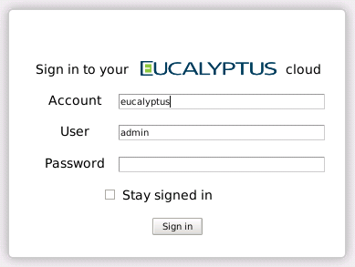
Log in to the Administrator Console
The default cloud administrator name is admin in the eucalyptus account.
The default password is admin.
Notes:
Accounts, user names, and passwords are covered in a later module about Eucalyptus Identity and Access Management (EIAM). By default, the only account that exists after installation is the eucalyptus account. The only user that exists in the eucalyptus account after installation is admin.

Slide 7
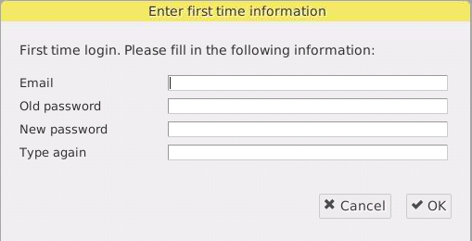
First Time Log In
At first log in to the Administrator Console you are prompted to:
Set your email address
Used to receive alerts and deliver account request emails
Change the default password
Notes:
At first log in all users, not just the admin user, are prompted for their email address and to change their default password.

Slide 8
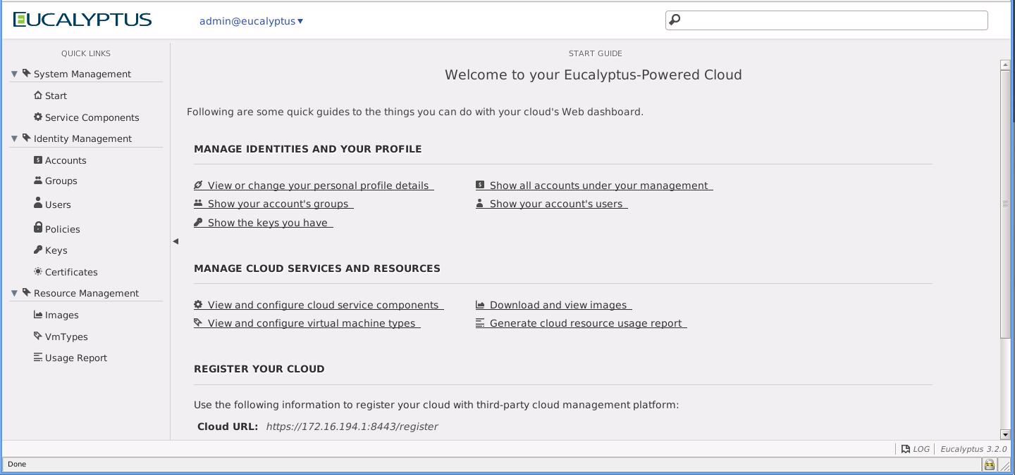
The Administrator Console
header
quick links
main content
status
Notes:
Red boxes were added to the screen capture for illustration purposes.
The header area includes the logo, the link to a user profile setting menu, and the big search box.
The quick links area provides links to various contents of the Administrator Console. The Quick Links area is organized into sections made up of two levels. The top level is a heading for that section. Under each heading is a second section that contains a list of links.
The center part of the main screen displays the main content, usually the search result list. In many content displays, the Administrator Console displays a toolbar that contains action buttons. The bottom of the content area provides the page navigation controls.
The bar at the bottom of the main screen shows system status messages, log window toggle button and the software version (from left to right).

Slide 9
Administrator Tools
Eucalyptus Administrator tools:
Are command-line equivalents of Administrator Console functionality
Sometimes provide more functionality than the Administrator Console
Automatically installed on the Cloud Controller in /usr/sbin and /usr/bin
Include such commands as:
euca_conf
euca-describe-services
euca-modify-services
euca-describe-arbitrators
euca-modify-properties
euca-register-<*>
euca-deregister-<*>
And others

Slide 10
Euca2ools Management
Euca2ools are a command-line user interface.
Manages images, instances, key pairs, addresses, volumes, snapshots, security groups
Euca2ools commands in /usr/bin
Online help available through:
# command –h
# command --help
# man command

Slide 11
Euca2ools Syntax
Euca2ools:
Emulate the command-line tools distributed by Amazon (api-tools and ami-tools)
Generally accept the same command-line options
Generally honor the same environment variables
Commands must be authenticated using command-line arguments or environment variables (eucarc).
Authentication arguments include:
# <command> <auth_args> <command_specific_args>
-a,--accesskey User's access key ID
-s,--secretkey User's secret key
-c,--cert Path to users PEM-encoded certificate
-k,--privatekey Path to users PEM-encoded private key
-U,--url URL of the cloud to connect to
--ec2cert Path to the cloud's X509 public key certificate.
Notes:
The actual options required varies by the actual command. See the online help pages for details about specific commands and their required options.
This slide only shows the potential authentication arguments for euca2ools commands.
Most every euca2ool command and option will work in Amazon, but not all amitools and options will work in Eucalyptus. The difference is that Eucalyptus only implements a subset of the Amazon APIs.
An X.509 certificate is used to authenticate requests to the SOAP API service. A secret access key is used to authenticate requests to the REST API service. A login password is used to authenticate the Administrator Console access.
Euca2ools issue Query requests. Query requests, as defined by the AWS APIs, are HTTP or HTTPS requests that use the HTTP verb GET or POST and a Query parameter named Action. The Action query parameter determines the action taken by the query request. The action, for example, can include any EC2 action (RunInstances, DescribeImages, etc.) and are not just requests that ‘query’ for information. Query requests can actually perform actions in the cloud. Although a Secret Access Key is required, for security reasons the Secret Access Key is never really sent via HTTP to the server. Instead, the Access Key ID is sent which allows the server to honor the request.

Slide 12
Third-Party Tools
Eucalyptus has over 200 partners.
See the Eucalyptus partner page at http://www.eucalyptus.com/partners.
Eucalyptus partners are divided into several categories.
Platform
System Integrator and Resellers
Products and Services
Partners provide third-party tools for:
Configuring and monitoring the Eucalyptus cloud
Creating and managing Eucalyptus images

Slide 13
Summary
There are many ways to configure and manage a Eucalyptus cloud.
The Eucalyptus Administrator Console is a graphical service, identity, and resource management tool.
Administrator tools are a command line equivalent to the Administrator Console.
Euca2ools are a set command-line user tools.
Third-party tools are available from large number of Eucalyptus partners.

Slide 14
Hands-On:
Management Tools
Perform first-time configuration of the Eucalyptus Administrator Console
Notes:
Quick overview of who we are

Slide 15
End of Module

