Slide 1
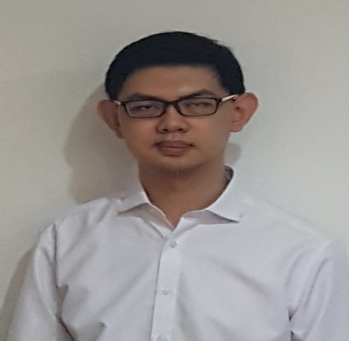

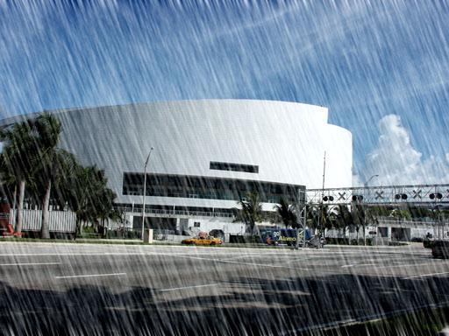
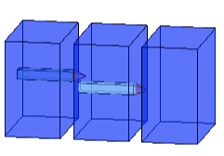
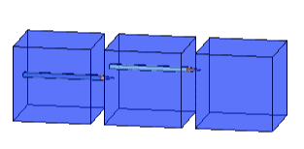
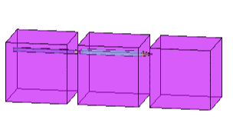
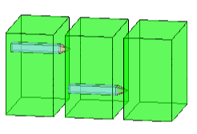
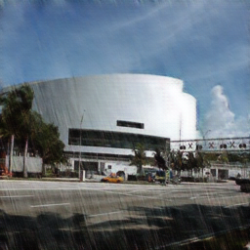
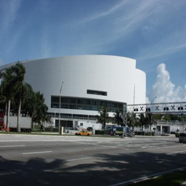
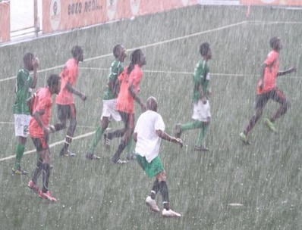
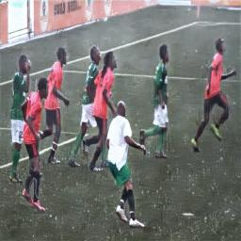
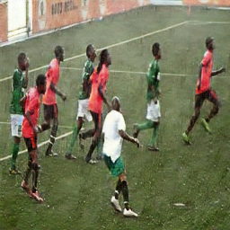
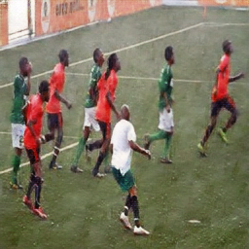
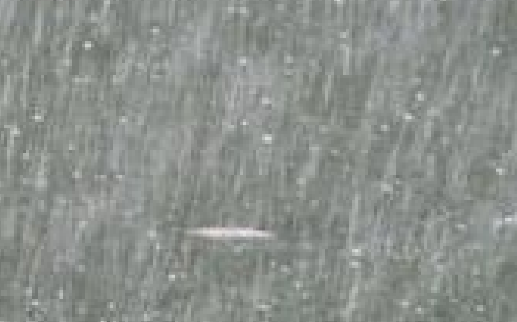
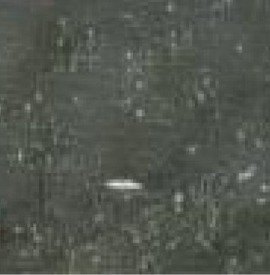
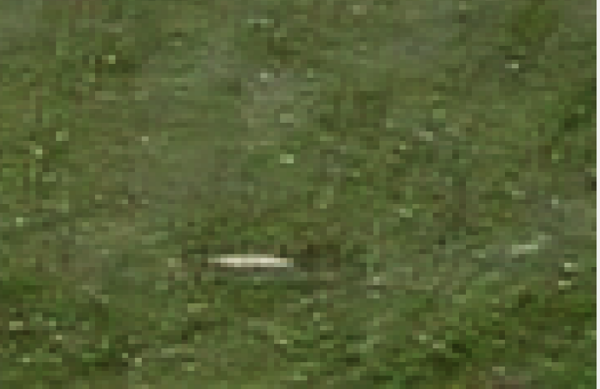
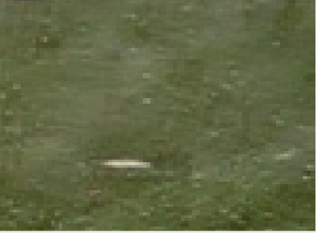
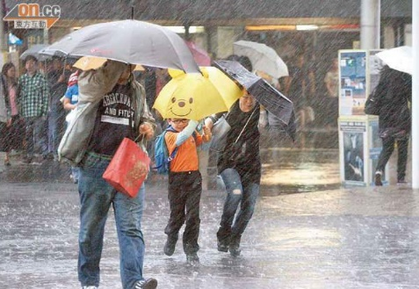
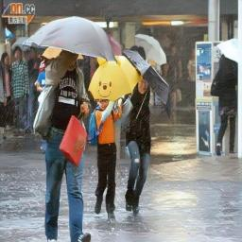

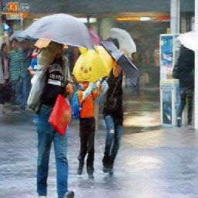
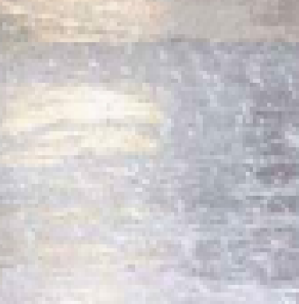
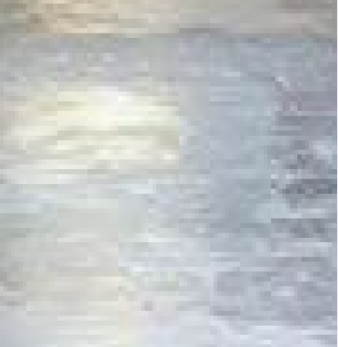
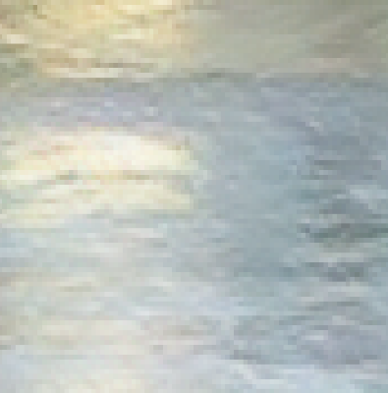
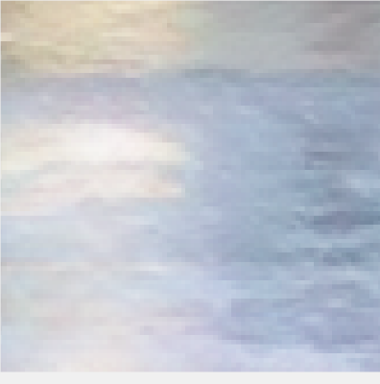

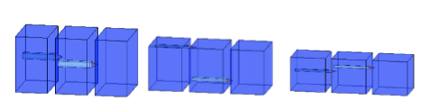
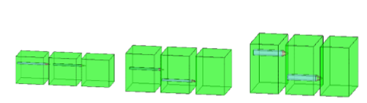
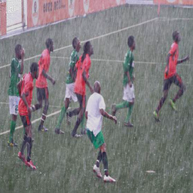
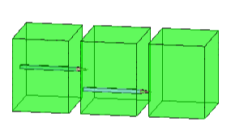
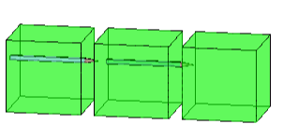
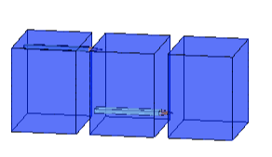

19118
TEO LIM FONG
Removal of Rain using WAVELET CYCLEGAN
The wavelet method has recently been developed to enhance image quality through noise removal resulting in images with enhanced resolution.
Wavelet CycleGan is a novel algorithm created for rain removal and preservation of colors of the images in HSV color space. Wavelet CycleGan consist of two stages – frequency sub bands and residual rain removal. Frequency sub bands focuses on different location of frequency information which enhances the structure of the images and retain the original color. Residual rain removal focuses on removing the rain.
Frequency sub bands can be obtained by applying DWT (Discrete Wavelet Transform) to the luminance(V) channel, where human vision is sensitive to luminance changes. After applying DWT, four coefficients will be obtained – LL (low-low), LH(low-high), HL(high-low), HH(high-high). These coefficients contains frequency information of different locations which is ideal for training in Convolutional Neural Network (CNN). It will be reconstructed back using IDWT (Inverse Discrete Wavelet Transform) and converted back to RGB channel. CycleGan is then used to remove most of the rain.
The proposed solution removed rain more efficiently, preserved the color of the images. Additionally, both quantitative comparison & qualitative analysis are much better than the existing solution – CycleGAN.
INTRODUCTION
Training Dataset
…
++
+
Synthetic Rain
$${Neural Network}^{\#}$$
Rain-free
# Applied to CycleGan & Wavelet CycleGAN
SSIM
Ground Truth
Figure 2 Demonstrating the process of Synthetic Rain with Neural Network and comparing it with the ground truth using SSIM
 | ID CGAN | CycleGan | Wavelet CycleGan
SSIM | 0.8133* | 0.8980 | 0.908
SSIM(Structural Similarity Index) quantifies image quality degradation by processing synthetic rain on the ground truth. SSIM also measures the perceptual difference between rain-free images and the ground truth. Wavelet CycleGAN evidently achieves superior quantitative results when compared to other algorithms as shown in Table 1.
Table 1. Quantitative Comparison between the different algorithms using the synthetic data set
* Lai Meng Tang, Li Hong Lim, and Paul Siebert (2018) Removal of Visual Disruption Caused by Rain using Cycle-Consistent Generative Adversarial Networks
Testing Dataset
NIQE (Naturalness Image Quality Evaluator) is an image comparison without any dependency (ground truth).
Real Rain
ID-CGAN
CycleGAN
Wavelet CycleGAN
Objective
NIQE (7.3045)
NIQE (3.7611)
NIQE (3.0532)
NIQE (2.7537)
Create and implement novel algorithm,
Wavelet CycleGAN to:
Remove rain efficiently
Retain the original color of the images
Achieve a lower NIQE (Naturalness Image Quality Evaluator)
NIQE (5.8153)
NIQE (3.1650)
NIQE (3.4610)
NIQE (3.0171)
METHOD
Encoding
Figure 3 Qualitative Analysis using real rain images
…
Decoding
RGB to HSV
DWT
Transformation
IDWT
HSV to RGB
Generator X to Y
+
Real Rain
Decoding
Transformation
Encoding
Generated Y
+
…
Rain-free
Generator X to Y
Wavelet CycleGan
Figure 1 Wavelet CycleGan Convolutional Neural Network
Supervisors (Singapore): Mr Tang Lai Meng
Supervisor (Glasgow): Dr. Liu Xiao Lei

