Slide 1
Implementing AI To Improve Business Continuity And Economic Resilience In Singapore During Covid-19
Vu Duc Thanh
Syed Ariff Syed Hesham

Slide 2
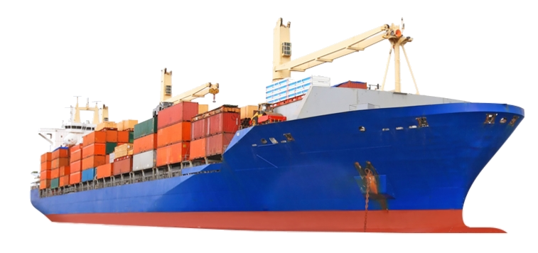


Due to covid19 demand for shipping has exponentially decreased!
15%
20%

Slide 3

Proposed Solution
(Predictive Analysis)
AI’s usage:
Monitors export of cargos from one country.
Suggest best prediction for the next shipment amount. Which could be used to arrange available resources for shipments.
Maps Geopolitical naval routes and trends of transportations.
Possible Add-on’s:
Notification System – Provide notification when the trend of cost goes low (consumer or business owner)/ if more transportation occurs (to shipment owners).

Slide 4
What has been done?
Training :
The Model comprises of:
  LSTM layer with a ReLu activation
  Loss: Mean Squared Error
  Optimization: Adam
The Train to test Ratio= 7:3
Training data: Export (in Tonnes) in from one country to the other (E.g., Singapore to Japan).
Test set is made sure that the window doesn’t overlap, hence it could be used for evaluation
Evaluation:
The evaluation is done using non-overlapping test dataset to avoid any bias.

Slide 5
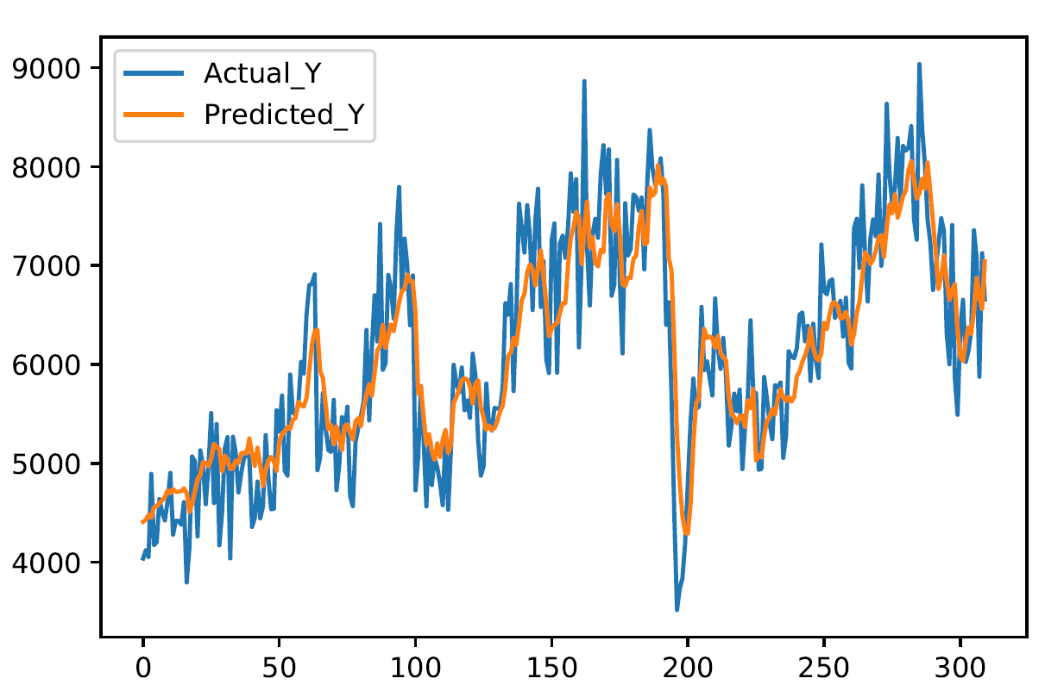
Evaluation results!
RMSE of model: 502
RMSE of logistic regression: 619
1.23x Better!

Slide 6

Questions?

Slide 7


