Slide 1
Smart Waste Management System
Presented by:
Ashesh Shrestha
Wachaspati Arya
Alaka Shrestha
Sweta Singh

Slide 2
Introduction
Smart waste management system is IOT based waste management system which include the website as dashboard and which help workers to track and monitor the status of solid waste all over the city .It also provides the full featured google map view of dustbin location and trash level as various indicator as well as it provide the smart route to unload the trash bin. This project also capable to track the efficiency of worker and also gives the routine update of city.

Slide 3
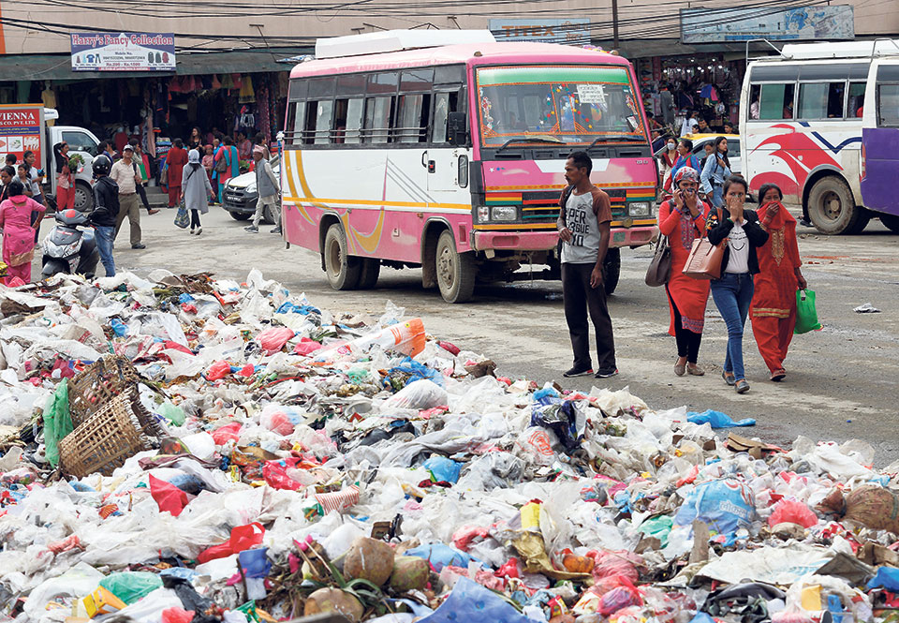

Why Smart Waste Management System?
Poor waste management system.
Irresponsible workers.
Route problem.
Poor work Schedule.

Slide 4
Objectives
The proposed system would be able to automate the solid waste monitoring process and management of the overall collection process using IOT (Internet of Things).
The Proposed system consist of main subsystems namely Smart Trash System(STS) and Smart Monitoring and Controlling Hut(SMCH).
In the proposed system, whenever the waste bin gets filled this is acknowledged by placing the circuit at the waste bin, which transmits it to the receiver at the desired place in the area or spot.
In the proposed system, the received signal indicates the waste bin status at the monitoring and controlling system.
In the proposed system, it would be able to configure the smart(shortest) route for collecting the garbage from the container.

Slide 5
Scope
This project helps to monitor the level of solid waste remotely and help to notify the worker for instance of waste level which provide greater accessibility to the dustbin.
It provides location of dustbin to the user which are recorded in the database.
It provides smart route for the garbage collector van which leads to reduction of fuel consuming and effective work.
Provide work tracking platform for the workers.
This project helps to maintain our city clean and minimize the pollution.

Slide 6
Limitations
Dustbin requires Wi-Fi network to upload the data to database. So Internet facility is required for each and every dustbin.
Sometimes garbage indicator may indicate wrong value due to linear reading of ultrasonic sensor.
Durability of the project is low on the hardware side.

Slide 7
Methodology
Software Development Process.
Software Interfaces.
Hardware Interfaces.
Software Management Tools.

Slide 8
Software Development Process
Fig. Incremental Model

Slide 9
Why Incremental Model?
Generates working software quickly and early during the software life cycle.
This model is more flexible – less costly to change scope and requirements.
It is easier to test and debug during a smaller iteration.
In this model customer can respond to each built.
Lowers initial delivery cost.
Easier to manage risk because risky pieces are identified and handled during iteration.

Slide 10
Software Interface:
Arduino IDE
WebServer

Slide 11
Front end Technologies
HTML5
CSS3
JavaScript
JQuery

Slide 12
Backend Technology
Django
MySql

Slide 13
Project Management Tools/Design Tools
Trello
GitHub
Draw.io
Adobe Photoshop, Illustrator

Slide 14
Hardware Interfaces
Arduino Uno/Nano or NodeMCU
Ultrasonic Sensor
Wi-Fi Module(Esp8266)

Slide 15
Use Case Diagram

Slide 16
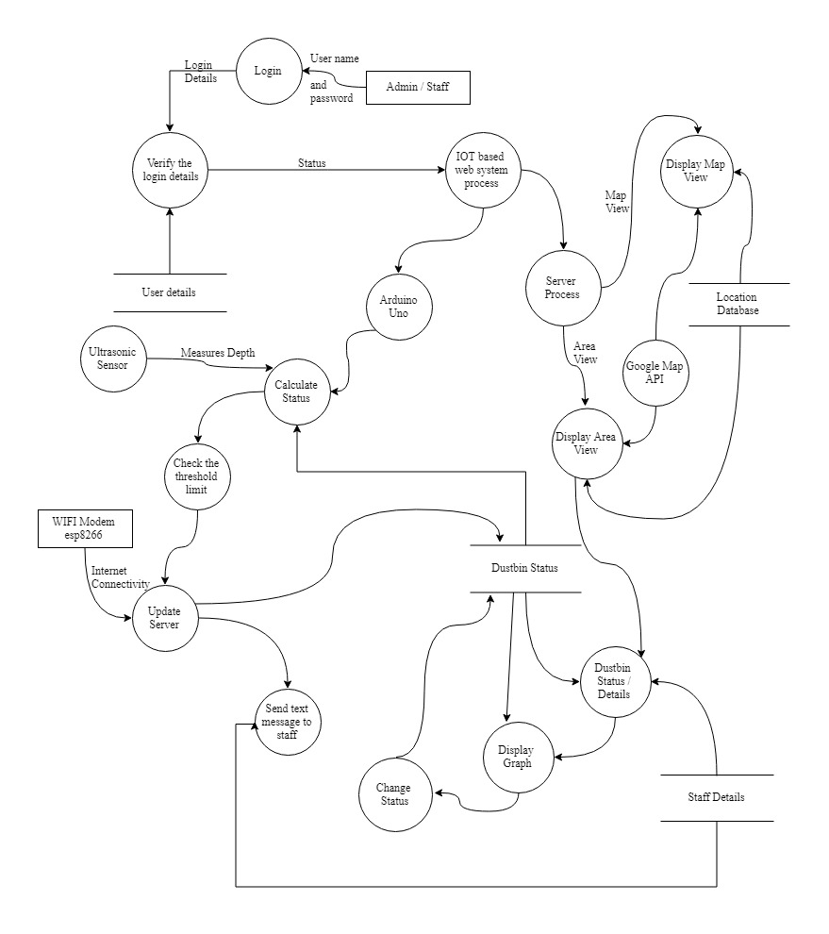
Level – 2-DFD

Slide 17
Project Task and Time Schedule
Weeks Works | 1st | 2nd | 3rd | 4th | 5th | 6th | 7th | 8th
Title Selection & Literature Review
Component Collection
Problem Discussion/Template Designing
Circuit Design, Connecting & Backend
Testing and debugging
Finalizing & Documentation

Slide 18
Work Division Table
Works | Name
Title Selection& Literature Review/Requirement Analysis | Ashesh, Wachas, Alaka, Sweta
ComponentCollection | Ashesh, Alaka
Problem Discussion/Template Designing | Alaka, Wachas
Circuit Design, Connecting & Backend | Ashesh, Sweta
Testing and debugging | Sweta, Wachas
Finalizing & Documentation | Alaka, Sweta, Ashesh

Slide 19
Thank You

