Slide 1
Stocks Forecast

Slide 2
Question
Can I really invest in a Company by using Machine Learning or Forecasting?

Slide 3
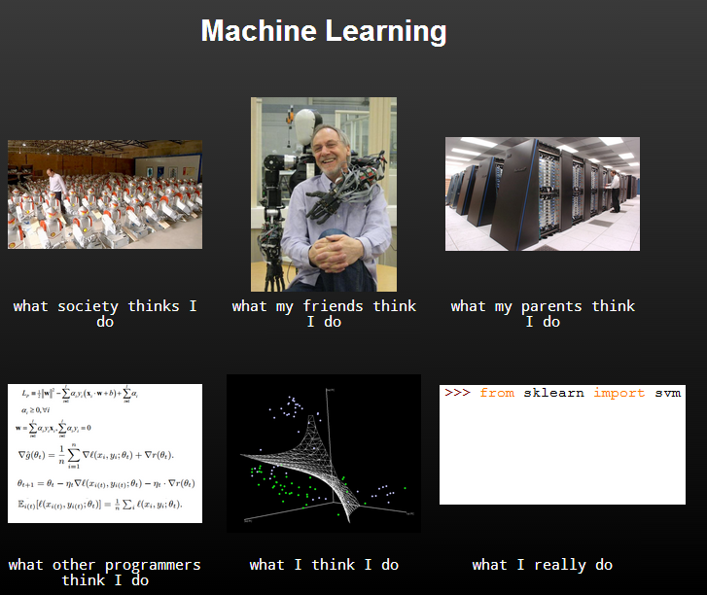
Python

Slide 4
Data Sources
Nasdaq.com
Built in Python datasets
Securities and Exchange Commission - Risky
Yahoo Finance
Pythonprogramming.net

Slide 5
Python Libraries
Numpy
Sklearn
Scipy
Mathplot
Pandas

Slide 6
Why?
Useful
Interesting
Money Money Money!

Slide 7
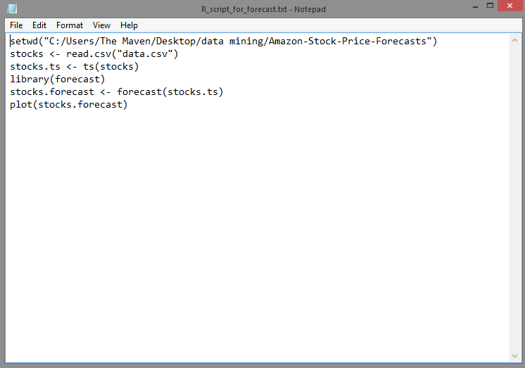
Some code

Slide 8
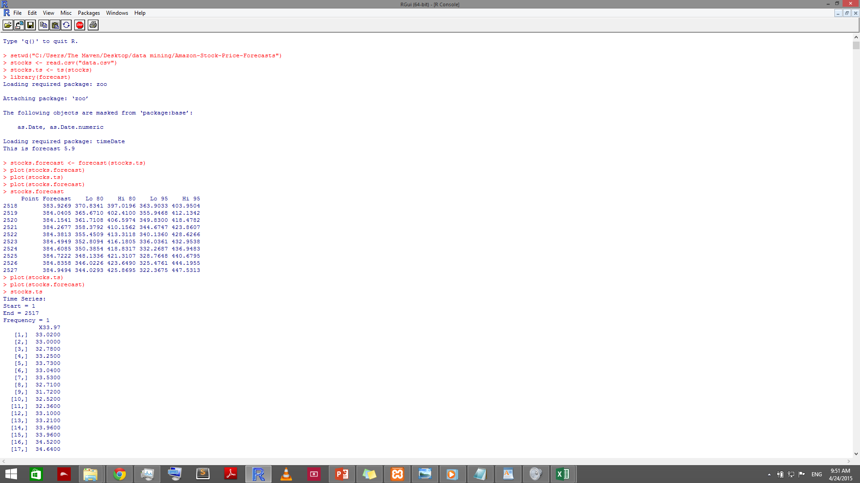
R stuff

Slide 9
Before forecast

Slide 10
After Forecast

Slide 11
Insights
Pretty much the same story
Prediction wasn’t spot on confirming you can’t really predict the market
For now at least Amazon remains profitable
389.80 Price increase 0.00 (0.00%) – 2 days ago.

Slide 12
On to the serious stuff
Character Recognition
Parsing and analyzing stock data – Apple Inc.

Slide 13
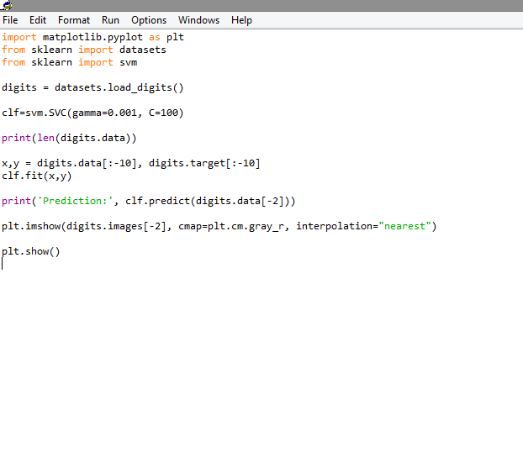
Character Recognition

Slide 14
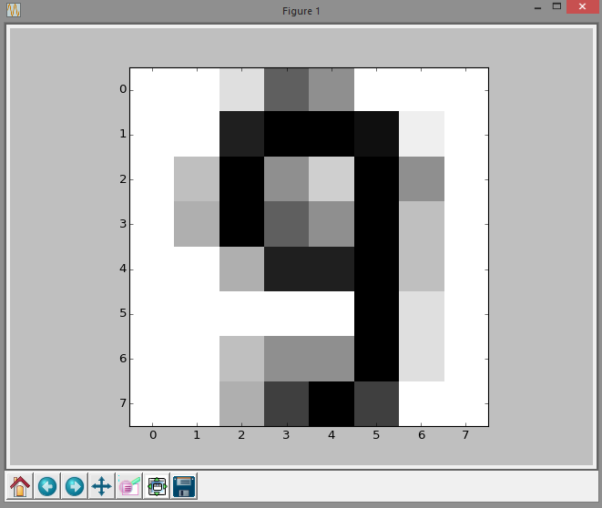
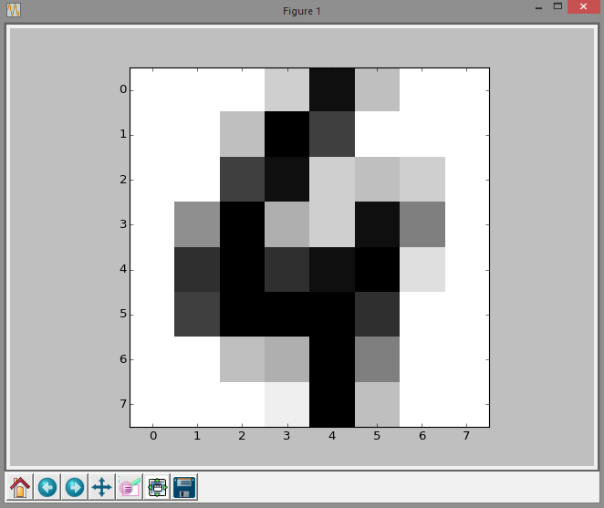
Images

Slide 15
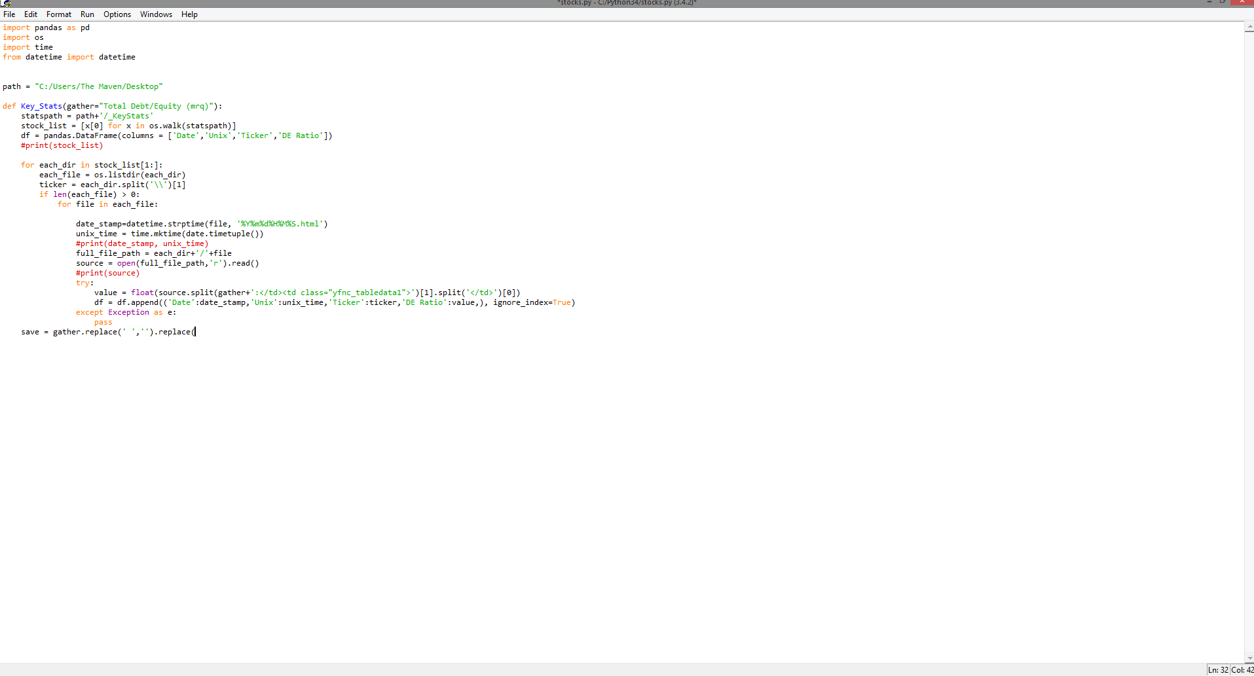
Further work

