Slide 1
Data For MasterCard Students And Their Eating Habits
Barbara Selassie adzudzor

Slide 2
A Walk Through…….
Where I got data
Exploration of data
Formulating of questions
Formulating my Analysis

Slide 3
Data Source And Exploration of Data
Got data from Dr. Jackson
Started with Geghi but found it difficult interpreting a lot of things
Had 5,896 items and 12 variables which consisted of
Anonuser, mealplanid, Item name, Item cost
Vendor, days, hours, minutes
Country, gender, major, year group

Slide 4
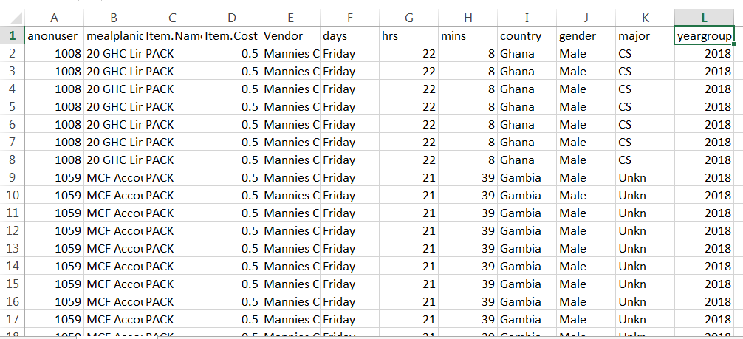
Data From Charles Jackson (5896 items)

Slide 5
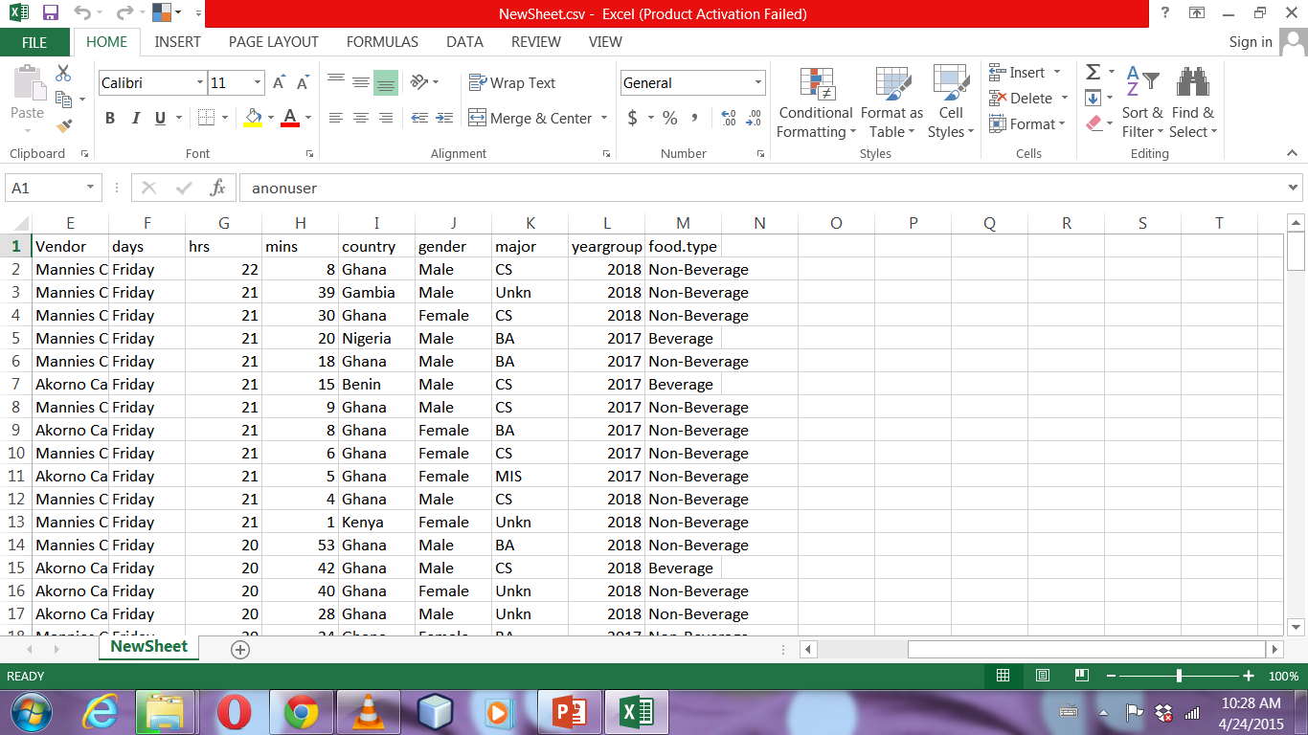
Data After Cleaning Up 166 items

Slide 6
Questions
How many males and females are on master card?
Population of the master card students
What kind of food do international and non international students like?
Which group of students prefer Akornor or Mannies Catering Services?
Which group of students like to eat in or want a take out?

Slide 8
79 males
87 females

Slide 11
Thank you

