Slide 1
DATA MINNING PRESENATION
Notes:
Expanded, beveled text and shadow
(Basic)
To reproduce the text effects on this slide, do the following:
On the Home tab, in the Slides group, click Layout, and then click Blank.
On the Insert tab, in the Text group, click Text Box, and then on the slide, drag to draw the text box.
Enter text in the text box, select the text, and then on the Home tab, in the Font group, select Calisto MT from the Font list and then select 60 from the Font Size list.
On the Home tab, in the Paragraph group, click Center to center the text in the text box.
On the Home tab, in the Font group, click Character Spacing, and then click More Spacing.
In the Font dialog box, on the Character Spacing tab, in the Spacing list, select Expanded. In the By box, enter 22.
Under Drawing Tools, on the Format tab, in the WordArt Styles group, click the arrow next to Text Fill, and then under Theme Colors click Tan, Background 2, Darker 50% (fourth row, third option from the left).
Under Drawing Tools, on the Format tab, in the bottom right corner of the WordArt Styles group, click the Format Text Effects dialog box launcher. In the Format Text Effects dialog box, click 3-D Format in the left pane, and then do the following in the right pane:
Under Bevel, click the button next to Top, and then under Bevel click Soft Round (second row, second option from the left). Next to Top, in the Width box, enter 4 pt, and in the Height box, enter 6 pt.
Under Depth, click the button next to Color, and then under Theme Colors click Tan, Background 2, Darker 50% (fourth row, third option from the left). In the Depth box, enter 6 pt.
Under Contour, click the button next to Color, and then under Theme Colors click White, Background 1 (first row, first option from the left). In the Size box, enter 0 pt.
Under Surface, click the button next to Material, and then under Translucent click Powder. Click the button next to Lighting, and then under Warm click Morning.
Also in the Format Text Effects dialog box, click Shadow in the left pane, and then do the following in the right pane:
Click the button next to Presets, and under Perspective, click Perspective Diagonal Upper Left (first row, first option from the left).
In the Transparency box, enter 85%.
To reproduce the background on this slide, do the following:
Right-click the slide background area, then click Format Background.
In the Format Background dialog box, click Fill in the left pane, select Gradient fill in the right pane, and then do the following:
In the Type list, select Radial.
Click the button next to Direction, and then click From Corner (first option from the left).
Under Gradient stops, click Add gradient stop or Remove gradient stop until three stops appear in the slider.
Also under Gradient stops, customize the gradient stops that you added as follows:
Select the first stop in the slider, and then do the following:
In the Position box, enter 45%.
Click the button next to Color, and then under Theme Colors click White, Background 1 (first row, first option from the left).
Select the next stop in the slider, and then do the following:
In the Position box, enter 80%.
Click the button next to Color, click More Colors, and then in the Colors dialog box, on the Custom tab, enter values for Red: 223, Green: 219, Blue: 211.
Select the last stop in the slider, and then do the following:
In the Position box, enter 100%.
Click the button next to Color, click More Colors, and then in the Colors dialog box, on the Custom tab, enter values for Red: 213, Green: 208, Blue: 197.

Slide 2
Outline of Presentation:
Introduction and Background
Title
Preparation Process
Tools used
Techniques used and why
Diagrams
Sources

Slide 3
INTRODUCTION & BACKGROUND
Infant mortality
Death of a child less than one year of age.
It is measured as infant mortality rate (IMR), which is the number of deaths of children under one year of age per 1000 live births.
CAUSES
Many factors contribute to infant mortality such as the mother's level of education, environmental conditions, and political and medical infrastructure

Slide 4
Title
Finding the relationship that exists between countries, their GDP , percentage of GDP spent on health , and IMR

Slide 5
The preparation process
Explored The relationship between Ages of Mothers and IM in Kenya
Found Data from UN.org –simple in CSV..yaay!

Slide 6
Procedure Used
1. Cleaning of Data
Excel
R
2. Merging data into one frame ; eventual reduction
Attempting Various Methods of Using R

Slide 7
SOURCES OF DATA
UN.ORG
WORLDBANK

Slide 8
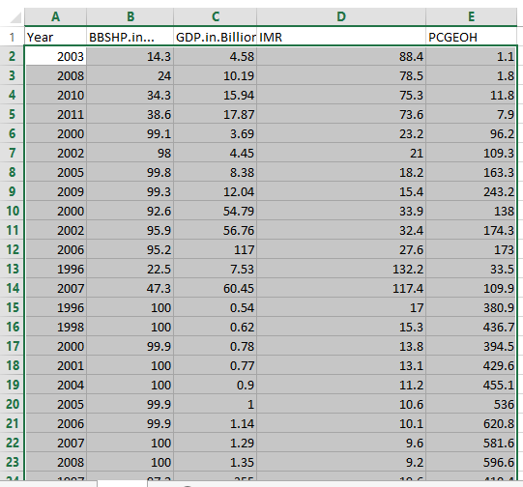
RAW DATA

Slide 9
TOOLS USED
R
Excel
Gephi

Slide 10
TECHNIQUES USED AND WHY
UNSUPERVISED DATA TYPE:
k-means clustering
An iterative, data-partitioning algorithm that assigns n observations to exactly one of k
k is usually chosen before the algorithm starts.

Slide 11
WHY K?
one of the simplest algorithms
Uses unsupervised learning method to solve known clustering issues.
It works really well with large datasets.

Slide 12
FORMULATION OF QUESTIONS
What is the relationship can be drawn between the GDP, Skilled Health Workers who attend to birth, GDP allocated to health and IMR.
Has Infant Mortality gotten better or worse over the years?
Answers?

Slide 13
DATA ANALYSIS
Notes:
Expanded, beveled text and shadow
(Basic)
To reproduce the text effects on this slide, do the following:
On the Home tab, in the Slides group, click Layout, and then click Blank.
On the Insert tab, in the Text group, click Text Box, and then on the slide, drag to draw the text box.
Enter text in the text box, select the text, and then on the Home tab, in the Font group, select Calisto MT from the Font list and then select 60 from the Font Size list.
On the Home tab, in the Paragraph group, click Center to center the text in the text box.
On the Home tab, in the Font group, click Character Spacing, and then click More Spacing.
In the Font dialog box, on the Character Spacing tab, in the Spacing list, select Expanded. In the By box, enter 22.
Under Drawing Tools, on the Format tab, in the WordArt Styles group, click the arrow next to Text Fill, and then under Theme Colors click Tan, Background 2, Darker 50% (fourth row, third option from the left).
Under Drawing Tools, on the Format tab, in the bottom right corner of the WordArt Styles group, click the Format Text Effects dialog box launcher. In the Format Text Effects dialog box, click 3-D Format in the left pane, and then do the following in the right pane:
Under Bevel, click the button next to Top, and then under Bevel click Soft Round (second row, second option from the left). Next to Top, in the Width box, enter 4 pt, and in the Height box, enter 6 pt.
Under Depth, click the button next to Color, and then under Theme Colors click Tan, Background 2, Darker 50% (fourth row, third option from the left). In the Depth box, enter 6 pt.
Under Contour, click the button next to Color, and then under Theme Colors click White, Background 1 (first row, first option from the left). In the Size box, enter 0 pt.
Under Surface, click the button next to Material, and then under Translucent click Powder. Click the button next to Lighting, and then under Warm click Morning.
Also in the Format Text Effects dialog box, click Shadow in the left pane, and then do the following in the right pane:
Click the button next to Presets, and under Perspective, click Perspective Diagonal Upper Left (first row, first option from the left).
In the Transparency box, enter 85%.
To reproduce the background on this slide, do the following:
Right-click the slide background area, then click Format Background.
In the Format Background dialog box, click Fill in the left pane, select Gradient fill in the right pane, and then do the following:
In the Type list, select Radial.
Click the button next to Direction, and then click From Corner (first option from the left).
Under Gradient stops, click Add gradient stop or Remove gradient stop until three stops appear in the slider.
Also under Gradient stops, customize the gradient stops that you added as follows:
Select the first stop in the slider, and then do the following:
In the Position box, enter 45%.
Click the button next to Color, and then under Theme Colors click White, Background 1 (first row, first option from the left).
Select the next stop in the slider, and then do the following:
In the Position box, enter 80%.
Click the button next to Color, click More Colors, and then in the Colors dialog box, on the Custom tab, enter values for Red: 223, Green: 219, Blue: 211.
Select the last stop in the slider, and then do the following:
In the Position box, enter 100%.
Click the button next to Color, click More Colors, and then in the Colors dialog box, on the Custom tab, enter values for Red: 213, Green: 208, Blue: 197.

Slide 14
SAMPLE CODE
x=matrix(rnorm(mydata), ncol=5)
> head(x)
[,1] [,2] [,3] [,4] [,5]
[1,] -0.8408555 1.384359 -1.255492 0.07014277 1.711441
> x=matrix(rnorm(681*5), ncol=5)
> head(x)
[,1] [,2] [,3] [,4] [,5]
[1,] -0.6029080 -2.7925930 0.9783359 0.79048131 -0.6224355
[2,] -0.4721664 1.6514171 1.0695528 -0.81098193 -0.3401807
[3,] -0.6353713 2.6095467 -1.3386475 -0.27759055 -1.2551173
[4,] -0.2857736 -0.6032469 0.9287718 0.01657095 -2.6034144
[5,] 0.1381082 0.4104312 1.3375707 0.57049206 1.4419410
[6,] 1.2276303 0.5518676 1.3683238 0.03512478 0.3230794
> km.out=kmeans(x,5,nstart=20)
> km.out$cluster

Slide 15
CLUSTER FORMATIONS
[1] 4 1 1 5 2 2 4 5 3 5 1 2 1 2 5 5 3 2 5 4 4 3 3 3 1 2 2 3 2 4 2 4 1 4 3 3 5 5 3 5 3 1 1 5 3 2 3 3 1 4 5 1
[53] 4 1 3 4 3 5 2 4 5 5 3 5 5 4 4 4 5 3 1 3 3 4 5 5 5 3 1 4 5 3 4 3 4 2 5 5 3 2 1 1 1 4 2 5 3 3 1 4 2 3 1 3
[105] 3 5 3 2 4 5 3 4 4 1 5 4 3 5 5 2 4 4 2 4 1 2 5 5 5 3 1 3 1 1 2 1 1 2 3 5 1 5 1 4 5 1 3 4 3 5 3 5 3 4 3 5
[157] 2 4 3 4 4 4 1 2 5 1 2 4 5 5 1 3 5 3 5 3 5 1 5 5 1 1 3 5 4 2 3 1 1 1 3 2 5 5 3 4 3 2 4 4 2 2 2 5 3 3 2 2
[209] 5 3 5 4 2 3 3 4 3 2 3 4 3 1 4 5 5 4 1 4 1 3 4 2 5 5 4 4 3 5 2 4 3 3 4 5 2 3 4 4 4 1 5 5 5 3 3 5 4 2 4 3
[261] 2 2 5 5 4 5 5 4 4 2 2 1 4 2 1 2 4 4 2 1 5 3 3 2 4 5 2 2 2 1 4 4 3 4 2 3 4 3 3 5 5 2 3 4 2 3 3 4 1 4 4 3
[313] 5 1 4 2 2 3 3 5 5 1 4 1 1 1 1 5 1 3 4 5 5 3 5 1 1 5 2 4 5 4 5 3 2 1 4 2 4 4 1 2 5 3 3 2 2 2 3 4 2 5 3 3
[365] 1 5 4 5 5 1 3 1 3 2 4 3 2 2 3 3 2 3 3 1 1 1 5 1 3 2 5 5 3 5 5 5 3 1 5 2 5 5 2 1 4 2 1 1 3 4 2 3 4 5 4 4
[417] 3 4 1 2 1 1 1 2 3 1 1 2 1 2 4 3 2 4 1 5 5 5 4 3 4 3 1 2 4 4 4 1 5 1 3 5 4 2 1 5 5 2 4 2 3 4 5 4 5 3 3 1
[469] 1 1 2 5 4 2 3 2 3 4 1 5 4 5 4 3 3 4 1 2 1 2 2 1 2 2 1 1 5 2 1 3 1 2 2 4 2 3 4 3 5 1 3 4 5 5 1 1 3 2 1 2
[521] 4 3 3 1 1 3 2 4 2 2 3 1 3 4 3 1 4 5 3 2 5 5 1 3 3 4 1 3 2 4 4 2 4 5 3 4 1 4 4 2 3 3 2 4 5 2 3 5 5 1 5 1
[573] 3 5 4 1 1 4 2 1 4 2 2 5 2 1 2 1 2 4 5 3 1 4 2 4 2 2 5 5 1 5 2 3 3 1 2 1 1 5 4 5 2 2 1 5 4 3 3 2 2 5 2 1
[625] 2 4 4 4 3 2 5 3 1 4 4 1 3 3 3 4 1 4 3 1 2 4 4 5 1 4 5 4 2 3 3 3 4 3 1 2 3 2 1 4 1 2 3 1 2 5 2 1 4 2 1 4
[677] 5 1 5 2 2

Slide 16
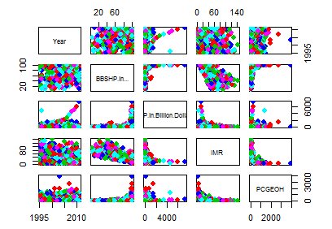
K-means Actual Values

Slide 17
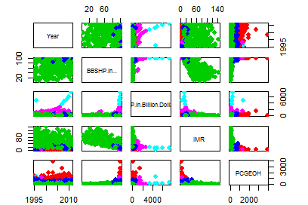

Slide 18
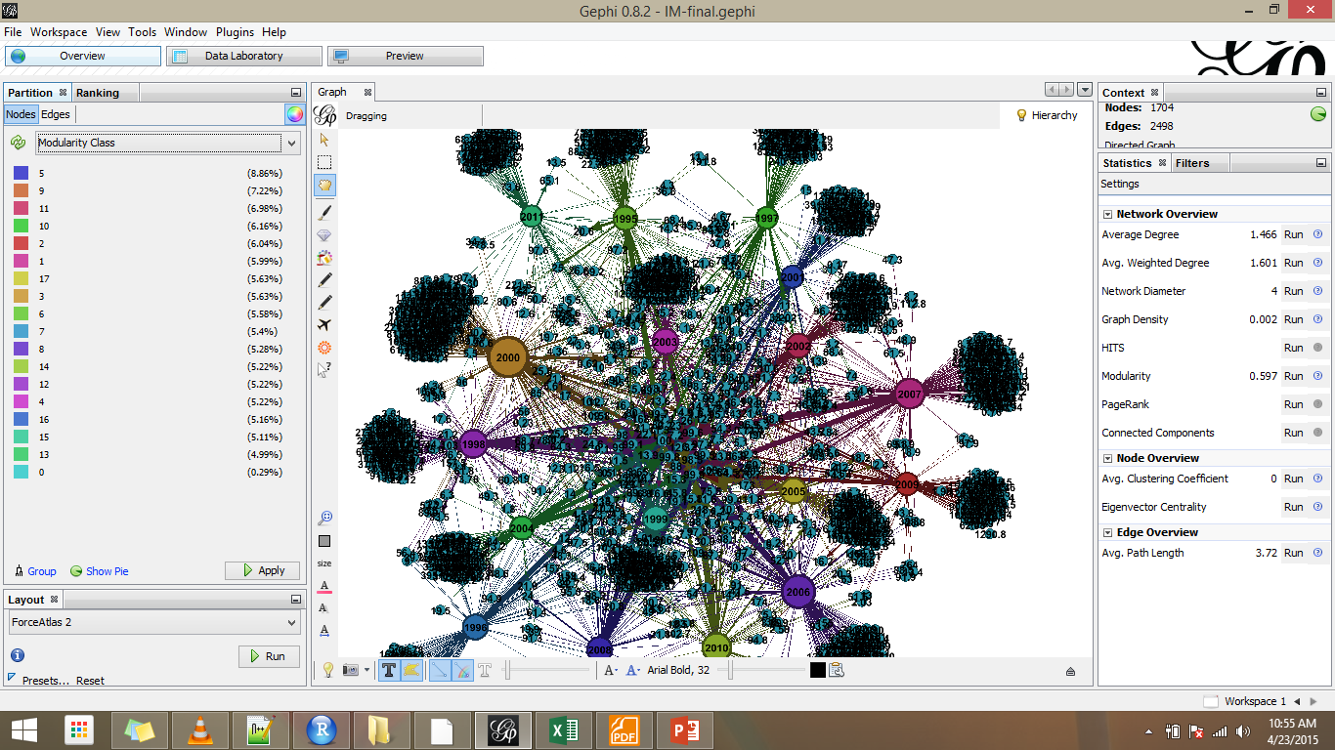

Slide 19
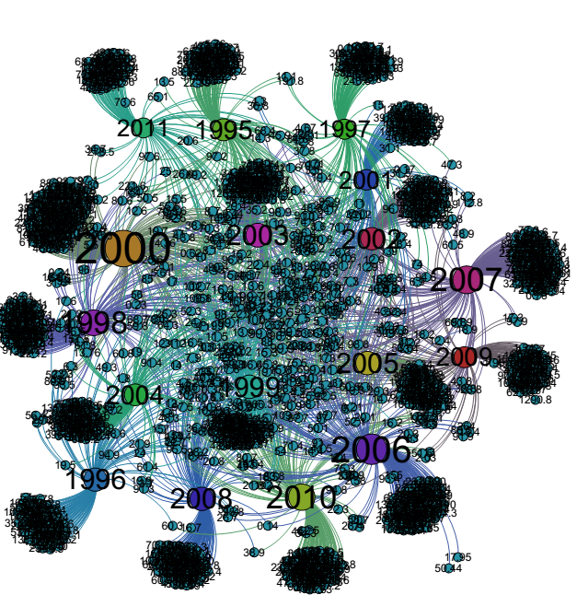

Slide 20
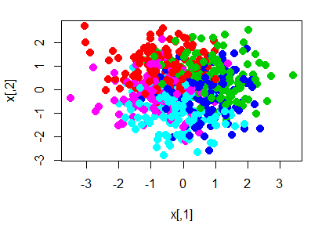
Kmeans-Modularity
Notes:
high modularity have dense connections between the nodes within modules but sparse connections between nodes in different modules. Modularity is often used in optimization methods for detecting community structure in networks. However, it has been shown that modularity suffers a resolution limit and, therefore, it is unable to detect small communities. Biological networks, including animal brains, exhibit a high degree of modularity.

Slide 21
CONCLUSIONS
Countries that have High GDP tend to allocate more money to the Health sector . They also have Skilled personnel attending to births and thus, low IMR.
With regards to time , factors like technology have decreased IMR over the years.

Slide 22
Sources of Data
http://data.un.org/Data.aspx?d=MDG&f=seriesRowID%3a561http://data.un.org/Data.aspx?q=Health&d=WHO&f=MEASURE_CODE%3aWHS7_108http://data.un.org/Data.aspx?q=Health&d=MDG&f=seriesRowID%3a570 http://data.un.org/Data.aspx?q=GDP&d=WDI&f=Indicator_Code%3aNY.GDP.MKTP.CD

