Slide 1


Data Mining
Kwadwo Busumtwi

Slide 2
Presentation outline
Project Background
My research questions
My analysis and what I learnt from this project

Slide 3
Background
YouTube is the largest user-driven video content provider in the world
According to public statistics, more than 48 hours of video content is uploaded every minute and 3 billion views are generated every day.

Slide 4

Successful Youtubers
How much does a YouTuber with 1 million subscribers earn a month?
Khan Academy
Estimated monthly earnings : $2k-$32.1k
Estimated Yearly Earnings $24.1k-$384.9k

Slide 5

Successful Youtubers
Jenna N. Mourey a.ka Jenna Marbles
Estimated monthly earnings : $5.9k-$94k
Estimated Yearly Earnings $70.5k-$1.1M

Slide 6
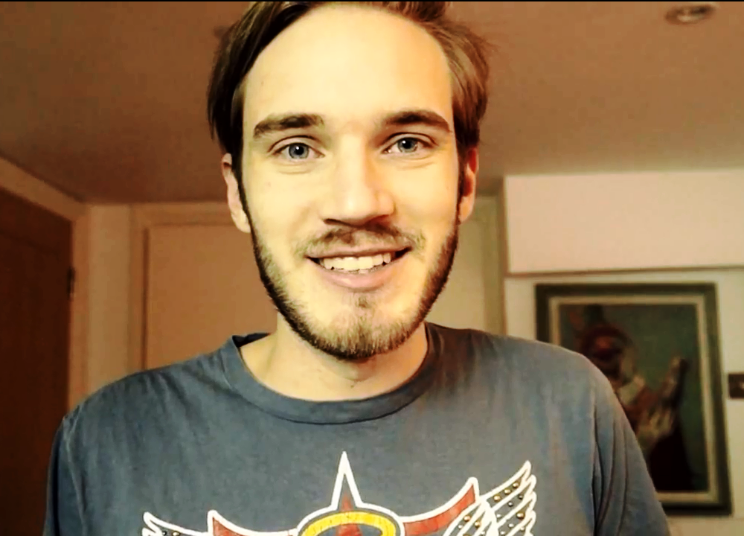
Successful Youtubers
Felix Arvid Ulf Kjellberg
Estimated monthly earnings : $93k-$1.5M
Estimated Yearly Earnings $1.1M-$17.9M

Slide 7
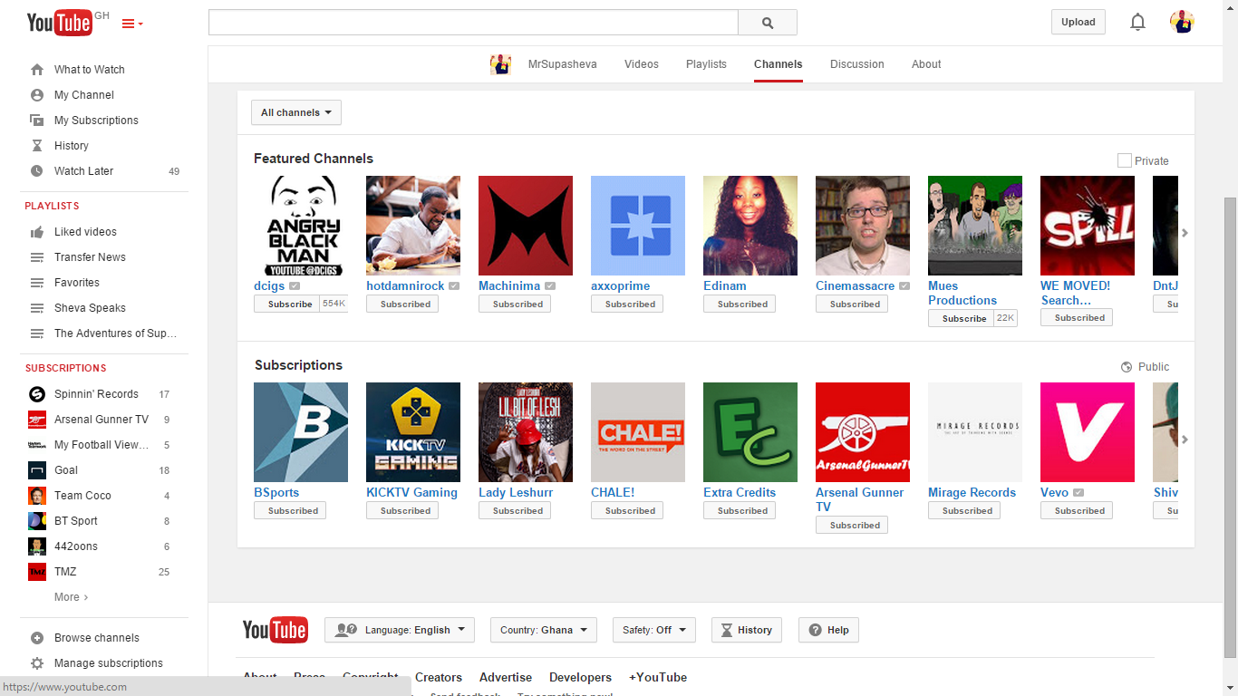

Slide 8
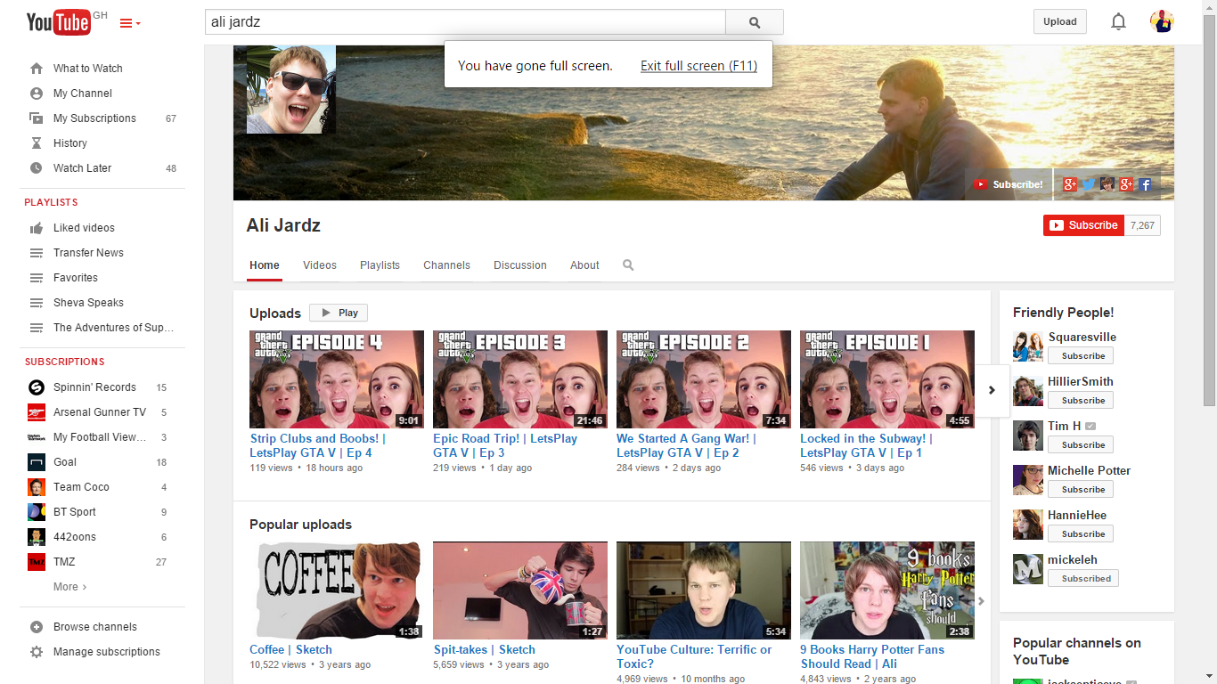
Where I got my data

Slide 9

Challenges
Getting to grips with R
Understanding the work Ali Jardz did
Cleaning my data

Slide 10

Research Questions
What is the most influential channel amongst the datasets?
What is the most popular channel group in Youtube UK?
Do Collaborations necessarily lead to more subscribers?

Slide 11
Tools Used
GEPHI
R
Excel

Slide 12
Most Influential Channel in the UK

Slide 13
Most Popular Channel Group in the UK

Slide 14
Collaborations Vs Subscribers

Slide 15
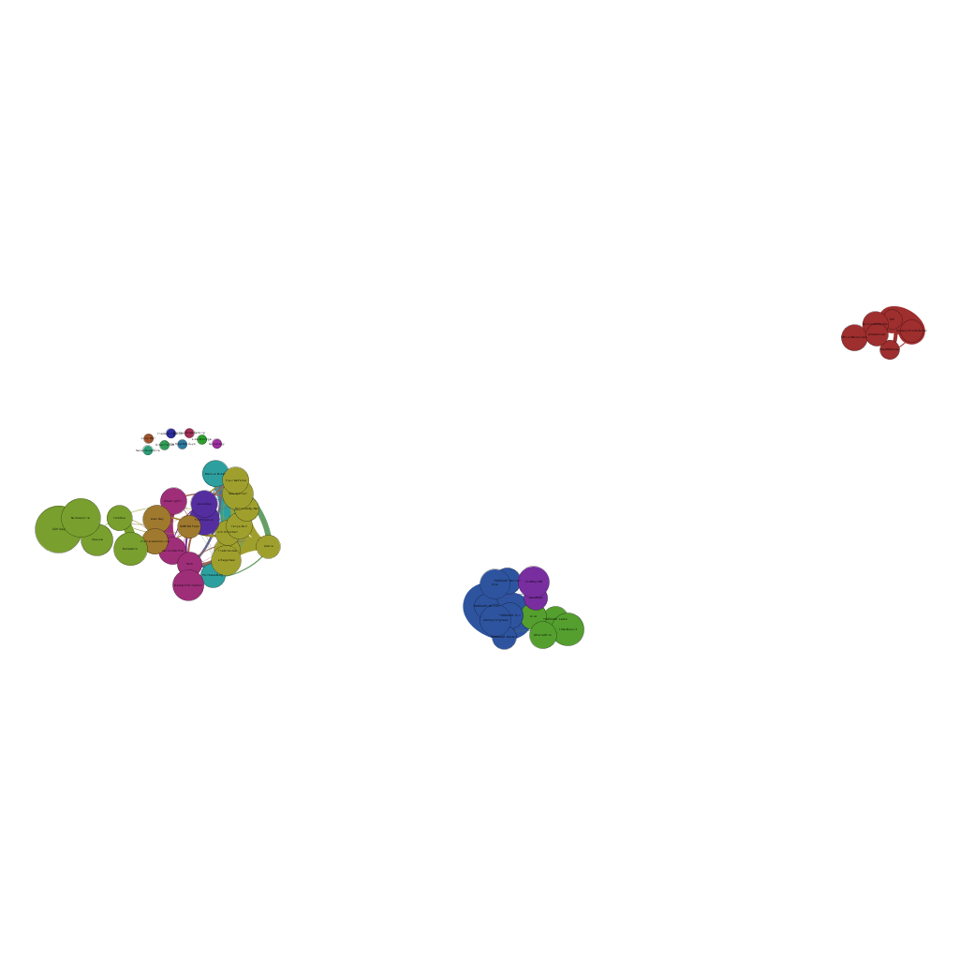
Gephi

Slide 16
Gephi Analysis
There are about 17 different cluster groups from my data
Gaming , Vlogging and Beauty Channels are the most popular groupings
Somehow the food channel works in someway with vloggers and beauty channels
The ‘Sidemen’ Group completely move themselves away from the other channels

Slide 17

Sources
https://www.youtube.com/watch?v=4XjiII4nx-4
https://drive.google.com/file/d/0B5-8EOddKWuxcG5ZZ182UzJySzA/edit
https://docs.google.com/spreadsheets/d/1iLzfp3nfAo9Pl_L5AkP-Sz4t6L2RRmxqGRrR6FKkjRg/edit#gid=2067174950
http://www.computer.org/csdl/proceedings/hicss/2008/3075/00/30750156.pdf
http://www.mpi-sws.org/~mmarcon/SocialNetworks-IMC.pdf
http://static.googleusercontent.com/media/research.google.com/en/us/pubs/archive/37738.pdf
http://www.personal.umich.edu/~ladamic/courses/networks/si508f07/projects/youtube.pdf

