Slide 1
Savings, population, wealth, corruption, and death rate
Shamir Adjaku

Slide 2
Data sources…
World bank
Transparency.org

Slide 3
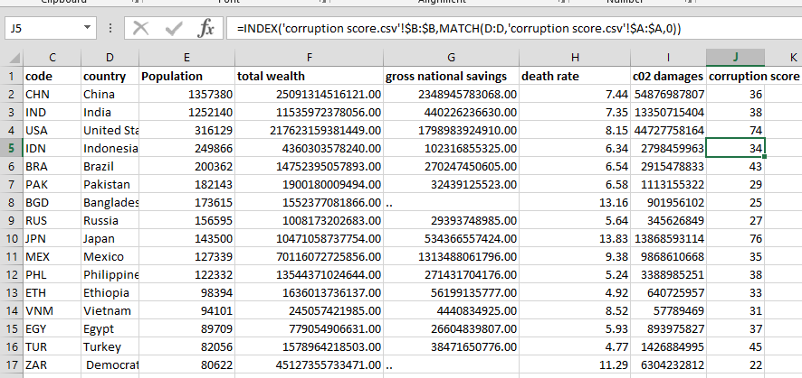
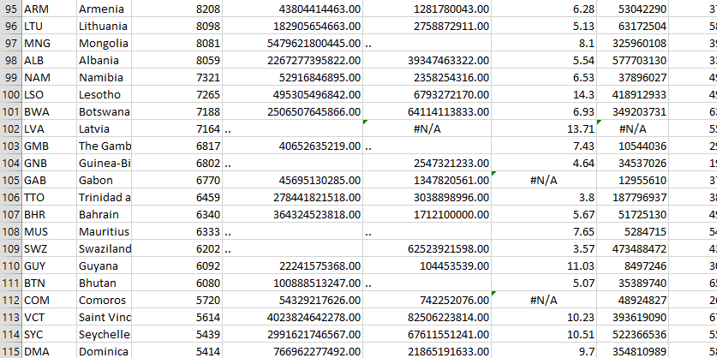
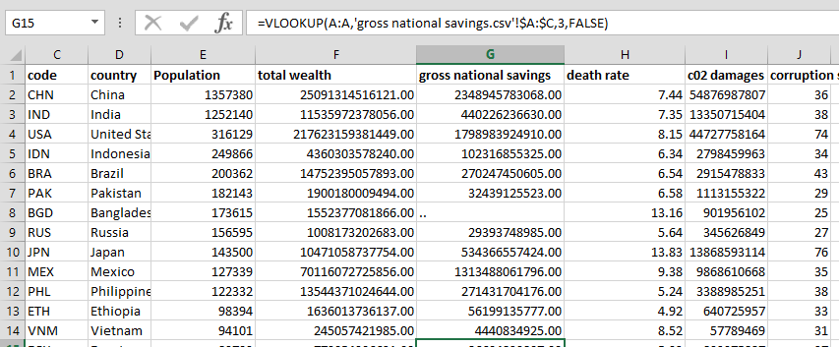
Data cleaning
Used excel to bring all data points together

Slide 4
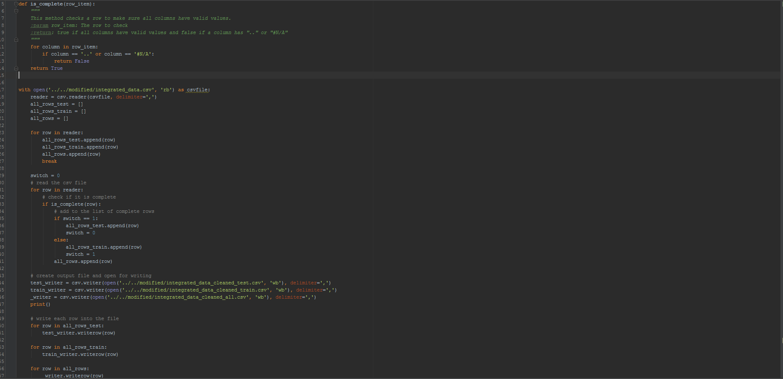
Data cleaning
Python scripts to remove invalid rows and break up into test and train sets

Slide 5
General exploratory analysis

Slide 11
Death rate vs. corruption

Slide 12
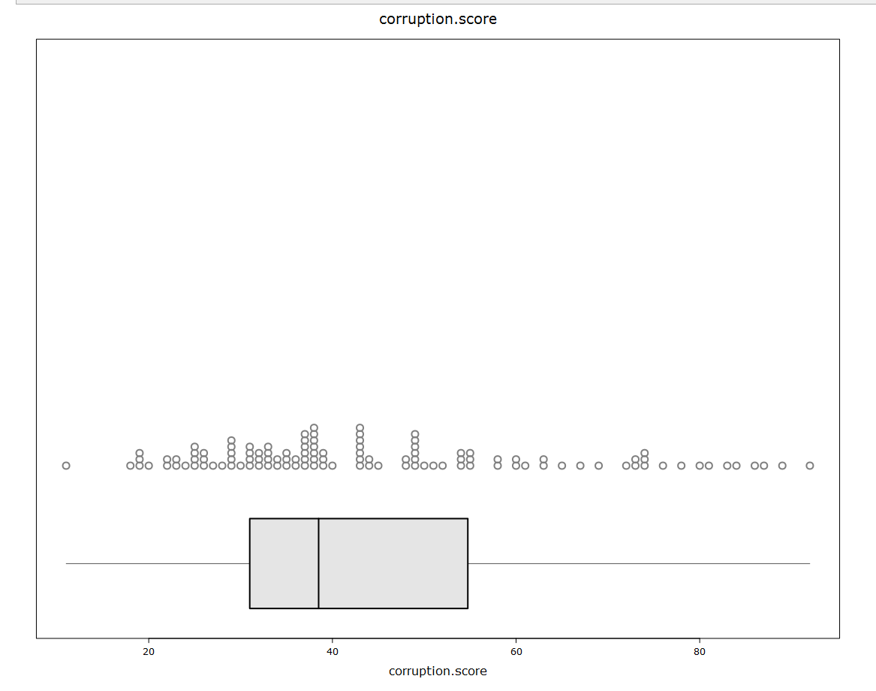
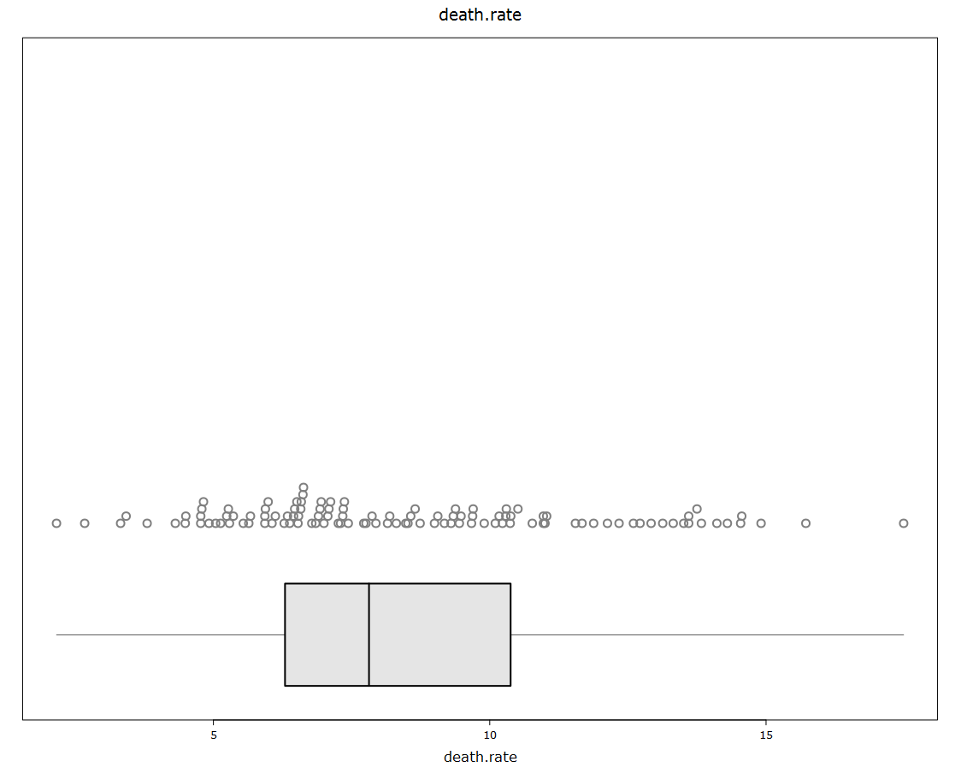

Slide 15
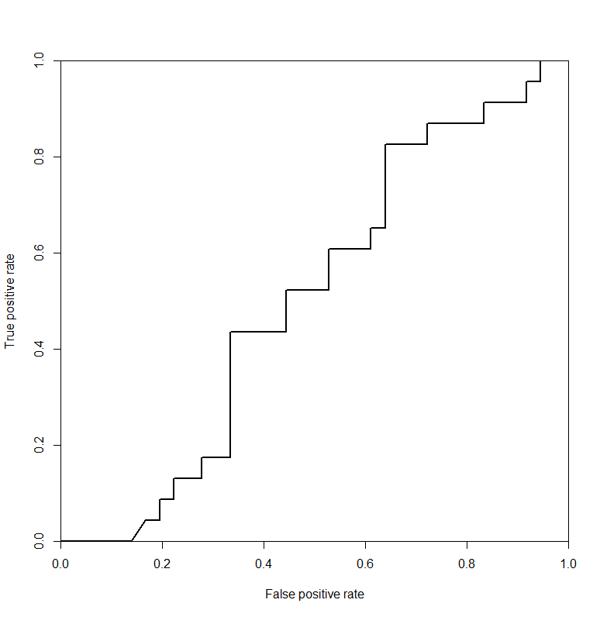
R’s prediction performance

