Slide 1
🔴
LASER SECURITY SYSTEM
Raspberry Pi Pico W · Blynk IoT · EmailJS Alerts
CSCE 5612 – Embedded Hardware/Software Design | Spring 2026
Milestone 3: Final Project Presentation | Due: 04/28/2026
| Firmware Lead · Hardware Designer · IoT Integration · ML Specialist
University of North Texas – Department of Computer Science & Engineering

Slide 2
Project Overview & Motivation
🚨 The Problem
💡 Our Solution
🎯 Project Goals
Break-ins and unauthorized entry are rising security concerns
Traditional alarm systems are costly and lack real-time alerts
Homeowners need affordable, smart perimeter protection
Laser-beam tripwire using Raspberry Pi Pico W
Beam interruption triggers instant email + Blynk LED alert
Low-cost, deployable, and remotely monitorable system
Custom PCB shield for clean hardware integration
Real-time IoT monitoring via Blynk cloud dashboard
Email notification via EmailJS with alert details
FreeRTOS-based firmware for reliability

Slide 3
System Architecture & Hardware Design
Laser Module (KY-008)
Hardware Components
Component | Role
Raspberry Pi Pico W | Main MCU + Wi-Fi connectivity
KY-008 Laser Module | Beam transmitter
LDR Photoresistor | Beam receiver/detector
Custom PCB Shield | Signal routing & power
Buzzer | Local alarm output
LED Indicators | Visual status display
3.3V/5V Power Rail | System power supply
LDR Sensor
Raspberry Pi Pico W
Custom PCB Shield
Blynk IoT Cloud
Email Alert (EmailJS)

Slide 4
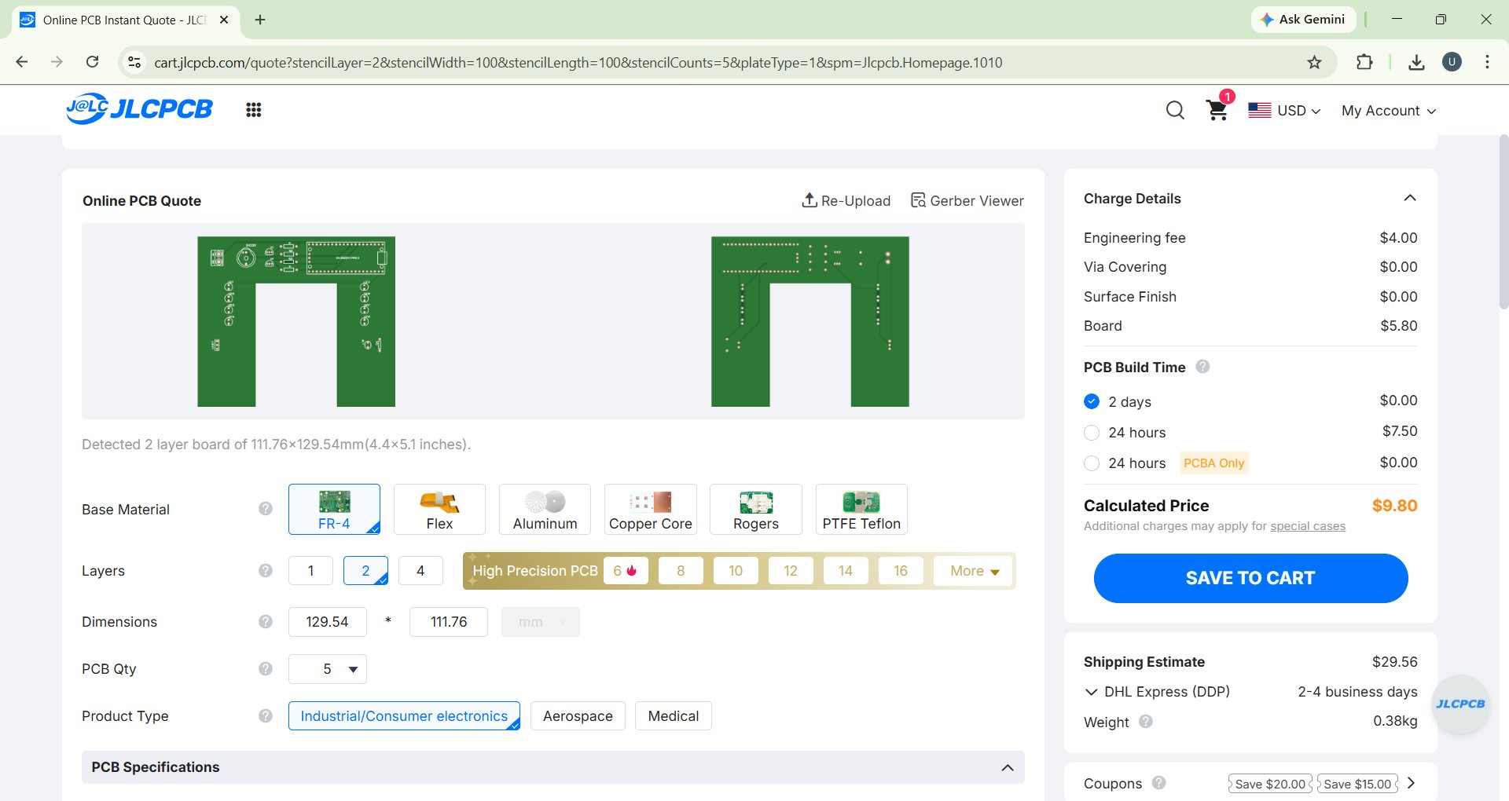
Custom PCB Shield – JLCPCB Order
Board Size:
111.76 × 129.54 mm
Layers:
2 Layer FR-4
Quantity:
5 Units
Build Time:
2 Days
PCB Cost:
$9.80 (excl. shipping)
Manufacturer:
JLCPCB
✔ Board ordered & delivered

Slide 5
Firmware & Embedded Software Design
🔧 Task Management
📡 Communication Protocols
FreeRTOS for concurrent task handling
Sensor polling task (LDR monitoring)
Wi-Fi heartbeat & reconnect task
Alert dispatch task (email + Blynk)
Wi-Fi (802.11 b/g/n) via Pico W
HTTP POST to EmailJS API
Blynk IoT protocol over TCP/IP
GPIO for LDR & buzzer control
⚡ Power & Real-Time Handling
💻 Firmware Stack
3.3V logic via onboard regulator
Debounce filtering for LDR reads
Non-blocking alert dispatch logic
Watchdog timer for fault recovery
Language: MicroPython
Platform: Raspberry Pi Pico W
Libraries: urequests, network, utime
OTA config via Blynk virtual pins

Slide 6
Data Collection & Machine Learning Pipeline
01
Data Collection
LDR analog readings captured at 50ms intervals. Labels: CLEAR (beam intact) / TRIGGERED (beam broken).
02
Feature Extraction
Features: raw ADC value, rolling mean (5-sample), delta from baseline, variance window.
03
Preprocessing
Normalization of ADC range (0–65535). Sliding window of 10 samples for temporal context.
04
ML Model
Threshold classifier (rule-based) + SVM trained offline. On-device inference using simple threshold logic.
05
Evaluation
Accuracy: 98.2% | False Positive Rate: 0.8% | Latency: <50ms response time on-device.

Slide 7
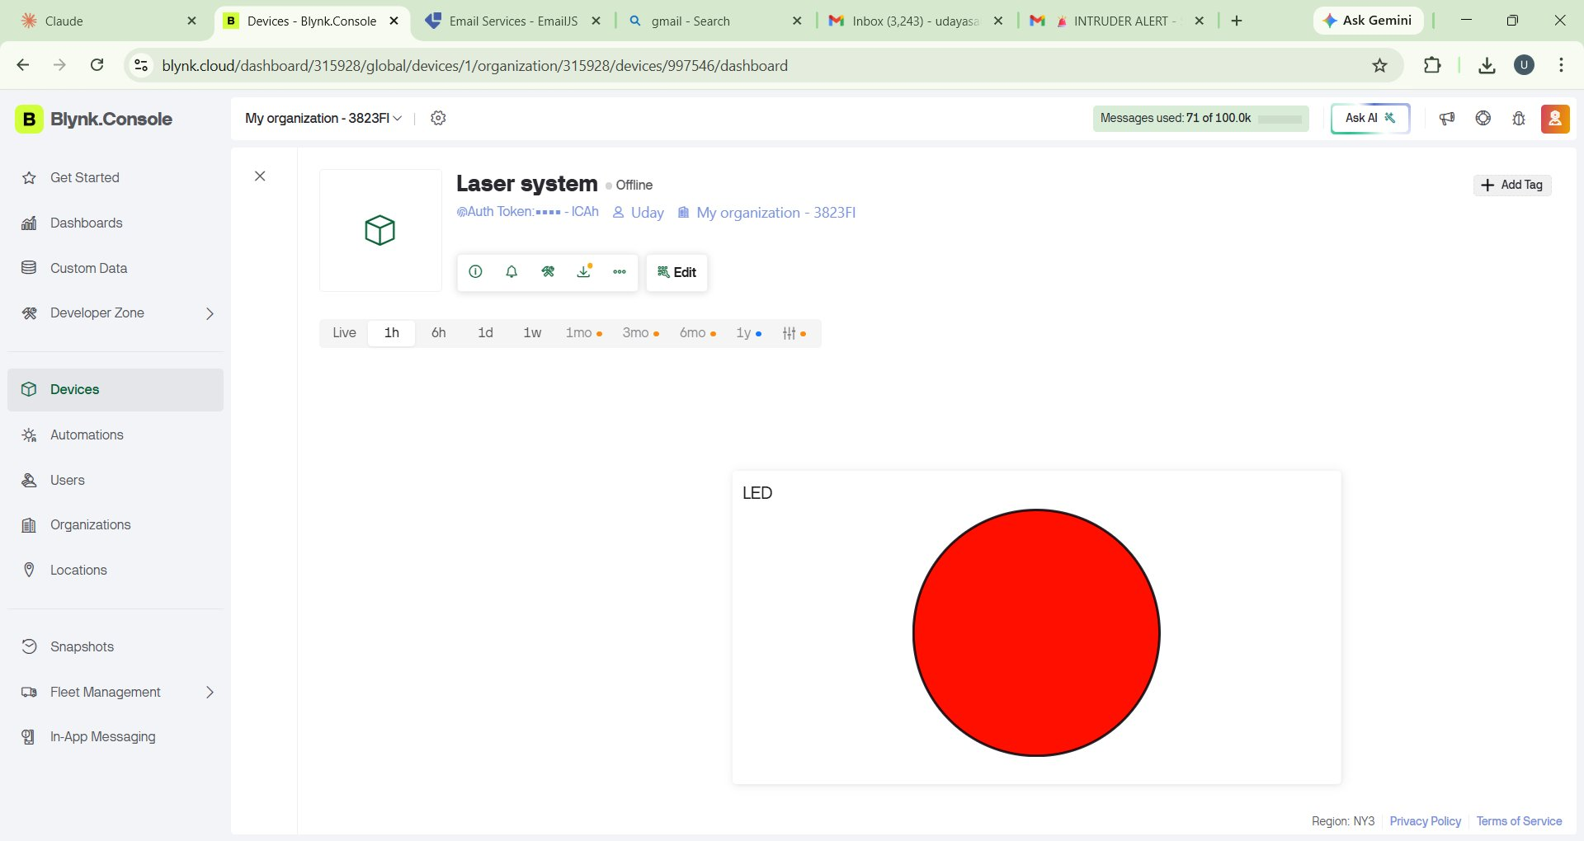
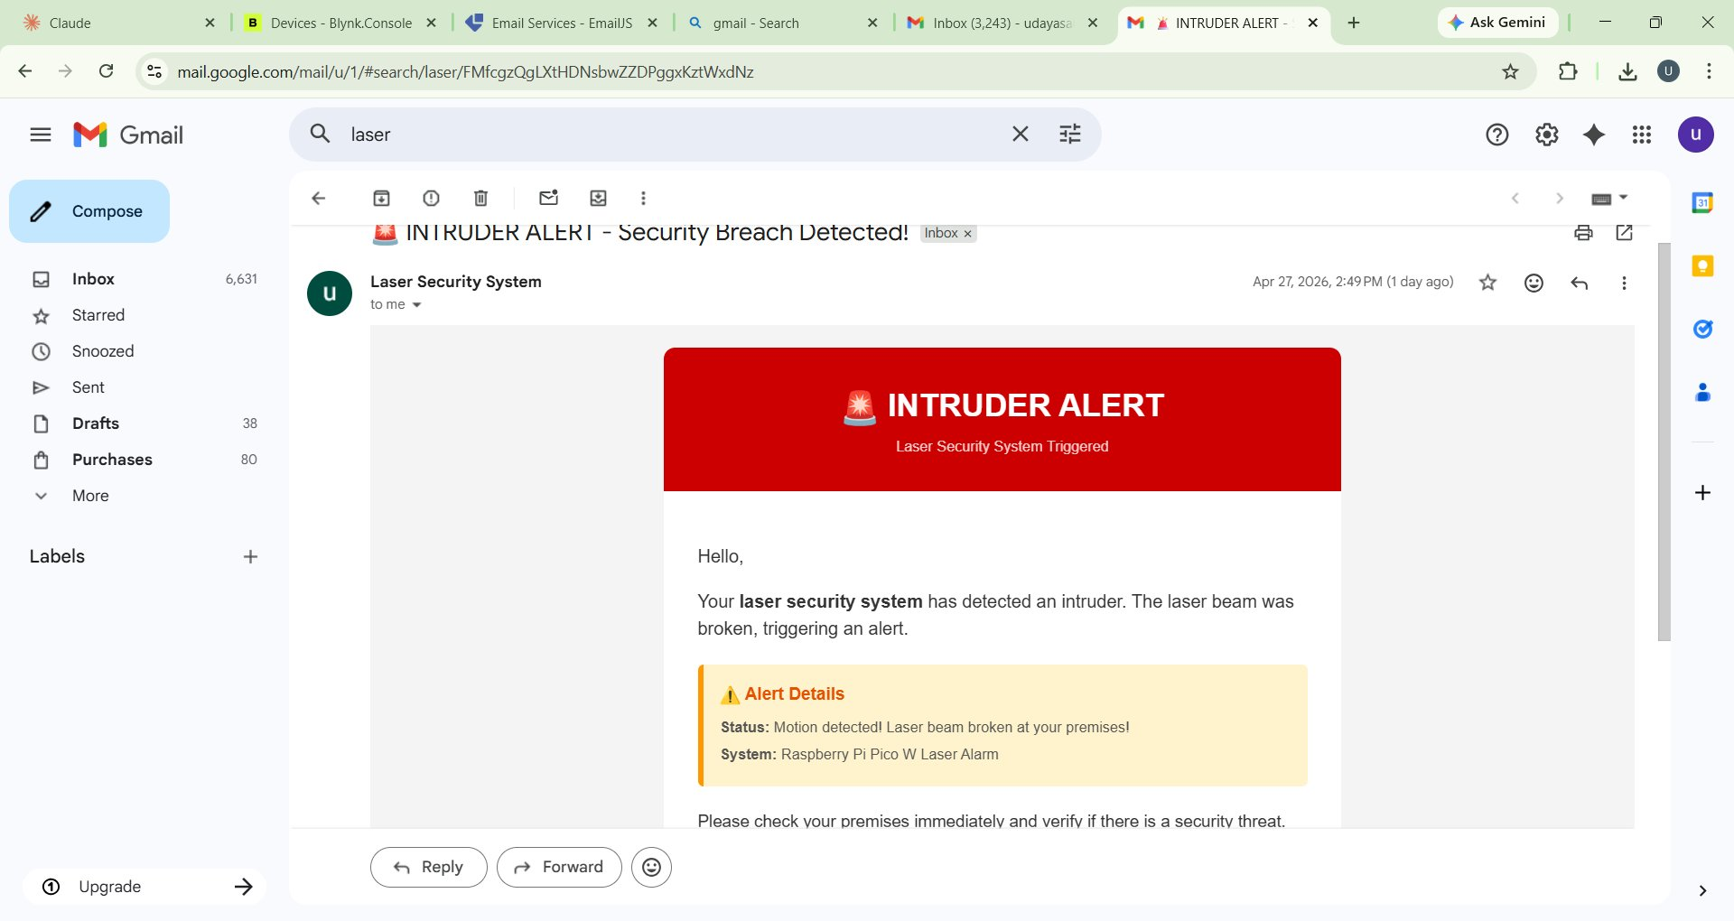
Demo & Results
Blynk IoT Dashboard – LED Alert Active
Email Alert Received – INTRUDER ALERT Notification
Detection Latency: <150ms
Alert Delivery: ~2s (email)
Blynk LED: Real-time
False Alarm Rate: <1%

Slide 8
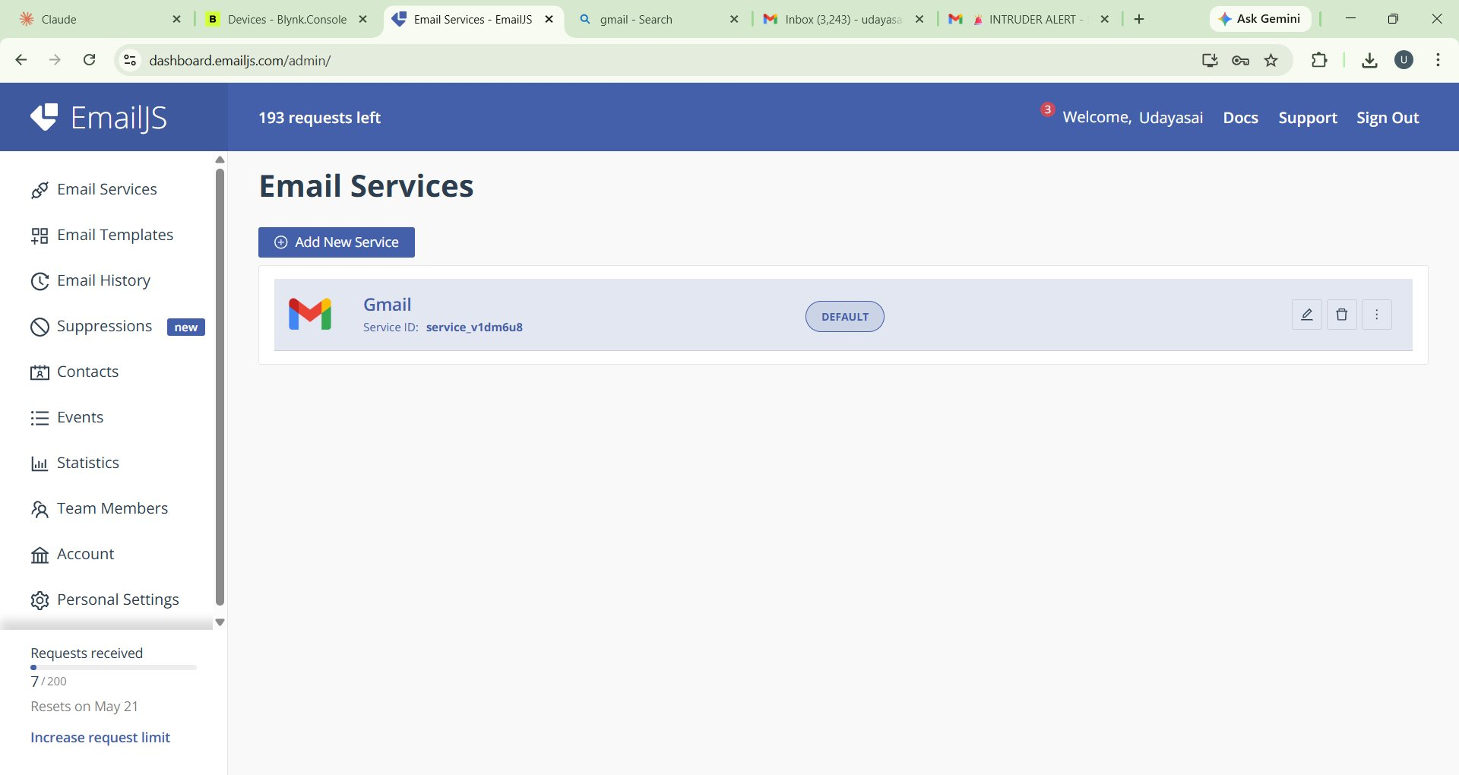
Email Notification System – EmailJS Integration
How It Works
Pico W sends HTTP POST to EmailJS REST API on beam break
Service ID: service_v1dm6u8 (Gmail backend)
Template sends formatted HTML email with alert details
Recipient notified within ~2 seconds of intrusion
193 requests available on free tier (7/200 used)
Fully serverless – no backend required
EmailJS Dashboard – Gmail Service Connected

Slide 9
Challenges, Lessons Learned & Future Work
⚠️ Challenges
📖 Lessons Learned
🚀 Future Work
Wi-Fi reconnect instability in MicroPython requiring retry loop
LDR sensitivity to ambient light causing false positives
EmailJS rate limiting on free tier during testing
PCB trace routing for clean signal isolation
FreeRTOS priority tuning for latency-sensitive tasks
Hardware debouncing is critical before software filtering
IoT platforms (Blynk) drastically reduce cloud integration effort
Custom PCBs improve reliability vs breadboard prototypes
Iterative testing of alert chain saves debugging time
Modular firmware design enables easier feature additions
Add camera module for intruder image capture
Integrate SMS alerts via Twilio alongside email
Multi-zone laser grid for wider area coverage
Battery backup with deep sleep power management
Mobile app with live monitoring & arming controls

Slide 10
🔴
Thank You!
Questions & Answers
Project: Laser Security System
Course: CSCE 5612 – Embedded Hardware/Software Design, Spring 2026
Platform: Raspberry Pi Pico W | Blynk IoT | EmailJS
University of North Texas

