Slide 1
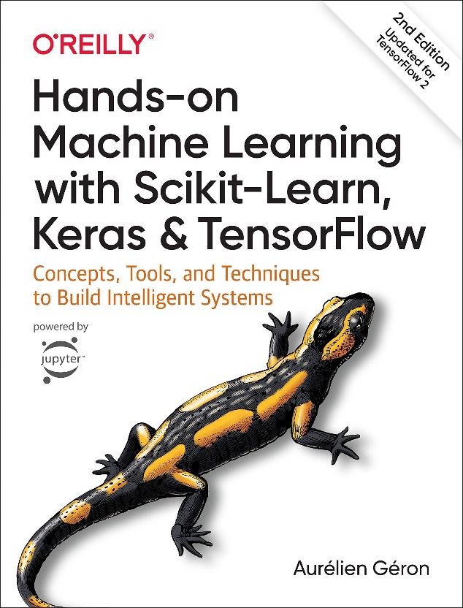
Chapter One
The Machine Learning Landscape
Md. Abu Naser Mojumder
Assistant Professor
Computer Science and Engineering
Sylhet Engineering College
Reference Book

Slide 2

Machine Learning Definition
Machine Learning is the science (and art) of programming computers so they can learn from data.
Here is a slightly more general definition: [Machine Learning is the] field of study that gives computers the ability to learn without being explicitly programmed. —Arthur Samuel, 1959
And a more engineering-oriented one: A computer program is said to learn from experience E with respect to some task T and some performance measure P, if its performance on T, as measured by P, improves with experience E. —Tom Mitchell, 1997

Slide 3
Main Challenges of Machine Learning
Insufficient Quantity of Training Data
Non-representative Training Data
Poor Quality Data
Irrelevant Features
Overfitting the Training Data
Underfitting the Training Data

Slide 4
Insufficient Quantity of Training Data
Machine Learning takes a lot of data for most Machine Learning algorithms to work properly. Even for very simple problems you typically need thousands of examples, and for complex problems such as image or speech recognition you may need millions of examples.
So, getting sufficient Training Data is a big challenge.

Slide 5
Non representative Training Data
In order to generalize well, it is crucial that your training data be representative of the new cases you want to generalize to.
This is often harder than it sounds: if the sample is too small, you will have sampling noise (i.e., nonrepresentative data as a result of chance), but even very large samples can be nonrepresentative if the sampling method is wrong. This is called sampling bias.

Slide 6
Poor Quality Data
Obviously, if your training data is full of errors, outliers, and noise (e.g., due to poor-quality measurements), it will make it harder for the system to detect the underlying patterns, so your system is less likely to perform well.
So, you need good quality data as well.

Slide 7
Irrelevant Features
Your system will only be capable of learning if the training data contains enough relevant features and not too many irrelevant ones.
A critical part of the success of a Machine Learning project is coming up with a good set of features to train on. This process, called feature engineering, involves the following steps:
Feature selection (selecting the most useful features to train on among existing features)
Feature extraction (combining existing features to produce a more useful one)
Creating new features by gathering new data

Slide 8
Overfitting The Training Data
Overgeneralizing is something that we humans do all too often, and unfortunately machines can fall into the same trap if we are not careful.
In Machine Learning this is called overfitting: it means that the model performs well on the training data, but it does not generalize well.
Overfitting happens when the model is too complex relative to the amount and noisiness of the training data.
Constraining a model to make it simpler and reduce the risk of overfitting is called regularization.
The amount of regularization to apply during learning can be controlled by a hyperparameter.
A hyperparameter is a parameter of a learning algorithm (not of the model).

Slide 9
Underfitting the Training Data
Underfitting is the opposite of overfitting: it occurs when your model is too simple to learn the underlying structure of the data.
Here are the main options for fixing this problem:
Select a more powerful model, with more parameters.
Feed better features to the learning algorithm (feature engineering).
Reduce the constraints on the model.

Slide 10
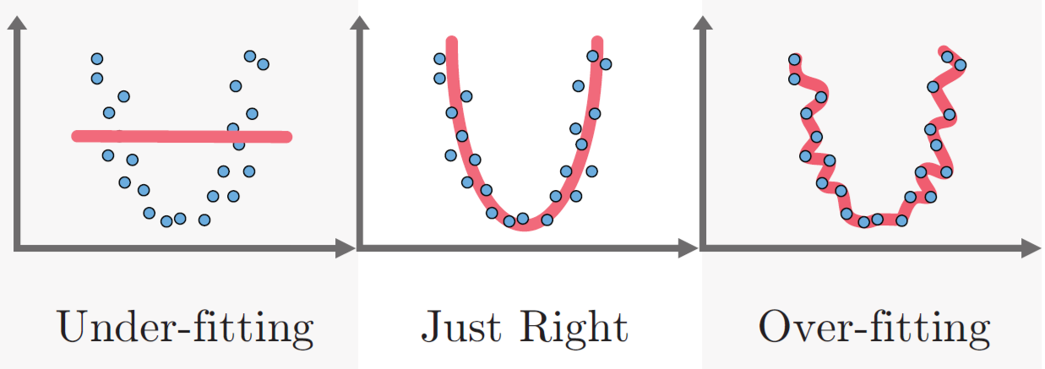
Overfitting vs Best Fitting vs Underfitting
Prediction Line
Original Data

Slide 11
How to know a model is good or bad?(Testing and Validation)
The only way to know how well a model will generalize to new cases is to actually try it out on new cases.
A good option is to split your data into two sets: the training set and the test set.
You train your model using the training set, and you test it using the test set.
The error rate on new cases is called the generalization error (or out-of-sample error), and by evaluating your model on the test set, you get an estimate of this error.
This value tells you how well your model will perform on instances it has never seen before.
If the training error is low (i.e., your model makes few mistakes on the training set) but the generalization error is high, it means that your model is overfitting the training data.
Then you might need regularization.

Slide 12
Model’s Performance Measure Techniques
Confusion Matrix
Accuracy
Precision
Recall
F1 Score

Slide 13
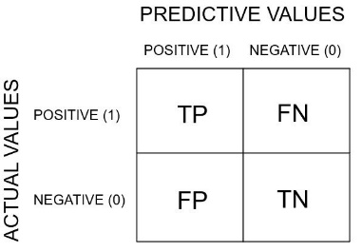
Confusion Matrix
Consider a classification model used to generate the result(see figure):
The blue points are labelled positive.
The red points are labelled negative.
Confusion Matrix Template:
Blue Type (Positive Type)
Red Type (Negative Type)

Slide 14
Confusion Matrix(cont..)
Making the Confusion Matrix:
True Positive: 6 blue above line. (TP)
True Negative: 5 red below line. (TN)
False Positive: 2 red above line (FP)
False Negative: 1 blue below line. (FN)
 | Predicted Blues | Predicted Reds
Actual Blues | 6 (TP) | 1 (FN)
Actual Reds | 2 (FP) | 5 (TN)
Blue Type (Positive Type)
Total Predictions : 14
Total Right Predictions: (TP+TN) 6+5 = 11
Total Wrong Predictions: (FP+FN) 2+1 = 3
Red Type (Negative Type)

Slide 15

Accuracy
Accuracy is one of the ways to measure how good a model is.
Lets calculate the accuracy of the previous example from Confusion Matrix:
$$Accuracy=\frac{Number of Correct Predictions}{Total Number of Predictions }$$
$$=\frac{TP+TN}{TP+TN+FP+FN}$$
$=\frac{6+5}{6+5+2+1}$
= $\frac{11}{14}$
$=0.786$
$=78.6\%$
 | Predicted Blues | Predicted Reds
Actual Blues | 6 (TP) | 1 (FN)
Actual Reds | 2 (FP) | 5 (TN)

Slide 16
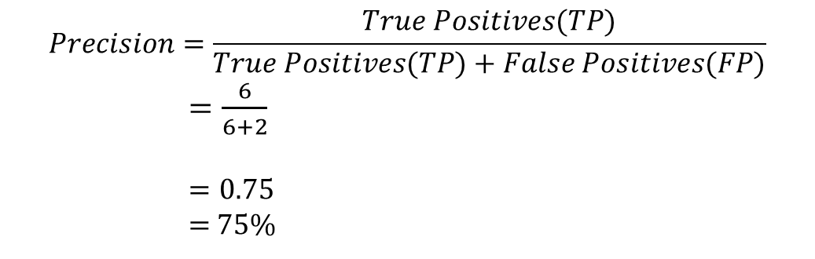
Precision
Precision is defined as the proportion of data that was predicted positive to the data was actually positive.
It says how good your model can classify True Positive compared to False positive
 | Predicted Blues | Predicted Reds
Actual Blues | 6 (TP) | 1 (FN)
Actual Reds | 2 (FP) | 5 (TN)
$$Precision=\frac{True Positives(TP)}{True Positives(TP)+False Positives(FP)}$$
$=\frac{6}{6+2}$
$=0.75$
= 75%

Slide 17
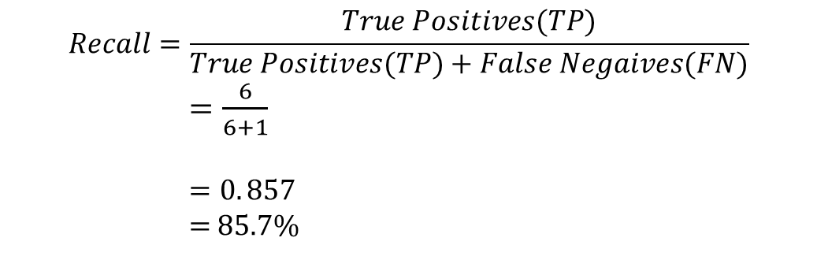
Recall
Recall is defined as the proportion of data that was predicted positive to the total positive(TP+FN). Recall attempt to answer the following question-
What proportion of actual positives was identified correctly?
 | Predicted Blues | Predicted Reds
Actual Blues | 6 (TP) | 1 (FN)
Actual Reds | 2 (FP) | 5 (TN)
$$Recall=\frac{True Positives(TP)}{True Positives(TP)+False Negaives(FN)}$$
$=\frac{6}{6+1}$
$=0. 857$
= 85.7%

Slide 18
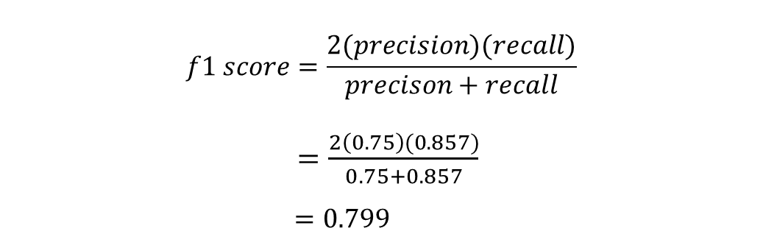
F1 Score
F1 score is combining both the Precision and Recall into a single metric for simplicity. It is the harmonic mean of the model’s precision and recall.
$$f1 score=\frac{2(precision)(recall)}{precison+recall}$$
$=\frac{2\left(0.75\right)(0.857)}{0.75+0.857}$
$=0.799$
From Previous example
Precision | Recall
0.75 | 0.857

Slide 19
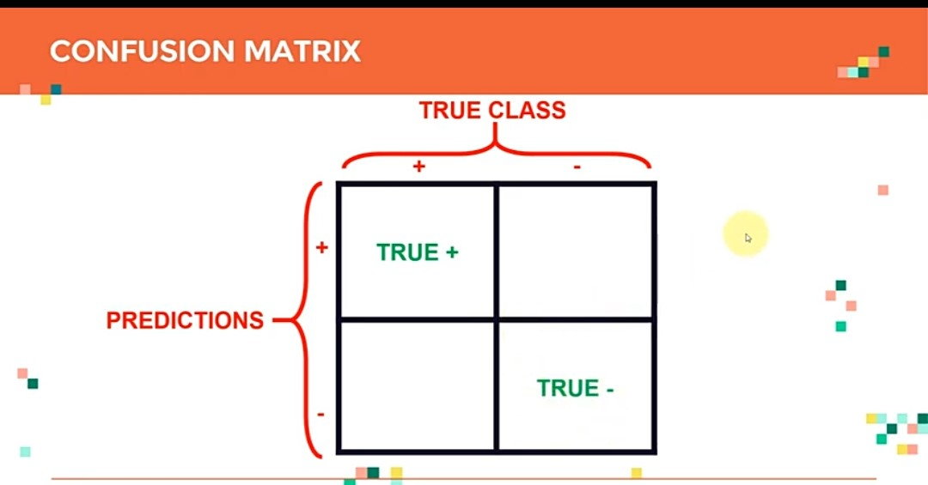

Slide 20
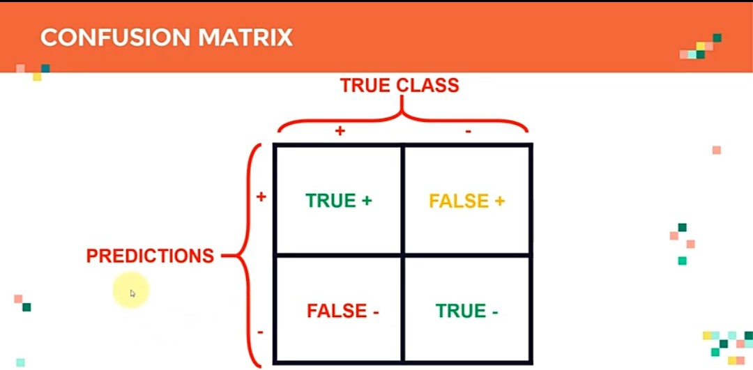

Slide 21
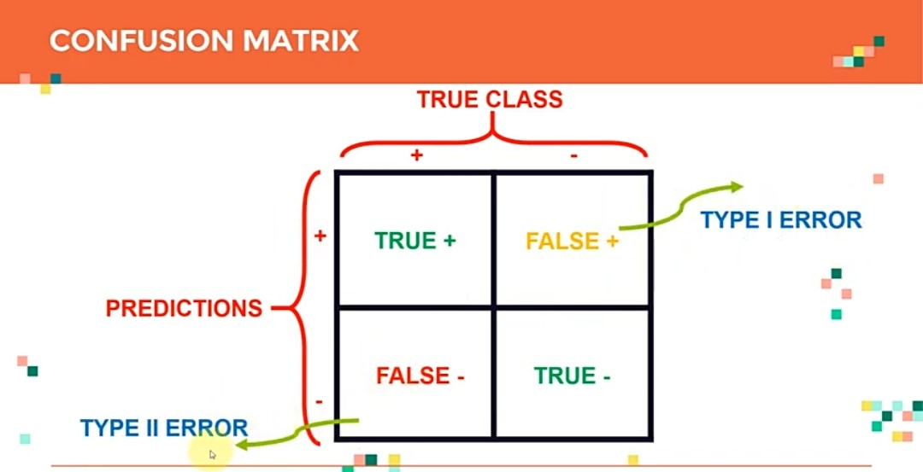

Slide 22
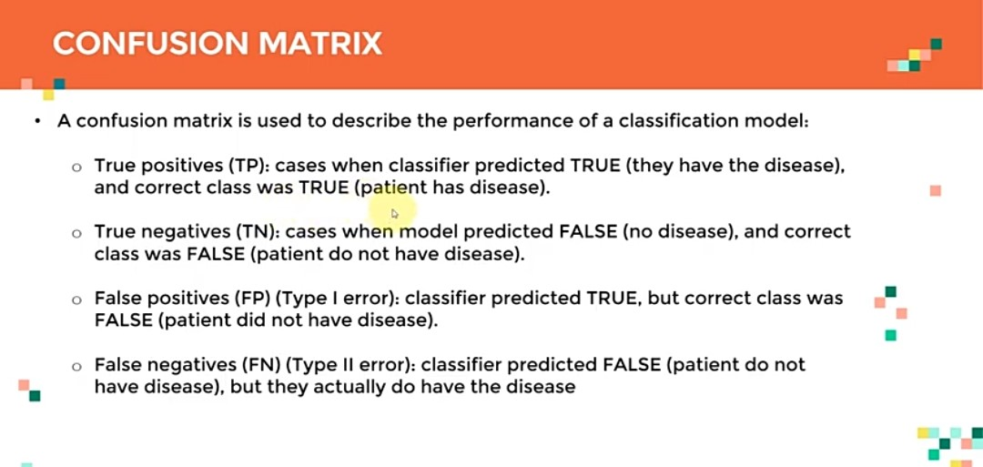

Slide 23
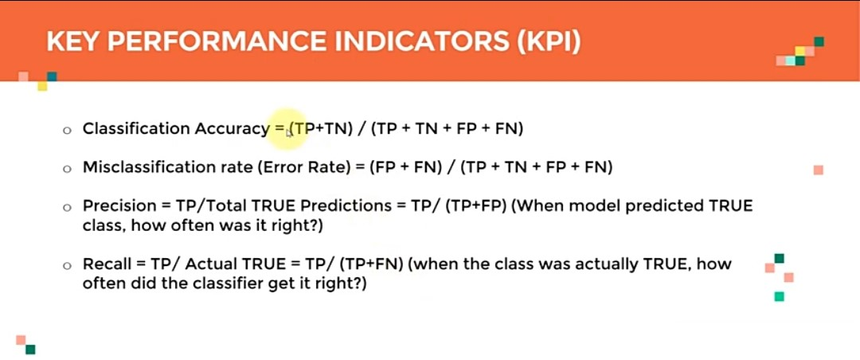

Slide 24
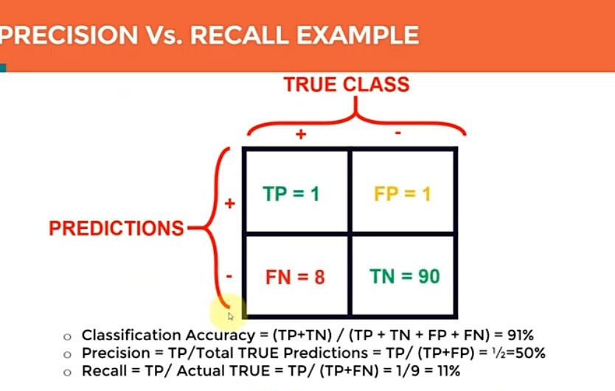

Slide 25
Chapter Two
End to End Machine Learning Project

Slide 26
Basic Steps of a Machine Learning Project
Data Collection and Problem Statement
Exploratory Data Analysis with Pandas and NumPy
Data Preparation using Sklearn
Selecting and Training a few Machine Learning Models
Cross-Validation and Hyperparameter Tuning using Sklearn
Deploying the Final Trained Model on Web or any Platform.

Slide 27
Data Collection and Problem Statement
The first step is to get your hands on the data.
If You have access to data, then the first step is to define the problem that you want to solve.
If We don’t have the data yet, so we are going to collect the data first.

Slide 28
Exploratory Data Analysis with Pandas and NumPy
Check for data type of columns
Check for null values.
Check for outliers.
Look for the category distribution in categorical columns
Plot for correlation etc.

Slide 29
Data Preparation using Sklearn
Preprocessing Categorical Attribute
Data Cleaning
Attribute Addition etc.

Slide 30
Selecting and Training Machine Learning Models
Create an instance of the model class.
Train the model using the fit() method.
Make predictions by first passing the data through pipeline transformer.
Evaluating the model using Root Mean Squared Error.

Slide 31
Cross-Validation and Hyperparameter Tuning using Sklearn
Scikit-Learn’s K-fold cross-validation feature randomly splits the training set into K distinct subsets called folds. Then it trains and evaluates the model K times, picking a different fold for evaluation every time and training on the other K-1 folds.
After testing all the models, you’ll find that your model has performed well but it still needs to be fine-tuned.

Slide 32
Deploying the Final Trained Model on Web or any Platform.
You can deploy your model into a Web app that can make predictions.
It can be weather prediction or image classification or OCR or anything.

