Slide 1

Naïve Bayes
Md. Abu Naser Mojumder

Slide 2
Naïve Bayes
Naïve Bayes Classifier
Naïve Bayes algorithm is a supervised learning algorithm, which is based on Bayes theorem and used for solving classification problems.
Naïve Bayes Classifier is one of the simple and most effective Classification algorithms which helps in building the fast machine learning models that can make quick predictions.
It is a probabilistic classifier, which means it predicts on the basis of the probability of an object.
Some popular examples of Naïve Bayes Algorithm are spam filtration, Sentimental analysis, and classifying articles.

Slide 3
Naïve Bayes
Why is it called Naïve Bayes?
The Naïve Bayes algorithm is comprised of two words Naïve and Bayes, Which can be described as:
Naïve: It is called Naïve because it assumes that the occurrence of a certain feature is independent of the occurrence of other features. Such as if the fruit is identified on the bases of color, shape, and taste, then red, spherical, and sweet fruit is recognized as an apple. Hence each feature individually contributes to identify that it is an apple without depending on each other.
Bayes: It is called Bayes because it depends on the principle of Bayes' Theorem.

Slide 4
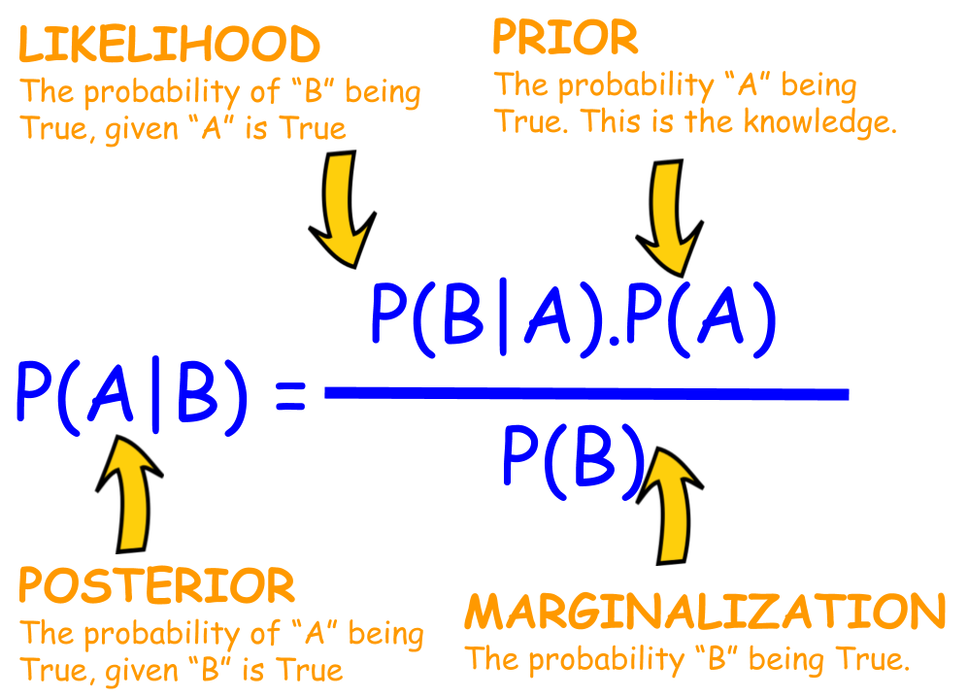
Naïve Bayes
Bayes Theorem
Bayes' Theorem is a way of finding a probability when we know certain other probabilities.
The formula is:

Slide 5
Working of Naïve Bayes' Classifier:
Suppose we have a dataset of weather conditions and corresponding target variable "Play". So using this dataset we need to decide that whether we should play or not on a particular day according to the weather conditions. So to solve this problem, we need to follow the below steps:
Convert the given dataset into frequency tables.
Generate Likelihood table by finding the probabilities of given features.
Now, use Bayes theorem to calculate the posterior probability.

Slide 6


Naïve Bayes
Naïve Bayes Classifier
Problem: If the weather is sunny, then the Player should play or not?
Solution: To solve this, first consider the below dataset:
Count | Outlook | Play
0 | Rainy | Yes
1 | Sunny | Yes
2 | Overcast | Yes
3 | Overcast | Yes
4 | Sunny | No
5 | Rainy | Yes
6 | Sunny | Yes
7 | Overcast | Yes
8 | Rainy | No
9 | Sunny | No
10 | Sunny | Yes
11 | Rainy | No
12 | Overcast | Yes
13 | Overcast | Yes
We will calculate the followings:
$$P\left(Yes | Sunny\right)=\frac{P\left(Sunny | Yes\right)∗P(Yes)}{P\left(Sunny\right)}$$
$$P\left(No | Sunny\right)=\frac{P\left(Sunny | No\right)∗P(No)}{P\left(Sunny\right)}$$

Slide 7
Naïve Bayes
Naïve Bayes Classifier
Problem: If the weather is sunny, then the Player should play or not?
Solution: To solve this, first consider the below dataset:
Count | Outlook | Play
0 | Rainy | Yes
1 | Sunny | Yes
2 | Overcast | Yes
3 | Overcast | Yes
4 | Sunny | No
5 | Rainy | Yes
6 | Sunny | Yes
7 | Overcast | Yes
8 | Rainy | No
9 | Sunny | No
10 | Sunny | Yes
11 | Rainy | No
12 | Overcast | Yes
13 | Overcast | Yes
Frequency table for the Weather Conditions:
Likelihood table for
weather condition:
Weather | Yes | No
Overcast | 5 | 0
Rainy | 2 | 2
Sunny | 3 | 2
Total | 10 | 4
Weather | No | Yes
Overcast | 0 | 5 | 5/14= 0.35
Rainy | 2 | 2 | 4/14=0.29
Sunny | 2 | 3 | 5/14=0.35
All | 4/14=0.29 | 10/14=0.71

Slide 8
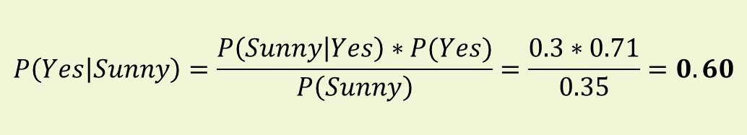
Naïve Bayes
Naïve Bayes Classifier
Frequency table for the Weather Conditions:
Likelihood table for
weather condition:
Weather | Yes | No
Overcast | 5 | 0
Rainy | 2 | 2
Sunny | 3 | 2
Total | 10 | 4
Weather | No | Yes
Overcast | 0 | 5 | 5/14= 0.35
Rainy | 2 | 2 | 4/14=0.29
Sunny | 2 | 3 | 5/14=0.35
All | 4/14=0.29 | 10/14=0.71
P(Sunny|Yes)= 3/10= 0.3
P(Sunny)= 0.35
P(Yes)=10/14=0.71
$$P\left(Yes | Sunny\right)=\frac{P\left(Sunny | Yes\right)∗P(Yes)}{P\left(Sunny\right)}=\frac{0.3∗0.71}{0.35}=0.60$$

Slide 9
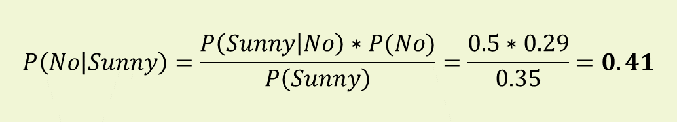
Naïve Bayes
Naïve Bayes Classifier
Frequency table for the Weather Conditions:
Likelihood table for
weather condition:
Weather | Yes | No
Overcast | 5 | 0
Rainy | 2 | 2
Sunny | 3 | 2
Total | 10 | 4
Weather | No | Yes
Overcast | 0 | 5 | 5/14= 0.35
Rainy | 2 | 2 | 4/14=0.29
Sunny | 2 | 3 | 5/14=0.35
All | 4/14=0.29 | 10/14=0.71
P(Sunny|No)= 2/4= 0.5
P(Sunny)= 0.35
P(No)=4/14=0.29
$$P\left(No | Sunny\right)=\frac{P\left(Sunny | No\right)∗P(No)}{P\left(Sunny\right)}=\frac{0.5∗0.29}{0.35}=0.41$$

Slide 10



Naïve Bayes
Naïve Bayes Classifier
$$P\left(Yes | Sunny\right)=\frac{P\left(Sunny | Yes\right)∗P(Yes)}{P\left(Sunny\right)}=\frac{0.3∗0.71}{0.35}=0.60$$
$$P\left(No | Sunny\right)=\frac{P\left(Sunny | No\right)∗P(No)}{P\left(Sunny\right)}=\frac{0.5∗0.29}{0.35}=0.41$$
$$P\left(Yes | Sunny\right)>P\left(No | Sunny\right)$$
Hence on a Sunny day, Player can play the game.

