Slide 1
Proposal For Improving Fingerprint and Motor Vehicle Record Check Processes
December 10th, 2015
By Ashfaqul (Ash) Haq

Slide 2
Overview
Fingerprint and Motor Vehicle Record check - part of hiring requirement
Identify inefficiencies and redundancy and focusing on overcoming them through streamlining the process further and reducing reverse logistics or error corrections through preventing measures
Significant importance - ASU has 10,000+ employees and growing
To reduce hiring cycle time and streamline documentation of hire

Slide 3
Process Improvement
Proactive task of identifying, analyzing, and improving upon existing business processes within an organization for optimization and to meet standards of quality

Slide 4
Process Improvement Steps
Learning about the process from stakeholders
Identifying inefficiency or redundancy or communication gap
Understanding in depth details regarding the issues
Gathering data
Brainstorming and listing potential solutions
Evaluating solutions and choosing the best ones
Developing cost-benefit analysis
Suggestions for maintaining the improvements
Notes:
Unnecessary work.
Duplication of job tasks.
Disconnects where critical information is not communicated.
Situations where consequences of one department’s decisions are not fully understood in the light of their impact on other departments, potentially hindering the other departments’ ability to achieve their goals.

Slide 5
Problem & Improvement Implementation Classification
 | Priority | Time | Cost | Benefit
Immediate | Low | Within 1 day to 1 month | Low. Easily Implementable | Slightly improve experience
Short Run | High/ Medium | Within 1 year | Medium. Requires involvement from stakeholders | Implement preventive measures
Long Run | High | Over 1 year to 5 years | High. Requires integrating organizations involved | Complete integration and automation Reduce running cost and improve satisfaction of employees

Slide 6
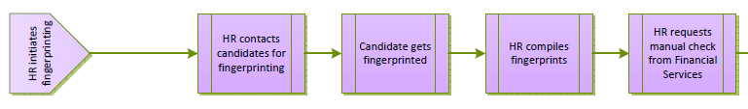
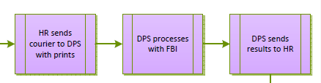
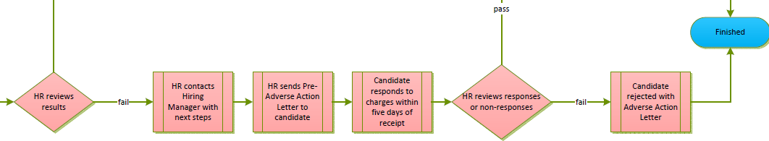
Fingerprint Check Process Overview and Objective
5 days
14 days or more
7 days
AVERAGE TOTAL OF 27 DAYS + 40 DAYS FOR HIRING DEPARTMENT = 67 DAYS TOTAL

Slide 7
Strong Points of Concern
Billing Process
Documentation
DPS Time Usage
Lack of automation and involving manual paperwork
Redundant use of payment process involving many steps
Wrong account number, lack of account balance error (70% error rate)
Constant logging of updates
14 days out of 27 (50%+)
Results should not be bottleneck for results

Slide 8
More Data
DPS checks for state records, FBI for federal. DPS has to be middleman
DPS checks 140,000 prints per year with 7 staff with <1% error rate
Only 3% fingerprint checks results in hits
High number of wrong account number for billing from departments
Facilities Management - Start dates are after fingerprint results
30% bad reference, 80% job offer denial

Slide 9
Immediate Improvement Implementation
Implementation
Email Department About Updates
Inform candidate about timeline, parking, and policy
Extend walk-in times
Encourage fingerprint card
Data backup
Low Priority
Very low time required
Zero Cost
Benefit of better candidate experience

Slide 10


Short Run Improvement Implementation
Barcode Tracker: Will be able to track and log each step of a candidate’s FP check and billing documentation and reduce manual data entry
Kenaxa Warning: Will warn the department hiring manager to ensure correct account number is entered and account has enough balance before submission for FP
Request for expedited service during peak season or more often
Notes:
https://www.waspbarcode.com/barcode-system-starter-kits/waspnest-wcs3900-ccd-barcode-scanner

Slide 11
Short Run Improvement Implementation - Barcode Tracker
Implication
Create an internal primary key
Automate Redundant Date Logging
Better Tracking And Reduced Data Entry Error
Time = 1+ month time
Predicted Cost |  | Predicted Benefit
Barcode Tracker = 1*$200 | $200 | Employee Satisfaction = $50,000 salary*0.01%*1 worker | $5000
Implementation = 6 hours * $50/hr | $300
Miscellaneous = | $200
Total Cost = | $900 (one time cost) | Total Benefit = | $5000 (recurring)

Slide 12
Short Run Improvement Implementation - Kenaxa Warning Sign
Implication
Able to confirm correct entry of account number
Double check account balance is enough
Avoid a whole batch of prints being stuck
Time = 1+ month time
Predicted Cost |  | Predicted Benefit
Pay to Kenaxa for modification = 1*$1000 | $1000 | Reduced job offer denials = $50,000 salary * 1/10 job | $5000
Wages for Programmers = 12 hours * $50/hr | $600
Miscellaneous = | $200
Total Cost = | $1800 (one time cost) | Total Benefit = | $5000 (recurring)

Slide 13
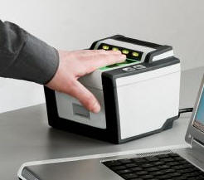
Long Run Improvement Implementation
Implementing and using LiveScan can provide instant results about a candidate’s history
Technology only currently used in Police Stations and Immigration
Can shorten, simplify and complete the whole process when coming for an interview
Mobile app with finger scanning options

Slide 14
Long Run Improvement Implementation - LiveScan
Implication
Be able to check and input report right away
Minimized data entry and labor work
Increased candidate and employee satisfaction
Time = 2+ year time
Predicted Cost |  | Predicted Benefit
Pay to Govt for License = 12*$1,000 | $12,000 | Reduced position = $50,000 salary * 1/2 job time | $25,000
Implementation = 12 hours * $200/hr | $2,400 | Reduced office expense = 1 * $1,000 | $1,000
Miscellaneous = 1*$2,000 | $2,000
Total Cost = | $16,400 (recurring) | Total Benefit = | $26,000 (recurring)

Slide 15
Motor Vehicle Record Check Process Overview and Objective
HR reviews result
Dept files for check to HR
Data entered into ASEDRA
Results sent to HR
HR reviews for updates periodically
Average of 3 days

Slide 16
Strong Points of Concern
Monitoring
System Disintegration
Risk Measurepoint
Lack of automated monitoring of driver’s record update
Constant manual check for updates
Huge paperwork inventory
Lack of link between ASEDRA and People to verify or update records
Measurable risk method needs to be updated
Inform candidate about actions with liability

Slide 17
Immediate Improvement Implementation
Employment Status Verification: To divide the database into active and inactive employees
Use a new worker to evaluate the database
Use IT teams of ASU and ASEDRA to divide - more efficient
Clarify Driving Requirements: Evaluate if employees are driving or not and whether it is part of the job
Evaluate from departments the employees who are driving or not
Making it mandatory to include driving requirement field when posting a job
Increase ASEDRA Functionality: Make it more user friendly
Create Excel reports to help crosscheck records and for data backup

Slide 18
Immediate Improvement Implementation - Employment Status Verification
Implication
Be able to divide into active and inactive employees
Reduced sample for active employees to check
Better data quality and database management
Time = 1 month
Predicted Cost |  | Predicted Benefit
Wage for part time worker = 160 hours * $20/hr | $3,200 | Reduced time usage = $35/hr * 40 hours | $1,400
Wage for IT workers = 60 hours * $50/hr | $3,000
Miscellaneous = 1 * $2,000 | $2,000
Total Cost = | $5,200 or $5,000 (one time) | Total Benefit = | $1,400 (recurring)

Slide 19
Immediate Improvement Implementation - Clarifying Driving Requirements
Implication
Clear indication of of driving requirement to understand liability
Understand from dept if employee is driving or not thus better database
Updated policy for employees to adhere by
Time = 1 month
Predicted Cost |  | Predicted Benefit
Time for documentation = 40 hours * $30/hr | $1,200 | Reduced time usage = $35/hr * 40 hours | $1,400
Expense for Updating Kenaxa = 3 hours * $50/hr | $150
Miscellaneous = 1 * $1,000 | $1,000
Total Cost = | $2,250 (one time) | Total Benefit = | $1,400 (recurring)

Slide 20
Immediate Improvement Implementation - Increase ASEDRA Functionality
Implication
Be able to derive excel reports
Crosscheck for matching records and finding errors
Reduce manual data entry
Time = 1 month
Predicted Cost |  | Predicted Benefit
Wage for IT workers = 60 hours * $50/hr | $3,000 | Reduced labor usage = $10/hr * 80 hours | $800
Miscellaneous = 1 * $2,000 | $2,000
Total Cost = | $5,000 (one time) | Total Benefit = | $800 (recurring)

Slide 21
Short Run Improvement Implementation
Adjust Risk Measurement Index: Including the adjusted weight on the faults and also including points accumulated
Will help identify which faults are more dangerous and provide classification
Include probation or warning range
Link ASEDRA and Peoplesoft: Creating an automatic daily adjustment of active and inactive employees in both the systems
Notification of risk drivers

Slide 22
Short Run Improvement Implementation - Adjusting Risk Measurement Index
Implication
Reevaluating and adjusting new index which are appropriate
Update of current policy
Can focus more on faults with higher liability for ASU
Time = 3 month
Predicted Cost |  | Predicted Benefit
Time for evaluation = 40 hours * $30/hr | $1,200 | Potential reduced risk = 1 out of 365 days * 5,000 | $10,000
Updating policy documentation = 40 hours * $30/hr | $1,200
Miscellaneous = 1 * $1,000 | $1,000
Total Cost = | $5,400 (one time) | Total Benefit = | $5,000 (one time)

Slide 23
Short Run Improvement Implementation - Link ASEDRA and Peoplesoft
Implication
Be able to divide into active and inactive employees
Gives instant update of employee status at ASU
Better data quality and database management
Time = 3 months
Predicted Cost |  | Predicted Benefit
Documentation = 40 hours * $30/hr | $1,200 | Reduced time usage = $35/hr * 40 hours * 3 months | $11,900
Wage for IT workers = 120 hours * $50/hr | $6,000
Miscellaneous = 1 * $2,000 | $2,000
Total Cost = | $5,200 or $5,000 (one time) | Total Benefit = | $11,900 (recurring)

Slide 24
THANK YOU
Thank you for being an awesome group to work with!
Questions?

