Slide 1
Introduction to Python
Darrel Robinson darrel.robinson@advectas.se

Slide 2
What is python?
zGeneral-purpose programming language
z”High-level” language
zInitially a scripting language but is now used for app development as well (YouTube)
zUsed widely in Data Science for analysis, visualization, and machine learning

Slide 3
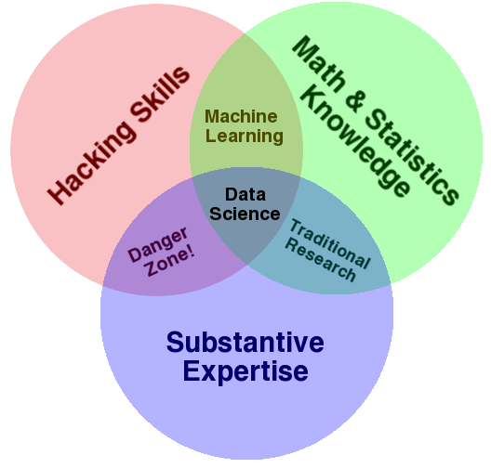
Data science

Slide 4
Python and r
zData scientists typically come from one of two backgrounds:
Computer science/programming – tend to start as python users
Statistics/Research – tend to start as R users
zR’s strengths are a much broader set of functions for traditional statistics and econometrics
zPython plays better with other systems and languages – better for production.
Projects written in R often need to be translated to C or Java for production
zBoth have machine learning / deep learning capabilities
zBoth have extensive ”base” functions and third-party libraries to extend functionality

Slide 5
Today
zIntroduction to Python – starting from the basics
zBasic operations, flow control, functions, introduction to modules, web-scraping, simple data analysis
zShort (but fast-paced), interactive ”lessons” followed by a short task for you to complete
zIn the afternoon I’ll introduce some of the more fun (and useful) applications of python – web scraping and some simple data analysis

Slide 6
Today
zWork through a series of python scripts
zI’ve uploaded them to my github, you can download from there and work along
zhttps://github.com/darrelrobinson/Intro-to-Python

Slide 7
Further resources
zAutomate the Boring Stuff – Introduction to Python:
I’ve used material from this book in this workshop
https://automatetheboringstuff.com/#toc
zWhirlwind Tour of Python – Introduction to python for those with programming experience in another language: https://jakevdp.github.io/WhirlwindTourOfPython/
zPython for Data Analysis – Introduction to data analysis with python:
http://bedford-computing.co.uk/learning/wp-content/uploads/2015/10/Python-for-Data-Analysis.pdf
zPython Data Science Handbook – slightly more advanced introduction to data analysis
https://jakevdp.github.io/PythonDataScienceHandbook/

Slide 8
Resources for R
zR for Data Science: https://r4ds.had.co.nz/ Probably the best book to learn intermediate R
zStat 545 – sligtly more advanced than R4DS: https://stat545.com/
zBut before you start either of these make sure to have done an introduction. The CRAN official introduction is a good place to start: https://cran.r-project.org/doc/manuals/r-release/R-intro.html

Slide 9
Task 1 – The basics
zUse variables to evaluate an expression
The final output should look like this:
”Adding 5 and 10 then multiplying by 10 then dividing by 7 gives 21.42857. Rounded down to the nearest whole number gives 21.”
zYou will need to create variables for 5, 10, 7, and the output of your expression
zThen you will need to combine your variables with some strings in a print() call

Slide 10
Task 1 – The basics: answer
a = 5
b = 10
c = 7
x = (a + b) * b / c
print("Adding", a, "and", b, "then multiplying by", b, "then dividing by", c, "gives", x, ". Rounded down to the nearest whole number gives", int(x), ".")
Now try with some different values of a, b, and/or c. You can see the benefit of programming. As new data comes into the system, your output can update automatically.
Order of operations
Assigning variables
Combining different variable types in a print call
Coercion to new variable type
Turn it into a program!

Slide 11
Task 1 – The basics: Solution
Turn it into a program!
print("pick an integer")
a = int(input())
print("now pick another integer")
b = int(input())
print("and one more")
c = int(input())
x = (a + b) * b / c
print("Adding", a, "and", b, "then multiplying by", b, "then dividing by", c, "gives", x, ". Rounded down to the nearest whole number gives", int(x), ".")

Slide 12
Task 2 – flow control
zWrite code that prints Hello if 1 is stored in spam, prints Howdy if 2 is stored in spam,
and prints Greetings! if anything else is stored in spam.
zWrite a short program that prints the numbers 1 to 10 using a for loop.

Slide 13
Task 2 – flow control: solution
1)
spam = 3
if spam == 1:
print("Hello")
elif spam == 2:
print("Howdy")
else:
print("Greetings!")
2)
for i in range(10):
print(i)

Slide 14
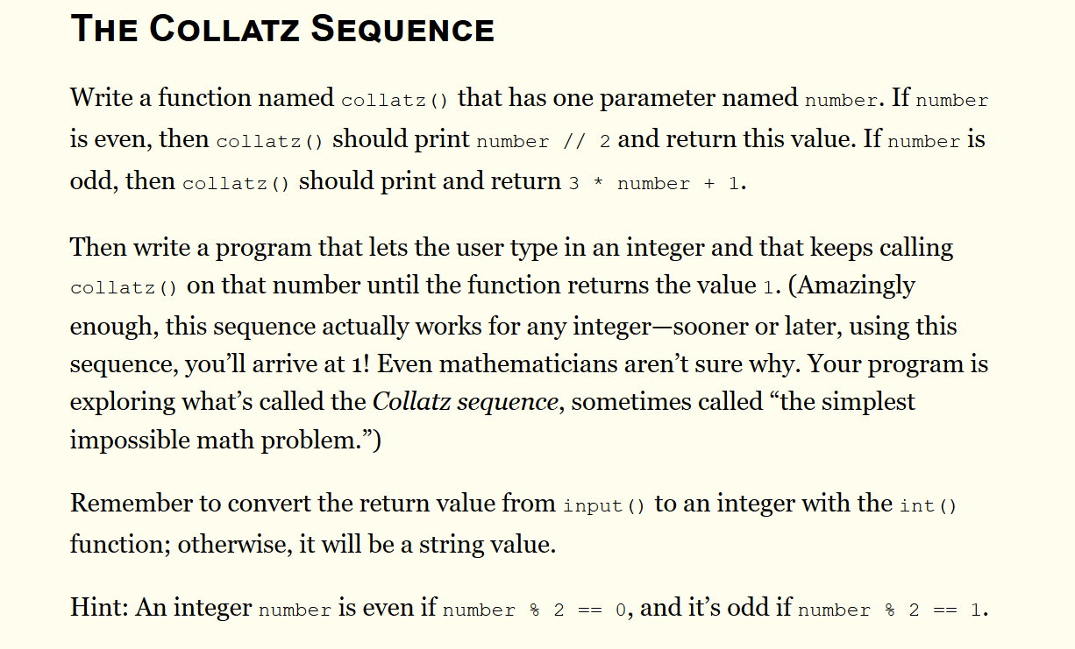
Task 3 – Functions

Slide 15
Task 3 – Functions - solution
def collatz(number):
if number % 2 == 0:
print(number // 2)
return number // 2
else:
print(number*3+1)
return(number*3+1)
print("input a number")
number = int(input())
while number != 1:
number = collatz(number)

Slide 16
Task 4 – data structures
zCreate a list with a for loop, any list. You’ll need to use the .append() method
zDo the same with a list comprehension
zUse a for loop on the birthdays dictionary to get a list of all of the keys in the dictionary
zUse a for loop on the birthdays dictionary to get a list of all of the values in the dictionary

