Slide 1

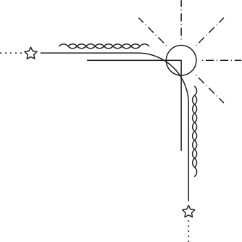
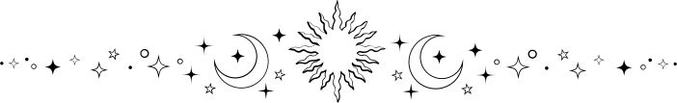
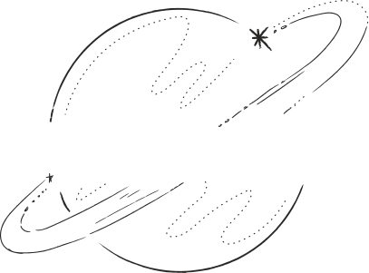


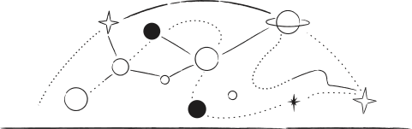





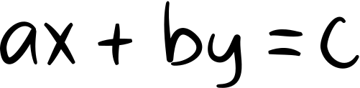
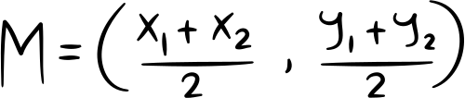
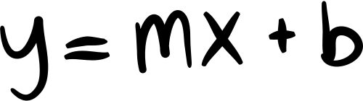



CERTIFICATE
of Completion
Shanta Das
in appreciation of the participation to the Astronomy to Academia workshop, which served as an introduction and gateway to advanced studies in the field of astronomy.
Shah M Bahauddin
Md. Abu Azad Tamim
Instructor
Coordinator
Organized By
Chittagong University Math Club
Chittagong Astronomical Society

