Slide 1
FIT VISION
AI-Based Virtual Fitness Trainer
Revolutionizing fitness with AI-powered personalized training. Real-time feedback, posture correction, and tailored workouts from the comfort of your home.

Slide 2

Addressing the Fitness Gap
High CostsInaccessibility
Personal trainers and gym memberships are often expensive and out of reach for many.
Injury Risk at Home
Lack of guidance leads to improper form, increasing the risk of injury during home workouts.
No Real-time Feedback
Current home solutions lack immediate, corrective guidance essential for effective training.

Slide 3
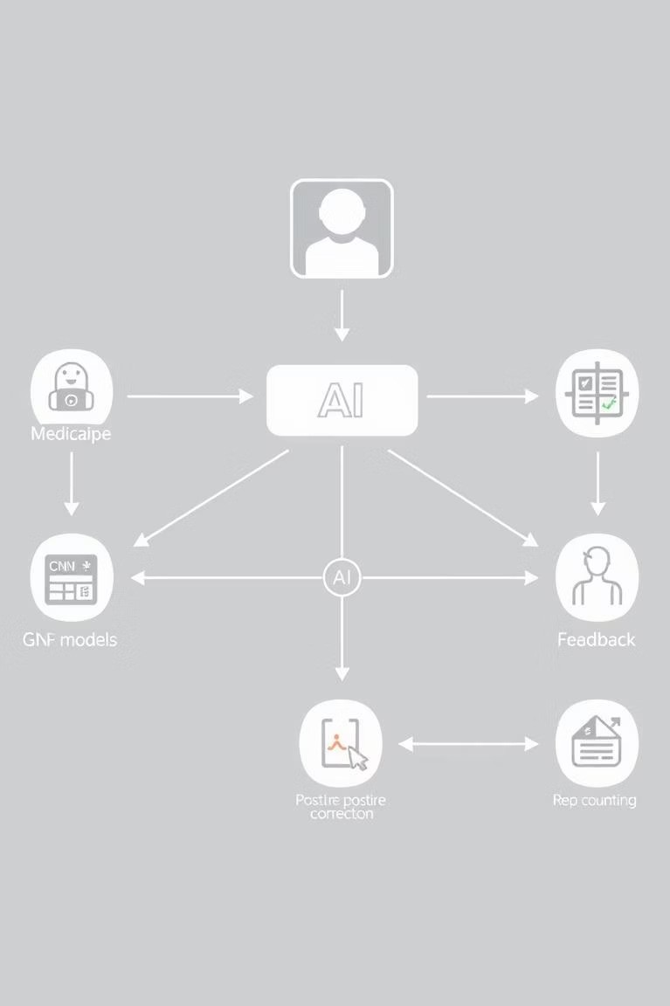
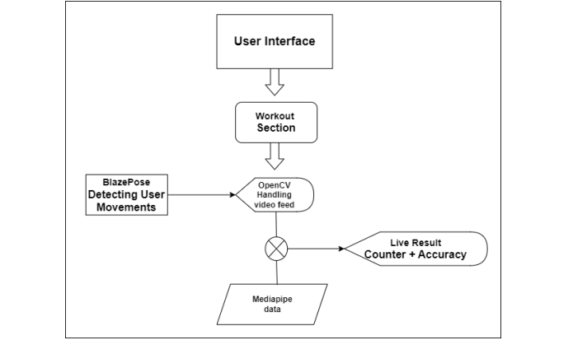
System Under the Hood
User Input
Webcam/camera captures user movements.
AI Layer
Pose detection using MediaPipe & OpenCV.
Processing
Real-time analysis with CNN models.
Output
Instant feedback, posture correction, rep counting.

Slide 4
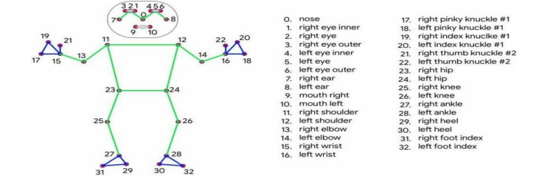
Mediapipe Blazepose’s 33 landmarks

Slide 5
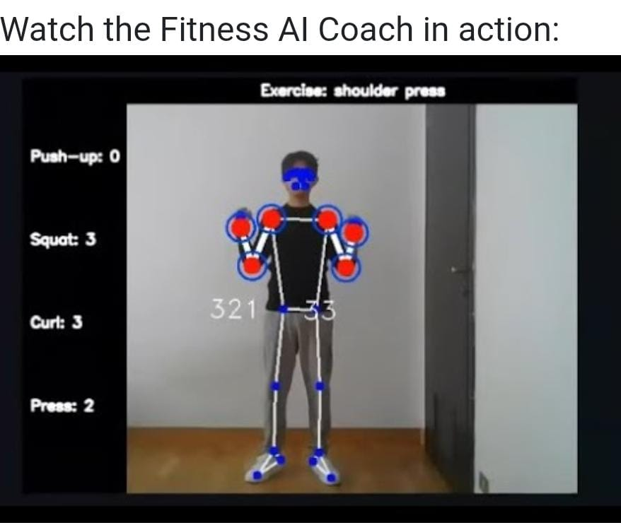
OUTPUT:

Slide 6
Powering the Platform
Frontend
Streamlit
Backend & AI
Python, MediaPipe, OpenCV
AI/ML Models
CNN for posture
Visualization
BlazePose framework

Slide 7

Future Horizons
Wearable Integration
Sync with smart fitness trackers.
AR/VR Immersion
Next-level interactive training.
Voice Assistance
Hands-free guidance and support.
Personalized workout plan
Holistic wellness solutions.

Slide 8
Empowering Fitness for All
Accessibles Affordable
Democratizing personalized fitness training.
Safer Workouts
Real-time feedback reduces injury risk.
Future-Proof Solution
Adaptable to evolving fitness needs and tech.
The AI Virtual Fitness Trainer is poised to become an indispensable tool for home fitness, enhancing motivation and ensuring safe, effective workouts for everyone.

Slide 9
REFERENCES:
https://www.jetir.org/view?paper=JETIR2204658
https://www.researchgate.net/publication/381120381_AI_Fitness_Trainer
https://ieeexplore.ieee.org/document/9824511
https://www.ijraset.com/research-paper/virtual-fitness-trainer-using-ai
https://www.internationaljournalssrg.org/IJCSE/2025/Volume12-Issue6/IJCSE-V12I6P101.pdf

Slide 10
THANK YOU

