Slide 1



KALPVRUKSH 2.0 MINI HACKATHON
Problem Statement ID – P16
Problem Statement Title –
Exposure of Personal Identity Through Routine Online Sign-Ups
Domain – Cybersecurity
Team ID – T049
Team Name – Cryptic_Vruksh
Project: TraceMask
A different you for every website —
and proof of who leaked it.

Slide 2







TRACEMASK: IDENTITY FIREWALL FOR ONLINE SIGN-UPS
Proposed Solution (Describe your Idea/Solution/Prototype)
TraceMask is a local-first web app that gives every sign-up its own real, deliverable email alias, checks each website live before any data is shared, automatically proves which company leaked or sold your identity, and turns that proof into a PDF evidence report and a DPDP/GDPR erasure request.
Detailed explanation of the proposed solution
How it addresses the problem
Innovation and uniqueness of the solution
1 SCAN before sign-up
Live risk score (0–100) from TLS, domain age (RDAP), breach history (HIBP), trackers, privacy policy and DMARC.
P16 pain point | TraceMask answer
A real address is a persistent identifier | Unique alias per site, so companies have nothing to link across services
Users can't tell who leaked or sold the address | Automatic leak attribution with authenticated-sender proof
Unsubscribe stops mail but keeps the data | Evidence-backed erasure request with 30-day follow-up
Fake data breaks account recovery | Aliases are real: resets always arrive (T2 never auto-blocked)
Many identities are hard to manage | Created in one click and all tracked in one dashboard
Sites deserve different trust | Tier T0–T3 from live risk score + purpose of sign-up
Leak attribution, not just aliasing
Names the leaking company within seconds, with signed-sender proof.
Risk-aware identity
Live scan + purpose decide the tier: burner, tracked, protected or real.
2 MASK with one alias per site
Real, deliverable alias (you+site-x7k2p@…) with a trust tier T0 Burner, T1 Tracked, T2 Protected or T3 Real.
Evidence-grade output
SHA-256 hashed headers, chain of custody, DPDP-referenced PDF.
Private by design
Runs on 127.0.0.1, zero third-party packages, encrypted vault.
3 TRACE leaks automatically
IMAP IDLE reads only headers; any sender other than that site is a leak, proven by SPF/DKIM/DMARC.
Capability | Alias services* | TraceMask
Automatic leak attribution | Manual | Yes
Pre-sign-up risk scan | No | Yes
Evidence PDF + erasure letter | No | Yes
4 ACT on the evidence
Auto-quarantine, SHA-256 evidence PDF and a one-click erasure letter under DPDP Act 2023 / GDPR.
*Firefox Relay, SimpleLogin, DuckDuckGo, addy.io (see ref. 12)

Slide 3
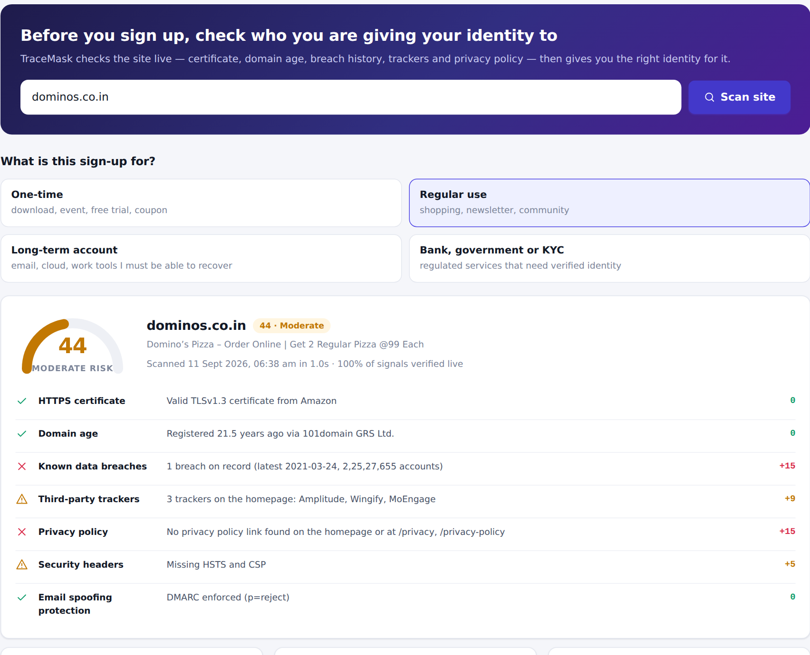







TECHNICAL APPROACH
Technologies to be used (e.g. programming languages, frameworks, hardware)
Methodology and process for implementation (Flow Charts/Images/ working prototype)
TraceMask server · 127.0.0.1
Node.js 24 (JavaScript)
Zero third-party npm packages
Site scanner + SSRF guard
Public sources
DNS · TLS · RDAP · HIBP · web
node:sqlite
Local database, WAL mode
Alias & trust-tier engine
Browser
Single-page app
strict CSP
API
Your mailbox
Gmail IMAP · TLS 993
Vanilla JS single-page app
Strict CSP, responsive UI
IMAP sync + leak engine
IMAP4rev1 + IDLE over TLS
Own client, headers only
PDF reports · erasure letters
Working prototype: live scan of dominos.co.in on the team laptop (score 44/100)
scrypt + AES-256-GCM
Encrypted local vault
Vault (AES-256-GCM) · SQLite
Local disk
data/ folder, encrypted secrets
RDAP · HIBP · Disconnect · PSL
Live public data sources
1. Scan site
2. Pick tier
3. Create alias
4. Sync
5. Attribute
6. Act
PDF 1.7 writer (own)
Compliance-grade reports
live risk score
purpose + risk
one per site
IMAP IDLE ~2 s
leak / lookalike
quarantine · PDF
Any laptop · Win / macOS / Linux
Runs on 127.0.0.1, Rs 0 cost
Verified end-to-end: real IMAP sync, leak attribution, quarantine (MOVE) and real-time IDLE alert tested; four compliance PDF reports generated from real records.

Slide 4



FEASIBILITY AND VIABILITY
24 / 24
web-attack security checks passed (OWASP-based probe)
~2 s
from a leaked email arriving to the alert (IMAP IDLE)
1–2 s
per live site scan on the team laptop (3 real sites)
0
third-party packages · Rs 0 running cost · no cloud server
Analysis of the feasibility of the idea
Potential challenges and risks → Strategies for overcoming these challenges
Challenge / risk | Strategy
Spammers can strip the +tag from Gmail aliases | Catch-all domain mode gives fully separate addresses
Sites block automated scans (HTTP 403) | Signal marked "unverified" and scored as risk, never as safe
Companies mail from other domains (false leaks) | "Lookalike" review + one-click "same company" trust list
Gmail needs an app password | Guided onboarding, TLS-only, password encrypted with AES-256
DPDP duties on companies start 13 May 2027 | Letters cite the Act + own policy today; GDPR where applicable
Local app could itself be attacked | SSRF guard, CSRF/DNS-rebinding checks, 24-check security probe
Already built and running — about 4,400 lines in 36 files, installed on the team laptop.
Uses free, public data — RDAP, Have I Been Pwned, Disconnect list, DNS and TLS.
Works with any IMAP mailbox — Gmail, Zoho or your own domain; no API approval needed.
No hosting cost — everything runs locally on 127.0.0.1.
Honest scoring — checks a site refuses are marked unverified and add risk.

Slide 5








IMPACT AND BENEFITS
Potential impact on the target audience
Benefits of the solution (social, economic, environmental, etc.)
Students & job seekers
Sign up to dozens of portals; keep the inbox clean
Online shoppers
Stop sales spam and phishing from sold data
Social
Economic
Everyday users regain control of who holds their identity
Evidence lets people exercise DPDP rights, not just complain
Free, open and local: no subscription, no cloud bill
Less phishing and fraud exposure from leaked addresses
Professionals
Keep work identity out of breach lists
Communities & SMEs
Evidence to hold vendors accountable
Environmental
Legal & regulatory
Runs on the laptop you already own; no servers or data centre
Reads headers only: minimal data processed and stored
Supports DPDP s.8(6), 11, 12, 13 and GDPR Art. 17
Pushes companies towards accountable data handling
Without TraceMask
One address shared everywhere, no idea who leaked it
With TraceMask
One alias per site, leaker named in seconds, with proof

Slide 6


RESEARCH AND REFERENCES
Details / Links of the reference and research work
Key research findings
# | Reference | Link
1 | Problem Statement P16 dossier (SPEC-P16-187E4A5F4) | Kalpvruksh 2.0 organisers
2 | Digital Personal Data Protection Act, 2023 | meity.gov.in (official PDF)
3 | DPDP Rules, 2025 notified (13 Nov 2025) | static.pib.gov.in
4 | DPDP phased implementation timeline | sansalegal.com
5 | GDPR Article 17: right to erasure | gdpr-info.eu/art-17-gdpr
6 | RFC 3501 IMAP4rev1 / RFC 2177 IMAP IDLE | rfc-editor.org/rfc/rfc3501
7 | RFC 8601 Authentication-Results (SPF, DKIM, DMARC) | rfc-editor.org/rfc/rfc8601
8 | RDAP domain registration data (RFC 9083) | rdap.org
9 | Have I Been Pwned API v3: breach catalogue | haveibeenpwned.com/API/v3
10 | Disconnect tracking-protection list | github.com/disconnectme
11 | OWASP Top 10 (2021) web application risks | owasp.org/Top10
12 | Email alias services compared (Relay, SimpleLogin, DDG…) | github.com/fynks
The gap we fill
Alias services exist, but none detects breaches automatically; users must map aliases to sites by hand (ref. 12). TraceMask automates that attribution.
DPDP roll-out (refs. 2–4): why now
13 Nov 2025
Data Protection Board set up
13 Nov 2026
Consent managers begin
13 May 2027
Duties incl. erasure apply
Prototype validation (11 Sep 2026)
Real scans of canva.com, dominos.co.in, myntra.com and github.com matched HIBP and RDAP records
24/24 OWASP-based security checks passed after fixing 6 findings
~2 s from a leaked email arriving to the leak alert (IMAP IDLE)

