Slide 1
LAB1
IDE

Slide 2
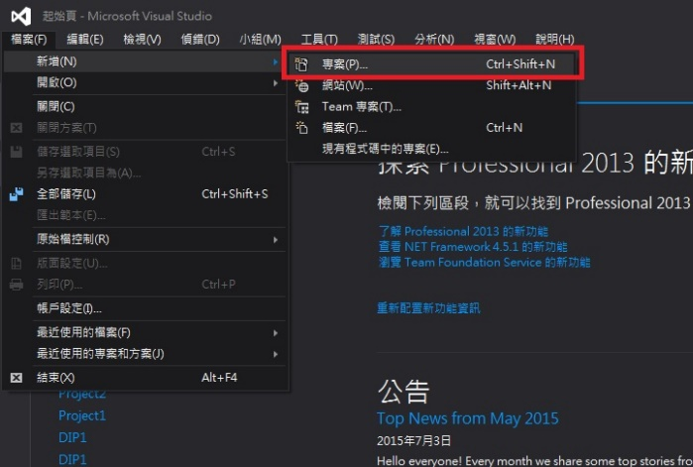
VC(1/5)

Slide 3
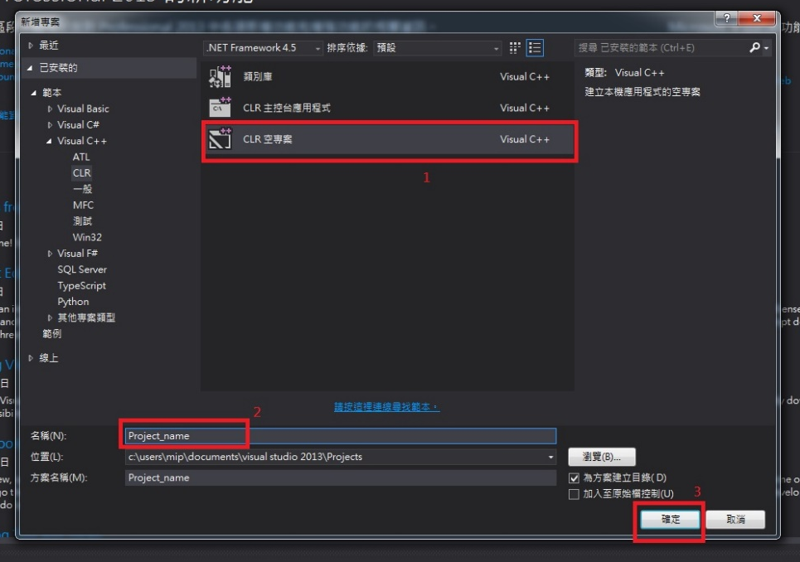
VC(2/5)

Slide 4
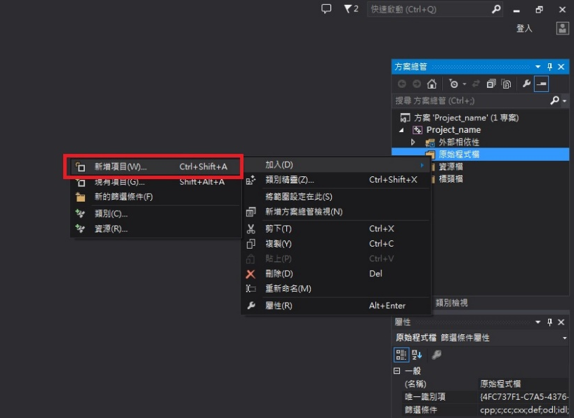
VC(3/5)

Slide 5
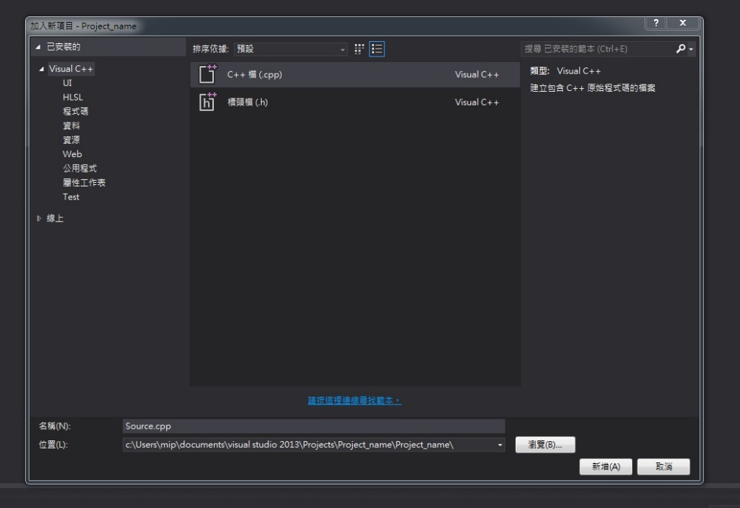
VC(4/5)
1
2
3

Slide 6
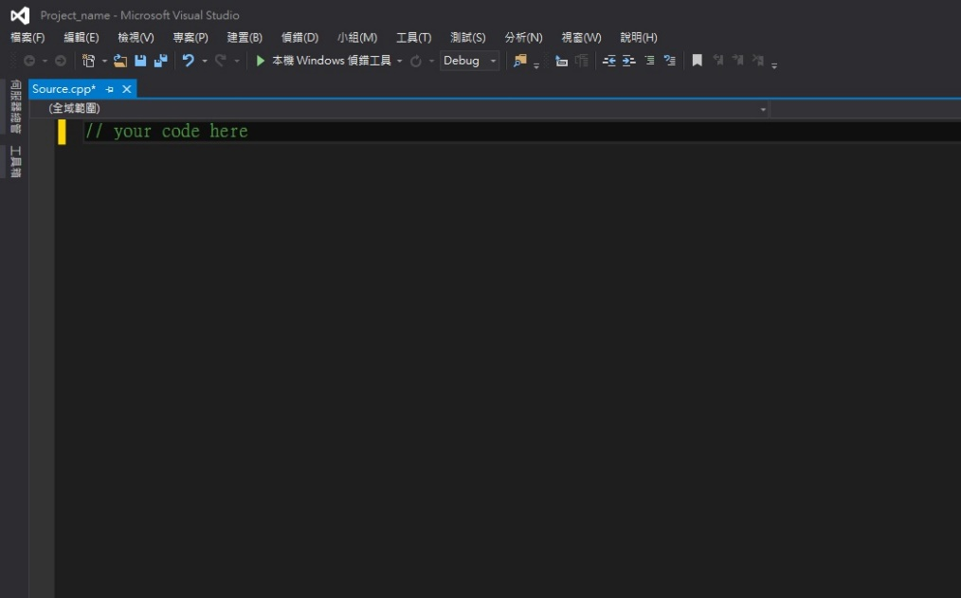
VC(5/5)
2. After you finish the code, press ’F11’ or push the following button.

Slide 7
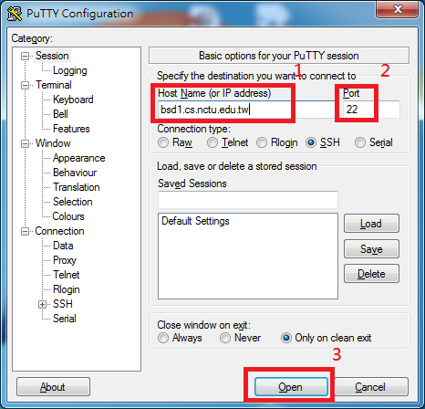
G++/Clang(1/6)

Slide 8
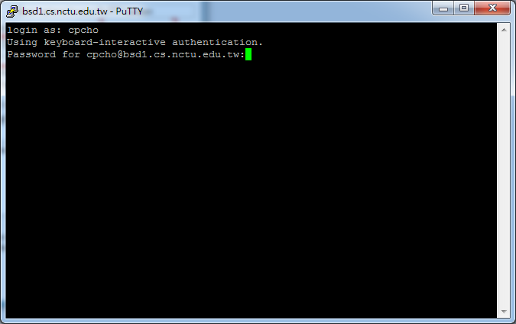
G++/Clang(2/6)

Slide 9
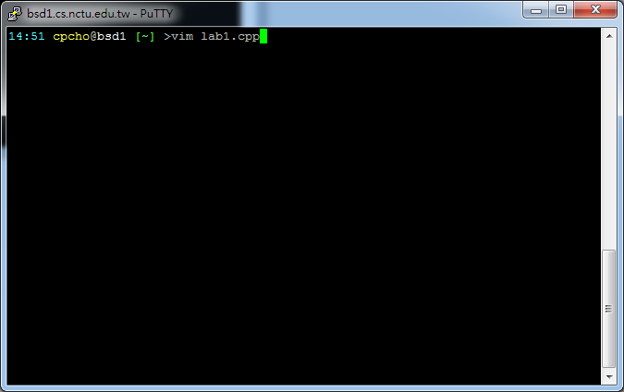
G++/Clang(3/6)

Slide 10
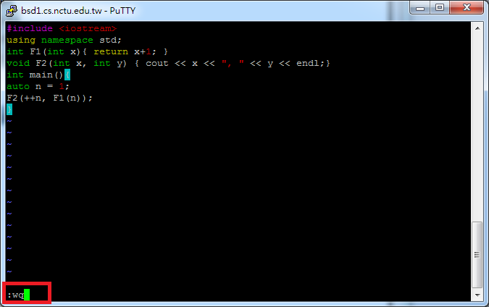
G++/Clang(4/6)
1. Press “i” to edit
2. After you finish the code, press ’esc’ and then key “:wq” to save file.

Slide 11
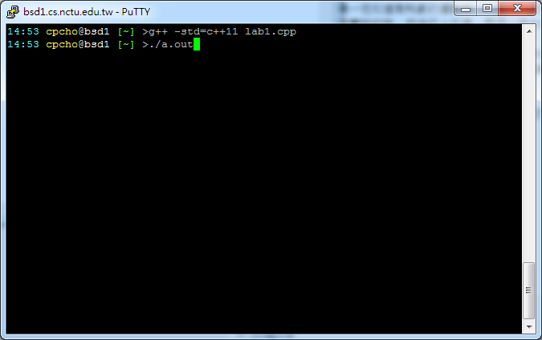
G++/Clang(5/6)
G++:

Slide 12
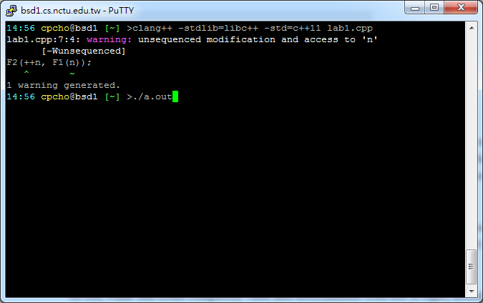
G++/Clang(6/6)
Clang:

