Slide 1

Book Recommendation System
PRESENTED BY ASHHAD QUADRI
1

Slide 2
Agenda
CHALLENGE SUMMARY
3
FUNTIONAL & NON FUNCTIONAL REQUIREMENTS
4-5
TECHNICAL DESIGNS
6-11
TESTING STRATEGY
12
SCALABILITY & IMPROVEMENTS
13-14
FUTURE SCOPE
15
2

Slide 3
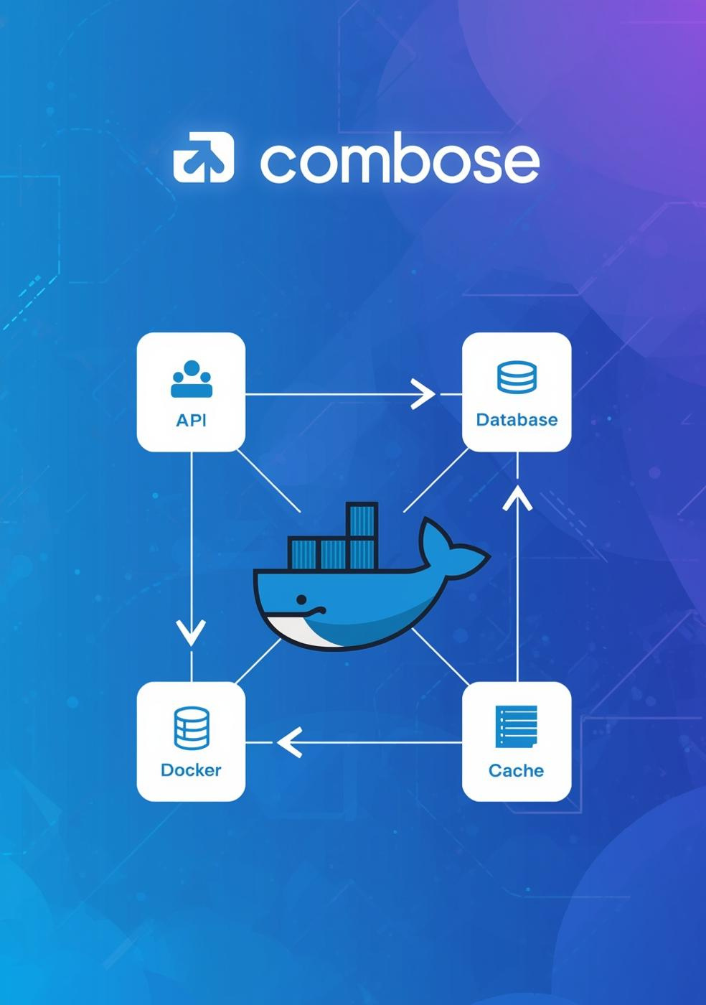
Challenge
Build a secure, scalable backend API for a book recommendation service.
Tech Stack Used
FastAPI (Async)
PostgreSQL & SQLite
SQLAlchemy & Alembic
Celery & Redis
Docker & Pytest
3

Slide 4
Functional Requirements
Authentication: User login with JWT, secure all book endpoints.
Book Listing: List/search books (title, author), show average rating, support pagination.
Reviews & Ratings: Add/update ratings (1–5) & text reviews, fetch reviews per book, update average dynamically.
Data Management: Seed books from JSON/API, store ratings in DB (SQLite/Postgres), support migrations.
API & Validation: RESTful endpoints, Pydantic models, input validation.
Testing: Unit tests for services, mock repositories/APIs.
4

Slide 5
Non-Functional Requirements
Scalability: Support async endpoints, background tasks.
Performance: Fast API responses, caching (if needed).
Security: Environment-based config, no secrets in code.
Maintainability: Layered architecture, clean modular structure.
Portability: Cross-platform via Docker, SQLite/Postgres options.
Testability: Dependency injection, mockable layers.
Reliability: Database migrations with Alembic.
5

Slide 6
Software Design Principles Applied
Single Responsibility Principle (SRP) → Each module handles one concern (API, services, CRUD).
Open/Closed Principle (OCP) → Easily extend (e.g., switch SQLite → Postgres) without changing core logic.
Dependency Inversion Principle (DIP) → Services depend on abstractions, not implementations (DI in FastAPI).
Separation of Concerns → API layer, business logic, and data access are isolated.
DRY (Don’t Repeat Yourself) → Reusable schemas, utilities, and repository methods.
KISS (Keep It Simple, Stupid) → Minimal, clear design avoiding over-engineering.
6

Slide 7
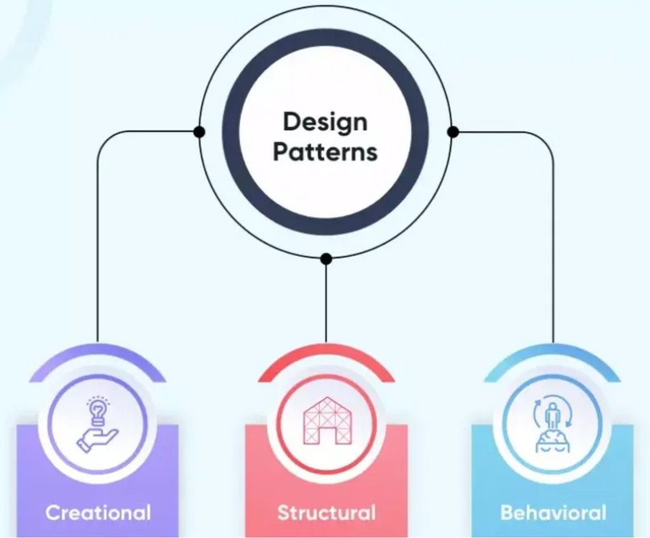
Design Patterns Applied
Layered Architecture → API → Service → Repository → Database.
Repository Pattern → CRUD layer abstracts DB operations.
Dependency Injection → FastAPI’s DI system for easy testing & flexibility.
Factory Pattern (implicit in FastAPI) → Dependency providers create DB sessions/services.
Schema Pattern → Pydantic models for request/response validation.
Decorator Pattern → Route decorators (@app.get, @app.post) and auth dependencies wrap extra behavior (auth, validation) without changing core logic.
7

Slide 8
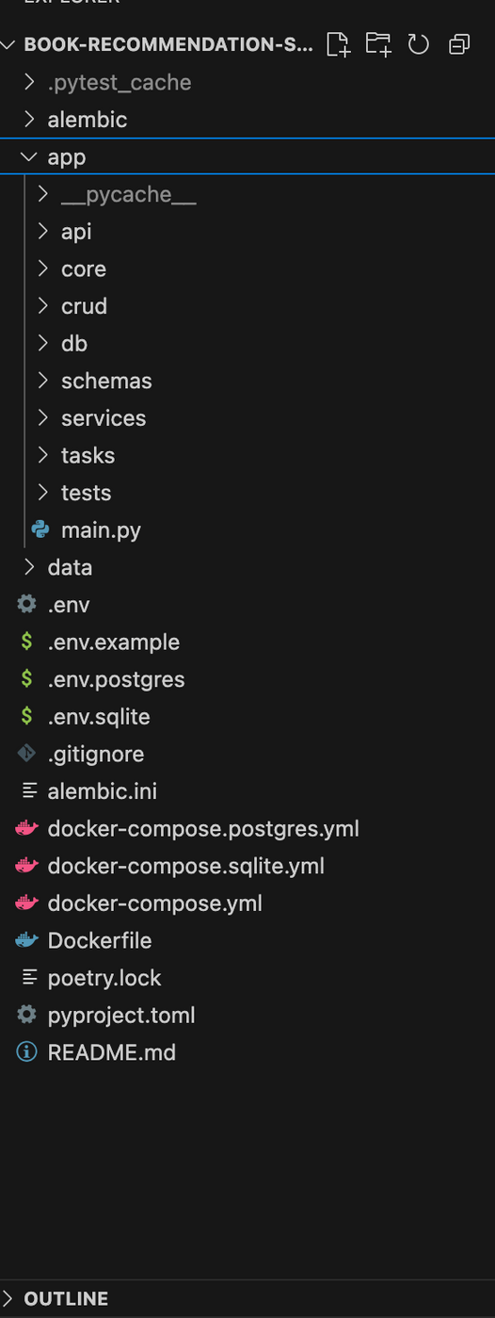
Project Structure
APP/API: API LAYER (ROUTES)
APP/CORE: CONFIGURATION AND SECURITY
APP/SERVICES: BUSINESS LOGIC
APP/CRUD: REPOSITORY LAYER (SQLALCHEMY QUERIES)
APP/SCHEMAS: PYDANTIC MODELS
APP/DB: DATABASE SESSION & MIGRATIONS
APP/TASKS: BACKGROUND JOBS
APP/TESTS: TEST CASES
DATA: MOCK DATA (JSON)
ALEMBIC: MIGRATION FILE
8

Slide 9
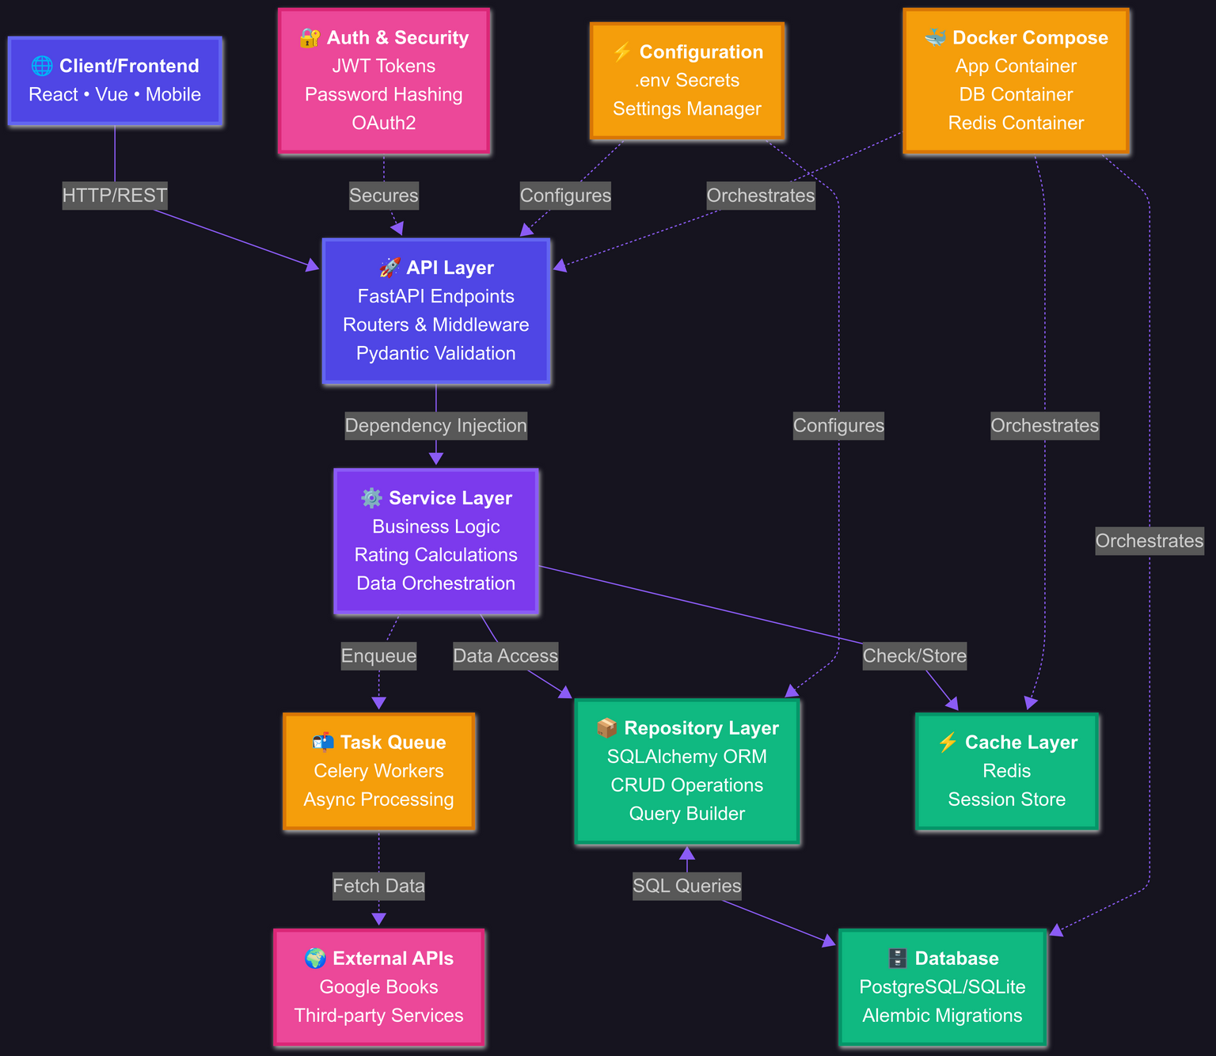
High Level Design
9

Slide 10
Database Schema Design
Book Table
id (PK), title, author, genre (required)
google_books_id, isbn, description, page_count, thumbnail_url (optional)
Indexed on: title, author, google_books_id
Review Table
id (PK), rating (1-5), review_text, book_id (FK), user_id
created_at, updated_at timestamps
Unique constraint: (user_id, book_id) - one review per user per book
Relationships: Book 1←→N Reviews
User Authentication
In-memory user store with hashed passwords
JWT token-based authentication
10

Slide 11
API Low-Level Design
GOOGLE BOOKS INTEGRATION
GET /GOOGLE-BOOKS/SEARCH - SEARCH EXTERNAL API
GET /GOOGLE-BOOKS/{ID} - GET BOOK DETAILS
POST /GOOGLE-BOOKS/IMPORT - IMPORT BOOK TO LOCAL DB
BACKGROUND TASKS
POST /TASKS/REFRESH-BOOKS - REFRESH FROM SEED DATA
POST /TASKS/REFRESH-GOOGLE-BOOKS - REFRESH FROM GOOGLE API
POST /TASKS/CALCULATE-STATISTICS - CALCULATE METRICS
POST /TASKS/NOTIFY-NEW-BOOK - SEND NOTIFICATIONS
GET /TASKS/STATUS/{ID} - CHECK TASK STATUS
GET /TASKS/ACTIVE-TASKS - MONITOR ACTIVE TASKS
AUTHENTICATION
POST /AUTH/LOGIN - JWT TOKEN GENERATION
BOOKS MANAGEMENT
GET /BOOKS/ - LIST BOOKS WITH SEARCH/PAGINATION
POST /BOOKS/{ID}/REVIEWS - ADD/UPDATE REVIEW
GET /BOOKS/{ID}/REVIEWS - GET ALL REVIEWS FOR BOOK
DELETE /BOOKS/{ID}/REVIEWS - DELETE USER'S REVIEW
GET /BOOKS/{ID}/REVIEWS/ME - GET CURRENT USER'S REVIEW
11

Slide 12
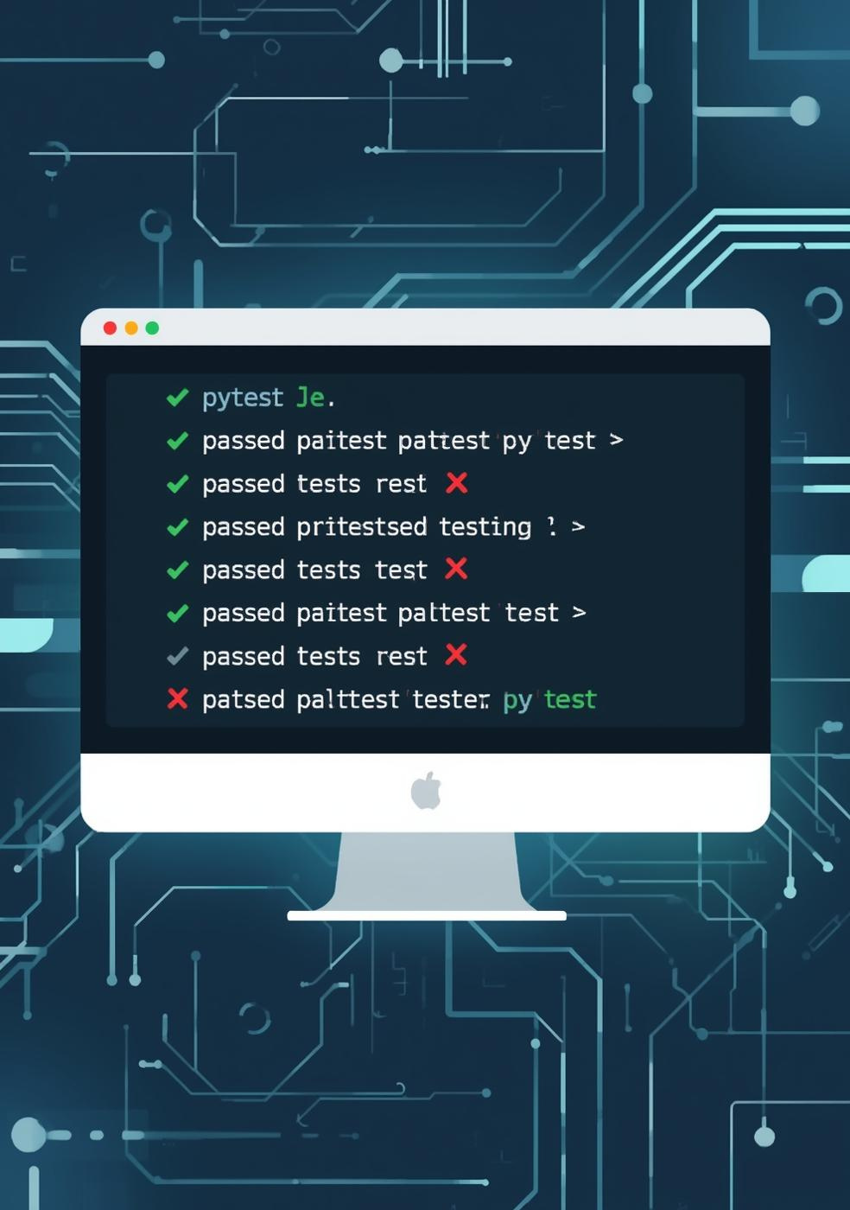
Testing Strategy
Framework & Tools
pytest + pytest-asyncio for async testing
unittest.mock for dependency mocking
AsyncMock for async function mocking
Testing Approach
Unit Testing: Service layer business logic
Mocking Strategy: Repository layer & external APIs
Test Data: Fixtures for consistent book/review data
Key Test Cases
✅ Average rating calculations
✅ Review creation & updates
✅ Multiple users per book
✅ Empty review handling
12

Slide 13
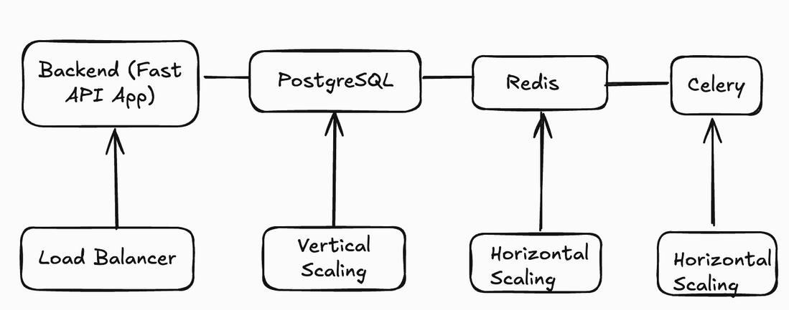
Scalability
Multi-Environment Support
PostgreSQL: Production (scalable, persistent)
SQLite: Development (lightweight, fast)
Redis: Celery broker & result backend
Maintainability
Environment Configs: Separate files for different setups
Health Checks: Database & Redis connectivity
Dependency Management: Clear service dependencies
Volume Persistence: Database data survives container restarts
Deployment Flexibility
Single Command: docker-compose up
Multi-Container: Isolated services
Production Ready: Health checks, proper service ordering
13

Slide 14
Scaling Improvements
DATABASE
READ REPLICAS FOR READ-HEAVY LOADS
CONNECTION POOLING WITH PGBOUNCER
DATABASE INDEXING FOR SEARCH PERFORMANCE
APPLICATION
HORIZONTAL SCALING WITH KUBERNETES
API RATE LIMITING
REDIS CACHING FOR FREQUENT QUERIES
ARCHITECTURE
MICROSERVICES: SPLIT AUTH, BOOKS, REVIEWS
CDN FOR BOOK COVERS AND STATIC ASSETS
ELASTICSEARCH FOR ADVANCED BOOK SEARCH
PERFORMANCE
MONITORING WITH PROMETHEUS + GRAFANA
14

Slide 15
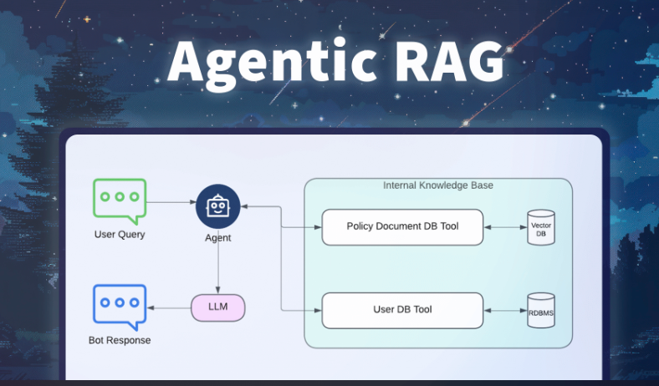
Future Scope
AI & Machine Learning
Personalized Recommendations: Collaborative filtering + content-based
Review Sentiment Analysis: Auto-detect positive/negative reviews
Book Similarity Engine: Find similar books using embeddings
15

Slide 16

Thank You
QUESTIONS?
16

