Slide 1
Robust data mining for medicine
Prediction of Chemotherapy Induced Amenorrhea and Menses Recovery for Breast Cancer
Ruoyi Gan
Supervisor: Long Song

Slide 2
Background
The most prevalent cancer among women is breast cancer
Chemotherapy is a common treatment
Possible side-effect: early menopause
Patients interested in their risk of early menopause after treatment
This project focuses on:
risk of the chemotherapy-induced amenorrhea (CIA) incidence
the likelihood of menstrual resumption
Notes:
one of the most common treatments that often used normally to stage II patients. An it is used in addition to other treatments, such as surgery, radiation or hormone therapy as well
early menopause: cardiovascular disease, neurologic disease, osteoporosis, psychosexual dysfunction, and mood disorder
benefit doctors in educating their patients on what to expect during therapy and the potential long-term consequences and help the patient construct a more carefully considered and satisfied treatment plan

Slide 3
Cox ph regression
Notes:
Before we start the explanation of the actual analysing progress, I would like to first introduce the Cox Proportional Hazard model, which is the statistical model that I used in this project.

Slide 4
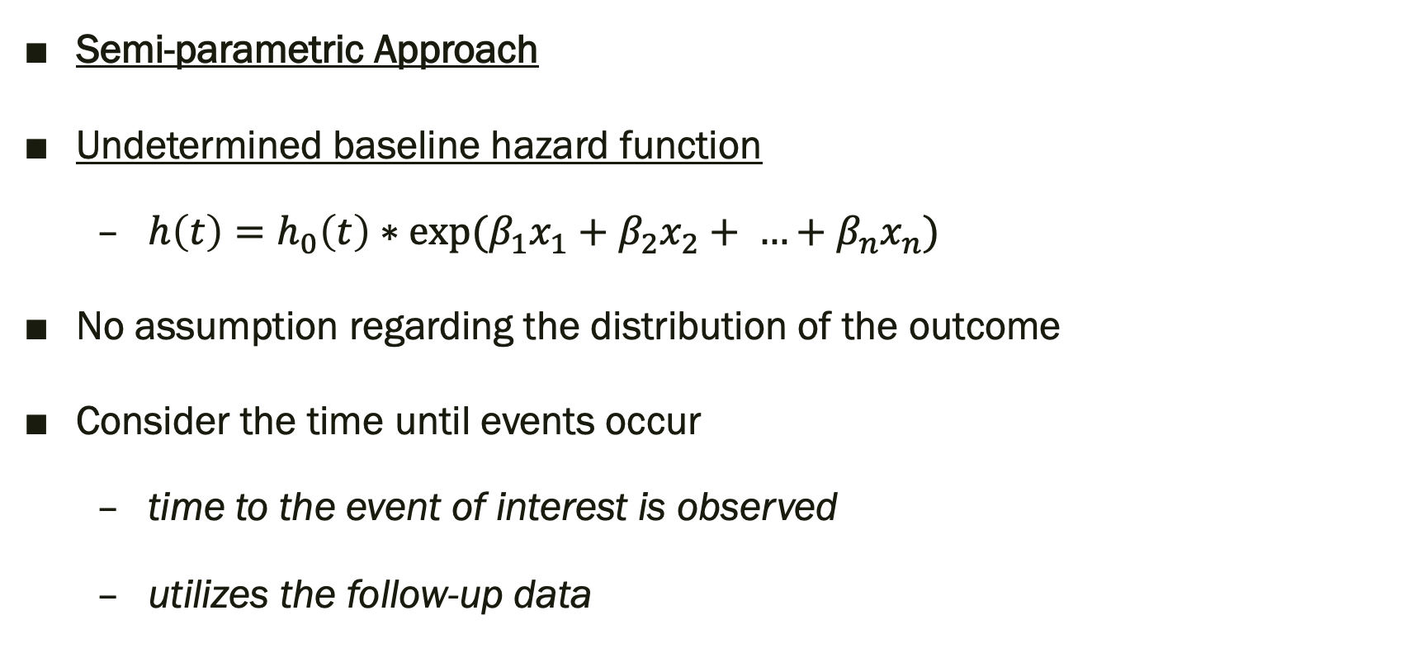
Why Cox proportional hazards model?
Semi-parametric Approach
Undetermined baseline hazard function
$h\left(t\right)=h_{0}\left(t\right)∗exp⁡(β_{1}x_{1}+β_{2}x_{2}+ …+β_{n}x_{n})$
No assumption regarding the distribution of the outcome
Consider the time until events occur
time to the event of interest is observed
utilizes the follow-up data
Notes:
First of all, the cox regression model is a semi-parametric approach because of the undetermined baseline hazard function, which is a non-parametric characteristic. And a finite set of parameters, similar to the logistic regression, which is therefore the parametric part.
time to the event of interest is observed over varying lengths of time.
No assumption on the distribution of the outcome – more flexible

Slide 5
Overview

Slide 6
Overview
Data exploration
Data pre-processing
Missing value imputation (features)
Pattern-matching validation (outcomes)
Model fitting
Part I: Risk of chemotherapy-induced amenorrhea (CIA)
Part II: Menses recovery after CIA
Conclusion and future work

Slide 7
DATA Exploration

Slide 8
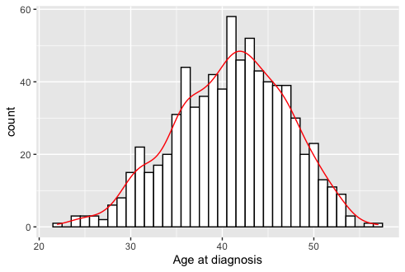
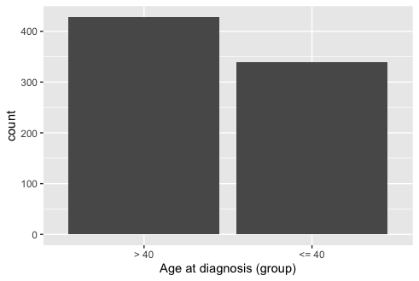
Age at diagnosis
Notes:
Mos patients around 40 years old
Split by 40 creates approximately the same sub-group sample size

Slide 9
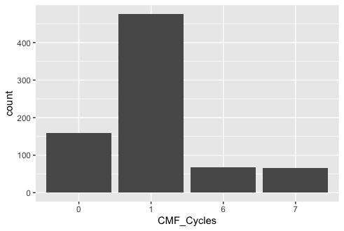
CMF cycles
Notes:
Most patients received 1 cycle of chemotherapy
0 indicates that no CMF

Slide 10
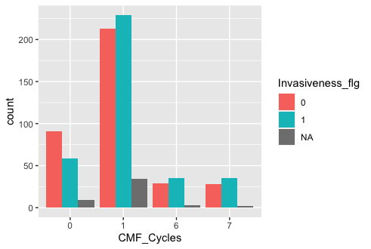
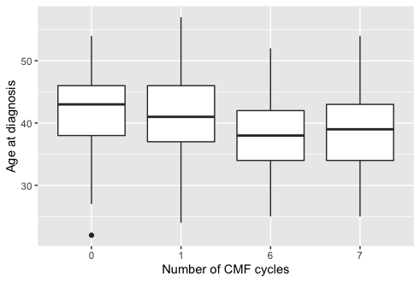
CMF cycles
Notes:
Intuitively, CMF cycles should be correlated to the risk of amenorrhea, since it is about the duration and possibly the amount of damage caused to the patient
Therefore, we can explore its relationship with other variables.
Left: amount patients that receive different duration of CMF with and without invasive cancer are approximately the same
Right: older patients tends to receive less cycles of CMF

Slide 11
Data cleaning and pre-processing

Slide 12
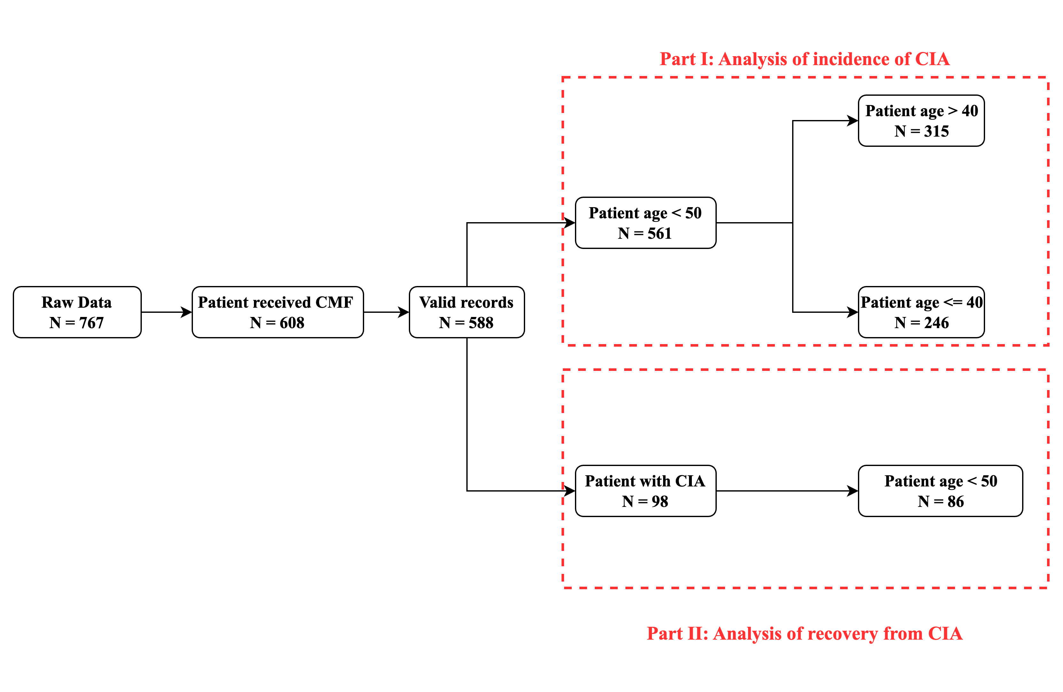
Pre-processing pipeline
Removed data:
⓵ Did not receive CMF
(N=159)
⓶ More than 50% Menstrual record missing for the first two years
(N = 20)
⓷
⓵
⓶
⓸
⓹

Slide 13
Pre-processing pipeline
Removed data:
⓷ Patient age > 50 (N = 27)
⓸ Patient without CIA (N = 490)
⓹ Patient age > 50 (N = 12)
⓷
⓵
⓶
⓸
⓹

Slide 14
Outcome validation
Shrinking the follow-up records list:
[0, 0, 1, 1, 1, 1, 1, 1] to [0, 1]
[1, 1, 0, 0, 0, 1, 1, 1] to [1, 0, 1]
Valid patterns:
[0] and [1]
[0, 1] and [1, 0]
[0, 1, 0] and [1, 0, 1]
[0, 1, 0, 1] and [1, 0, 1, 0]
Identify invalid record:
Amenorrheic status should not change too frequently
Different status of last two records
Notes:
If too frequent, more likely to have record/reporting mistake, or too uncertain for the study to be feasible.

Slide 15
Outcome correction
Use two variables that both record the menstrual status of the patient to fix the unmatched record
menstrual status: [0, 0, 1, 1, 1]
amenorrheic status: [1, 1, 0, 0, 0]
Matched
Notes:
If the two records do not match, then the amenorrheic status should be replaced by the menstrual status information.
For every missing value in amenorrheic status, the corresponding observation of menstrual status will be checked.
If the latter one is non-missing, then the amenorrheic status will be fixed by the menstrual status.
If both are missing, then they will be replaced by the previous value.
After iterating through the integer list, if the first record (at the third month) is missing, it should be replaced by the value of the second record

Slide 16
Outcome correction
Amenorrheic status after one year will be neglected
generally, occurs within one years from chemotherapy
Status was originally recorded for the 3rd, 6th and 12th months
status at the ninth month was added using menstrual status
Ensure data consistency
Notes:
Since amenorrhea generally occurs within two years from chemotherapy,

Slide 17
Feature selection
Remove variables that is:
redundant,
irrelevant,
and variables with all identical values
Remaining variables:
Age at diagnosis
Cancer invasive (Boolean)
ER Status
CMF cycles
Notes:
Redundant:
Variable Age and Age diagnosis are identical to each other, there the variable Age was excluded. The Agediag category was a grouping of Age diagnosis but with overlap- ping intervals (both 0 and 1 can contain patients aged 40), thus was excluded. Variables CMF, CT flg and CMF Cycles provide similar meanings. CMF and CT flg are identical to each other. A non-zero value of CMF Cycles indicates receiving CMF and a missing value of CMF Cycles means did not receive CMF. Therefore, CMF and CT flg can be excluded. Variable Nodal Status and ER Status are identical to each other for every observation, thus Nodal Status was excluded from the data set. Variable Invasiveness flg and Tumor Size are identical to each other, Tumor Size was excluded from the data set
Irrelevant:
ID, Data track, Prg1 age and Preg PostCA
identical values:
Neoadj CT, AC, AC+CMF, AC+T and Taxel are 0

Slide 18
Missing value imputation
Complete case analysis:
discard all observations with missing value
Smaller sample size
Missing value imputation:
Predict missing value
Maintain as much sample as possible
Variable name | Percentage of missingness
Age at diagnosis | 0 %
Cancer invasiveness | 6.414 %
ER Status | 13.980 %
CMF Cycles | 0 %
Notes:
Many research used the complete case analysis, which is to simply ignore all the cases with missing value, resulting in a redunction of the sample size
In this research, I decided to use the missing value imputation method instead of complete case analysis, since the sample size is already small (N = 588) after pre-processing
The imputation method will predict the missing value by the other non-missing observations.
This can maintain as much sample as possible

Slide 19
Imputation methods
Multivariate Imputation by Chained Equations (MICE)
based on Fully Conditional Specification
each incomplete variable is imputed by a separate model
K-Nearest Neighbours Algorithm (k-NN)
Finding the samples in the training set “closest” to the missing value
averaging these nearby points to fill in the value
Notes:
There were two candidate imputation methods, one is the MICE and the other is the k-NN
MICE: different feature imputed independently, create multiple imputed data set (50) and then fit a model on the merged complete data set
k-NN: rather a simpler method, if numeric (countinuous), replace by the mean of the nearby points, if categorical, replace by mode

Slide 20
Comparison of imputations
Imputation method | Average concordance | MICE method | Allowed no. of missingness
MICE | 0.7008 | CART | 2
MICE | 0.7021 | CART | 1
MICE | 0.6755 | CART | 0
MICE | 0.7008 | PolyReg | 2
MICE | 0.7020 | PolyReg | 1
MICE | 0.6770 | PolyReg | 0
MICE | 0.7008 | RF | 2
MICE | 0.7038 | RF | 1
MICE | 0.6989 | RF | 0
K-NN | 0.7006 | - | 2
*Note:
CART: Classification and regression tree
PolyReg: Polynomial regression
RF: Random forest
Notes:
To select the imputation method, we performed experiments and compares the resulting concordance of the model corresponds to the imputed data set.
The concordance is similar to AUC, which has a range from 0 to 1. Higher concordance indicates that the model is better.
Since there will be 3 sub-part of the analysis, the quality of the imputation is therefore assessed by the average of the concordance of the three models
The best one is the MICE with random forest, the allowed no. of missingness means that if there is no missing or one missing value in one observation, then this observation will be used in the imputation, and if there is more than one missing values, then this particular record will be discard

Slide 21
Model Fitting Part I
Risk of chemotherapy-induced amenorrhea (CIA)

Slide 22
Risk of CIA Patients older than 40 years old
Variable | Coefficient | exp(coef) | se(coef) | Pr(>|z|)
Age_diagnosis | 0.1439 | 1.1548 | 0.0076 | <0.001
Invasiveness_flg1 | 0.4732 | 1.6052 | 0.0487 | <0.001
ER_Status1 | 0.5601 | 1.7509 | 0.0529 | <0.001
CMF_Cycles6 | 2.9075 | 18.3108 | 0.0879 | <0.001
CMF_Cycles7 | 2.4294 | 11.3521 | 0.1375 | <0.001
Invasiveness_flg1*CMF_Cycles6 | -0.9312 | 0.3941 | 0.0995 | <0.001
Invasiveness_flg1*CMF_Cycles7 | -1.1621 | 0.3128 | 0.1354 | <0.001
ER_Status1*CMf_Cycles6 | -1.3036 | 0.2716 | 0.1070 | <0.001
ER_Status1*CMF_Cycles7 | -1.3752 | 0.2528 | 0.1371 | <0.001
Notes:
Using this complete version of the imputed data set, the cox regression model was fitted.
notice that we split the patients into two groups, age over 40 and below 40. This criteria was used because that the physical condition for younger and older women are different. Many other research also made use of this sub-setting method, for example, an analysis done by Lee and his collegues in Korea (Chemotherapy-related amenorrhea in premenopausal women with breast cancer)
With the group of older than 40, the significant predictors and their corresponding coefficient estimates are presented in this table

Slide 23
Risk of CIA Patients older than 40 years old
Variables that increase on the hazard ratio:
Age_diagnosis,
Invasiveness_flg
ER_Status1
CMF_Cycles6
CMF_Cycles7
Variables that decrease the hazard ratio:
Invasiveness_flg : CMF_Cycles
ER_Status : CMF_Cycles

Slide 24
Risk of CIA Patients younger than 40 years old
Variable | Coefficient | exp(coef) | se(coef) | Pr(>|z|)
Age_diagnosis | -0.0093 | 0.9908 | 0.0068 | 0.173
Invasiveness_flg1 | 0.9643 | 2.6229 | 0.0701 | <0.001
ER_Status1 | 0.8097 | 2.2473 | 0.0562 | <0.001
CMF_Cycles6 | 1.8661 | 6.4628 | 0.0843 | <0.001
CMF_Cycles7 | 0.9579 | 2.6062 | 0.1013 | <0.001
Invasiveness_flg1*CMF_Cycles6 | -2.3235 | 0.0979 | 0.1296 | <0.001
Invasiveness_flg1*CMF_Cycles7 | -2.1326 | 0.1185 | 0.1777 | <0.001
Notes:
For the group of younger patient, the significant variables are similar to those for the older patient, except that the interaction term between ER status and CMF cycles

Slide 25
Risk of CIA Patients younger than 40 years old
Variables that increase on the hazard ratio:
Invasiveness_flg
ER_Status1
CMF_Cycles6
CMF_Cycles7
Variables that decrease the hazard ratio:
Age_diagnosis,
Invasiveness_flg:CMF_Cycles

Slide 26
Coefficient estimates interpretation
All the interaction terms will decrease the hazard ratio of developing CIA
But cannot vanish the positive effect introduced by the first-order main effects
Sub-group analysis is essential:
Opposite sign of Age_diagnosis
Baseline hazards are lower for the younger group
Timestamp | 3 | 6 | 9 | 12
> 40 | 0.0232 | 0.0479 | 0.0722 | 0.0791
<= 40 | 0.0105 | 0.0217 | 0.0325 | 0.0363
Notes:
patients aged equal to or below 40 years old have lower baseline hazards than the group above 40 years old, more specifically, the baseline hazard of developing CIA for the former group of patients is approximately half that of the latter group at all timestamps (at 3， 6， 9， 12 months).
This result demonstrates the importance of sub-setting patients by age at diagnosis, and further suggest that when discussing the possible risks and side effects of chemotherapy for cancer with a patient, it is important to treat patients separately according to their age.
40 years could be an informed cut-off point. Moreover, since the average baseline hazards for older patients are higher than the younger patients, the treatment duration and strength should be considered more carefully in order to minimise the influence of the potential side effects.

Slide 27
Model Fitting Part II
Menses recovery

Slide 28
Menses recovery All patients
Variable | Coefficient | exp(coef) | se(coef) | Pr(>|z|)
Age_diagnosis | -0.0527 | 0.9487 | 0.0031 | <0.001
Amen_time | -0.2320 | 0.7930 | 0.0078 | <0.001
Fewer explanatory variable selected
Both have a negative impact on recovery of menstrual functionality
Notes:
In contrast to the analysis of the incidence of CIA, there were fewer predictors selected. Only 2 selected predictors in the model of this section, which were Age_diagnosis and Amen_time (the month of CIA occurred after CMF regimen).
Both predictors have a negative coefficient estimate which illustrates the negative effect on the likelihood of menstrual resumption.
For every 1-year increase in patient's age at diagnosis, the hazard (event) ratio of menses recovery is decreased by 0.9487. On the other hand, for every 1-monthl increase in the lasting time of CIA, the event ratio of menses recovery is decreased by 0.7930.

Slide 29
Menses recovery Baseline likelihood
As time increase, the baseline likelihood of recovery increases
recovery requires a longer time
Significant increase from 18th month to 21st month
Most patients will recovery within 18 months of CMF regimen
Timestamp | 6 | 9 | 15 | 18 | 21 | 24
Baseline likelihood | 0.1526 | 0.2157 | 0.3005 | 0.4259 | 0.6462 | 0.6756
Timestamp | 27 | 30 | 33 | 42 | 60
Baseline likelihood | 0.7055 | 0.7358 | 0.8017 | 0.7055 | 0.8381
Notes:
since the recovery time recorded and input into the model was recorded from the time chemotherapy began and the most patient experienced CIA within one year of CMF began, therefore it is reasonable that the baseline likelihood of menses recovery is low before the 15th month as there was overlap of Amen_time and Recovery_time.
After the 15th month, there is a significant increase of the baseline hazard from the 18th month to 21th month, potentially advises that most patients will be more likely to have their menses recovered after 18 months of CMF regimen.

Slide 30
Conclusion
Results summary and future directions

Slide 31
Importance of missing data imputation
Minimize the disadvantages of small data set
higher probability of producing false-positive results
the chance of excluding important predictors
MICE with RF imputation is the best method for this data set

Slide 32
Risk of CIA
Divided the patients into two groups by their age at cancer diagnosis
Above and below 40 years old
baseline hazards and variable coefficients prove the importance of sub-groups
Significant variables:
Age, ER status, invasive cancer, CMF cycles
Interaction terms:
invasive cancer and CMF cycles,
ER status and CMF cycles (older group only)
Both models for the two groups achieved concordance ~ 0.7

Slide 33
Menses Recovery
Significant variables:
patient's age at diagnosis
the timestamp that CIA occurs
Both variables imply negative effect on the likelihood of menses recovery
Limited sample size (N = 86)
May excluded important variable
Model concordance ~ 0.7

Slide 34
Future directions
Perform analysis with data of larger sample size.
Perform data collection that obtains a more comprehensive record of the patients
Experimenting more missing data imputation method.
Validates the model on external data set.
Notes:
Perform analysis with data of larger sample size. This could decrease the probability of excluding important predictors and the probability to producing false-positive result.
Perform data collection that obtains a more comprehensive record of the patient's physical characteristics, medical history and measure patient's hormone levels at follow-ups.
Experimenting more missing data imputation method. Pre-select methods based on the preliminary knowledge on the type of missing data. For example, missing completely at random (MCAR), missing at random (MAR), missing not at random (MNAR), and structurally missing. Different types of missing data may require different approaches.
Validates the model on external data set. The model always have the probability of over-fitting to a particular data set, therefore, it is important to examine the model performance with unobserved data to the model.

Slide 35
REference

Slide 36
Reference
Azur, M. J., Stuart, E. A., Frangakis, C., & Leaf, P. J. (2011). Multiple imputation by chained equations: What is it and how does it work? International Journal of Methods in Psychiatric Research, 20(1), 40–49. https://doi.org/10.1002/mpr.329
Bines, J., Oleske, D. M., & Cobleigh, M. A. (1996). Ovarian function in premenopausal women treated with adjuvant chemotherapy for breast cancer. J. Clin. Oncol., 14(5), 1718–1729.
Brand, J. P. L. (1999). Development, implementation and evaluation of multiple imputation strategies for the statistical analysis of incomplete data sets. Erasmus Universiteit Rotterdam.
Cancer Australia. (2013). Breast cancer and early menopause — a guide for younger women (3rd ed.). Cancer Australia.
Chen, D., Liu, S., Kingsbury, P., Sohn, S., Storlie, C. B., Habermann, E. B., Naessens, J. M., Larson, D. W., & Liu, H. (2019). Deep learning and alternative learning strategies for retrospective real-world clinical data. NPJ Digit. Med., 2(1), 43.
Cox, D. R. (1972). Regression Models and Life-Tables. Journal of the Royal Statistical Society. Series B (Methodological), 34(2), 187–220. http://www.jstor.org/stable/2985181
Early Breast Cancer Trialists’ Collaborative Group (EBCTCG), Peto, R., Davies, C., Godwin, J., Gray, R., Pan, H. C., Clarke, M., Cutter, D., Darby, S., McGale, P.,

Slide 37
Reference
Taylor, C., Wang, Y. C., Bergh, J., Di Leo, A., Albain, K., Swain, S., Piccart, M., & Pritchard, K. (2012). Comparisons between different polychemotherapy regimens for early breast cancer: meta-analyses of long-term outcome among 100,000 women in 123 randomised trials. Lancet, 379(9814), 432–444.
Fornier, M. N., Modi, S., Panageas, K. S., Norton, L., & Hudis, C. (2005). Incidence of chemotherapy-induced, long-term amenorrhea in patients with breast carcinoma age 40 years and younger after adjuvant anthracycline and taxane. Cancer, 104(8), 1575–1579.
Gadducci, A., Cosio, S., & Genazzani, A. R. (2007). Ovarian function and childbearing issues in breast cancer survivors. Gynecological Endocrinology, 23(11), 625–631.
Global Burden of Disease Collaborative Network. (2021). Global burden of disease study 2019 (GBD 2019) Reference life table. In GHDx. Institute for Health Metrics. https://ghdx.healthdata.org/record/ihme-data/global-burden-disease-study-2019-gbd-2019-reference-life-table
Graham, J. W., Olchowski, A. E., & Gilreath, T. D. (2007). How many imputations are really needed? Some practical clarifications of multiple imputation theory. Prev. Sci., 8(3), 206–213.

Slide 38
Reference
Hackshaw, A. (2008). Small studies: Strengths and Limitations. European Respiratory Journal, 32(5), 1141–1143. https://doi.org/10.1183/09031936.00136408
Harlow, S. D., & Ephross, S. A. (1995). Epidemiology of menstruation and its relevance to women’s health. Epidemiol. Rev., 17(2), 265–286.
Harlow, S. D., & Zeger, S. L. (1991). An application of longitudinal methods to the analysis of menstrual diary data. J. Clin. Epidemiol., 44(10), 1015–1025.
Harrell, F. E. (1982). Evaluating the yield of medical tests. JAMA, 247(18), 2543–2546.
Hashim, D., & Weiderpass, E. (2019). Cancer Survival and Survivorship. In P. Boffetta & P. Hainaut (Eds.), Encyclopedia of Cancer (Third Edition) (Third Edition, pp. 250–259). Academic Press. https://doi.org/https://doi.org/10.1016/B978-0-12-801238-3.65102-4
Heymans, M. (2022). psfmi: Prediction Model Pooling, Selection and Performance Evaluation Across Multiply Imputed Datasets. https://mwheymans.github.io/psfmi/
Jeon, S. J., Lee, J. I., Jeon, M. J., & Lee, M. (2016). Prognostic effects of adjuvant chemotherapy-induced amenorrhea and subsequent resumption of menstruation for premenopausal breast cancer patients. Medicine (Baltimore), 95(14), e3301.

Slide 39
Reference
Kuhn, M., & Johnson, K. (2019). Applied predictive modeling. Springer.
Kuhn, M., & Wickham, H. (n.d.). Impute via K-Nearest Neighbors - step_impute_knn. In Impute via k-nearest neighbors. https://recipes.tidymodels.org/reference/step_impute_knn.html#ref-usage
Lee, S., Kil, W. J., Chun, M., Jung, Y.-S., Kang, S. Y., Kang, S.-H., & Oh, Y.-T. (2009). Chemotherapy-related amenorrhea in premenopausal women with breast cancer. Menopause, 16(1), 98–103.
Liem, G. S., Mo, F. K. F., Pang, E., Suen, J. J. S., Tang, N. L. S., Lee, K. M., Yip, C. H. W., Tam, W. H., Ng, R., Koh, J., Yip, C. C. H., Kong, G. W. S., & Yeo, W. (2015). Chemotherapy-related amenorrhea and menopause in young Chinese breast cancer patients: Analysis on incidence, risk factors and serum hormone profiles. PLoS One, 10(10), e0140842.
Mera-Gaona, M., Neumann, U., Vargas-Canas, R., & López, D. M. (2021). Evaluating the impact of multivariate imputation by mice in feature selection. PLOS ONE, 16(7). https://doi.org/10.1371/journal.pone.0254720

Slide 40
Reference
Park, I. H., Han, H. S., Lee, H., Lee, K. S., Kang, H. S., Lee, S., Kim, S. W., Jung, S., & Ro, J. (2012). Resumption or persistence of menstruation after cytotoxic chemotherapy is a prognostic factor for poor disease-free survival in premenopausal patients with early breast cancer. Ann. Oncol., 23(9), 2283–2289.
Partridge, A., Gelber, S., Gelber, R. D., Castiglione-Gertsch, M., Goldhirsch, A., & Winer, E. (2007a). Age of menopause among women who remain premenopausal following treatment for early breast cancer: long-term results from International Breast Cancer Study Group Trials V and VI. Eur. J. Cancer, 43(11), 1646–1653.
Partridge, A., Gelber, S., Gelber, R. D., Castiglione-Gertsch, M., Goldhirsch, A., & Winer, E. (2007b). Age of menopause among women who remain premenopausal following treatment for early breast cancer: Long-term results from International Breast Cancer Study Group Trials V and VI. European Journal of Cancer, 43(11), 1646–1653. https://doi.org/10.1016/j.ejca.2007.04.006
Partridge, A. H., Gelber, S., Peppercorn, J., Sampson, E., Knudsen, K., Laufer, M., Rosenberg, R., Przypyszny, M., Rein, A., Winer, E. P., & et al. (2004). Web-based survey of fertility issues in young women with breast cancer. Journal of Clinical Oncology, 22(20), 4174–4183. https://doi.org/10.1200/jco.2004.01.159

Slide 41
Reference
Parulekar, W. R., Day, A. G., Ottaway, J. A., Shepherd, L. E., Trudeau, M. E., Bramwell, V., Levine, M., Pritchard, K. I., & National Cancer Institute of Canada Clinical Trials Group. (2005). Incidence and prognostic impact of amenorrhea during adjuvant therapy in high-risk premenopausal breast cancer: analysis of a National Cancer Institute of Canada Clinical Trials Group Study–NCIC CTG MA.5. J. Clin. Oncol., 23(25), 6002–6008.
Raghunathan, T. E., Solenberger, P. W., & Van Hoewyk, J. (2002). IVEware: Imputation and variance estimation software. Ann Arbor, MI: Survey Methodology Program, Survey Research Center, Institute for Social Research, University of Michigan.
Rosenberg, S. M., & Partridge, A. H. (2013). Premature menopause in young breast cancer: effects on quality of life and treatment interventions. J. Thorac. Dis., 5 Suppl 1, S55-61.
Schafer, J. L., & Graham, J. W. (2002). Missing data: Our view of the state of the art. Psychological Methods, 7(2), 147–177. https://doi.org/10.1037/1082-989x.7.2.147

