Slide 1







Current and Future technologies trends with demographics of respondents from sales data
Ayushi Sahu
12/16/2022

Slide 2



OUTLINE
Executive Summary
Introduction
Methodology
Results
Visualization – Charts
Dashboard
Discussion
Findings & Implications
Conclusion
Appendix

Slide 3

EXECUTIVE SUMMARY
Company’s information:
Global IT and business consulting services firm
- Expertise in IT solutions and consultants
Company’s Motive:
Analyzes data to help identify future skill requirements.
Company’s Vision:
To keep pace with changing technologies and remain competitive

Slide 4

INTRODUCTION
Includes the comparison between future and current technology
Intended to potential employees
Learning objectives:
Understand the current popular Languages and Databases
Understand the future demand for Languages and Databases
Qualification for hiring

Slide 5

METHODOLOGY
Project goal:
Collect data from job postings, training portals and surveys.
Analyze the data and identify trends.
Find current and future trends in top programming languages, top database skills and popular IDEs.
Visualize analysis using IBM Cognos Analytics and create dashboard to present the data.

Slide 6
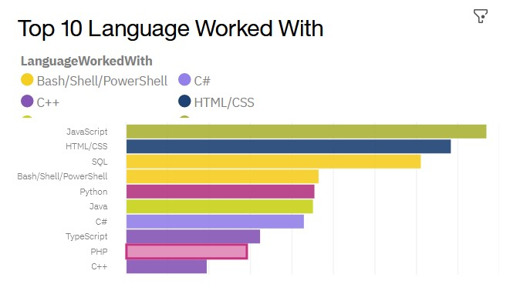
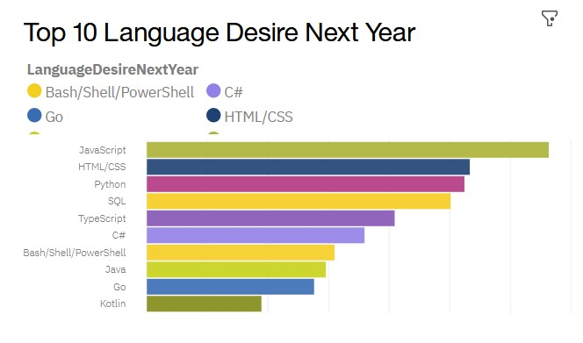
PROGRAMMING LANGUAGE TRENDS
Current Year
Next Year

Slide 7
PROGRAMMING LANGUAGE TRENDS - FINDINGS & IMPLICATIONS
Findings
The top 10 languages worked with we can find that PHP and C++ programming languages have been replaced from the top 10 languages desires next year.
Another noticeable difference we can find is the position of Bash/Shell/PowerShell programming language which was earlier in 4th position it dropped to 7th position.
We can see clearly that more people desire to learn Python programming language in next year as compared to current trends.
Implications
PHP and C++ will be replaced in future by Go and Kortin programming languages.
TypeScript and Python language will become more popular in future.
Fall in desires of Bash/Shell/PowerShell programming language.

Slide 8
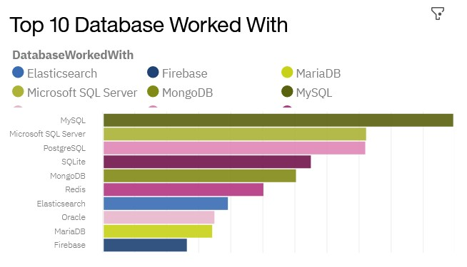
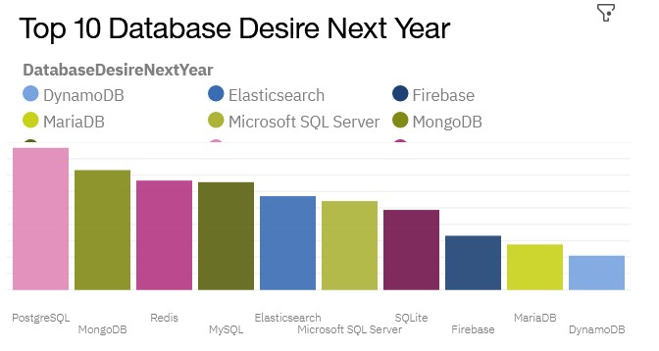
DATABASE TRENDS
Current Year
Next Year

Slide 9
DATABASE TRENDS - FINDINGS & IMPLICATIONS
Findings
MySql and Microsoft SQL Server database had huge fall from the top positions of current trends to 4th and 6th position of future trends.
Another visible difference we can find is that Oracle database has been eliminated from the top 10 future trends which is also astonishing, there’s DynamoDB that is introduced in future trends that indicates the desires for learning new databases.
Microsoft SQL Server and SQlite databases had same number of people working with it in current trends but in future trends SQlite has decreased as compared to Microsoft SQL Server database.
Implications
PostgreSQL will become the leading database in future followed by MongoDB.
Firebase and Elasticsearch will experience and increase in future trends with DynamoDB, ditching the Oracle database from top 10 future trends.

Slide 10

DASHBOARD
https://dataplatform.cloud.ibm.com/dashboards/a9dbf7bd-d1e6-43bb-a0d6-9e97eaff3ebf/view/6000e73e0e95029653f3dce4079f78042c36760eb2bbd50a828d7b490d667397a93a1a92c82b1d5ad8475137f6eb475ecb

Slide 11
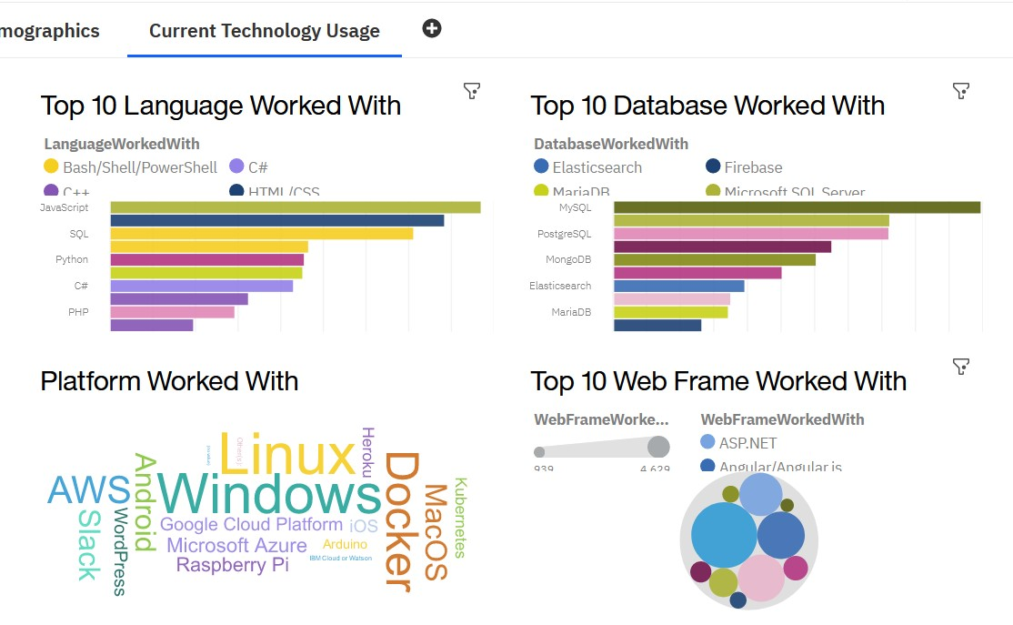
DASHBOARD TAB 1

Slide 12
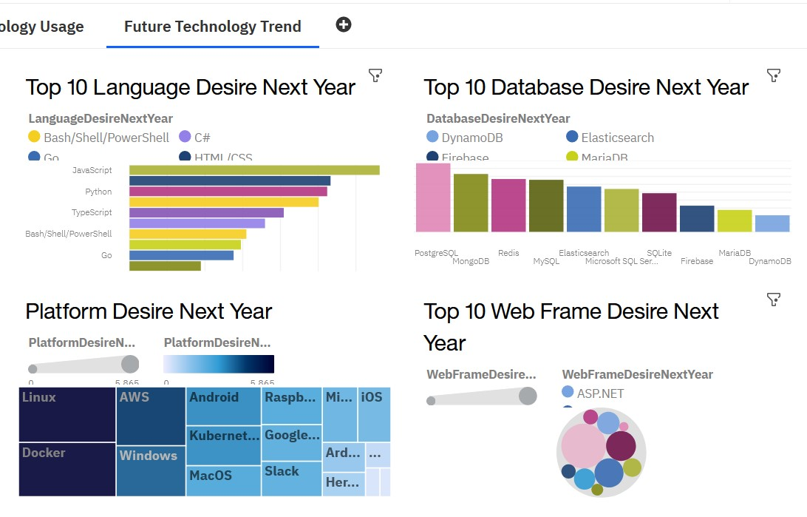
DASHBOARD TAB 2

Slide 13
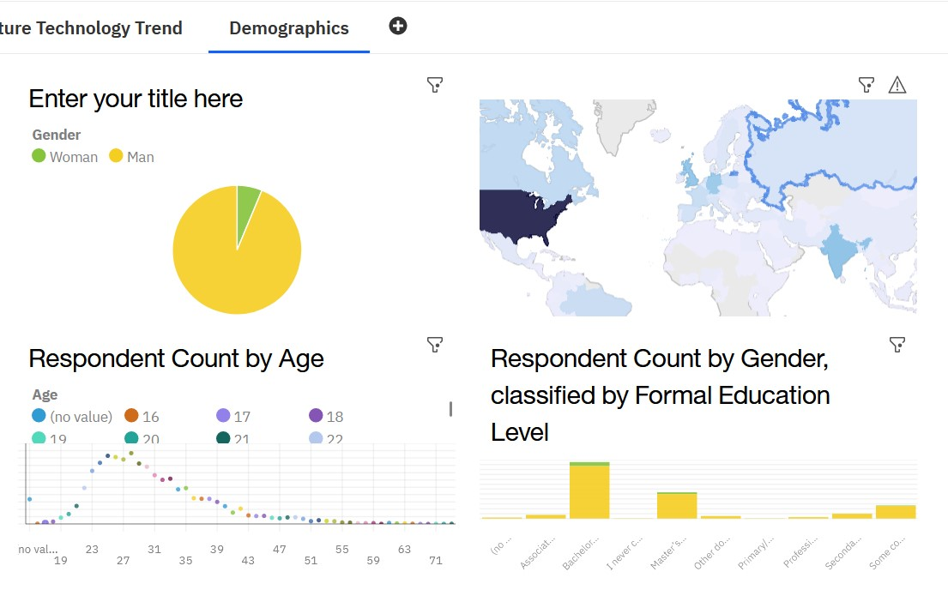
DASHBOARD TAB 3

Slide 14
OVERALL FINDINGS & IMPLICATIONS
Findings
From Asia region we can find that India has the top number of respondents.
From Europe, we find 2 countries Germany and UK have comparable members of respondents.
Age 23-33 have the maximum number of respondents.
Implications
Younger individuals are more engaging in learning new technologies, as it’s the prime age for finding jobs and gaining experience.
US is the top country for respondents which is also the top country for immigration for job opportunities and thus it has higher hiring opportunities.

Slide 15

CONCLUSION
Top languages in future:
JavaScript, HTML, and Python
Top Databases in future:
PostgreSQL, MongoDB, and Redis
Top Platforms in future:
Linux, Docker, and AWS
Top Data frames in Future:
React, Angular, and Vue.
Age group that are more explorative in technologies: 23 - 33 years.

