Slide 1
Network Security Assignment
Group 32 Members :-
IIT2018156 Kartik Nema
IIT2018163 Bhupendra
IIT2018172 Prakhar Srivastava
IIT2018175 Ashish Patel
IIT2018177 Shubham Soni

Slide 2
Theory :- Compare and contrast the nature of certificates in PGP and S/MIME. Explain the web of trust made from certificates in PGP and in S/MIME. (8)
Practical:- Create a simple mail server using S/MIME. (3)

Slide 3
A public key certificate is digitally signed from one identity which confirms that the public key of another entity has a certain value. Public key refers to the value associated with an identity, which is known to everyone.
Pretty Good Privacy (PGP) uses the X.509 certificates and PGP certificates
S/MIME uses the X.509V3

Slide 4
Protocols that use X.509 certificates depend on the hierarchical structure of trust. Hierarchical structure here implies that there is a single path from fully trusted authority to any certificate. All X.509 certificates have the following data :-
(i) Version
(ii) Serial number:
(ii) Algorithm information (signature algorithm)
(iv) Issuer’s unique name
(v) Subject Public Key Information: It has 2 fields
The value of the public key owned by the subject.
Algorithm identifier :- Specifies the algorithm with which public key is used. It specifies both the public-key algorithm and hashing algorithm.
(vi) Validity period of the certificate – start/end date and time

Slide 5
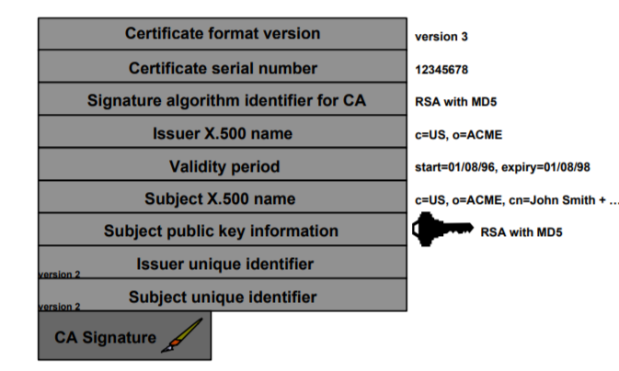
Structure of X.509 certificate
(source : http://ftp.gnome.org/mirror/archive/ftp.sunet.se/pub/security/docs/PCA/misc/Entrust/x509v3.pdf)

Slide 6
PGP certificates
In PGP there is no need for CAs, i.e. anyone in the ring can sign a certificate for anyone else in the ring. So there can be multiple paths from fully or partially trusted authorities to any subject. The mechanism of PGP is based upon
Introducer Trust
Certificate Trust
Legitimacy of the public keys
S/MIME
X.509V3
X.509V3 introduces a mechanism by which the certificate can be extended to include additional information.
Each extension consists of three fields: type, criticality, and value.

Slide 7
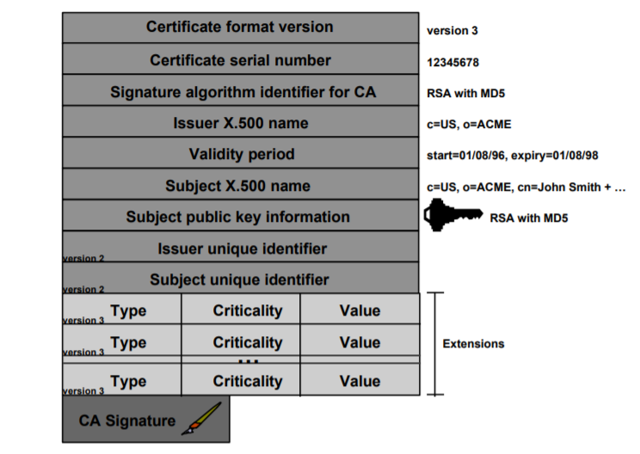
In summary, X.509V3 has the following attributes for all extension fields-
extnId - Used to uniquely identify the extension
critical - If set indicates extension is vital
extnValue - the actual extension value
Structure of X.509V3 certificate
(source : http://ftp.gnome.org/mirror/archive/ftp.sunet.se/pub/security/docs/PCA/misc/Entrust/x509v3.pdf)

Slide 8
Web of Trusts Certificates in PGP and S/MIME
Introduction
In cryptography Web of Trust model is used to authenticate the binding between the public key and its owner.
Operation
Let's say Alice trusts Bob.
Assume Bob gives a key and says that this is Stacy’s key.
Since Alice trusts Bob therefore she will sign the key for Stacy proving that the key is of Stacy.

Slide 9
Different values of a trust in a key
Ultimate Trust: Owner is the user.
Complete Trust: The owner is always trusted.
Marginal Trust: the owner is usually trusted.
Untrusted: the owner is not trusted.

Slide 10
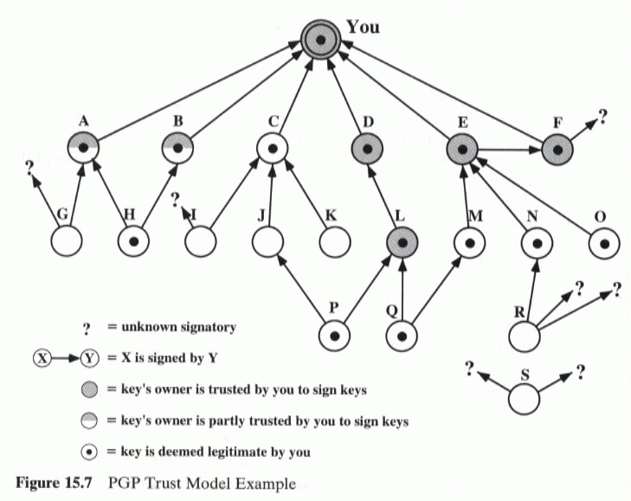
Four cases are demonstrated here.Assume You is Alice.
Case for Alice and C:Alice and D are good friends.Therefore Alice can sign for D and also trust D.
Case for Alice and C: In this case, Alice says that the key is of C but Alice doesn’t necessarily believe C.
Case for Alice and L: Here Alice may not have signed the key for L but trusts L but because of less electronic communication between them they were not able to sign keys.
Case for Alice and P:Alice may have not signed P’s key and also has no trust in P since they don’t know each other.
(Source:-https://www.cs.bham.ac.uk/~mdr/teaching/modules/security/lectures/PGP.html)

Slide 11
Difference between PGP and S/MIME Trust Model
In PGP model one user has the ability to give directly a public key to another user and vice-versa.
Therefore PGP does not mandate any policy for creating trust hence they are free to choose the length of trust.
In S/MIME sender and receiver do not rely on shared keys rather they rely on a common certifier on which both can trust.
In short we say that PGP depends on each user key exchange while S/MIME uses hierarchically validated certifier for key exchange.

Slide 12
S/MIME:
S/MIME (Secure/Multipurpose Internet Mail Extensions) is a widely accepted method (or more precisely, a protocol) for sending digitally signed and encrypted messages. S/MIME allows you to encrypt emails and digitally sign them. When you use S/MIME with an email message, it helps the people who receive that message to be certain that what they see in their inbox is the exact message that started with the sender. It will also help people who receive messages to be certain that the message came from the specific sender and not from someone pretending to be the sender. To do this, S/MIME provides for cryptographic security services such as authentication, message integrity, and non-repudiation of origin (using digital signatures). It also helps enhance privacy and data security (using encryption) for electronic messaging.

Slide 13
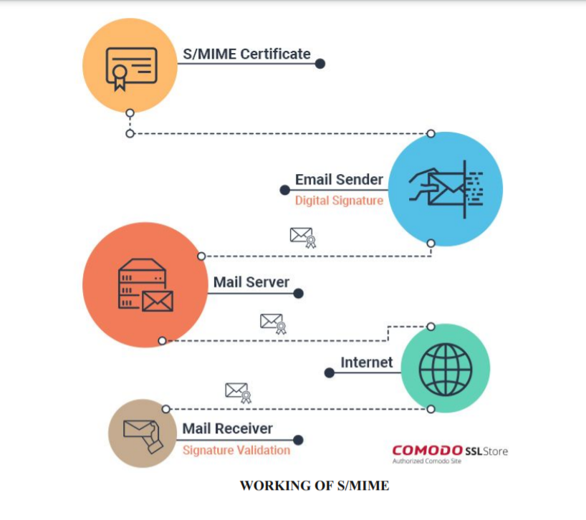
Working

Slide 14


