Slide 1
The Wider Ecosystem
Subtitle or speaker name

Slide 2
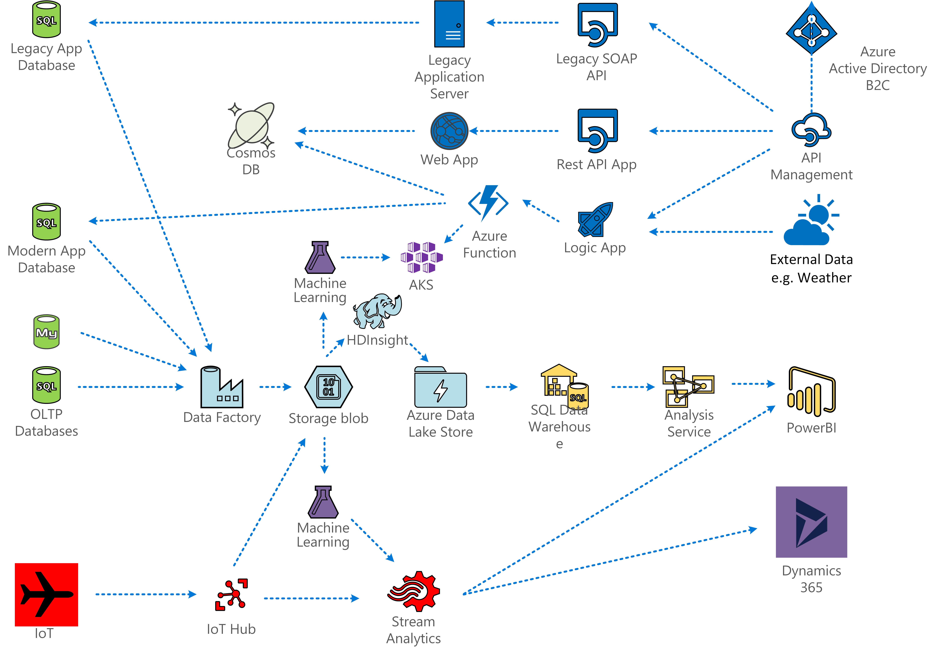

Slide 3
Internet of Things

Slide 4
Machine Learning Models

Slide 5
API Integration

Slide 6
CRM and ERP

