Slide 1

A Project On 'DEFORESTATION'
Presented by:-
Ashif Raza.
Department:-BCA(2nd sem.)
ROLL NO:-007

Slide 2
CONTENT
WHAT IS DEFORESTATION.
DATA OF DEFORESTATION.
CAUSES OF DEFORESTATION.
EFFECT OF DEFORESTATION.
SOLUTION OF DEFORESTATION.

Slide 3
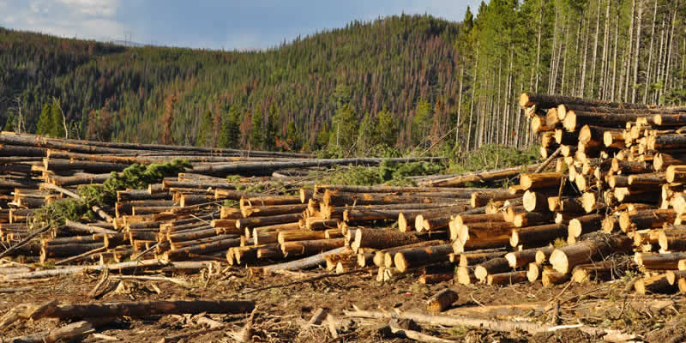
WHAT IS DEFORESTATION
Deforstation is when human remove or clear large areas of forest land and related eco-system for non-forest use.

Slide 4
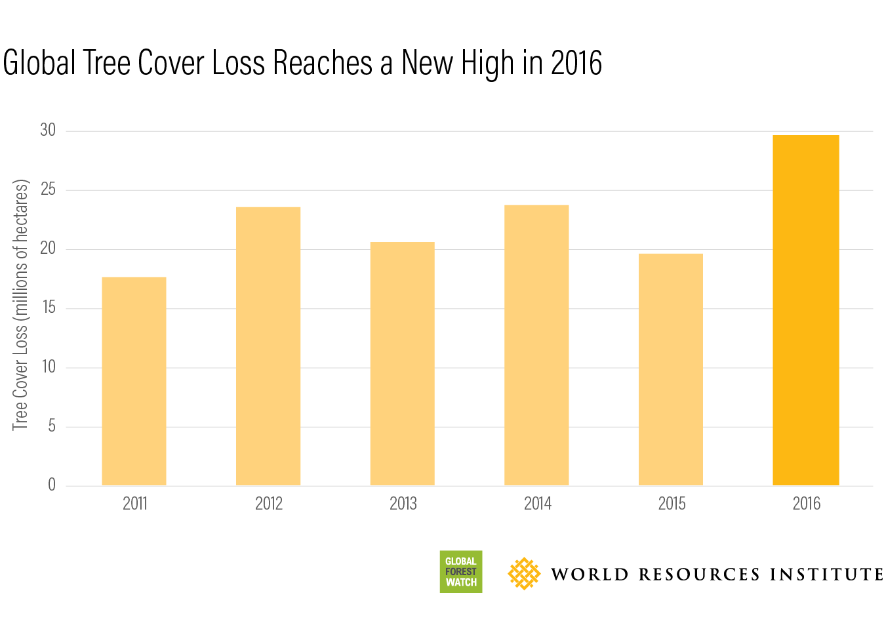
DATA OF DEFORESTATION

Slide 5
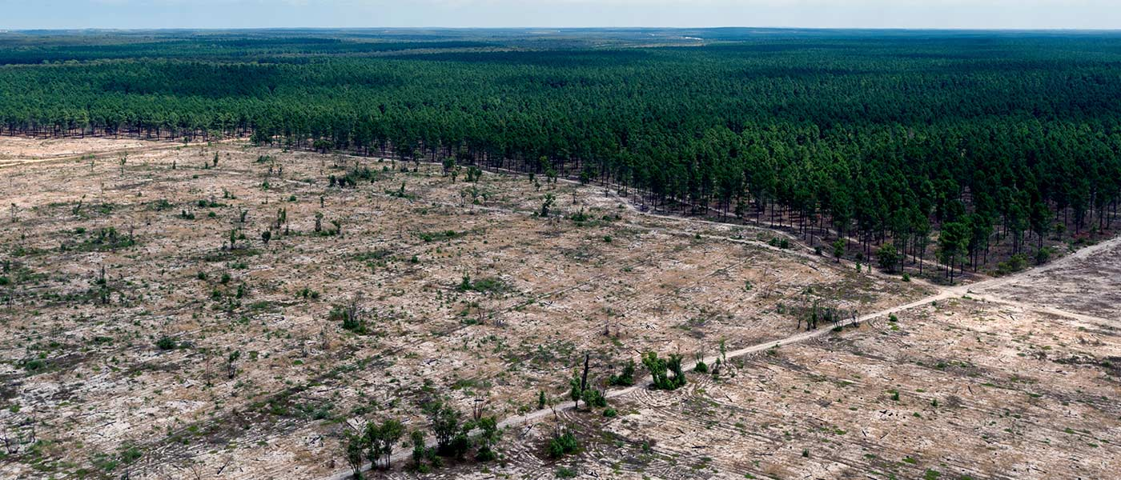
CAUSES OF DEFORESTATION
AGRICULTURE ACTIVITY:

Slide 6
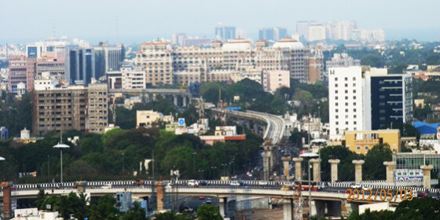
URBANIZATION:-

Slide 7
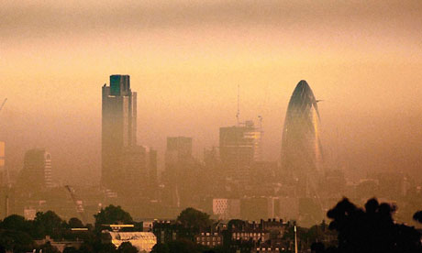
BUILT LARGE INDUSTRIES:-

Slide 8
EFFECT OF DEFORESTATION
Deforestation highly impact the ecosystem.
Extinction of many species.
Change in climate. which make the season unrealible and change again & again.
Emission of carbon di-oxide which increase in global warming.
Reduce no. of forest. Pollution increase which effect the environment, human beings & other organism.

Slide 9
SOLUTION OF DEFORESTATION
1.CORPORATION:-Corporation can implement anti-deforestation policies.
2.GOVERMENTS:-The cutting down of trees must be counterd by replacing old ones that with young ones.
3.INDIVIDUAL:-You may never know what result come from your action.but if you do nothing there will be no result.

Slide 10


Slide 11
THANK YOU.

