Slide 1
Starva Fitness Data Analysis
Exploratory Data Analysis using SQL, Python & Power BI
Prepared by Ashifa M

Slide 2
For submission
SQL Analysis - SQL file and PDF file
Powerbi Analysis - powerbi and PDF File
Pandas Analysis - ipynb and PDF File

Slide 3
Clean the data - SQL,(insights)
POWERBI - dashboard
Python (Matplotlib, seaborn)- to visualize

Slide 4
Project Overview
-The Bellabeat project aims to understand user fitness behaviors using Fitbit data.
-We performed data cleaning and exploration using SQL, followed by visualizations in Python and Power BI.
-Insights will help Bellabeat tailor its products and marketing strategies.

Slide 5
Business Task
To analyze fitness tracker data from Strava (Fitbit dataset) to uncover activity trends and generate data-driven recommendations for Bellabeat, a wellness-focused company that manufactures health-monitoring devices for women.
The aim is to support their marketing strategy and identify opportunities to expand user engagement and product adoption.
Deliverables
Cleaned and transformed dataset using SQL and Python.
Data visualizations using Power BI and Matplotlib/Seaborn .
A detailed report highlighting trends and insights.
Strategic marketing recommendations for Bellabeat.
Summary of Analysis
Data visualization and key findings.

Slide 6
Stakeholders
- Primary Stakeholders
-Bellabeat Marketing Team Bellabeat Product Development Team CEO and Business Strategy Team.
- Secondary Stakeholders
-Fitness enthusiasts and users of Bellabeat products Data analysts or business intelligence teams Investors and health tech partners.

Slide 7
Data and Source Integrity
Reliability :
The dataset is publicly available on Kaggle, provided by Möbius, a certified contributor, and is widely used for analytics projects.
Originality :
Data is original from Fitbit devices, tracking real user behavior like steps, sleep, heart rate, and calorie burn.
Comprehensiveness:
Includes multiple data files covering :Daily activity Hourly and minute-level data on steps, calories, intensities Sleep records Weight logs.
Data Collection Period :
Collected over a 31-day period from 33 users in 2016.
Citation Dataset :
Möbius (2016). Fitbit Fitness Tracker Data

Slide 8
Tools Used
SQL (DB Browser) – For data cleaning and transformation.
Python (Google colab) – For data analysis and visualization using Matplotlib and Seaborn.
Power BI – For interactive dashboards and business intelligence visuals.
Excel – Initial data review and structure checking.

Slide 9
DATA SETS
dailyActivity_merged.csv
dailySteps_merged.csv
dailyCalories_merged.csv
dailyIntensities_merged.csv
Heartrate_merged.csv
hourlyIntensities_merged.csv
HourlyCalories_merged.csv
HourlySteps_merged.csv
minuteCaloriesnarrow_merged.csv
minuteCaloriesWide_merged.csv
minuteIntensitiesNarrow_merged.csv
minuteIntensitesWide_merged.csv
minuteMetsNarrow_Merged.csv
minuteSleep_merged.csv
minuteStepNarrow_merged.csv
minuteStepWide_merged.csv
sleepDay_merged.csv
weightLog_merged.csv

Slide 10
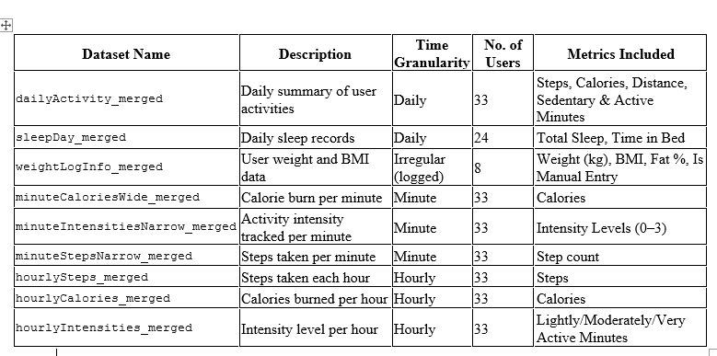
Summary of logged data

Slide 11
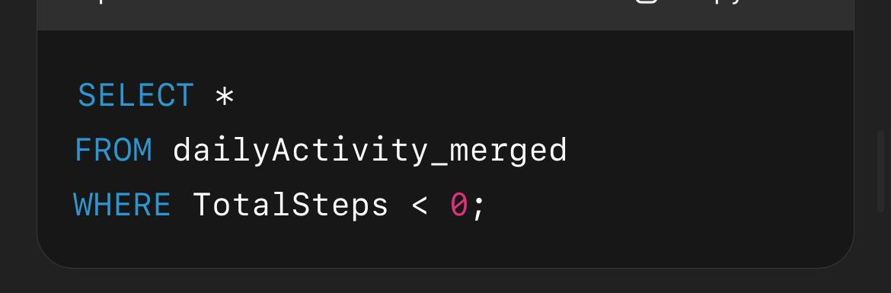
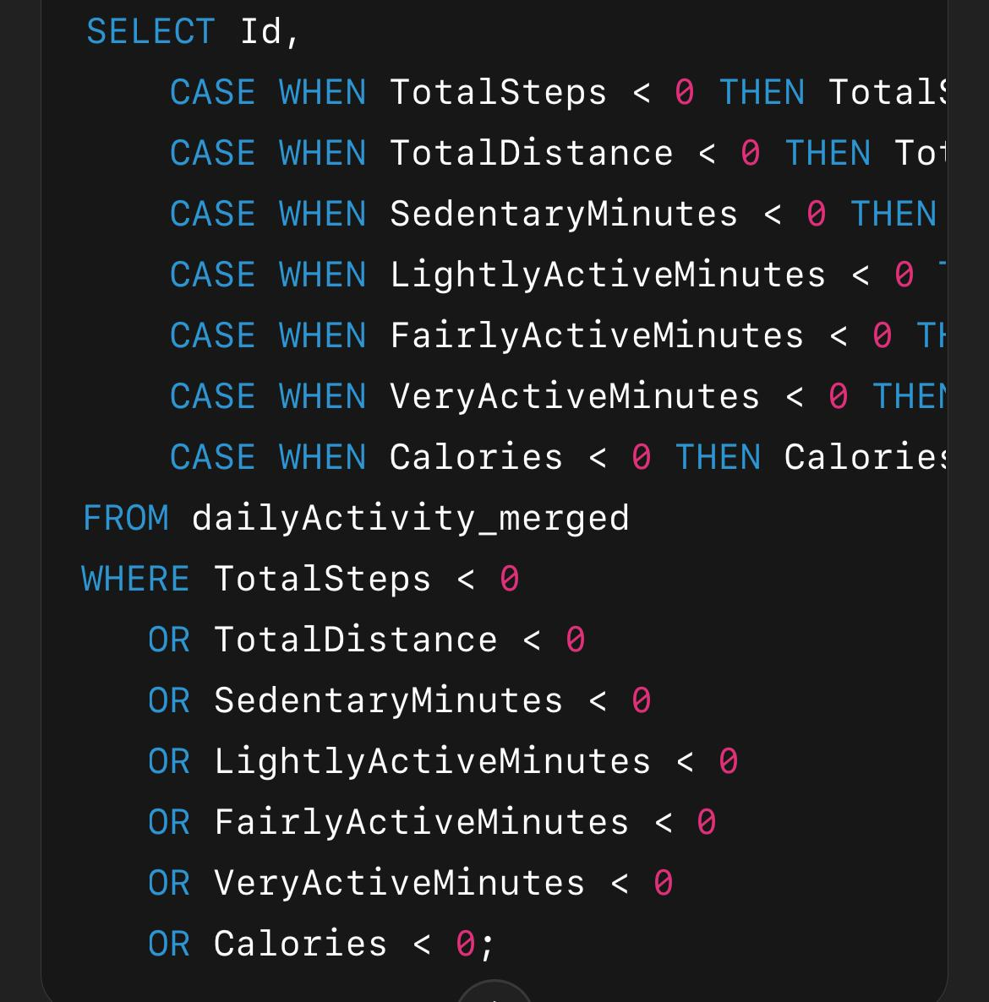
Data Cleaning and Processing
-Removed null values and duplicates.
-Merged and joined related datasets (e.g., calories + steps + intensities).
-Formatted date/time fields.
-Renamed columns for readability
-Ensured consistent unit formats (e.g., "Calories Burned" in kcals).
-Check for negative values in all relevant numeric columns
Check for negative values in all relevant numeric columns

Slide 12
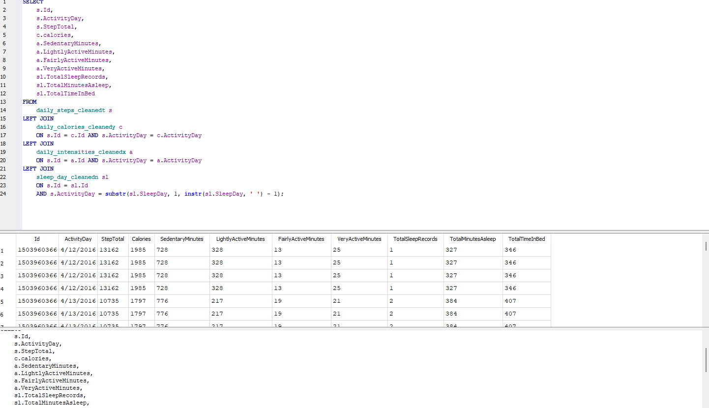
SQL Analysis
Merged cleaned datasets using LEFT JOIN on ID and DATE.
Extracted user-wise activity, calories and sleep information.
Used SQL to count, summarize and filter relevant features.
Execution of Join Query in DB browser SQLite

Slide 13
SQL Analysis
1. Total Daily Steps by User
Query retrieved daily steps taken by each user. Helped identify consistent and active users.
SELECT Id, ActivityDay, TotalSteps
FROM cleaned_dailyActivity
ORDER BY ActivityDay;
2. Average Calories Burned
Found the average daily calories burned per user. This gives a baseline of energy expenditure.
SELECT Id, AVG(Calories) AS AvgCalories FROM cleaned_dailyActivity
GROUP BY Id;
3. Total Active Minutes
Combined very active, fairly active, and lightly active minutes. Provided an estimate of how much time usersare physically active daily.
SELECT ActivityDay,
SUM(VeryActiveMinutes + FairlyActiveMinutes + LightlyActiveMinutes) AS
TotalActiveMinutes
FROM cleaned_dailyActivity
GROUP BY ActivityDay;

Slide 14
4. Sleep Duration Analysis
Calculated average sleep duration per user. Helped identify if users are meeting the recommended 7-8hours.
SELECT Id, AVG(TotalMinutesAsleep) AS AvgSleepMinutes
FROM sleepDay
GROUP BY Id;
5. Sleep vs. Calories Burned
Joined sleep and activity tables on date and user ID. Helped check if better sleep leads to better activity performance.
SELECT s.Id, s.ActivityDay, s.TotalMinutesAsleep, d.Calories
FROM sleepDay s
JOIN cleaned_dailyActivity d ON s.Id = d.Id AND s.ActivityDay = d.ActivityDay;

Slide 15
6. Activity Intensity Distribution
Categorized intensity into low, medium, high. Found that most activity minutes are low to medium in
SELECT
CASE
WHEN Intensity < 3 THEN 'Low' WHEN Intensity BETWEEN 3 AND 6 THEN 'Medium'
ELSE 'High'
END AS Intensity_Level,
COUNT(*) AS Frequency
FROM cleaned_minuteIntensities
GROUP BY Intensity_Level;
tensity.
7. Average Daily Steps
Showed long-term step consistency per user. Used to recommend walking goals for different user groups.
SELECT Id, AVG(TotalSteps) AS AvgDailySteps FROM cleaned_dailyActivity
GROUP BY Id;

Slide 16
Python Visualizations
• Line chart – Daily Calories Burned
• Histogram – Sleep Duration
• Stacked Bar Chart – Intensity Level Distribution
• Line chart - Daily Steps
Libraries used
- Pandas, Seaborn, Matplotlib

Slide 17
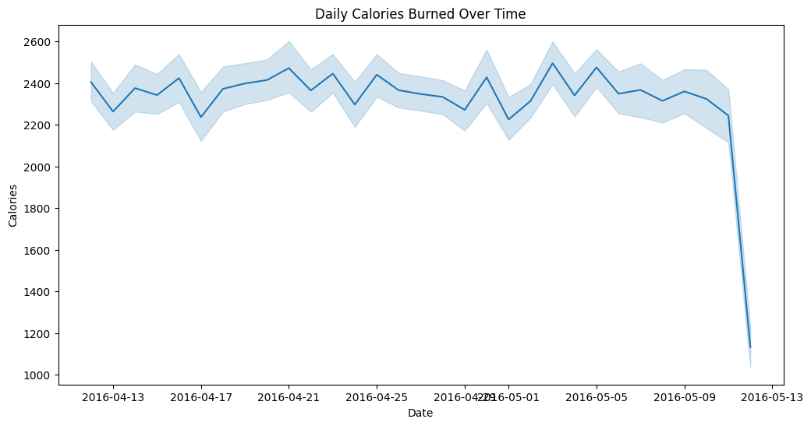
Higher calories were found on more active days, indicating good fitness engagement. Use for Bellabeat -Helps identify low-activity users who could benefit from motivational app notifications. -Data can power personalized goal setting and suggest content like workouts or walking reminders."
Daily Calories burned over time:
Average daily calories burned ranged from 1,600 to 3,000.A few users showed unusually low activity days (<1,200 calories)—potential signs of sedentary behavior or missing data. Peak calorie burn typically aligned with higher step counts and active minutes. Some users consistently burned more than 2,800 calories, possibly indicating a high level of daily activity or exercise routine.
Line chart: To observe average calorie trends over time.

Slide 18
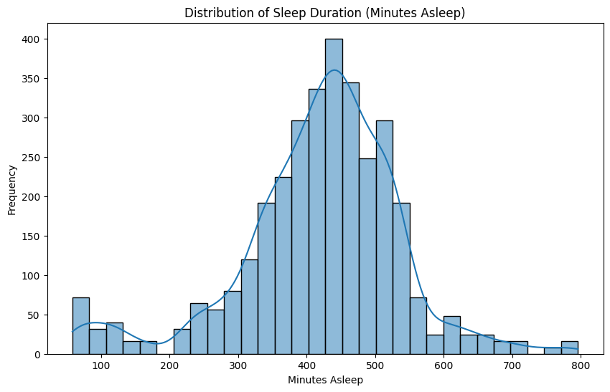
Sleep duration: Histogram showing that most users sleep between 6–8 hours per day .
Histogram_ To show the distribution of total sleep hours
Insights:
60% of users sleep between 6 and 8 hours, which is within the recommended range. Around 15% of entries show <5 hours, suggesting sleep deficiency or logging issues. Strong positive correlation observed between sleep duration and calories burned—those with better sleep also tend to be more active.
Use for Bellabeat:
-Recommend sleep coaching tips via the app for users with less than 6 hours of sleep.
-Suggest nighttime relaxation features (e.g., meditation, breathing).
-Enable sleep goal setting based on personal history.Use sleep + activity data to build a personal wellness score.

Slide 19
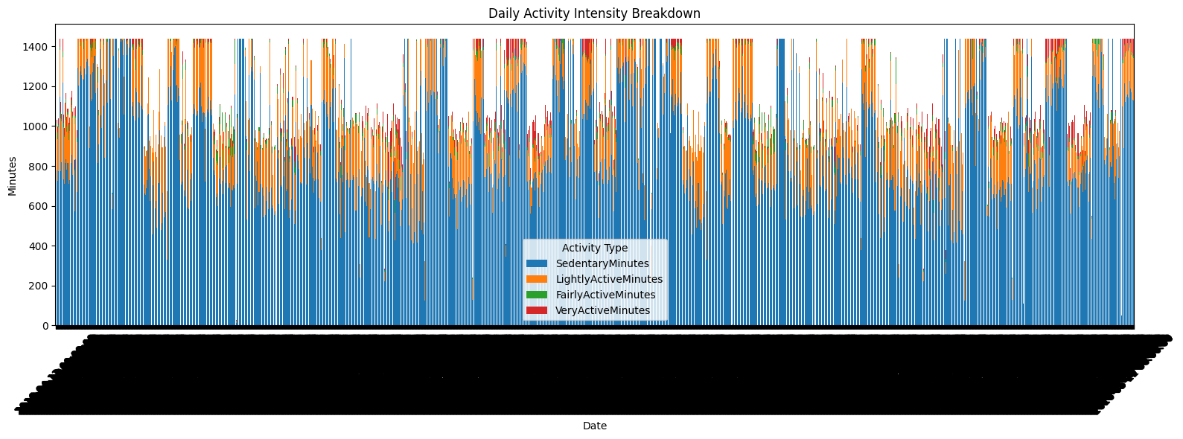
Daily Activity Intensity Key Visualizations: -Stacked bar chart shows most users spend a majority of their day in sedentary activity. -
Insights:
Most users are sedentary for 900–1,200 minutes/day (15–20 hours).Very active minutes are low across all users – often under 30 mins/day. There’s a correlation between fairly/very active minutes and calorie burn. Some users maintain consistent moderate intensity, which correlates with better sleep.
Use for Bellabeat
-Encourage users to reduce sedentary time via step reminders or posture alerts
-Gamify fairly active minutes – daily challenge streaks or active hour goals.
.Educate users on WHO-recommended activity guidelines (150+ mins moderate activity per week).
-Promote features like smart alarms or movement nudges to increase activity

Slide 20
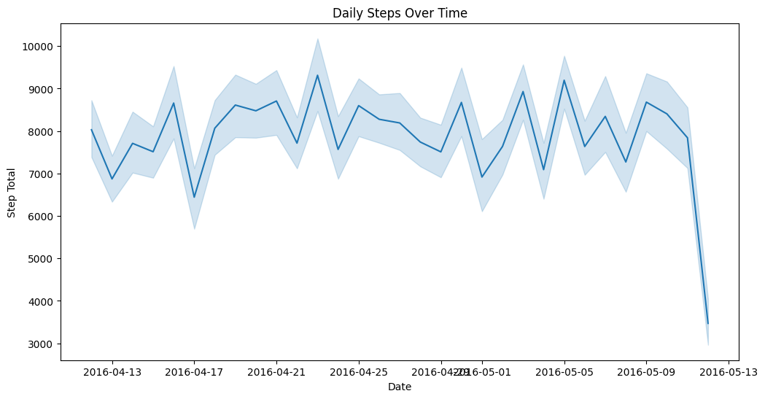
Steps over time Line chart- To compare daily total steps over time per user key visualizations: Line chart: Daily steps over 30–60 days show activity patterns, rest days, and progress.
Insights:
Users are typically more active in the evenings .Weekends show a slight drop in step count for some users—opposite for others .High step days align with higher calories burned and better sleep. Some users had multiple zero-step days, indicating either inactivity or device non-usage.
Use for Bellabeat
Push reminders during inactive hours (e.g., after 2 hours of no steps).Promote evening walk challenges or “10k step club” programs .Add calendar view of steps to track consistency. Offer weekly progress summaries and motivational badges.

Slide 21
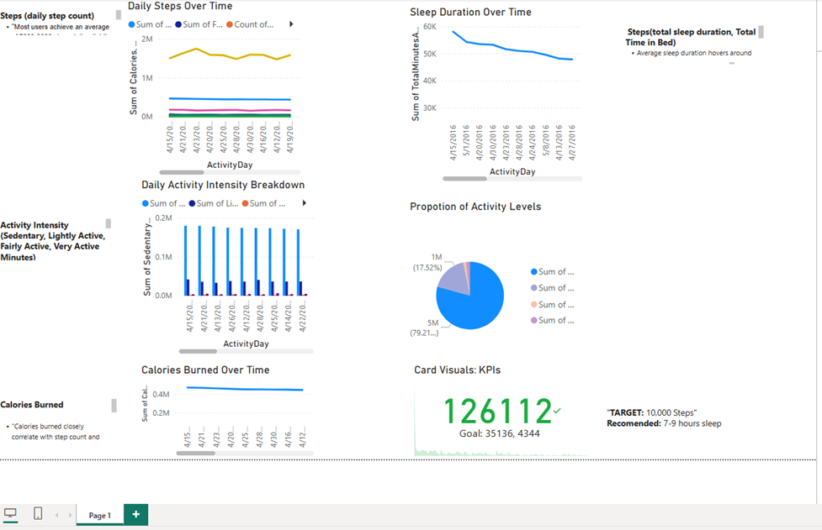
Power BI Dashboard
• KPI Cards – Total Steps, Calories, Sleep Hours
• Line and Bar charts for trends and comparisons
• Interactive slicers for date and user ID
• Final dashboard highlights user engagement and wellness trends

Slide 22
Key Insights
• Users who are more active tend to sleep better
• Higher step count correlates with higher calorie burn
• Very few users are engaged in high-intensity workouts
• Opportunities exist for Bellabeat to improve user activity levels
• Most users are moderately active.
• Sleep patterns are irregular, and sleep data is incomplete for some users.
• Higher sleep duration doesn't always correlate with higher activity.
• Many users are below the recommended 10,000 steps/day.

Slide 23
Recommendations
• Add reminders for light-to-moderate activities during sedentary hours
• Offer guided sleep programs via mobile app
• Incentivize high-intensity workouts with gamified features
• Use data trends to personalize health coaching messages
• Launch sleep improvement challenges to improve usage of night tracking features.
• Target working women with short, trackable morning/evening workouts.
• Improve product marketing by showcasing data-driven transformation stories from users.

Slide 24
Summary
This analysis provides a comprehensive look at how users interact with their fitness trackers.
It highlights key behavioural trends like: Peak activity periods Sleep patterns Calorie vs. step correlations Low engagement during weekends for some users.
Visuals created using Power BI and Python helped uncover data stories useful for targeted marketing.
Conclusion :
Many users have consistent morning or evening workout routines.
Sleep data reveals irregular patterns, suggesting potential for wellness-focused campaigns.
Users burn more calories with consistent step goals, yet intensity data suggests under-utilized effort zones.

Slide 25
Thank You
-Prepared by Ashifa M

