Slide 1

PROGRESS UPDATE
Group D - Air Ticket Booking System

Slide 2
Scope of Work – Progress:
The scope of work for this system includes:
User
Login Page - implemented
User authentication and authorization
Sign Up Page - implemented
User sign up for creating new account.
Home Page / Dashboard – basic implementation
Basic information such as Flight Searching, Departure Date , Class, Return Date, Traveler count.
Search Results – basic implementation
Basic information such as (Flight Details, Time of the flight, Date of the flight, Expected delay)about the Flight requested by the user.

Slide 3
Passenger Details – to be implemented
Information about the passenger details who are traveling in the flight.
Select Seats – to be implemented
To select the seats as required by the user
Boarding Pass – to be implemented
Information about the complete details of the flight and the journey as well as the passenger's details.
Airline Staff/Admin authorized accounts - to be implemented

Slide 4
Nature of Implementation
Currently the frontend has been coded using HTML/CSS.
We chose to at least have a basic but fully functional backend before starting to finalize the work on the frontend.
The database currently has sample data sourced to present it’s working for the demo.

Slide 5
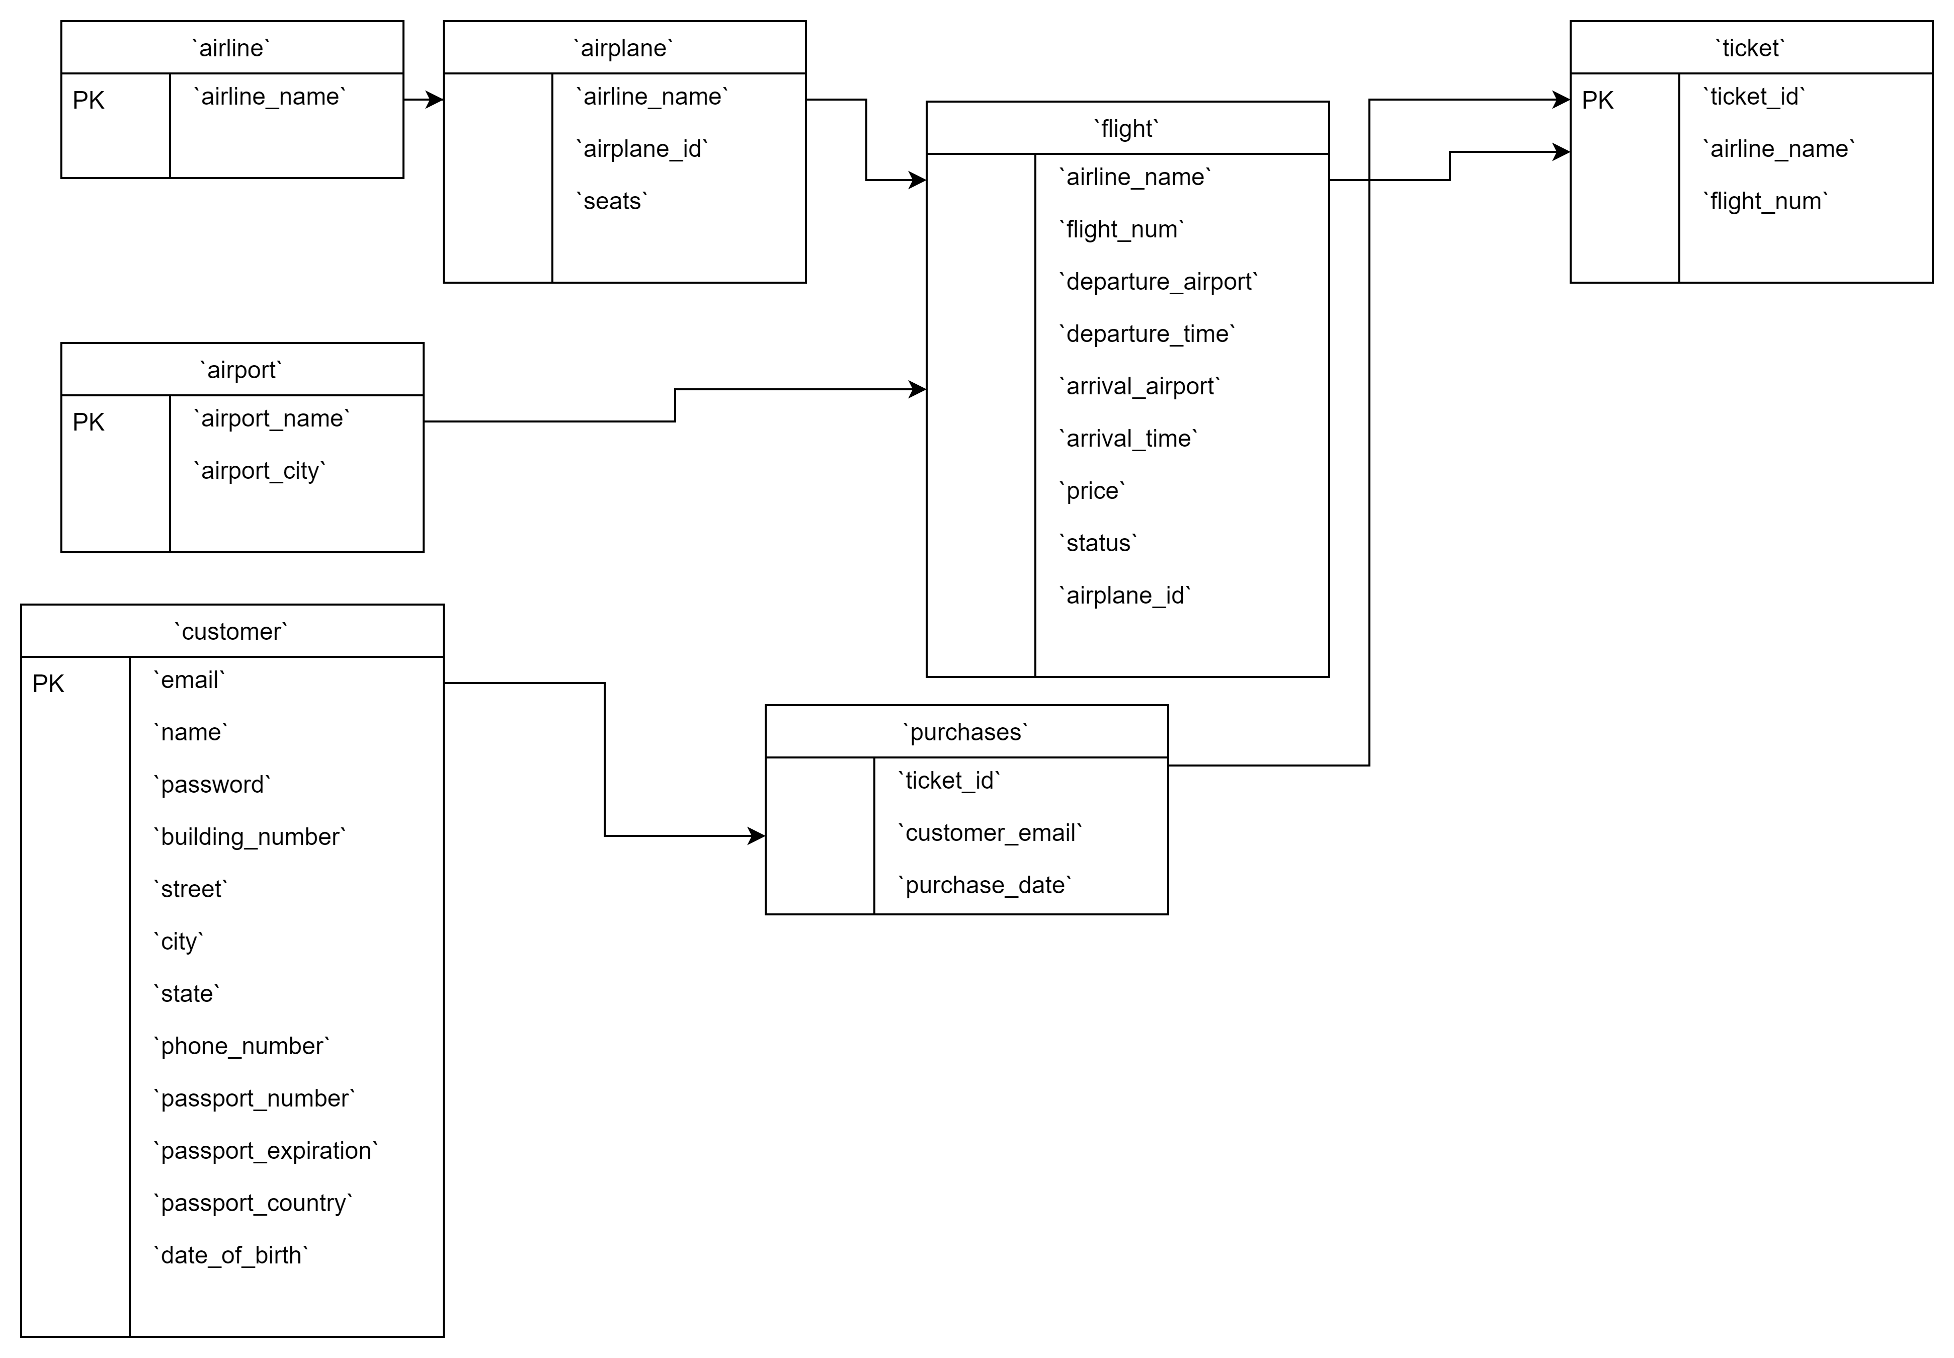
SQL ER Diagram

Slide 6
DevOps:
GitHub Repository has been created at:
https://github.com/roguehunter7/Air-Ticket-Booking-System
Docker Dev Environment:
We are planning to try out Docker’s inbuilt Dev Environment Functionality since it ensures that we all have the latest code and same tools across our devices.
Docker Compose Build: (showing connection error)
The Docker Compose builds successfully but connection between the app and database containers are not being established,
needs to be resolved.

Slide 7
AI/ML - MODEL SELECTION

Slide 8
Model Selection
We have gone through various regression models such as Linear Regression, Decision Tree Regression, Random Forest regression and Gradient Boosting.
From all these above we have taken Random forest Regression as the best model, since:
The R-squared values for both the training and testing sets are very high and similar.
The mean squared errors are relatively low.
The adjusted R-squared values are close to 1, indicating that the model is not overfitting.
Overall, these metrics suggest that the random forest regression model is performing well on both the training and testing sets and is not overfitting or underfitting the data.

Slide 9
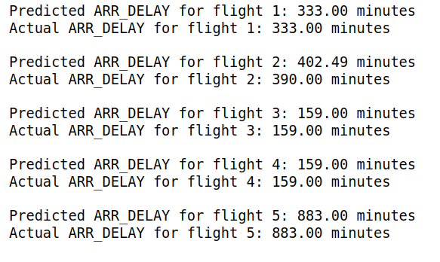
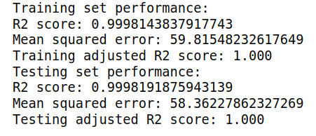
Model Performance :
Model Predictions

Slide 10
Project Phases & Timelines
March
April
May
June
July
Requirements
Demo 1
Demo 2
Demo 3
Final Demo
Project Phases:
End of April - Discovery Phase (completed)
End of May – Initial working demo
Website with basic functionality
Finalization of ML Model
End of June:
Fully Functional Website with integrated frontend, backend and AI/ML Model.
End of July:
Final Demo and Deployment of proposed website

Slide 11
THANK YOU

