Slide 1

PROGRESS UPDATE Demo - 3
Group D - Air Ticket Booking System

Slide 2
Scope of Work – Progress:
The scope of work for this system includes:
Login Page - implemented
User authentication and authorization
Sign Up Page - implemented
User sign up for creating new account.
Home Page / Dashboard - implemented
Basic information such as Flight Searching, Departure Date , Class, Return Date, Traveler count
.
Search Results – Implemented
Basic information such as (Flight Details, Time of the flight, Date of the flight, Expected delay)about the Flight requested by the user.

Slide 3
Passenger Details – implemented
Information about the passenger details who are traveling in the flight.
Printable Ticket – implemented
Information about the complete details of the flight and the journey as well as the passenger's details.

Slide 4
Nature of Implementation
Due to Issues faced during the complete integration (mostly with complex SQL queries) with Flask API, the backend was ported to Django and is currently functional.
The database currently has a relatively smaller dataset (sourced from https://gettocenter.com/) to present it’s working for the demo.

Slide 5
MySQL ER Diagram

Slide 6
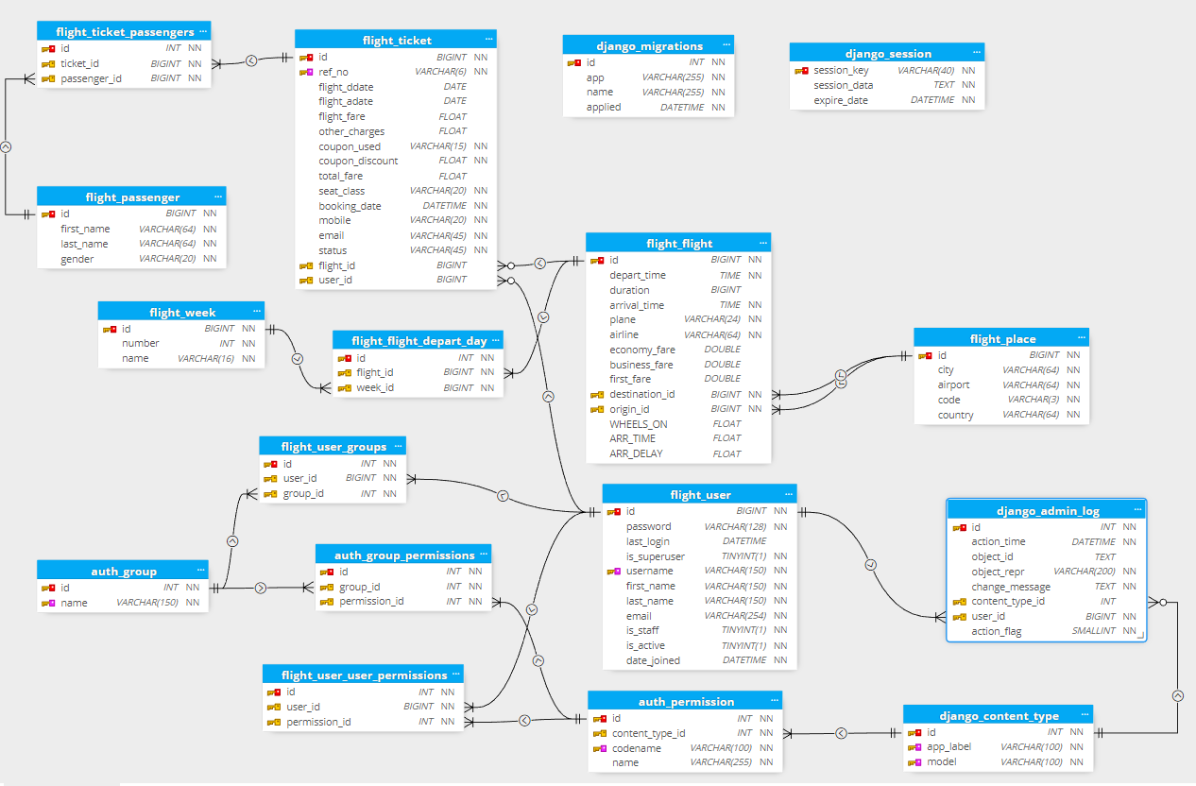

Slide 7
DevOps:
GitHub Repository has been created at:
https://github.com/roguehunter7/Air-Ticket-Booking-System
Docker Dev Environment:
We are planning to try out Docker’s inbuilt Dev Environment Functionality since it ensures that we all have the latest code and same tools across our devices.
Docker Compose Build: (showing connection error)
The Docker Compose builds successfully but connection between the app and database containers are not being established,
needs to be resolved.

Slide 8
AI/ML - MODEL SELECTION

Slide 9
Model Selection
We have gone through various regression models and we have taken Gradient Boosting Regression as the best model, since:
The R-squared values for both the training(0.883) and testing(0.884) sets are similar.
The mean absolute errors are relatively low (102.9 and 102.4).
The adjusted R-squared values are also similar, indicating that the model is not overfitting and underfitting.
Overall, these metrics suggest that the Gradient Boosting Regression model is performing well on both the training and testing sets and is not overfitting or underfitting the data.

Slide 10
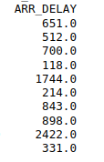
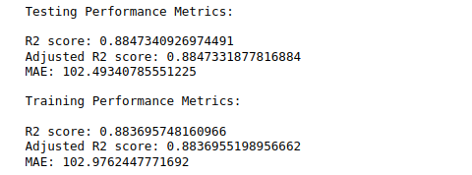

Performance
Model Performance :
Model Predictions

Slide 11
Model Usage
The trained model has been saved as a pickle file.
The pickle file can be directly integrated in backend, which can provide the delay by feeding the required features to the model.

Slide 12
Project Phases & Timelines
March
April
May
June
July
Requirements
Demo 1
Demo 2
Demo 3
Final Demo
Project Phases:
End of April - Discovery Phase (completed)
End of May – Initial working demo
Website with basic functionality
Finalization of ML Model
(completed)
End of June:
Fully Functional Website with integrated frontend, backend and AI/ML Model.
End of July:
Docker Deployment
API Documentation
Final Presentation

Slide 13
THANK YOU

