Slide 1

PROGRESS UPDATE FINAL DEMO
GROUP D- AIR TICKET BOOKING SYSTEM

Slide 2
Scope of Work –Previous Progress:
The scope of work for this system includes:
Login Page - Implemented
User authentication and authorization
Sign Up Page - Implemented
User sign up for creating new account.
Home Page / Dashboard - Implemented
Basic information such as Flight Searching, Departure Date , Class, Return Date, Traveler count
Search Results – Implemented
Basic information such as (Flight Details, Time of the flight, Date of the flight, Expected delay)about the Flight requested by the user.

Slide 3
Passenger Details – Implemented
Information about the passenger details who are traveling in the flight.
Printable Ticket – Implemented
Information about the complete details of the flight and the journey as well as the passenger's details.

Slide 4
Scope of Work: Current Progress
Fixed UI/UX Bugs and implemented the recommendations that were given in the last demo.
Created Docker Compose YAML file to define and run the Frontend and Backend Containers.
Deployed the web app online to a server.

Slide 5
Docker Compose File:
version: '3'
services:
db:
image: mysql:latest
restart: always
environment:
MYSQL_ROOT_PASSWORD: 'mysql'
volumes:
- ./db:/docker-entrypoint-initdb.d
ports:
- '3306:3306'
networks:
- air-ticket-net
web:
build:
context: .
dockerfile: Dockerfile
restart: always
ports:
- '8000:8000'
environment:
DB_HOST: db
DB_NAME: online_air_ticket_reservation_system
DB_USER: root
DB_PASSWORD: mysql
depends_on:
- db
command: sh -c "sleep 60s ; python manage.py runserver 0.0.0.0:8000"
networks:
- air-ticket-net
networks:
air-ticket-net:

Slide 6
Deployment:
The Web App has been deployed with the help of an online service called PythonAnywhere By Anaconda
The Current Implementation of the Web App can be Viewed at :
http://krsreeram007.pythonanywhere.com/

Slide 7
AI/ML - MODEL
.

Slide 8
Model
The model we selected is Gradient Boosting Regression for predicting the arrival delay, which performs better than any other ML algorithm.
The R-squared and adjusted R-squared values for training and testing sets are similar, and the mean Absolute errors are relatively low.
Overall, these measures suggest that the Gradient Boosting Regression model is performing well on both the training and testing sets and is not prone to overfitting or underfitting the data.

Slide 9
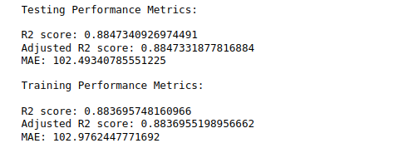
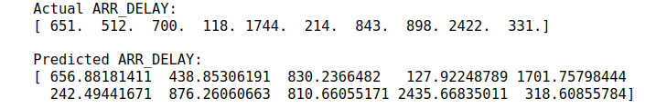
Model Performance :
Model Predictions

Slide 10
THANK YOU

