Slide 1
Real-Time Streaming EHR Ingestion and Validation Pipeline
Hanuman Ashik Akshintala
EECS 247 Course Project Presentation
Inspired by "Real-Time Data Ingestion Pipelines for Streaming EHR Systems"
April 29, 2026
Local streaming pipeline using Kafka, Flink, Redis, Cassandra, and a React/Material UI dashboard
Synthetic EHR events with validation, deduplication, quarantine, and performance reporting

Slide 2
Problem and Motivation
Modern healthcare systems increasingly receive EHR data as streams rather than offline batches.
Bad records can silently corrupt downstream analytics and decision-support systems if there is no validation path.
Streaming pipelines need duplicate detection, late-event handling, and clear quarantine routing.
The project goal was to implement a local version of a paper-inspired real-time EHR ingestion system.
experiment runs
events tested
4
30,000
accepted
quarantined
94.25%
5.75%
All runs use synthetic EHR events and execute locally without cloud services or real patient data.

Slide 3
System Architecture
Synthetic EHR Producer
Kafka
Flink
Redis
Cassandra
Dashboard / Reports
Kafka carries the raw synthetic EHR stream and separates valid, quarantine, and alert topics.
Flink performs validation, keyed-state duplicate detection, event-time processing, enrichment, and alert logic.
Redis stores low-latency patient metadata. Cassandra stores accepted records, quarantined records, and alerts.

Slide 4
Implemented Components
Synthetic Generator
Flink Validation
Vitals, labs, medications, admissions; injects duplicates, late events, and invalid records.
Schema checks, value-range checks, timestamp parsing, keyed duplicate detection, watermarks.
Quarantine Path
Serving Layer
Bad records are stored separately with explicit reasons instead of being silently dropped.
Redis for enrichment metadata; Cassandra for valid events, quarantine, and alert tables.

Slide 5
Validation and Stream Logic
Required-field validation: event ID, patient ID, event type, event time, schema version
Clinical value validation: vital and lab out-of-range detection
Duplicate detection: keyed state over event IDs in Flink
Late and out-of-order handling: event-time watermarks with allowed lateness window
PHI-like field rejection: direct patient-name fields are quarantined
Possible-sepsis alert generation from the valid-event stream
top duplicate count
direct PHI rejects
175
84
missing patient ID
unknown event type
83
80
Top quarantine reasons come from the 10,000-event final run with unlimited producer rate.

Slide 6
Experiment Setup
Synthetic patients: 5,000
Allowed lateness window: 300 seconds
Invalid record injection: 4%
Duplicate injection: 2%
Out-of-order injection: 12%
Late-event injection: 3%
Run | Events | Rate limit
events_5000_rate_1000 | 5,000 | 1,000/s
events_5000_rate_0 | 5,000 | as fast as possible
events_10000_rate_1000 | 10,000 | 1,000/s
events_10000_rate_0 | 10,000 | as fast as possible
The goal of the matrix was to compare controlled-rate ingestion against maximum-speed producer throughput and observe the effect on latency.

Slide 7
Results Highlights
best throughput
lowest p95 latency
accepted records
alerts
33,783/s
783 ms
94.25%
1
Unlimited producer rate increased throughput to 33,783 events/sec but also increased p95 latency.
Controlled-rate ingestion at 1,000 events/sec achieved the lowest p95 latency of 783 ms.
The latest 10,000-event run accepted 9,425 records and quarantined 575.
Latest-run average latency was 5,459 ms and p95 latency was 9,826 ms.

Slide 8
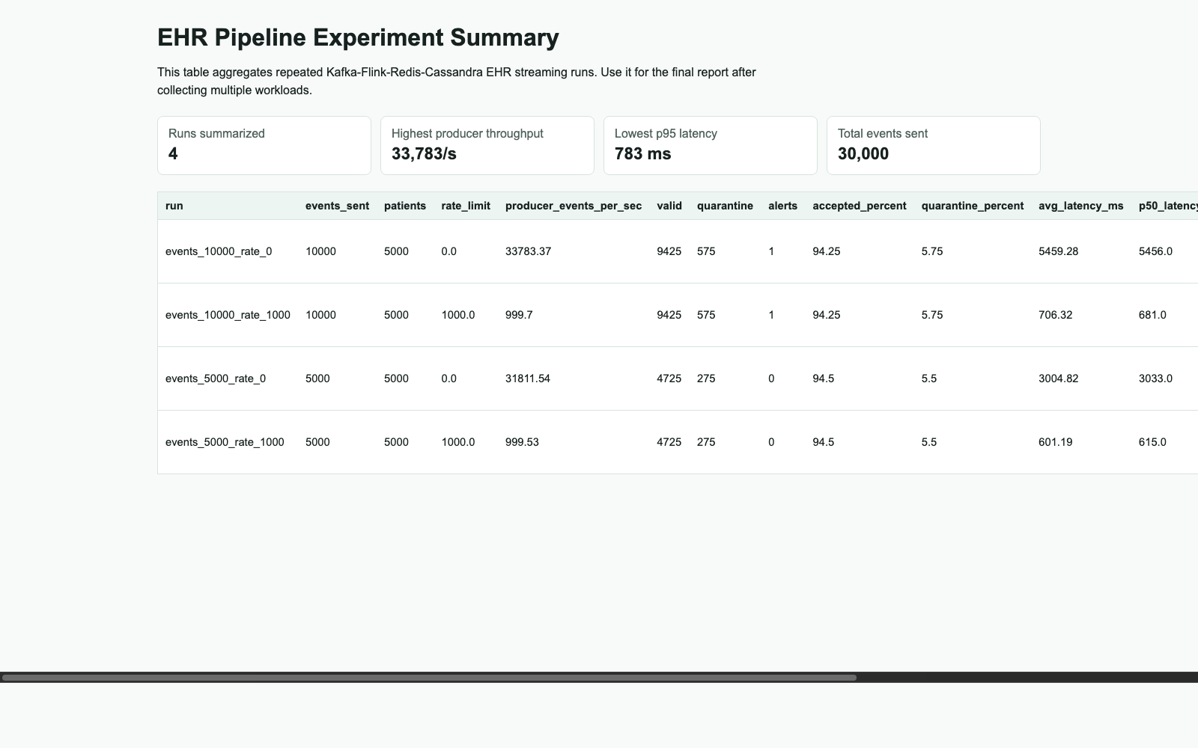
Experiment Matrix Summary
Final table aggregating the four workload configurations.

Slide 9
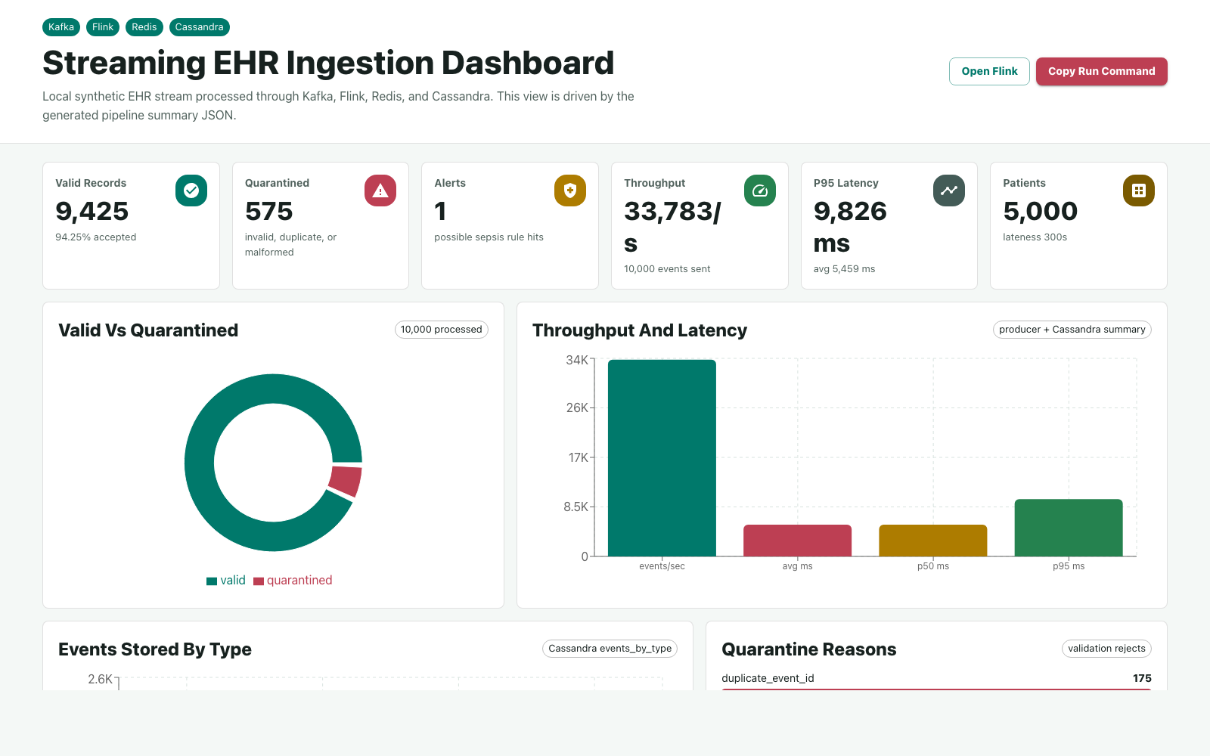
React Dashboard
Live React + Material UI dashboard served at localhost:5173.
The live dashboard shows 9,425 valid records, 575 quarantined records, and 1 alert(s).
Latest-run p95 latency is 9,826 ms, and throughput is derived directly from the generated pipeline summary.

Slide 10
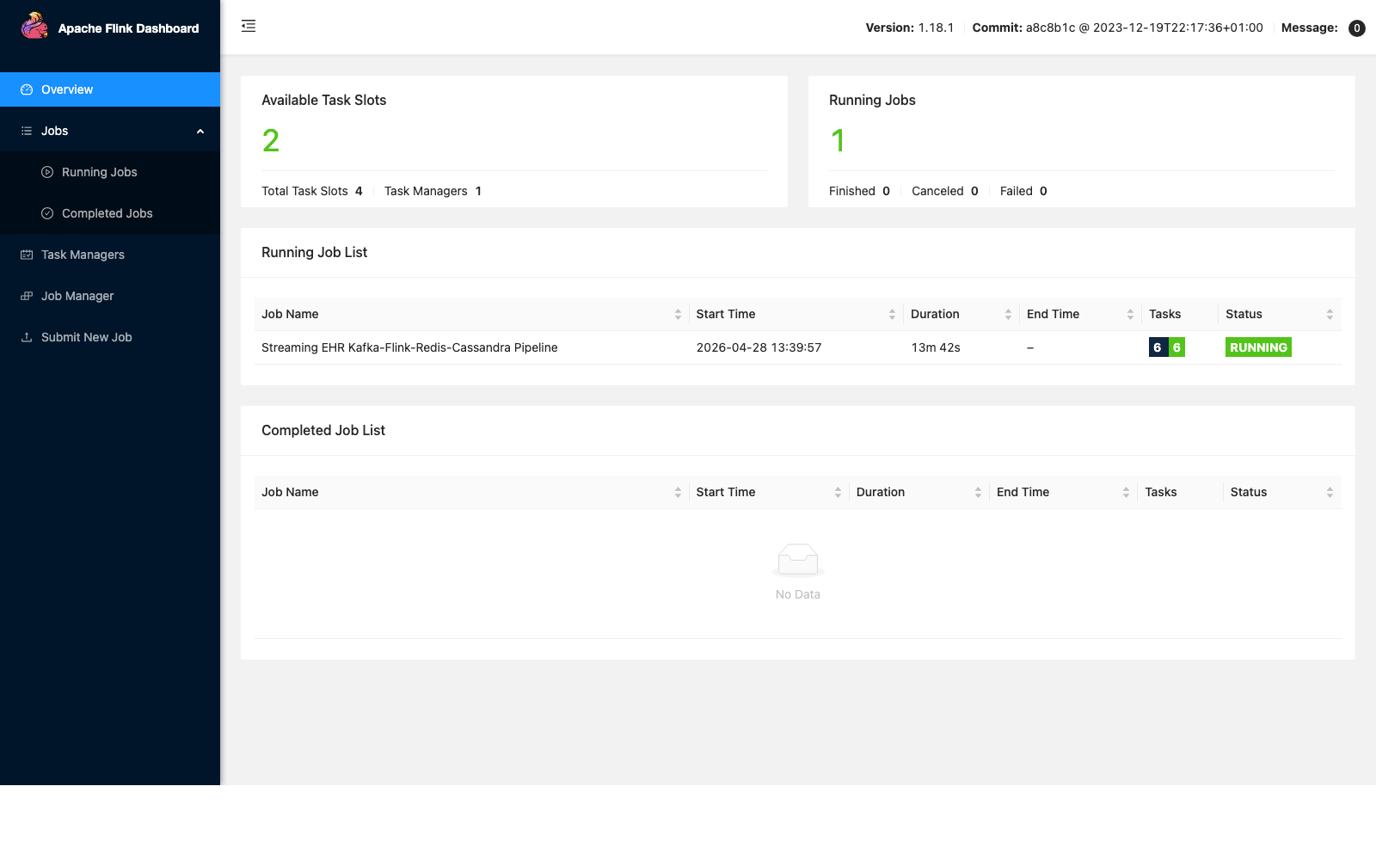
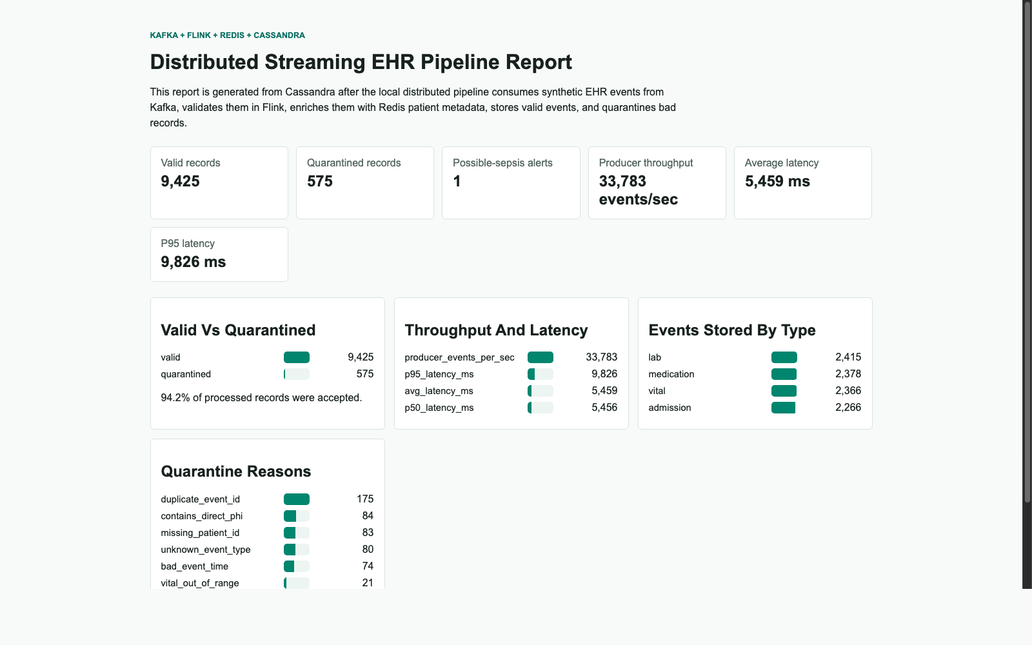
Runtime and Generated Output
Flink dashboard confirming the streaming job is running.
Generated report summarizing final output from Cassandra summaries.
The Flink UI shows the live streaming job. The report view is a stable output for final analysis and presentation backup.
Quarantined records are expected because the generator intentionally injects duplicates, malformed timestamps, PHI-like fields, and range violations.

Slide 11
Discussion, Limitations, and Future Work
Why Redis: fast metadata enrichment during stream processing.
Why Cassandra: scalable write-heavy serving store for valid events, quarantine, and alerts.
Why latency rises at unlimited rate: the producer can outrun downstream storage and processing.
Limitations: synthetic data, single-node local deployment, and simple alert logic.
Future work: Synthea/FHIR input, restart/failure experiments, and more advanced alert rules.
patients
lateness window
5,000
300s
invalid injection
out-of-order
4%
12%

Slide 12
Presentation Demo Plan
Start with the architecture slide and explain the Kafka -> Flink -> Redis/Cassandra data path.
Show the experiment summary table to compare 5,000 vs 10,000 events and rate-limited vs unlimited ingestion.
Open the generated output report to explain valid records, quarantine reasons, alerts, and event-type counts.
If Docker Desktop is available, open the live dashboard at http://localhost:5173 and Flink at http://localhost:8081.
cd "/Users/hanumanashikakshintala/Documents/New project/ehr_stream_pipeline"
./scripts/start_presentation_demo.sh

Slide 13
Takeaway
The project demonstrates that a paper-inspired streaming EHR ingestion pipeline can be implemented locally with real Kafka, Flink, Redis, and Cassandra components while producing measurable throughput, latency, and quarantine behavior.
Questions?

