Slide 1



PRESENTATION
SOFTWARE PROJECT LAB - I
Project Title : The El doˈɾaðo Explorer
Presented By,
Supervised By,
MD. Azizul Hakim
Prof. Dr. Mohammad Shoyaib
BSSE 1634
Professor
Software Engineering
Institute of Information Technology
University of Dhaka
Institute of Information Technology
University of Dhaka

Slide 2
PROJECT OVERVIEW
El Dorado Explorer is a multi-modal local retrieval system designed to efficiently search and extract information from large-scale heterogeneous data sources.

Slide 3
RETRIEVAL STRATEGY
Follows a two-phase retrieval approach.
Initial query:
Uses direct brute-force processing.
Performs full computation (PDF parsing, pixel-level analysis).
Subsequent queries:
Use module-specific cached representations.
Avoid repeated expensive computations.
Result in significantly faster execution.

Slide 4
CURRENT MODULES
Supports pluggable search modules (extensible design).
Current modules:
1. PDF text retrieval (large-scale document search).
2. Bayesian-based image skin segment retrieval.

Slide 5
MODULE-1

Slide 6
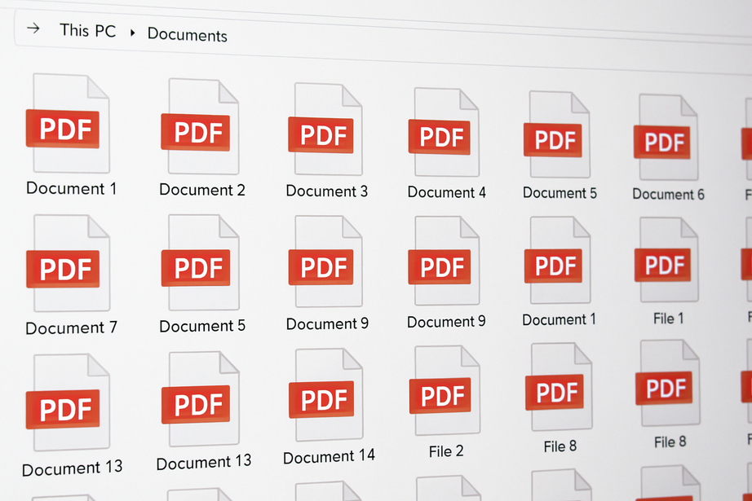
MOTIVATION - 1
Thousands of PDF files stored
Need to find specific content quickly
Manual search is inefficient and time-consuming

Slide 7
MODULE-1
PDF Text Retrieval
Performs keyword search over PDFs with linear scanning and cached text representations for efficient repeated retrieval.

Slide 8
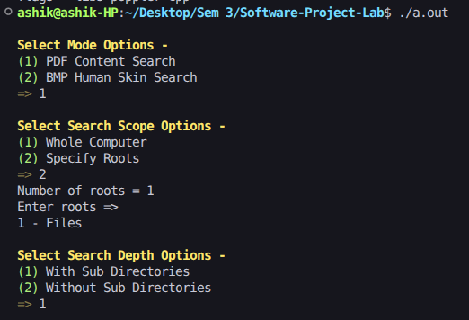
MODULE-1
PDF Text Retrieval
Inputs -
Search Mode - PDF or Image
Search Scope
Number of Roots
Specifying Root names
Search Depth

Slide 9
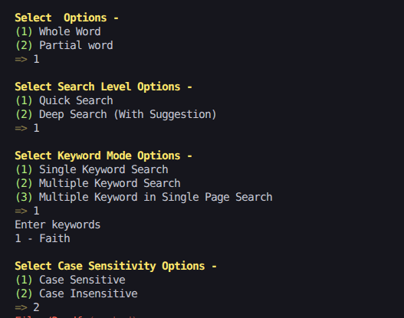
MODULE-1
PDF Text Retrieval
Inputs -
Whole or partial word?
Search Level
Keyword Mode
Specifying Keywords
Case sensitivity

Slide 10
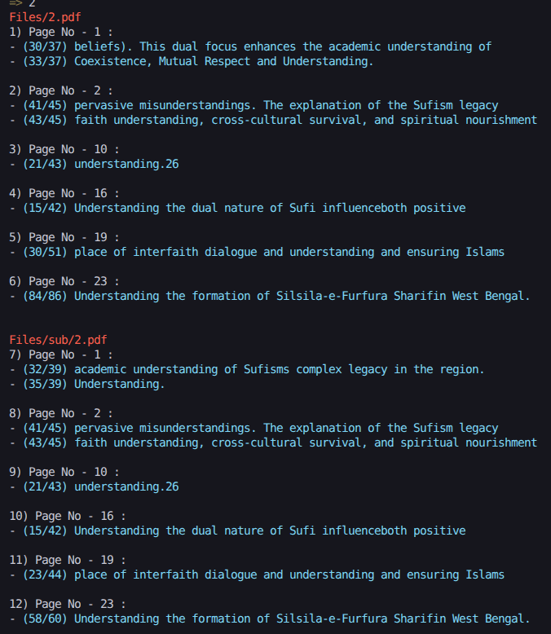
MODULE-1
PDF Text Retrieval
Output -
File paths inside roots
Page numbers
Line numbers
Target Lines with keywords
Suggestion of words

Slide 11

MODULE-1
PDF Text Retrieval
Navigation -
User enters the serial number.
The corresponding PDF opens at the specified page in the browser.

Slide 12
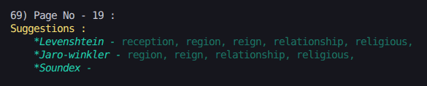

MODULE-1
PDF Text Retrieval
If Deep Search is ON, then it shows WORD SUGGESTIONS
Keyword : Religion
Keyword : Present

Slide 13
MODULE-1
PDF Text Retrieval
Three word-matching algorithms -
Levenshtein distance
Jaro-winkler similarity
Soundex

Slide 14
MODULE-1
PDF Text Retrieval
Problem - Efficiency ?
Text is repeatedly extracted from the same PDF files !!
PDF text extraction is time-consuming and computationally expensive !!

Slide 15
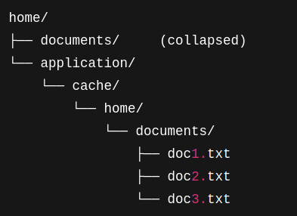
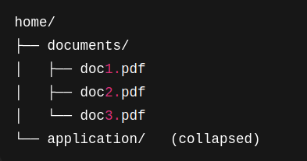
MODULE-1
PDF Text Retrieval
CACHE MECHANISM
Stores extracted text from PDFs after the first search.
Eliminates repeated PDF-to-text conversion.
Original File Structure
MIRROR File Structure

Slide 16
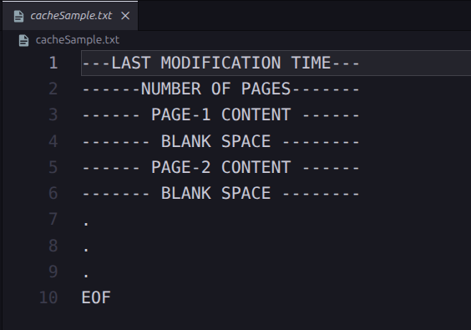
MODULE-1
PDF Text Retrieval
CACHE MECHANISM
Sample Cache File

Slide 17
MODULE-1
PDF Text Retrieval
OVERALL CACHE WORKFLOW ( HIGH-LEVEL VIEW )
PDF_SEARCH(){
- Iterate through PDF Files
- if ( PDF file does have a Cache File ) {
if(The Cache File is valid)
SEARCH_CONTENT(Cache File);
else{
DELETE_OLD_CACHE(PDF File);
SEARCH_CONTENT(Convert_to_text(PDF File));
STORE_CACHE(PDF File);
}
}else{
SEARCH_CONTENT(Convert_to_text(PDF File));
STORE_CACHE(PDF File);
}
}

Slide 18
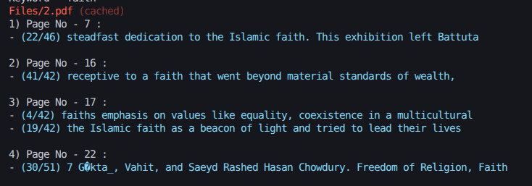
MODULE-1
PDF Text Retrieval
CACHE OUTPUT
Here, Search Result is retrieved from the cache file.

Slide 19


MODULE-1
PDF Text Retrieval
CACHE EFFICIENCY
A normal PDF File size -
Its Cache File size -

Slide 20
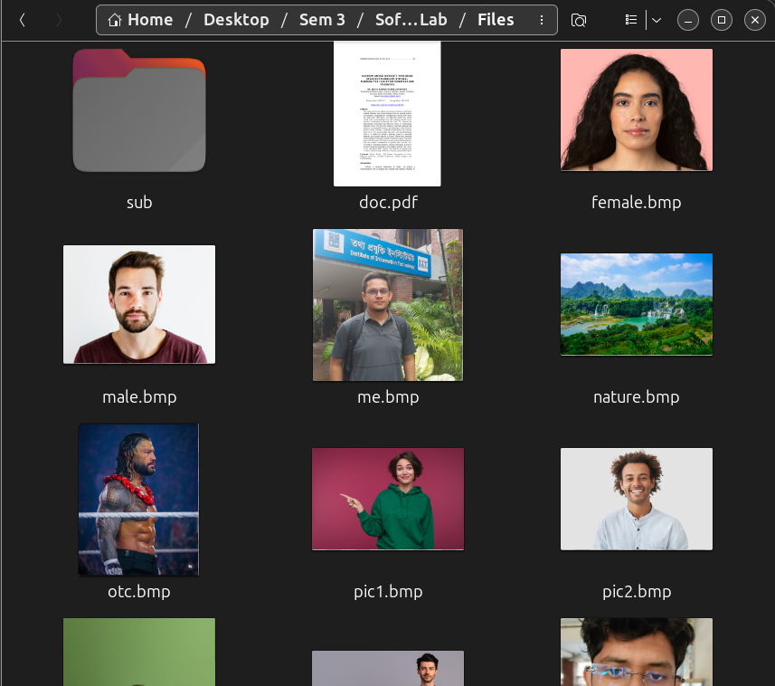
MOTIVATION - 2
Thousands of Image files stored.
Need to search and detect HUMAN SKIN regions from the images.

Slide 21
MODULE-2

Slide 22
MODULE-2
Skin Region Retrieval
The system includes an image retrieval module that identifies and extracts human skin regions using a pixel-level Naive Bayes classification model.

Slide 23
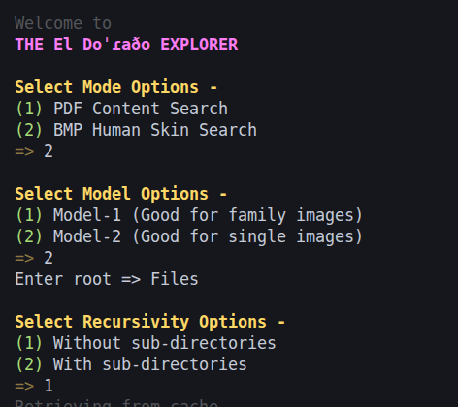
MODULE-2
Skin Region Retrieval
Inputs -
Search Mode - PDF or Image
Model Version
Specifying Root name
Search Depth

Slide 24
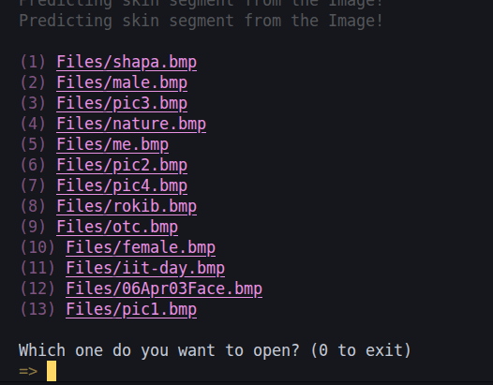
MODULE-2
Skin Region Retrieval
Outputs -
Performs pixel-level human skin region classification.
Generates and caches skin-segmented image representations
Allows the user to select which image’s skin-segmented result to view.

Slide 25
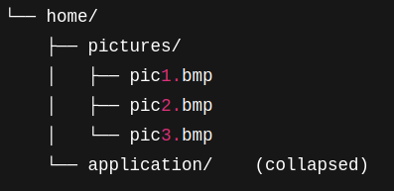
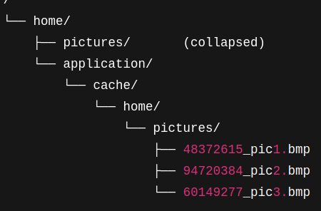
MODULE-2
Skin Region Retrieval
CACHE MECHANISM
Stores precomputed skin-segmentation results.
Avoids repeated pixel-level classification.
Original File Structure
MIRROR File Structure
Last Modification Time

Slide 26
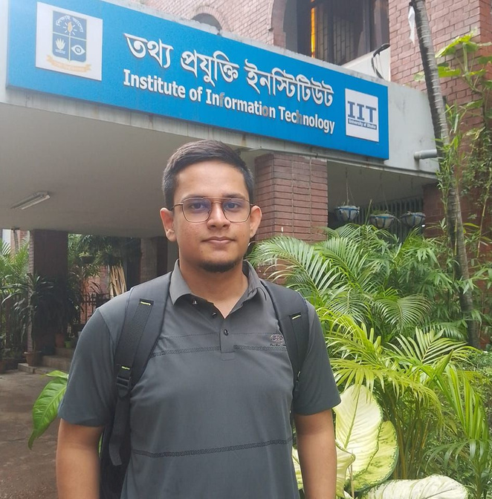
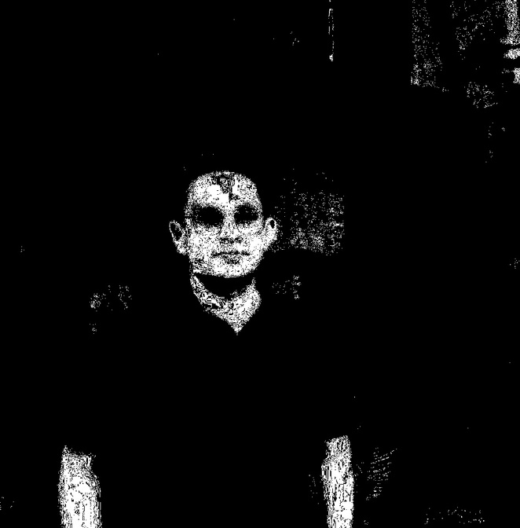
MODULE-2
Skin Region Retrieval
Original Image
Predicted Skin Segment by Model

Slide 27
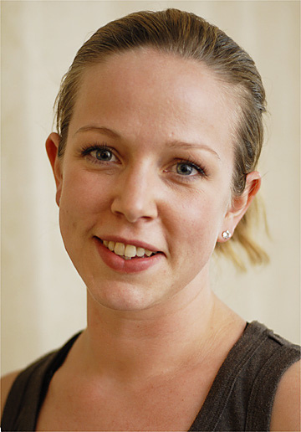

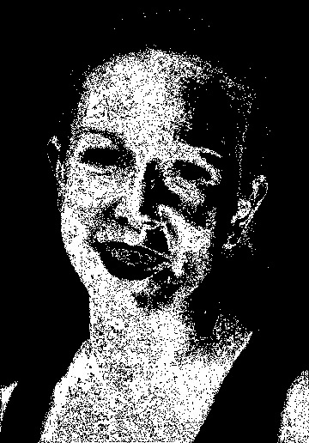
MODULE-2
Skin Region Retrieval
Original Image
Ground Truth
Predicted by Model

Slide 28
DEPENDENCIES
OS - Linux
Language - C++
Integrated Development Environment (IDE) - VS code
Version Control System - Git / Github
Library - Poppler
Dataset: Human Skin Dataset that will be used to train and test skin detection across diverse skin tones and lighting conditions.

Slide 29
THANK YOU

