Slide 1
Web-scraping project – Rent the Runway
Yunrou Gong (Crystal)
August 14, 2016

Slide 2
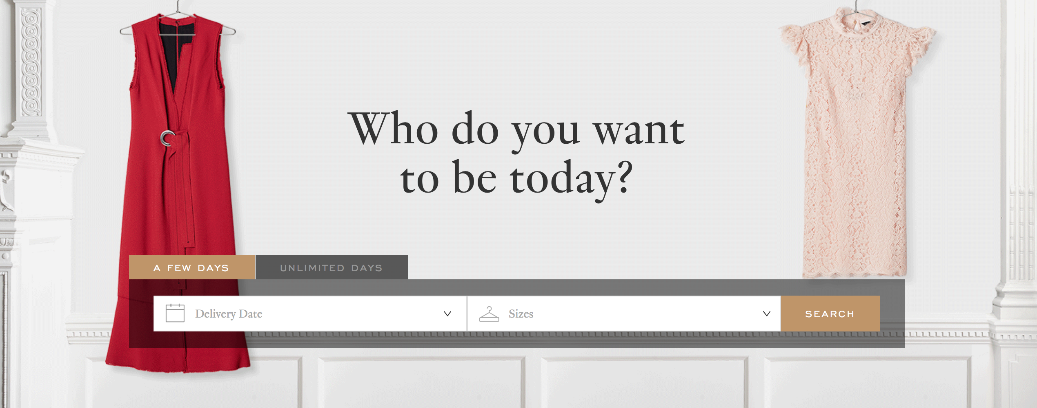
Predict Rental Prices of Rent the Runway’s Dresses

Slide 3
Contents
1.Introduction & Background Review
2. Visualization the data
3. Predictive Modelling Approaches
4. Accuracy &Validation
5. Conclusion and Recommendation

Slide 4
What is their business model?
1. Background Review
What is rent the runway?
Two time options for customer to rent: 4- day or 8-day
back-up size at no additional cost to ensure fit
Additional cost for getting a second dress style with their order
Rental price is a fraction of retail price, include the dry cleaning and care of the garments
Return policy: pre-paid, pre-addressed package to return the dress
Online rental service for designer dress and accessory
purely e-commerce company
opened brick-and-mortar retail locations in New York City, Chicago, Washington, DC and Las Vegas.
Designer partners : Badgley Mischka, Vera Wang, Alexis Bittar, and Calvin Klein, etc.
4 million customers
Notes:
What is rent the runway?
Rent the Runway is an online service that provides designer dress and accessory rentals. Initially a purely e-commerce company, it later opened brick-and-mortar retail locations in New York City, Chicago, Washington, DC and Las Vegas.Rent the Runway now offers over thousands of dresses and accessories from over hundreds of designer partners, including Badgley Mischka, Vera Wang, Alexis Bittar, and Calvin Klein.
What is their business model?
Rent the Runway's 4 million customers can lease Rent the Runway’s designer dresses and accessories for a 4- or 8-day period for a fracton of the retail price. Rent the Runway carries apparel in sizes 0 to 22, depending on the designer. Each dress rental includes a back-up size at no additional cost to ensure fit. Customers can get a second dress style with their order for an additional cost. Rent the Runway provides customers with a pre-paid, pre-addressed package to return the dress, and offers insurance fee to protect against accidents. Rental prices include the dry cleaning and care of the garments.

Slide 5
Summary of the data
2072 observations
13 variables
Categorical variables: item, brand, type and img_url
Numerical variables: number of reviews, avgrating(0-10) , fit_large, true_to_size, fit_small, retailPrice , rentalPrice_4, rentalPrice_8, discount

Slide 6
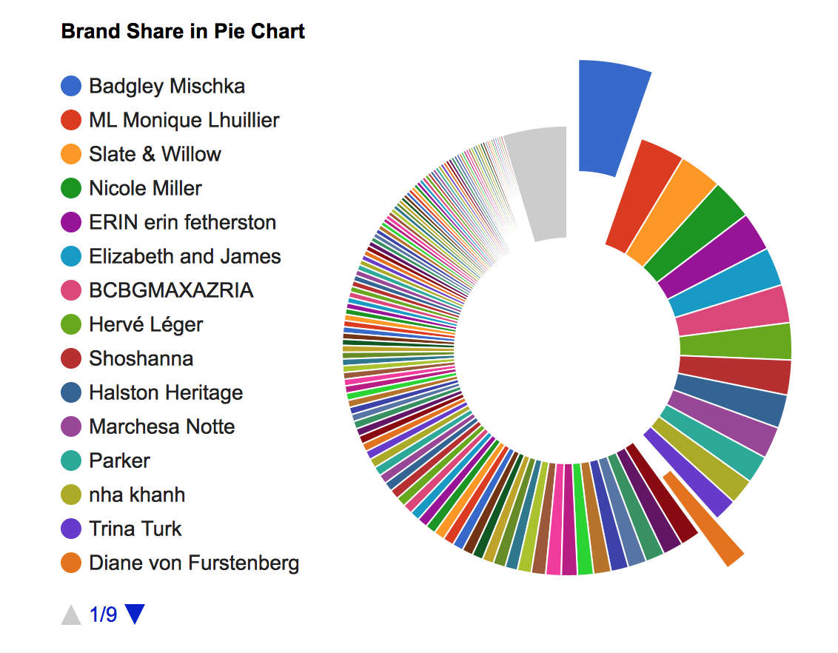
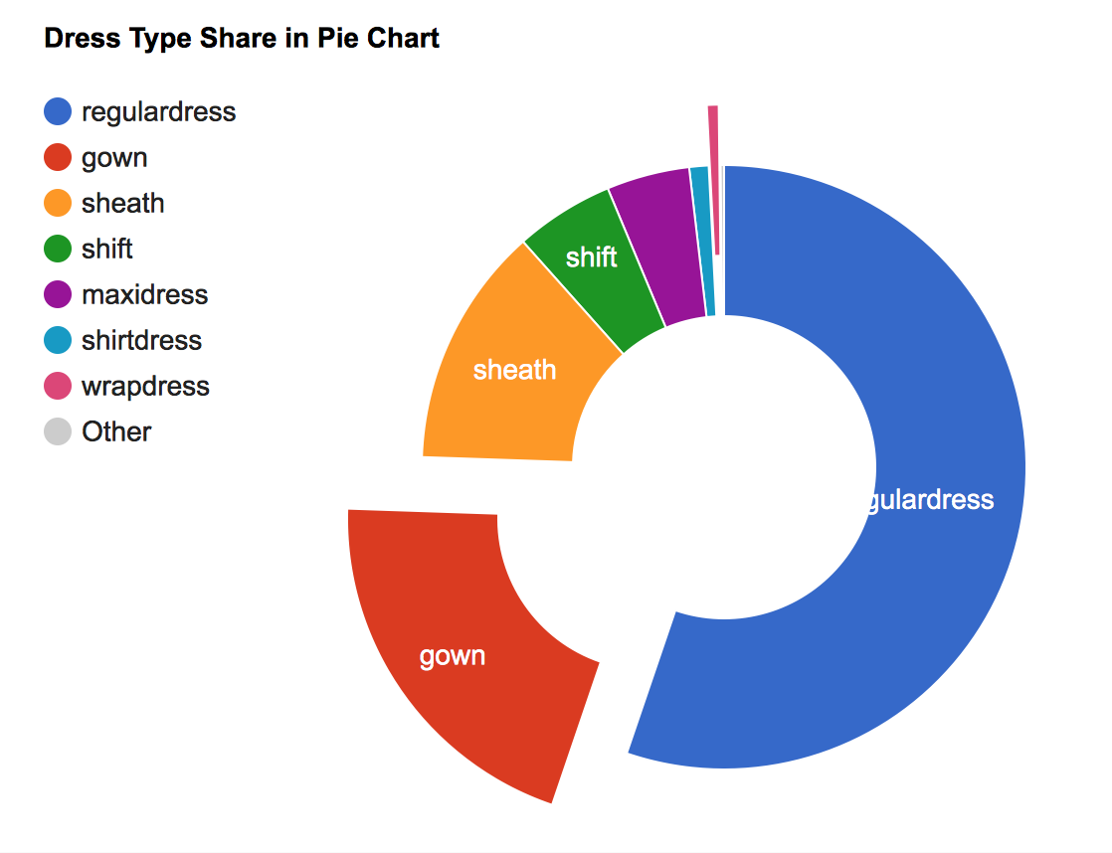
Visualization of the data by brand ,type
Notes:
Before we started to conduct the project,

Slide 7
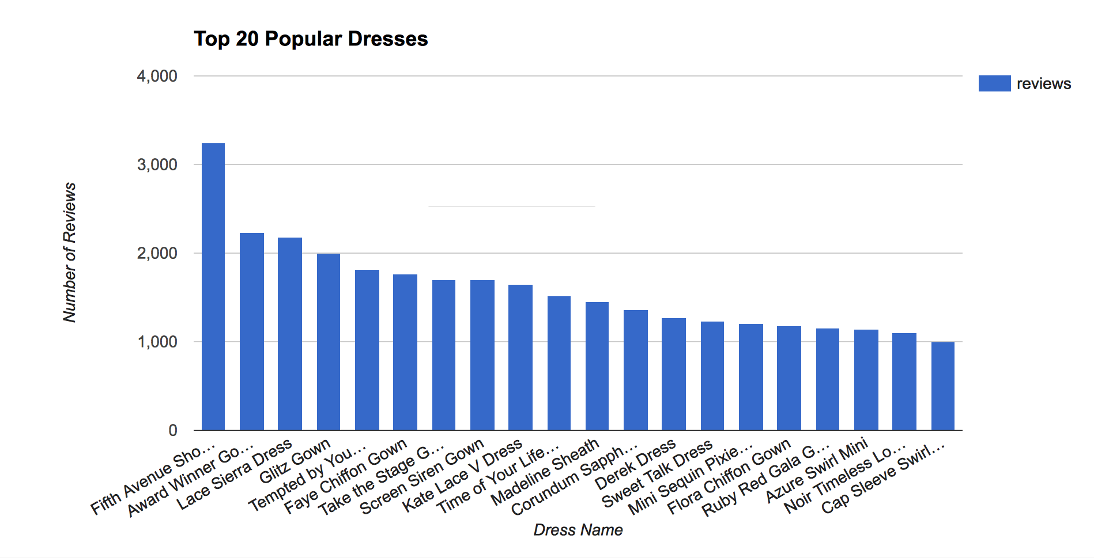
Popularity of the Dresses
Measurement : number of reviews , the more number of reviews a brand have , the more popular the it will be.
Notes:
Number of reviews treated as customer renting activity records , a random sample from the true population who rent the dresses .

Slide 8
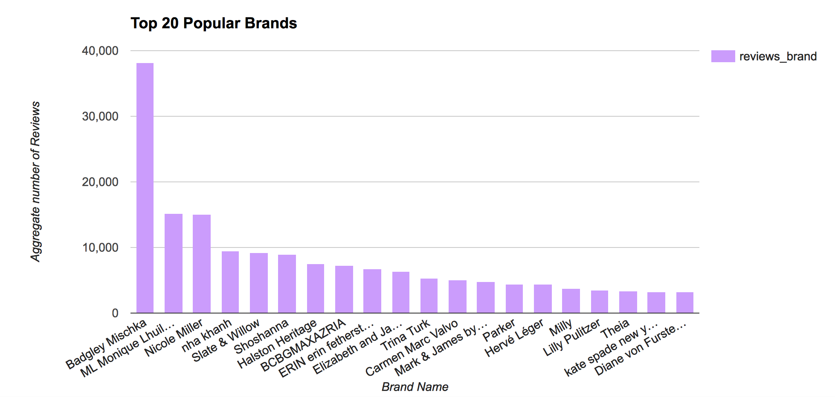
Popularity of the Brands

Slide 9
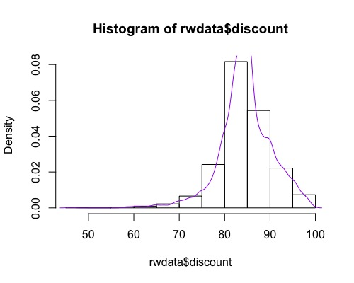
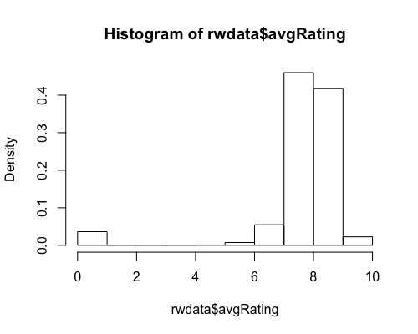
Exploratory Data Analysis

Slide 10
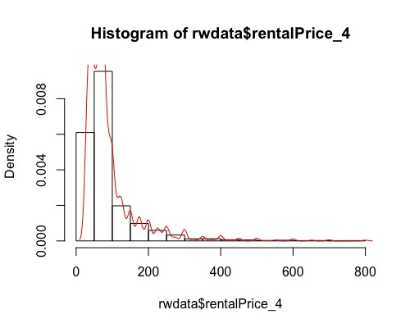
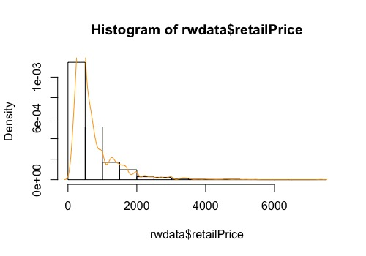
Exploratory Data Analysis

Slide 11
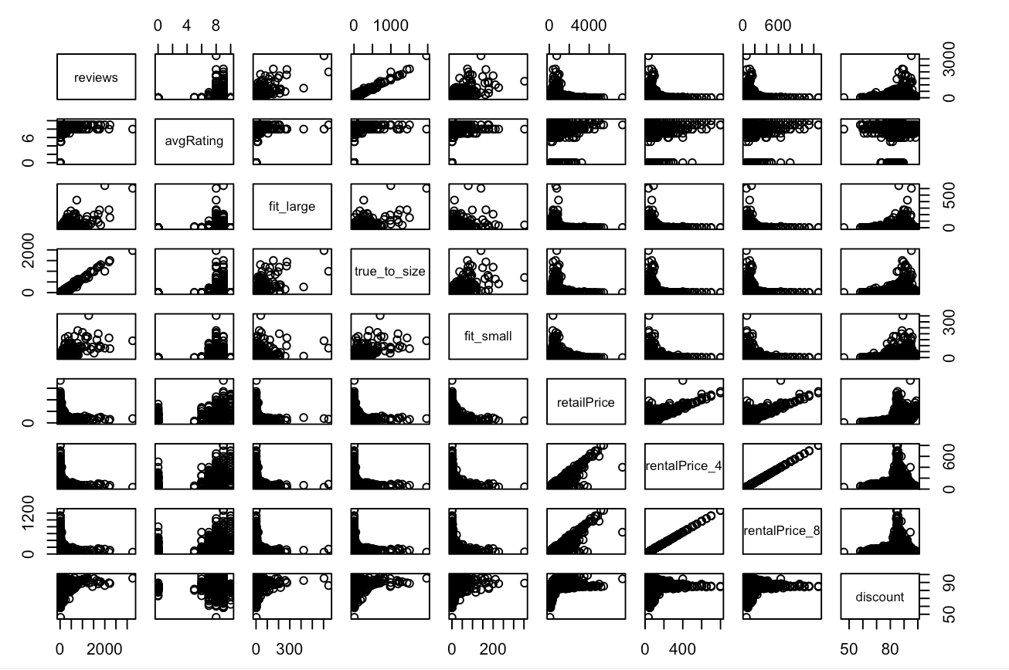
Exploratory Data Analysis

Slide 12
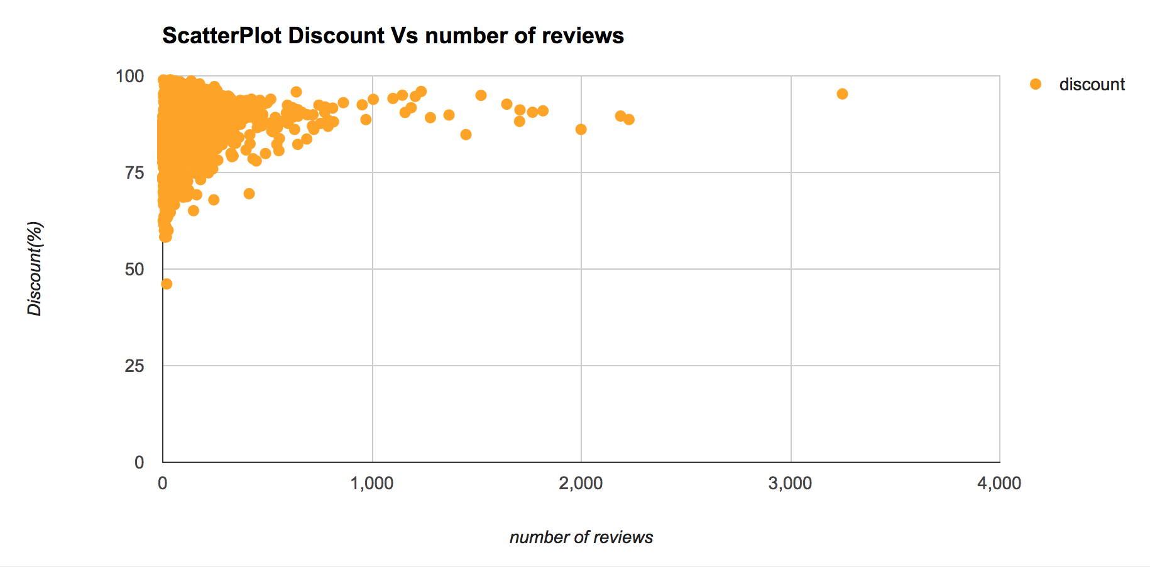
Exploratory Data Analysis

Slide 13
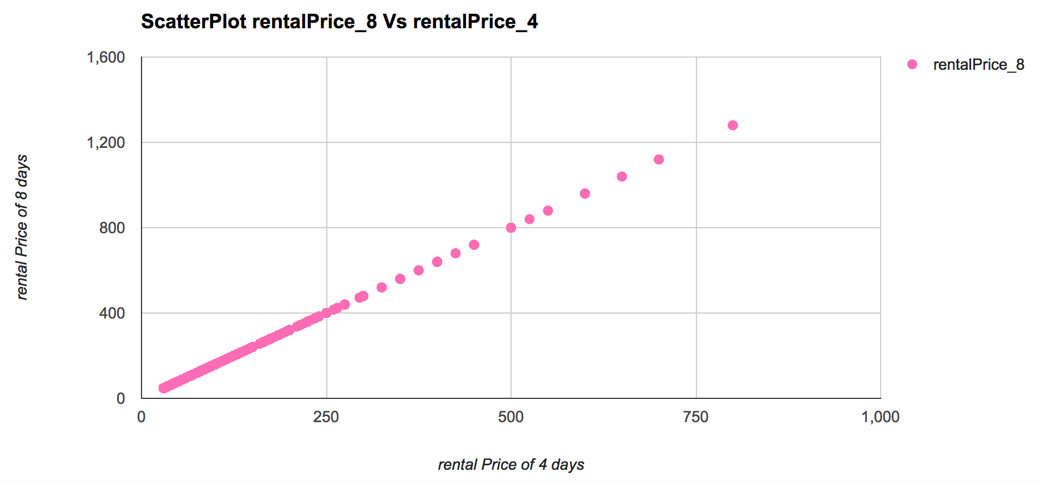
Exploratory Data Analysis

Slide 14
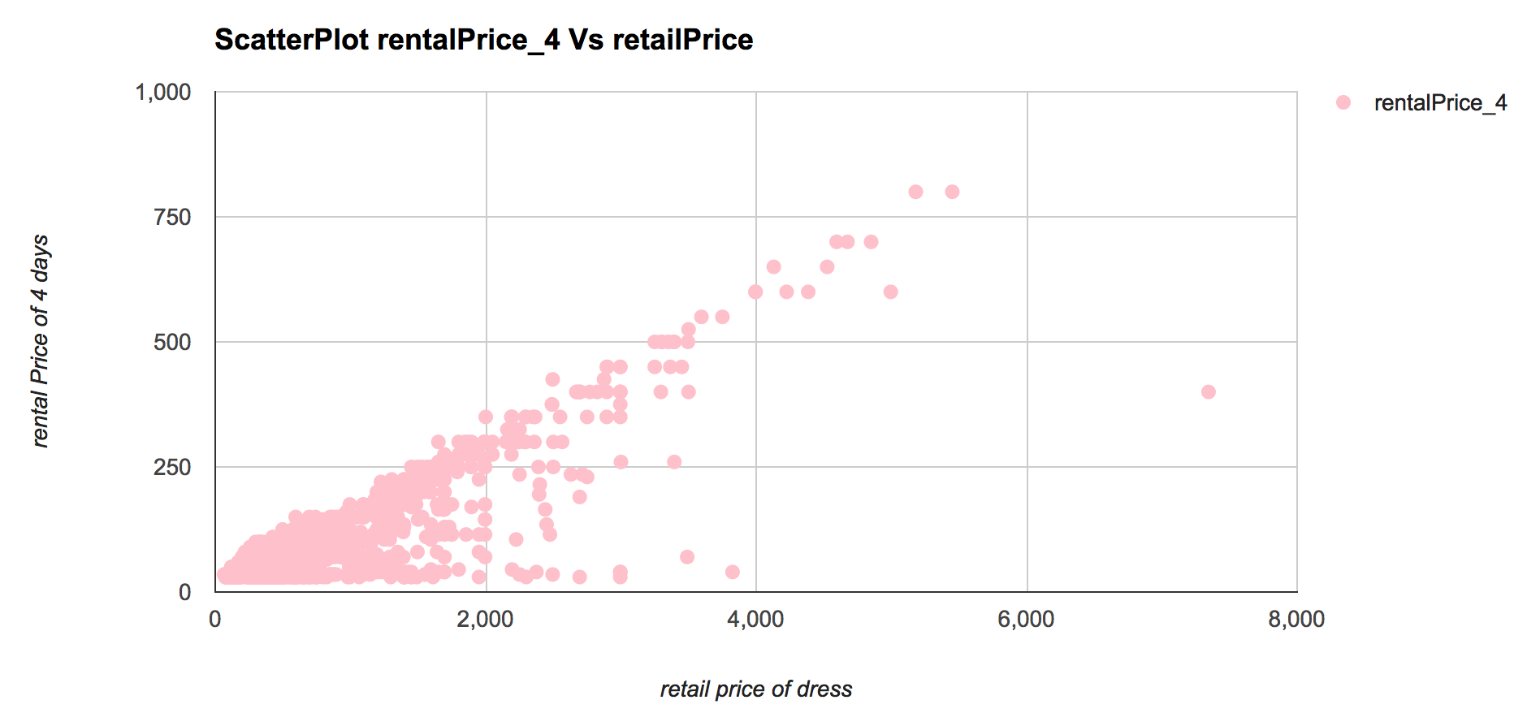
Exploratory Data Analysis

Slide 15
2.Predictive Modelling Approaches
 | Advantages | Disadvantages
Decision Tree | Easy to understand Numerical &nominal data No pre-processing | Lower accuracy if prevent over-fitting Complex calculation with uncertainty
Clustering | different methods can be applied for grouping | better for static data, not for time series
Artificial Neural Network | non-linear dependence powerful in modeling any relationship | complex calculation over-fitting
Regression (linear & non-linear) | Easy to build model with multiple variables | Factor selection Not able to deal with higher dimension data

Slide 16
4.Accuracy & Validation
Classify unseen data
Build model
Measure performance
assessing how the results of a statistical analysis will generalize to an independent dataset.
uses the training set of data
based on iteratively partitioning the full set of training data into training and test subsets
Training set
(seen data)
The more training, the better the model
Test set
(unseen data)
The more test data, the more accurate the error estimate
Notes:
Cross validation is a model validation technique for assessing how the results of a statistical analysis will generalize to an independent dataset.
For classification problems, we measure the performance of a model in terms of its error rate, that is, percentage of incorrectly classiﬁed instances in the data set.
So we build a model based on the training set because we want to use it to classify testing set. In other words, we use training data (seen data) to build the model and use the testing set (unseen data) to measure its performance.

Slide 17
5.Conclusions and Recommendation
Key findings
Recommendation

Slide 18

Questions and Answers

