Slide 1

Exploration of Alexa website rankings

Slide 2
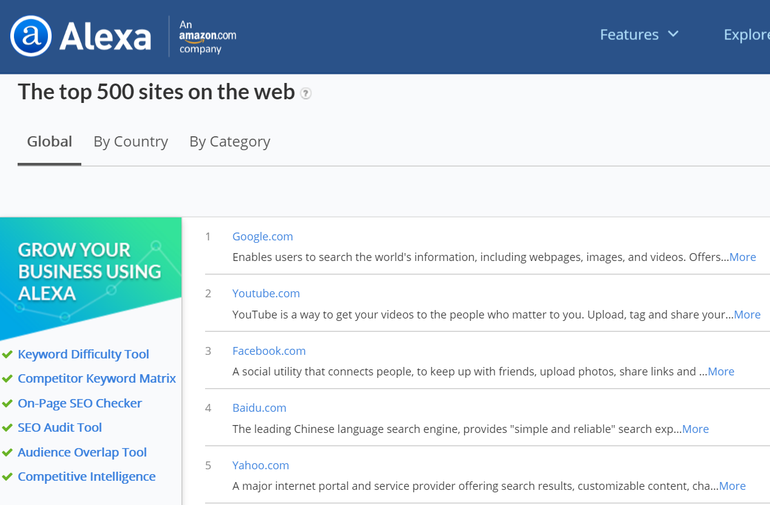

Slide 3
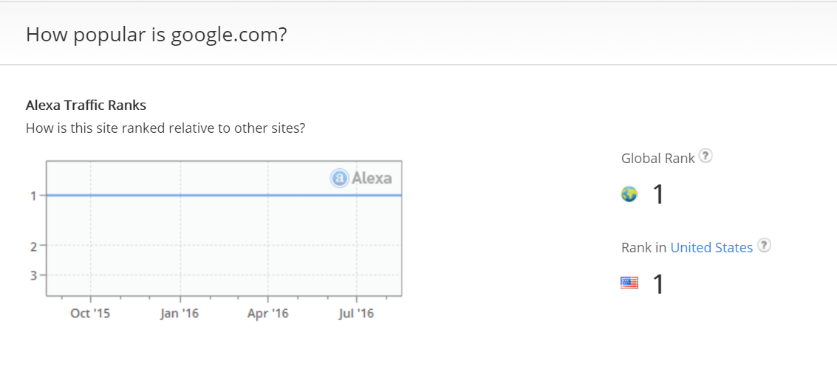

Slide 4
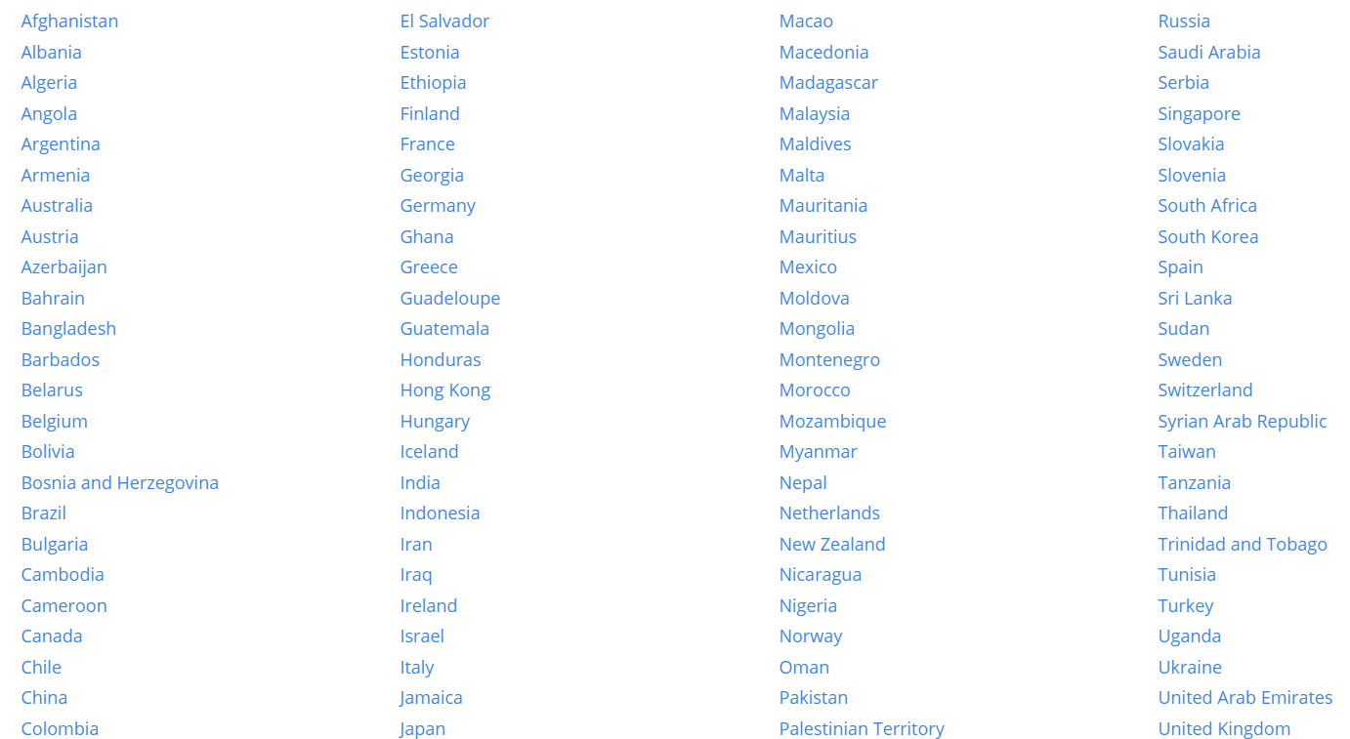

Slide 5










Top 10 Websites by Global Traffic

Slide 6
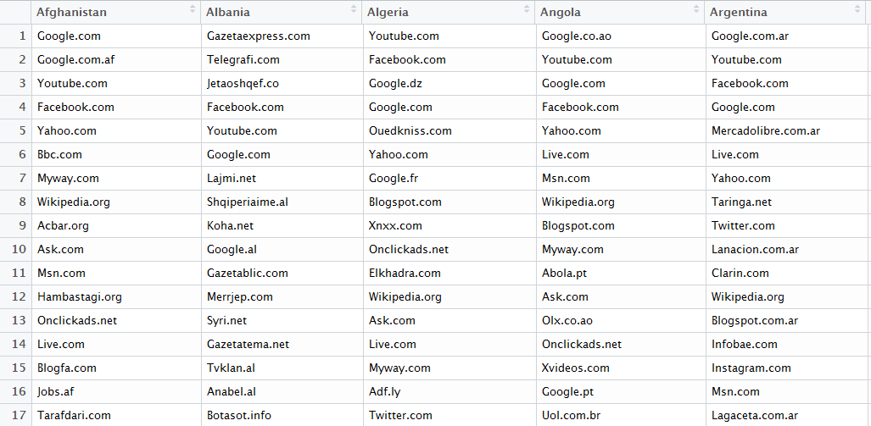
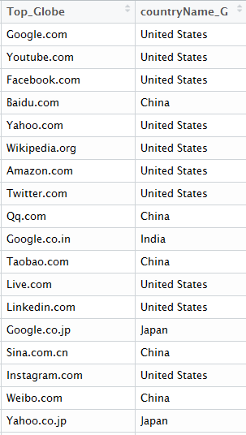
All Categorical Data!!!

Slide 7
Questions
(1)How to identify the biased Websites in the global ranking ?
(2)How to define bias?

Slide 8
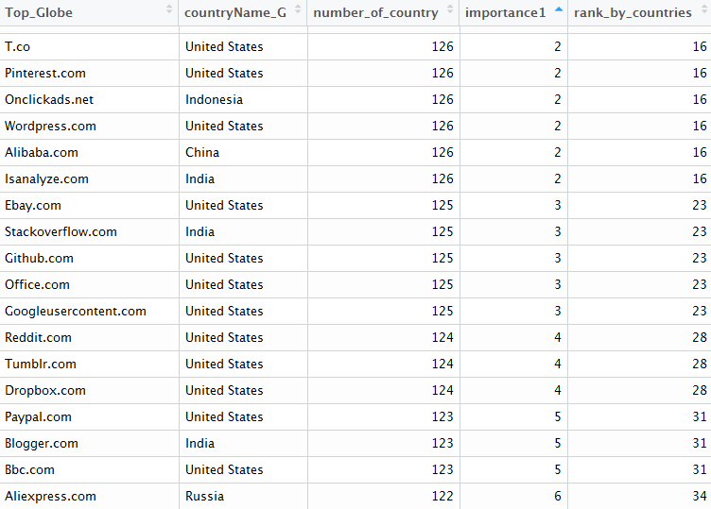

Slide 9



Top 10 Websites by Popularity among countries

Slide 10
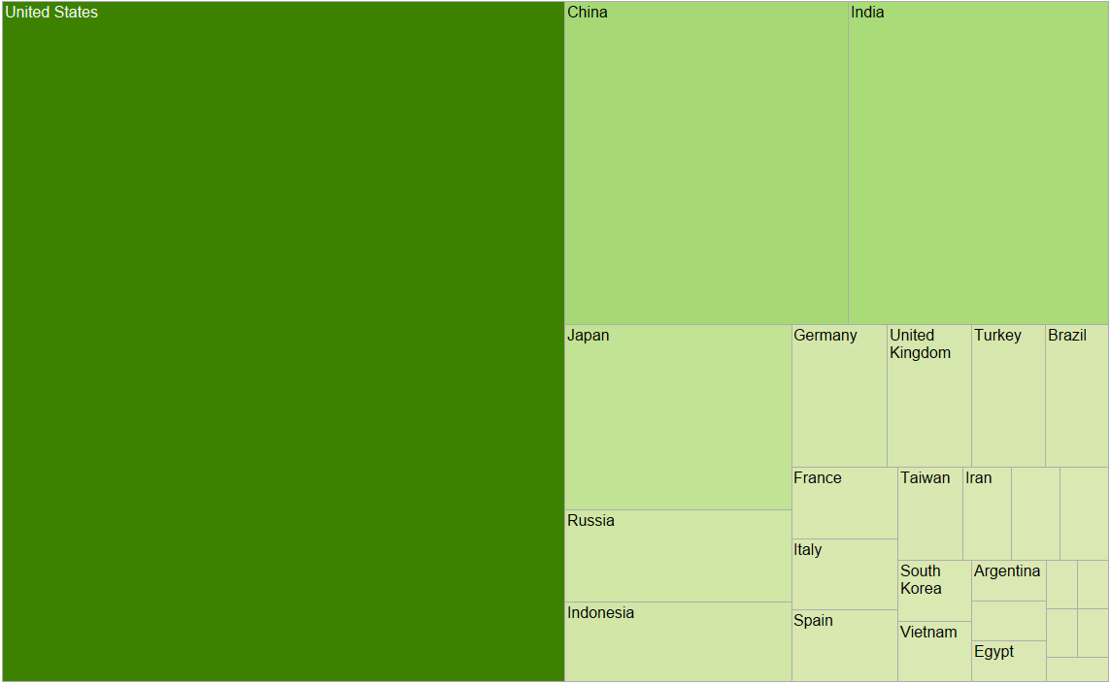

Slide 11
