Slide 1
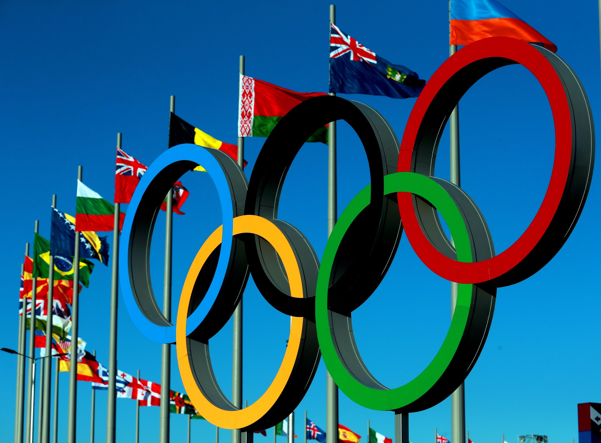
Analysis of Olympics Games
Shuo Zhang
August 14, 2016

Slide 2
Web scraping
website: http://www.sports-reference.com/olympics/
web scraping:
Events of country medal leaders among 28 summer Olympics Games
Events of country medal leaders of 3 sports among 28 summer Olympics Games
Events of athletes and medalists of 84 countries during 2012 Olympics Game
analysis:
History of country medal leaders
Contributing factors to total medals by different countries
Gender and age distribution of athletics and medalists in 2012 Olympics
History of country medal leaders in 3 sports: swimming, athletics and gymnastics

Slide 3
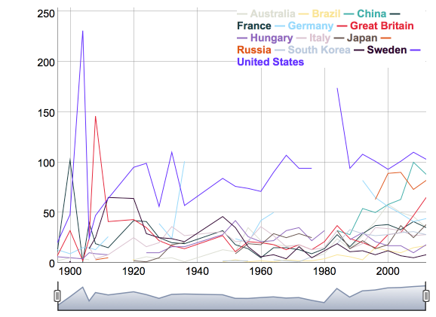
Medal by country
History of Medal by Country:
231:48
St. louis, US
1890 Olympics:
Led by the United States, 65 countries boycotted the games because of the Soviet war in Afghanistan.
174:94
LA, US
146:24
London, UK
100:63
Beijing, China
102:11
Paris, France
1890:
Moskva, Soviet Union
1932–1948:
as part of the Republic of China
1952–1980:
China did not participate.
1894 Olympics:
China attended the games for the first time.
27:41:58
Sydney, Australia
30:47:65
London, UK
Past Olympic success:
Medals won in the past can be seen as an indicator of "sports culture”.
Host-country effect:
Performing in front of a home crowd, combined with extra investment in sport, gives the country a medals boost.
Future-host effect:
Due to increased investment in sport in the future, the country performs better.

Slide 4
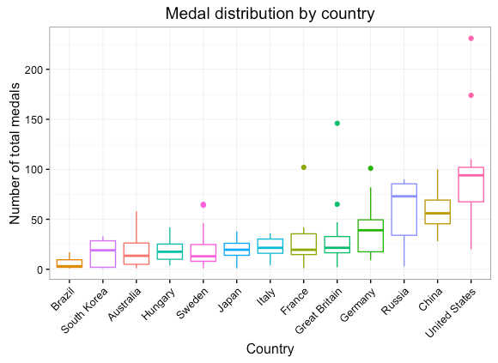
What about other contributing factors?
Wealth (GDP)?
Countries with a high GDP, like Germany or USA, can afford to invest in sports facilities, and their populations have enough leisure time and money to take part in sports.
Population?
A big population means a big talent pool to choose athletes from, like China.
Planned economies (GDP growth)?
These countries tend to have more money to invest in sport, like China.
Health (life expectancy)?
Countries with a high life expectancy, have a big healthy pool to choose athletes from, like Japan.

Slide 5
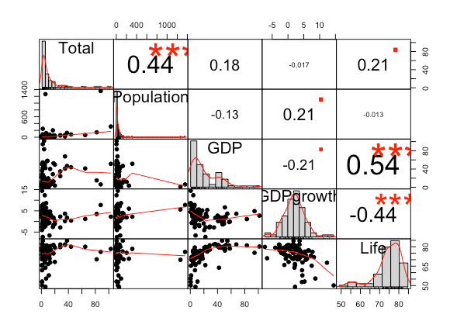
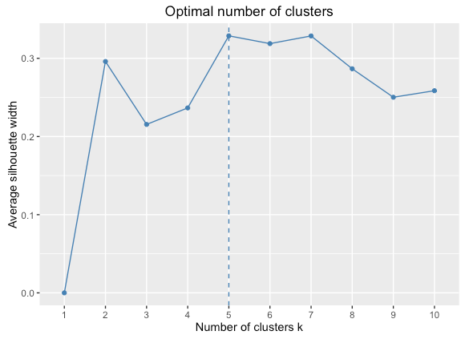
K-means clustering (2012 Olympics):
K Means Clustering:
An unsupervised learning algorithm: no outcome to be predicted
Cluster data based on their similarity: find patterns.
Drawbacks:
Strong sensitivity to outliers and noise
Average silhouette method to determine clusters K:
Compute clustering algorithm for different values of k.
For each k, calculate the average silhouette of observations (avg.sil)
Plot the curve of avg.sil according to the number of clusters k.
The location of the maximum is considered as the appropriate number of clusters.

Slide 6
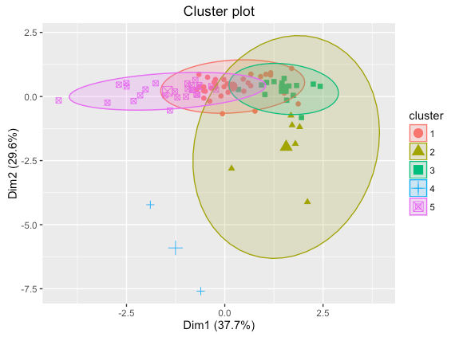
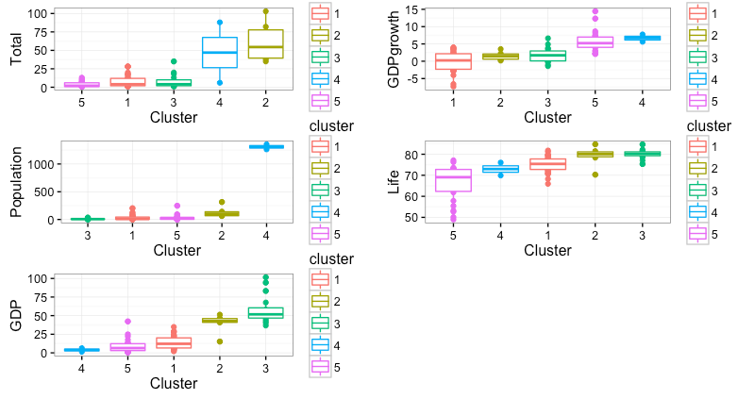
K-means clustering (2012 Olympics):

Slide 7
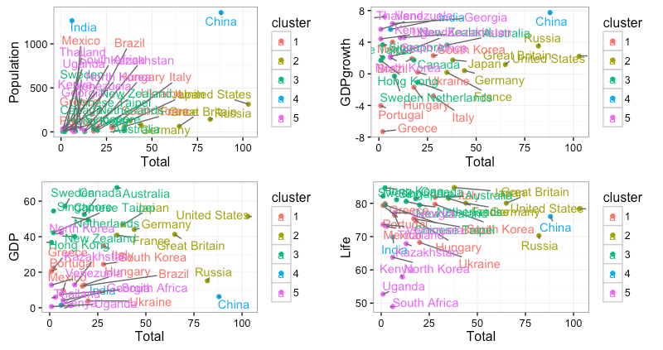
K-means clustering (2012 Olympics):
Cluster 4(China, India):
developing countries
higher avg total medal
highest avg population
lowest avg GDP
highest avg GDP growth
lower avg life expectancy
Cluster 1(Mexico, Greece,
Portugal):
developed countries
lower avg total medal
lower avg population
medium avg GDP
lowest avg GDP growth
medium avg life expectancy
Cluster 5(Kenya, South African, Thailand):
developing countries
lowest avg total medal
medium avg population
lower avg GDP
medium avg GDP growth
lowest avg life expectancy
Cluster 2(UA, UK, Russia):
developed countries
highest avg total medal
higher avg population
higher avg GDP
lower avg GDP growth
higher avg life expectancy
Cluster 3(Australia,Netherlands,Canada):
developed countries
medium avg total medal
lowest avg population
highest avg GDP
medium avg GDP growth
highest avg life expectancy

Slide 8
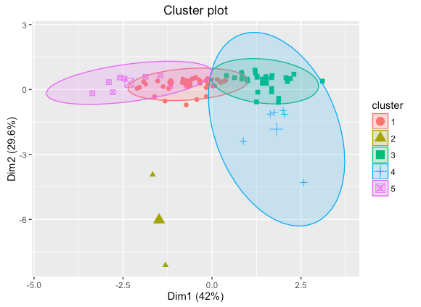
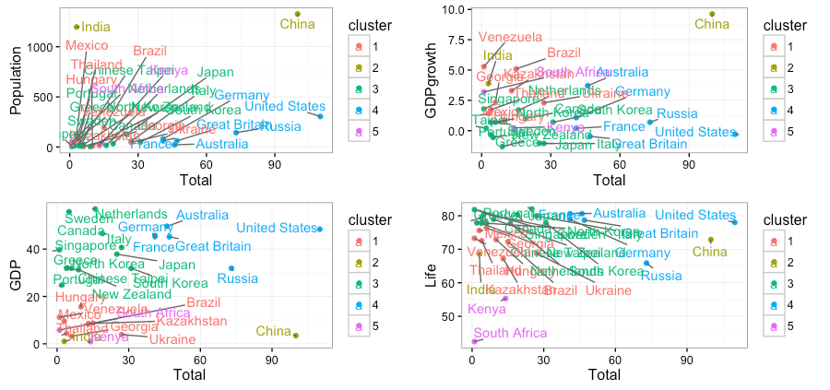
K-means clustering (comparison 2012 and 2008 Olympics):
Drawbacks:
Strong sensitivity to outliers and noise
2012
2012
2008
2008
Country Total Population GDP GDPgrowth Life cluster Year
1 Australia 46 21.37035 49.62812 3.7066995 80.62 4 2008
2 Greece 4 11.16175 31.99728 -0.3351726 79.38 3 2008
3 Japan 25 127.31790 37.86562 -1.0416360 82.02 3 2008
4 Portugal 2 10.57746 24.81561 0.1992723 77.87 3 2008
5 Japan 38 127.13982 46.70101 1.7422004 84.74 2 2012
6 Greece 2 11.10966 22.24268 -7.3004939 79.92 1 2012
7 Portugal 1 10.51502 20.57740 -4.0282567 79.33 1 2012
8 Australia 35 22.91137 67.64610 3.6327203 81.81 3 2012

Slide 9
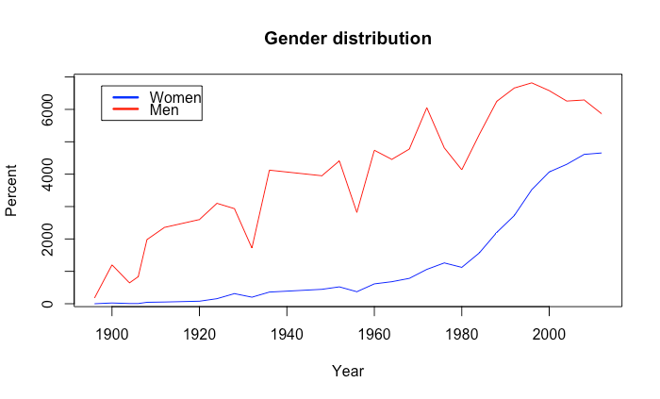
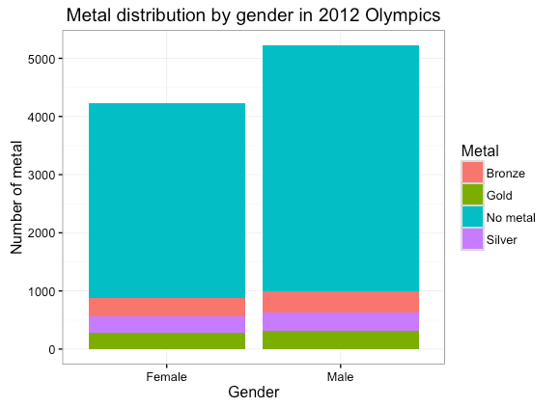
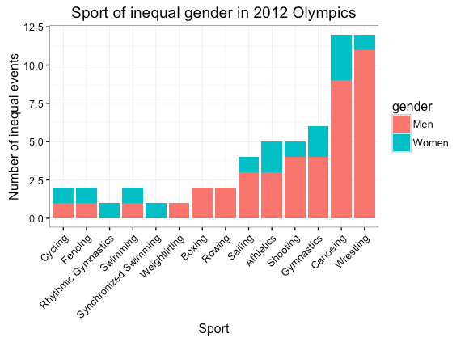
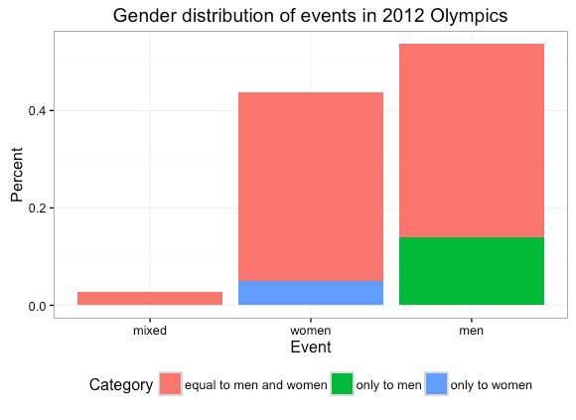
Gender distribution (2012 Olympics):
872
991
162
132
8
15
42
More women are engaged in Olympics.
There is still some way to go to achieve gender equality.

Slide 10
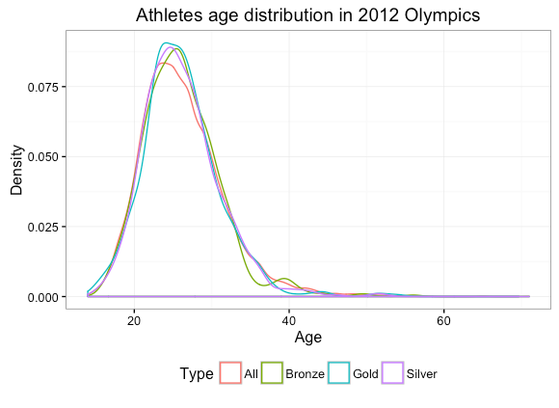
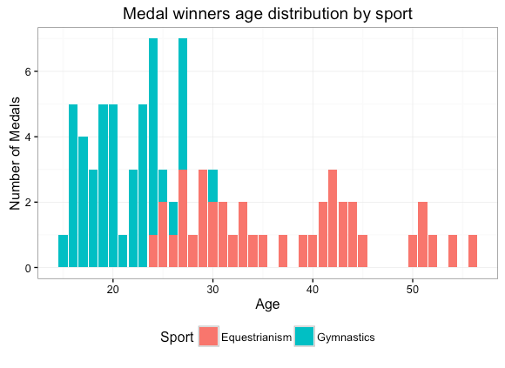
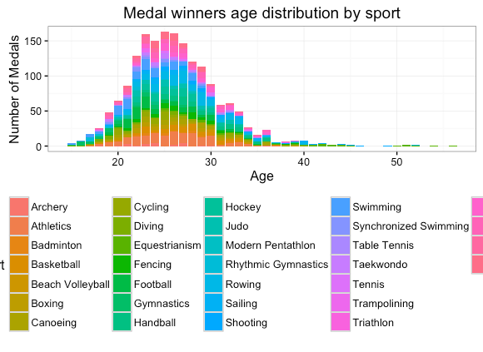
Age distribution (2012 Olympics):
Age distribution:
youngest medalists :15
oldest medalists: 56
older medalists (late 30s-over 40) win fewer total medals
than medalists within the age-range “sweet spot” of late teens-early 30s.
Sport:
Some sports, like equestrianism,have older athletes winning medals, whereas a sport like gymnastics has a peak age-range of early-to-late teens and early 20s.

Slide 11
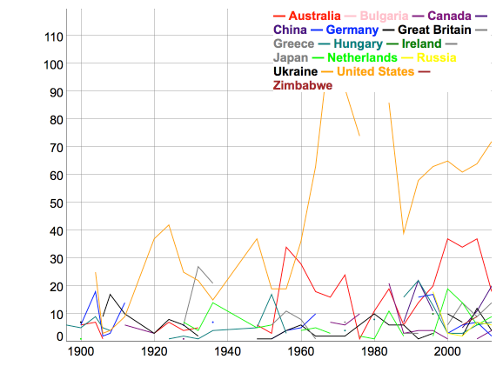
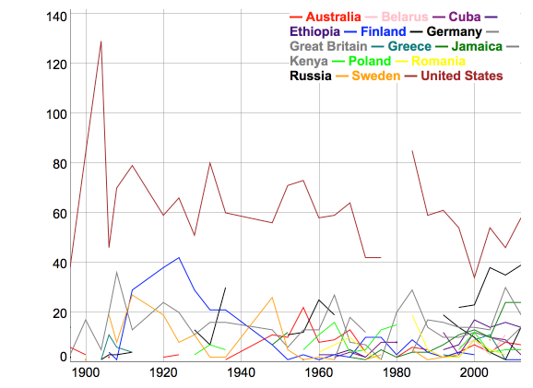
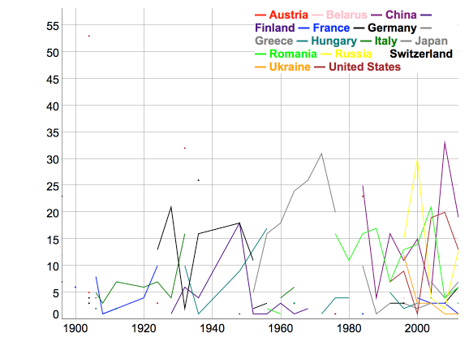
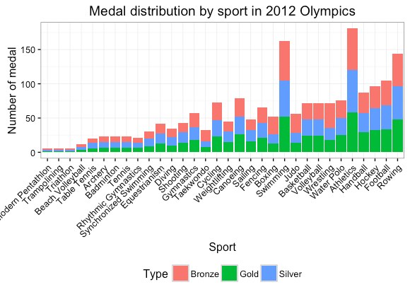
Medals by sport:
swimming by score (with greater weights on Gold)
athletics by score (with greater weights on Gold)
leading country:
US
Australia
China
Netherland
leading country:
US
Russia
Jamaica
Kenya
gymnastics by score (with greater weights on Gold)
leading
country:
China
US
Russia
Romania
Athletics is number one, followed by swimming, rowing, and football.

Slide 12

If I have more time:
K-means clustering analysis among 1960-2004 year
analysis of gender and age distribution of all Olympics games
analysis of more sports

