Slide 1
Pump it up, Drill it down:
An Analysis of Tanzanian Water Projects
Linlin Cheng lc1603@nyu.edu
NYC Data Science Academy
September 18, 2016
Capstone Project Presentation

Slide 2
Overview
Linlin Cheng | lc1603@nyu.edu
Question:
How to classify the functionality of water projects, which are functional, which needs some repair, and which don’t work at all?
Methodology:
Data Visualization
Extreme Gradient Boosting
Result:
i) Significantly negative impact observed on regional and cross-regional regressions.
ii) Obscured effects from macroeconomic indicators.
iii) Case Study: Cambodia, an outlier
Further research:
i) Case study for other outliers: Haiti, Jamaica and Tajikistan.
ii) Reasons behind obscured effects from macroeconomic indicators.
iii) Policy implications in minimizing the cost of de-dollarization.

Slide 3

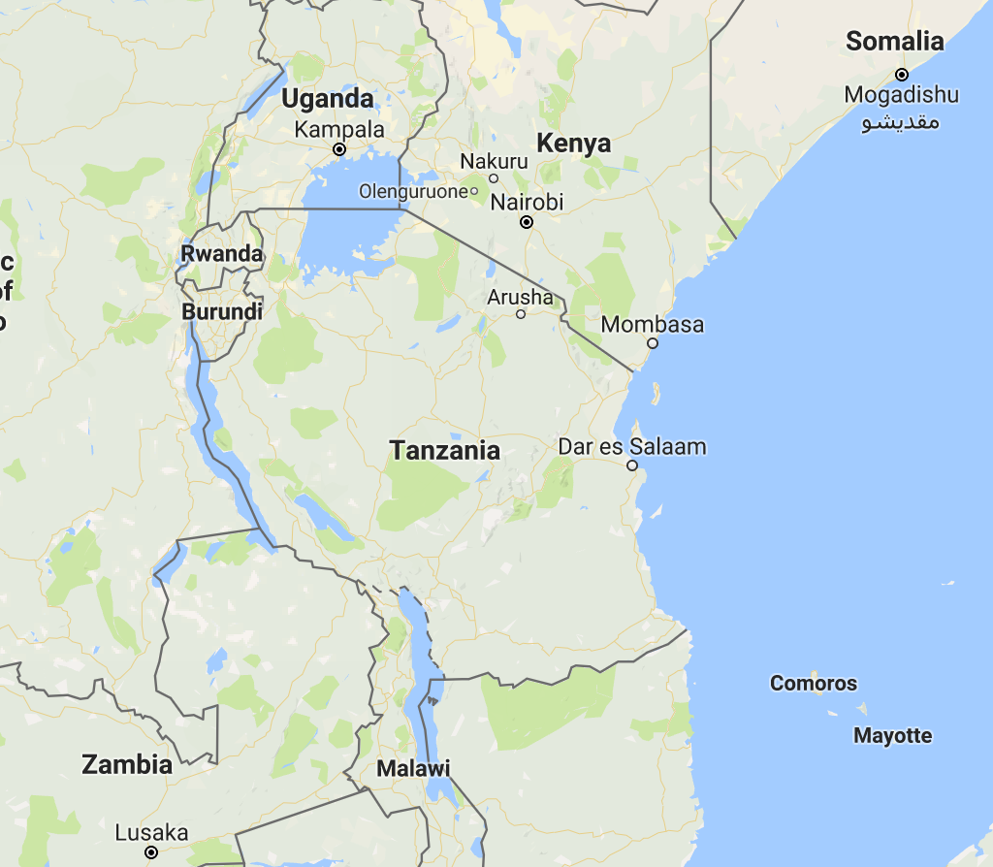
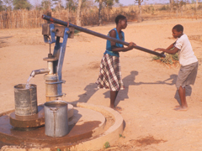
I. Tanzania, so much water, what is the problem?
Tanzania, borders three of the largest fresh water lakes in the world:
Lake Victoria
Lake Tanganyika
Lake Malawi
Yet huge numbers of the country have only minimal or none access to water:
54% of rural lack access to water
92% of rural lack sanitation
Due to:
Lack of safe water supply infrastructure
Ground water contaminations
Distant surface water source
Mixed pattern overall
Common increase during crisis
Increasing: Cambodia, Haiti. Jamaica
Decreasing: Laos, Vietnam, Bolivia, Paraguay, Costa Rica, Kyrgyz Republic, Azerbaijan
Unclear: Indonesia, Tajikistan, Kazakhstan
Notes:
Social , gender inequalities

Slide 4

Imagine walking 3-5 miles per day for some questionable buckets of water…

Slide 5
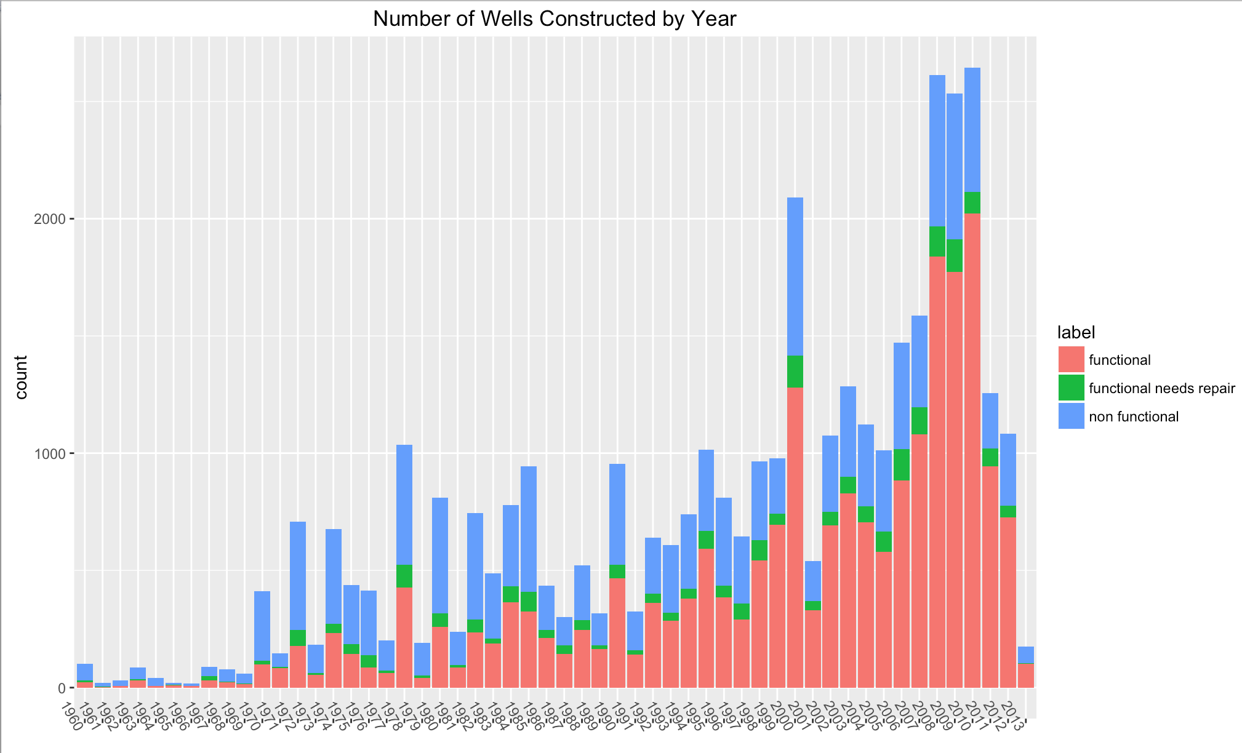
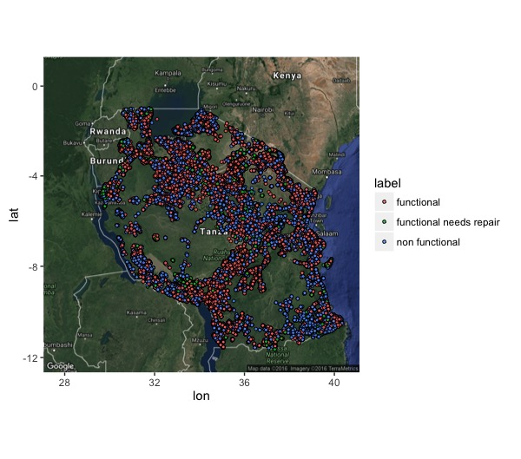
II. Water Projects, an effective solution?
NGOs, Central governments,
and local communities have
stepped in to build individual
Improved water points.
How effective are they?

Slide 6
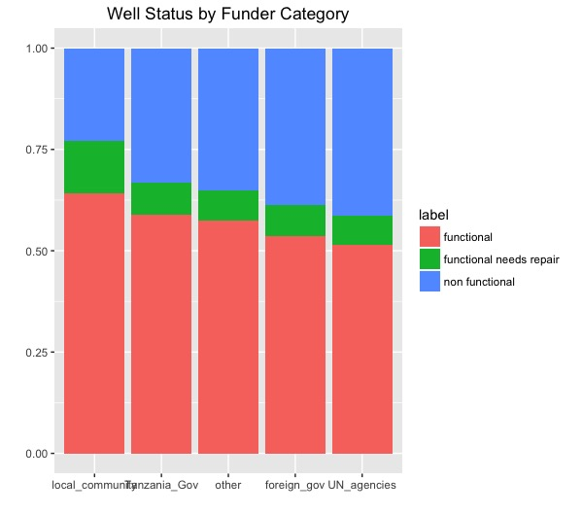
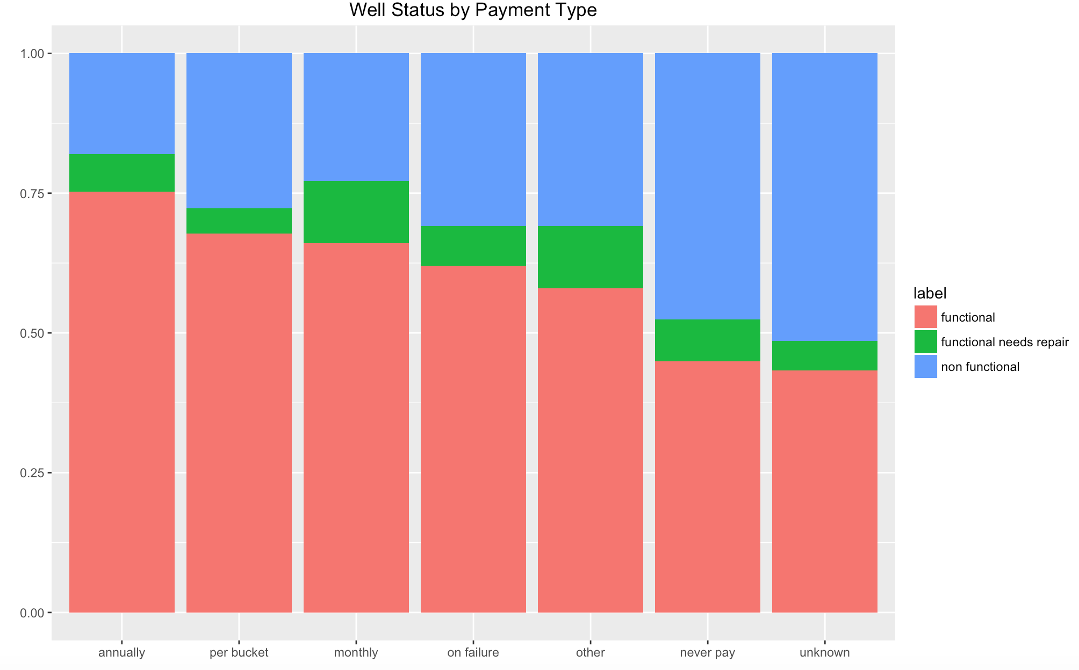
III. Exploratory Data Analysis
Market
Non-Market
Searcher
Planner
Due to lack of feedback loop and lack of
market existence, local communities are doing
better jobs but in need to more funding

Slide 7
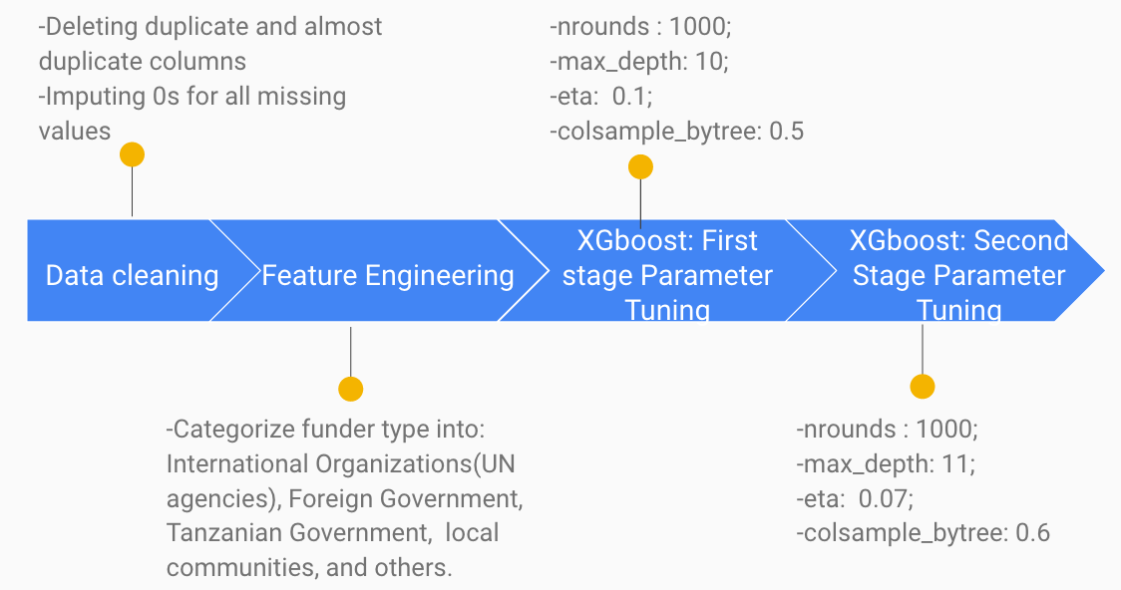
III. A Machine learning approach to identify functionality of future projects
Data:
Source: DrivenData.org (collected from Taarifa and Tanzanian Ministry of Water)
Sample Size: 41 features with 59,400 observations
Notes:
Fuzz matching

Slide 8
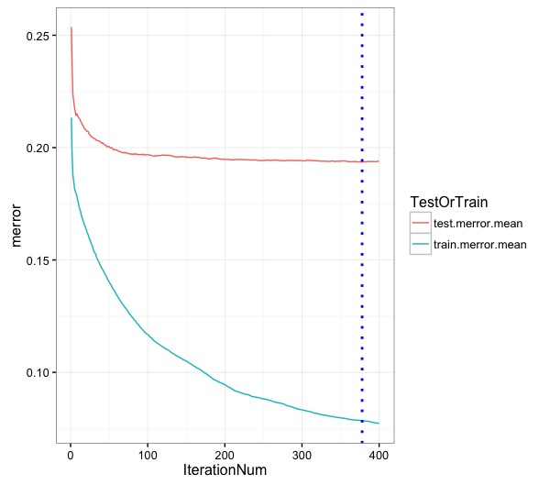
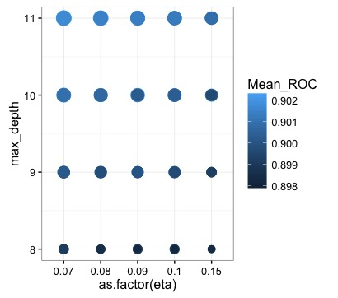
IV. Result
Parameter Tuning results:
Confusion Matrix for on Test data classification
 | Functional | Need repair | Non-functional
Functional | 4051 | 238 | 2215
Need repair | 562 | 31 | 266
Non-Functional | 2846 | 129 | 1542
Accuracy: 81%

Slide 9
V. Conclusion
1. Without further accountability and feedback loop, international donors are not as efficient as local communities.
2. Free goods are often exploited. We need to create a market to reward for project construction and maintenance.
3. repair functional needs repair, non-functional ones that are listed as “enough”
Suggestion: Drill international funds down to local searchers, create incentives where there is none, and establish systems for maintenance.
Notes:
After all those qualitative and quantitative research, we again want to emphasize our two main conclusions for today’s presentations.
First of all, panel regression model indicates a significantly negative relation between the level of dollarization and trade growth on a cross-regional basis.
However, in countries with previous experience of macroeconomic turmoil or civil wars, such as Cambodia and Haiti, dollarization helps promote trade.

Slide 10
VI. Further Research
Further feature engineering
Investigate other applicable algorithms
Post-analysis on miss-classification
Shiny-app on agency donation recommendation and geo-location recommendation
Notes:
The last but not the least is the area for our further research. As what I have mentioned in the regional analysis that besides Cambodia, three other countries also display a positive relationship between trade growth and the level of dollarization, which are Haiti, Jamaica and Tajikistan. So we would like to conduct further research to find out the reasons for their trade promotion by dollarization. And we are particularly interest in comparing the similarities and the differences for those reasons.
What’s more, further research aiming at investigate why inflation and GDP growth rate don’t significantly explain trade growth in Southeast Asia and Central Asia would also be an interesting research area since obscured effects from macroeconomic indicators is what beyond our expectation.
Also, we would like to get some possible policy implications in minimizing the cost of de-dollarization in sample countries, such as how to the avoid the problem of capital flight as a result of de-dollarization.
That’s all for our presentation. Thank you for your time and attention. Any question is welcomed.

Slide 11
Thank you for your time. Questions?

