Slide 1
Sky and Sea
Disaster analysis and
remediation using new technology
By Anne Song

Slide 2
sky
Flight disasters

Slide 3
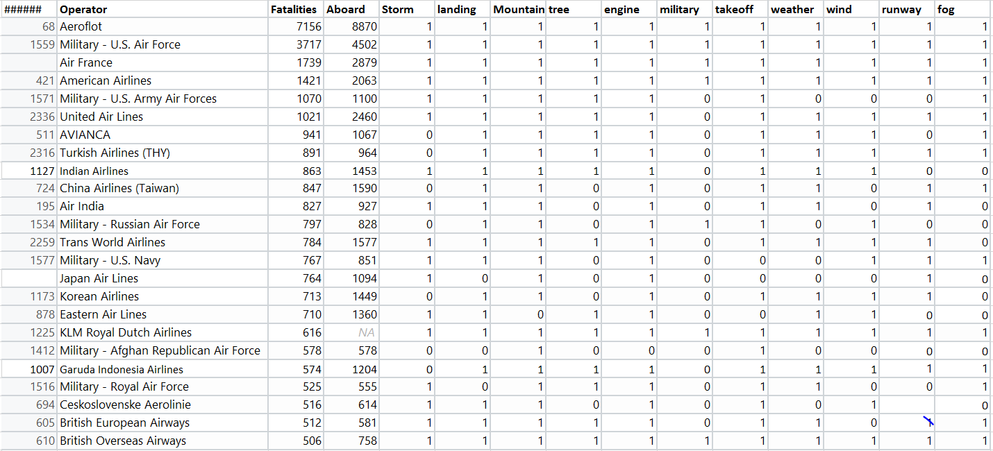
Airline Accidents by Numbers Descending Order (1908- )
Total 5268 obs.

Slide 4
Key words frequency
Key Words | Frequency
military | 861
mountain | 754
engine | 750
runway | 703
landing | 609
weather | 552
takeoff | 461
fog | 323
tree | 304
storm | 255
wind | 201

Slide 5
SEA
Oil spill

Slide 6
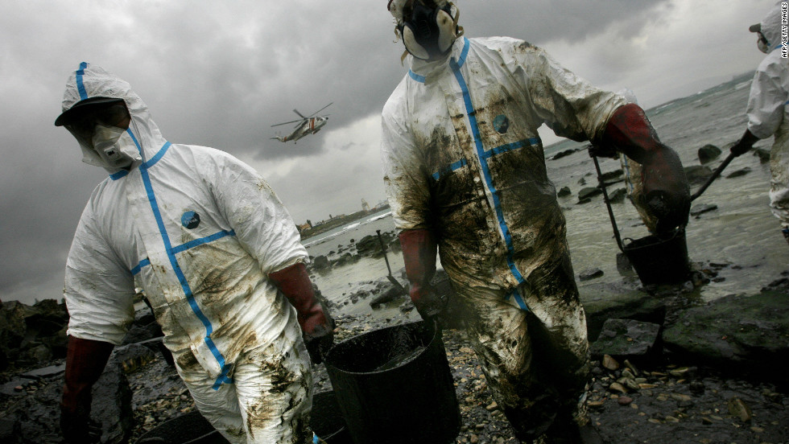
Researchers hope the use of magnets will allow them to recover more oil and lead to an easier clean up operation

Slide 7
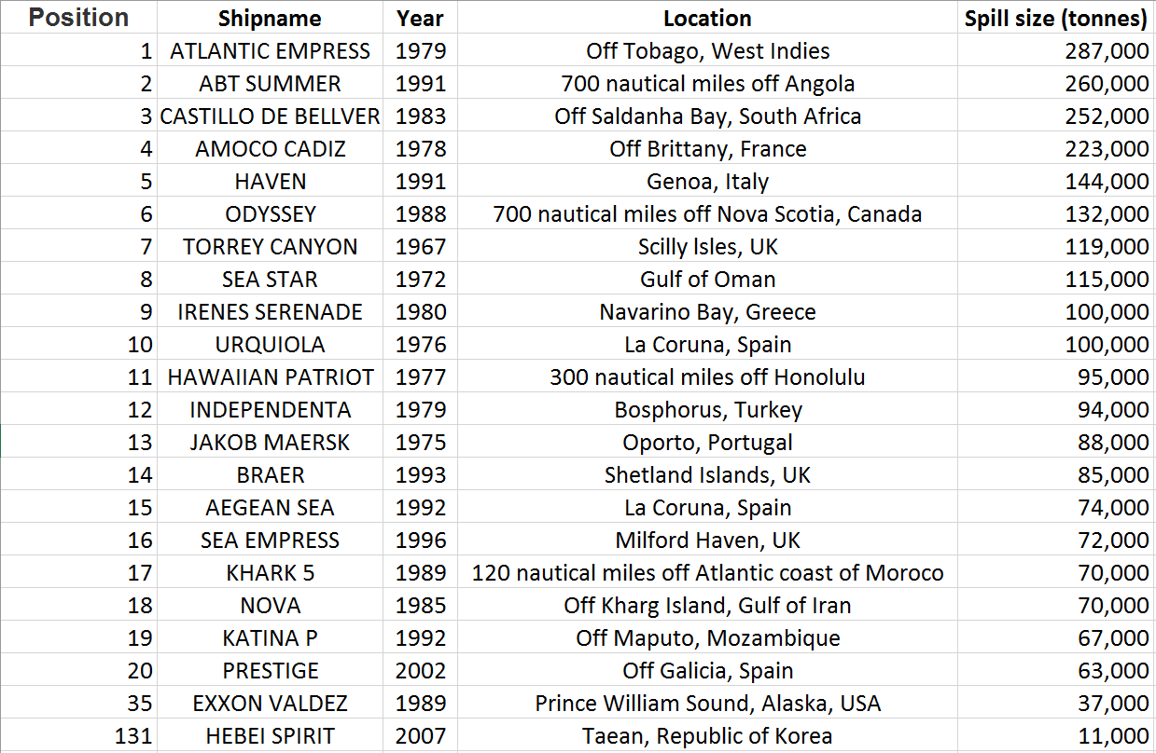
Major Oil Spill stats

Slide 8
New Technology on the horizon
Oil spills from container ships or offshore platforms are a frequent hazard to marine and coastal ecosystems.
Cleaning up oil spills could be very expensive operation. Bp Gulf of mexico oil spill in 2010, the worst environmental disaster in Us history costed BP $40 billion.
Recently, MIT scientists found a method of recovering oil after a spill using magnets, potentially saving companies like bp money in clean up bills.
On it’s own, oil is not magnetic. But when mixed with water-repellant nanoparticles that contain iron, the oil can be magnetically separated from the water. The nanoparticles can later be removed to enable the re-use of the oil.
The recovery process would be conducted out at sea after the oil spill. Seawater polluted with oil would be pumped onto a boat treatment facility. Once onboard, the magnetic nanoparticles would be added and attach themselves to the oil.
The liquid would then be filtered with the magnets to separate the oil and water with the water returned to the sea and the oil carried back to shore to an oil refinery.

Slide 9
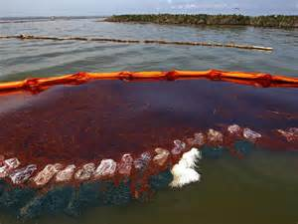
Nanotechnology Cleaning up oil spills

Slide 10
Other proposed solutions for oil spill
Use of microorganisms to digest the oil
Mechanical means like skimmers, booms, pumps, mechanical separators
Sorbents to remove oil from water through adsorption and/or absorption
Use of chemical dispersants like detergents
#Conventional techniques are not adequate to solve the problem of massive oil spills.
In recent years, nanotechnology has emerged as a potential source of novel solutions to many of the
world’s outstanding problems.

Slide 11
Nanomaterials for oil Spill cleanup
Aerogels
-Hydrophobic Aerogel
-Aeroclays
-Rice husk derived silica aerogel
Nanodispersants
-Micelles forming
-Colloidal solution of bio- based chemicals
Magnetic Nanocomposites
-Nano-hybrids of magnetic Fe-oxide NPs in organo-clays
-Magnetic carbon-metal nanocomposites

Slide 12
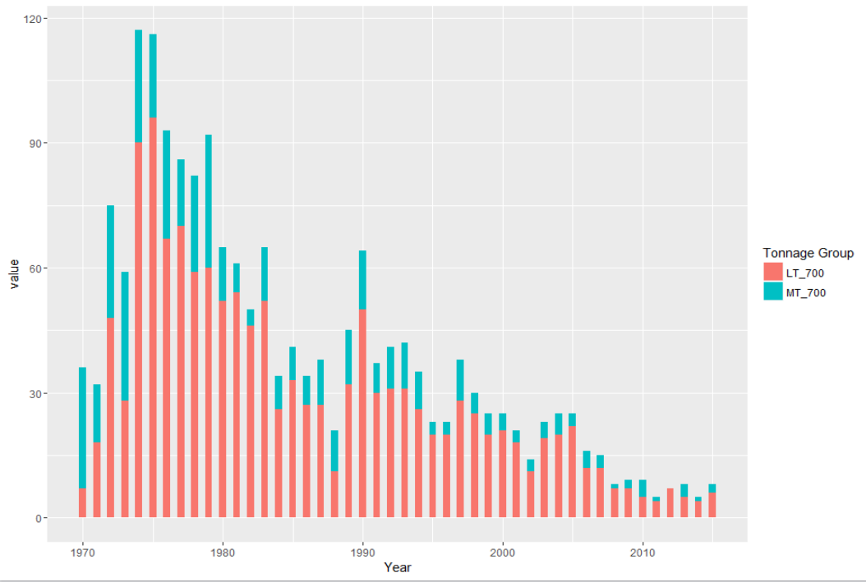
Oil Spill 1970 - 2015

Slide 13
Code
library(dplyr)
AirFatal <- read.csv('AirPlaneFatal.csv')
By_Operator <- group_by(AirFatal, Operator) %>%
summarise(Sum.Fatalies = sum(Fatalities),
Sum.Aboard = sum(Aboard),
Summaries = paste(Summary, collapse = ' '))
create.data <- function(vec, old.data) {
temp <- seq(1,nrow(old.data), by = 1)
df <- data.frame(temp)
for (i in vec) {
values <- c()
for (j in 1:nrow(old.data)) {
val <- ifelse(test = (grep(i, By_Operator$Summaries[j])), yes = 1, no = 0)
values <- c(values, length(val))
}
df[i] = values
}
return(df)
}
key.vec <- c('storm', 'landing', 'mountain', 'tree', 'engine', 'military', 'takeoff',
'weather', 'wind', 'runway', 'fog')
data <- create.data(key.vec, By_Operator)
data <- data[,-1]
new.data <- cbind(By_Operator[,-4], data)

