Slide 1


Yelp Dataset Challenge
Using topic models
to help
restaurant owners
improving their business.
Charles Leung | Danli Zeng | Jiaxu Luo | Samriddhi Shakya
09/19/2016

Slide 2
Agenda
1
EXECUTIVE SUMMARY
2
BUSINESS PERSPECTIVE
3
DATA PREPARATION
4
MODELING
5
KEY FINDINGS

Slide 3
Agenda
1
EXECUTIVE SUMMARY
The YelpQuest
2
BUSINESS PERSPECTIVE
3
DATA PREPARATION
4
MODELING
5
KEY FINDINGS

Slide 4
YelpQuest
- EXECUTIVE SUMMARY
New business owners struggle to compete in a saturated market of restaurants. We developed an application that allows the user to identify:
Strong locations for starting or expansion
Negative review topics from similar restaurants
Popular dishes within market segment
Business owners can explore this information without crawling through each individual Yelp’s web page and adjust their strategy accordingly to gain market share.

Slide 5
Agenda
1
EXECUTIVE SUMMARY
2
BUSINESS PERSPECTIVE
SPQA | Objective & Business Benefits
3
DATA PREPARATION
4
MODELING
5
KEY FINDINGS

Slide 6
SPQA
- BUSINESS PERSPECTIVE
Problem
Answer
Cornell University Research shows that 27% of restaurants fail within the first year and nearly 60 % close by year three.
How to use the Yelp data to help restaurants improving their business?
Most restaurant owners have nearly no knowledge about the market
An app analyzing the Yelp data and showing the keys to success for specific types of restaurants
Situation
Question
Notes:
Cornell University Research shows that 27% of restaurants fail within the first year and nearly 60 % close by year three.

Slide 7



Objective & Business Benefits
- BUSINESS PERSPECTIVE
Objective
Determining the keys to success of a restaurant.
Potential Business Benefits
For restaurants
Provide restaurant owners with insights into the area they need to focus on to succeed
Restaurant Perspective
If the Yelp rating can somehow reflect the level of success of a restaurant.
Among all the attributes of a restaurant, which factors impact the rating the most?
For Yelp
Allow yelp to add value by providing this information to its clients other than merely advertising options
Customer Perspective
For Vendors
Provide opportunity to vendors who may contract with restaurants to help improve service, food quality and beyond
What do customers like about the “good” restaurants?
What do customers hate about the "bad" restaurants?

Slide 8
Agenda
1
EXECUTIVE SUMMARY
2
BUSINESS PERSPECTIVE
3
DATA PREPARATION
Data Access | Cleaning | Transformation | Selection
4
MODELING
5
KEY FINDINGS

Slide 9
Workflow
- DATA PREPARATION
Data Selection
Data Transformation
Which variables did we finally chose to use
Data Cleaning
How did we manipulate and summarized some of the variables
Data Access
How did we deal with the file format and texts
The data we can access and we chose to access

Slide 10

- DATA PREPARATION
Data Access
To Greater Phoenix, AZ metropolitan area only
Business
Review
Tip
User
Check-in
Photos
Merge
Sum
Discard
9427 rows
98 columns
622446 rows
10 columns
156933 rows
6 columns
166702 rows
23 columns
8570 rows
170 columns
Location
Rating
Category
Attributes
Stars
Text
Date
Votes
Text
Date
Likes
Review count
Avg. stars
Elite Status
Friends & Fans
Votes & Compliments
Time
Frequency
Caption
Label
All the data is available here:
https://www.yelp.com/dataset_challenge

Slide 11
- DATA PREPARATION
Data Cleaning
Data itself is already quite clean
Keep only Restaurants
No NA imputation
Data Transformation
Using only the cuisine labels as category (i.e.: Japanese; Chinese; Mexican…)
Sum up total number of Check-ins by business ID
Summarize the average star of reviews by business ID
Summarize the average votes of reviews by business ID
Data Selection
Delete the business attributes that are mostly missing
( ex: BYOB, Coat Check)
Tree based algorithms were used for further feature selection

Slide 12
Agenda
1
EXECUTIVE SUMMARY
2
BUSINESS PERSPECTIVE
3
DATA PREPARATION
4
MODELING
EDA | Predictive Modeling | Text MIning
5
KEY FINDINGS

Slide 13
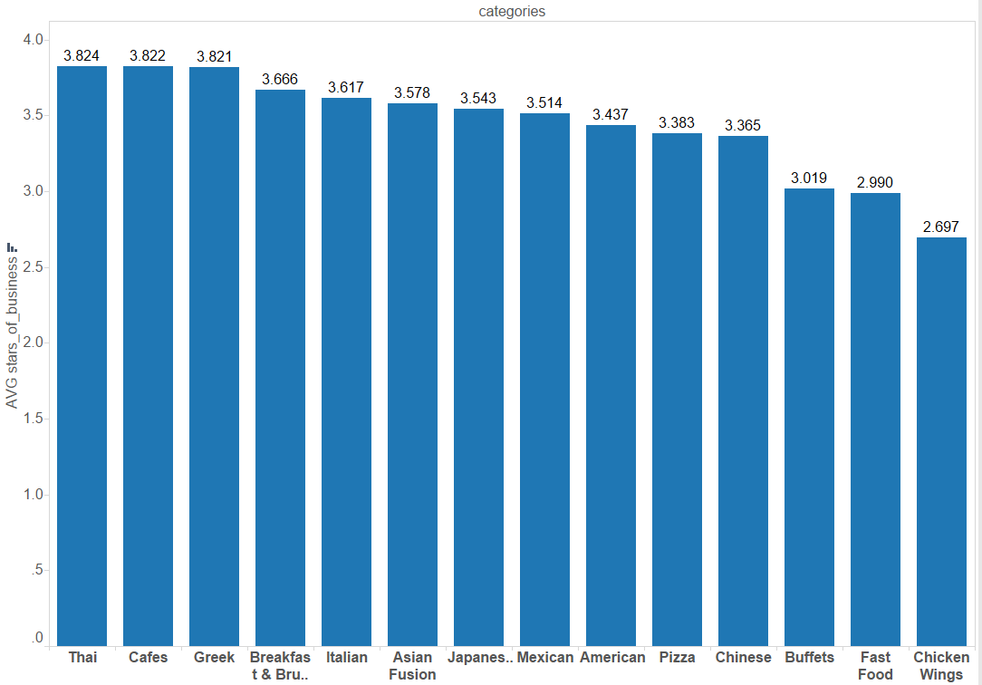
Categories are an important predictor of average stars
- Exploratory Data Analyses
Categories vary greatly in average stars
Whether a restaurant is doing good or bad should be classified relative to its category

Slide 14
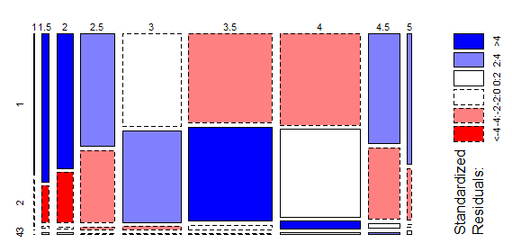

Price Range has influence on Star Rating
- Exploratory Data Analyses
Mosaic Plot
Business Stars
Chi-Squared Test shows dependency between a business’ average star ratings and their price range
Price Range

Slide 15
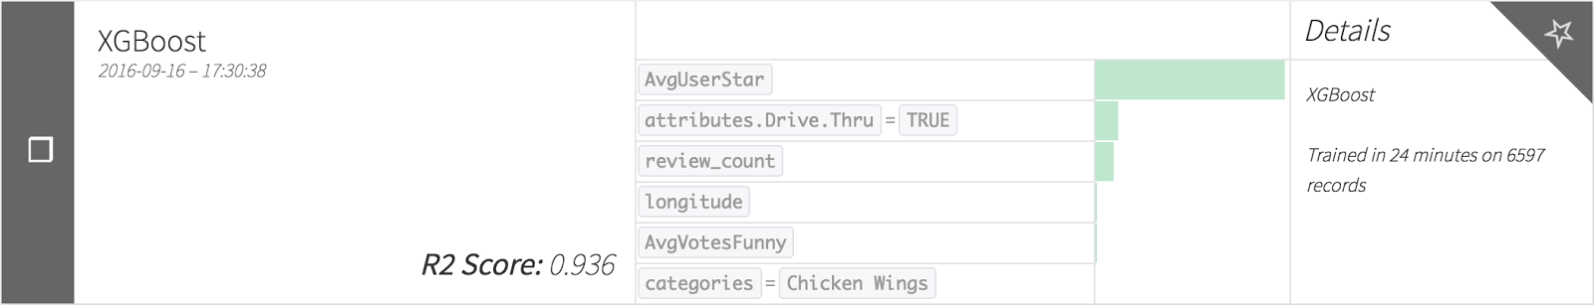
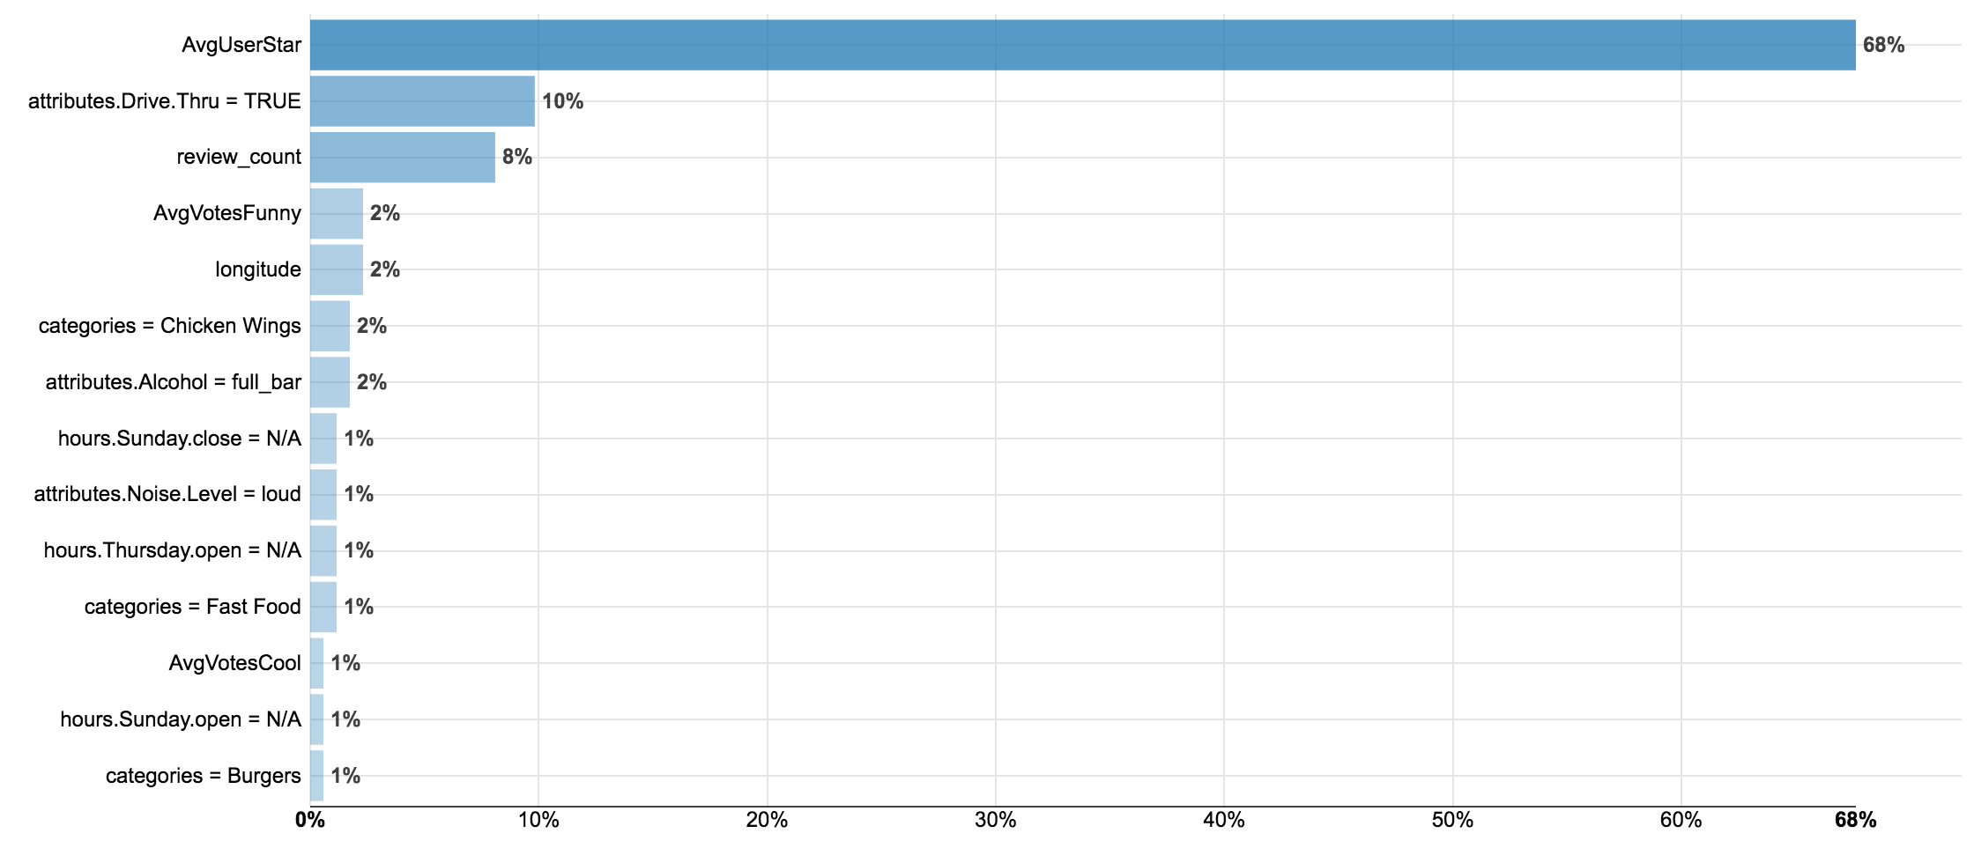
First Try - High Accuracy with all variables
- PREDICTIVE MODELING
XGBoost:
Regression
Target variable: Stars of business
All features except texts(review body)
70/30 Train/Test
5-folds Cross Validation
176 trees; Max Tree Depth:1; Eta: 0.1
Metrics:
R square: 0.936
MSE: 0.037
Insights:
Model is very accurate
Avg_User_Star - super strong predictor
Many other important vars are also from the review table
Variables Importance Plots of XGBoost_no_review_vars
Since stars of business is somehow calculated by review ratings, it’s not fair for us to use the information inside the review table to predict it.
Why not try ditching them and see how other features perform?

Slide 16
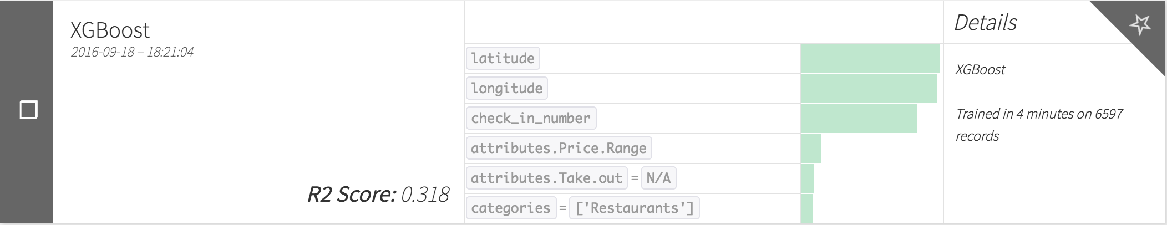
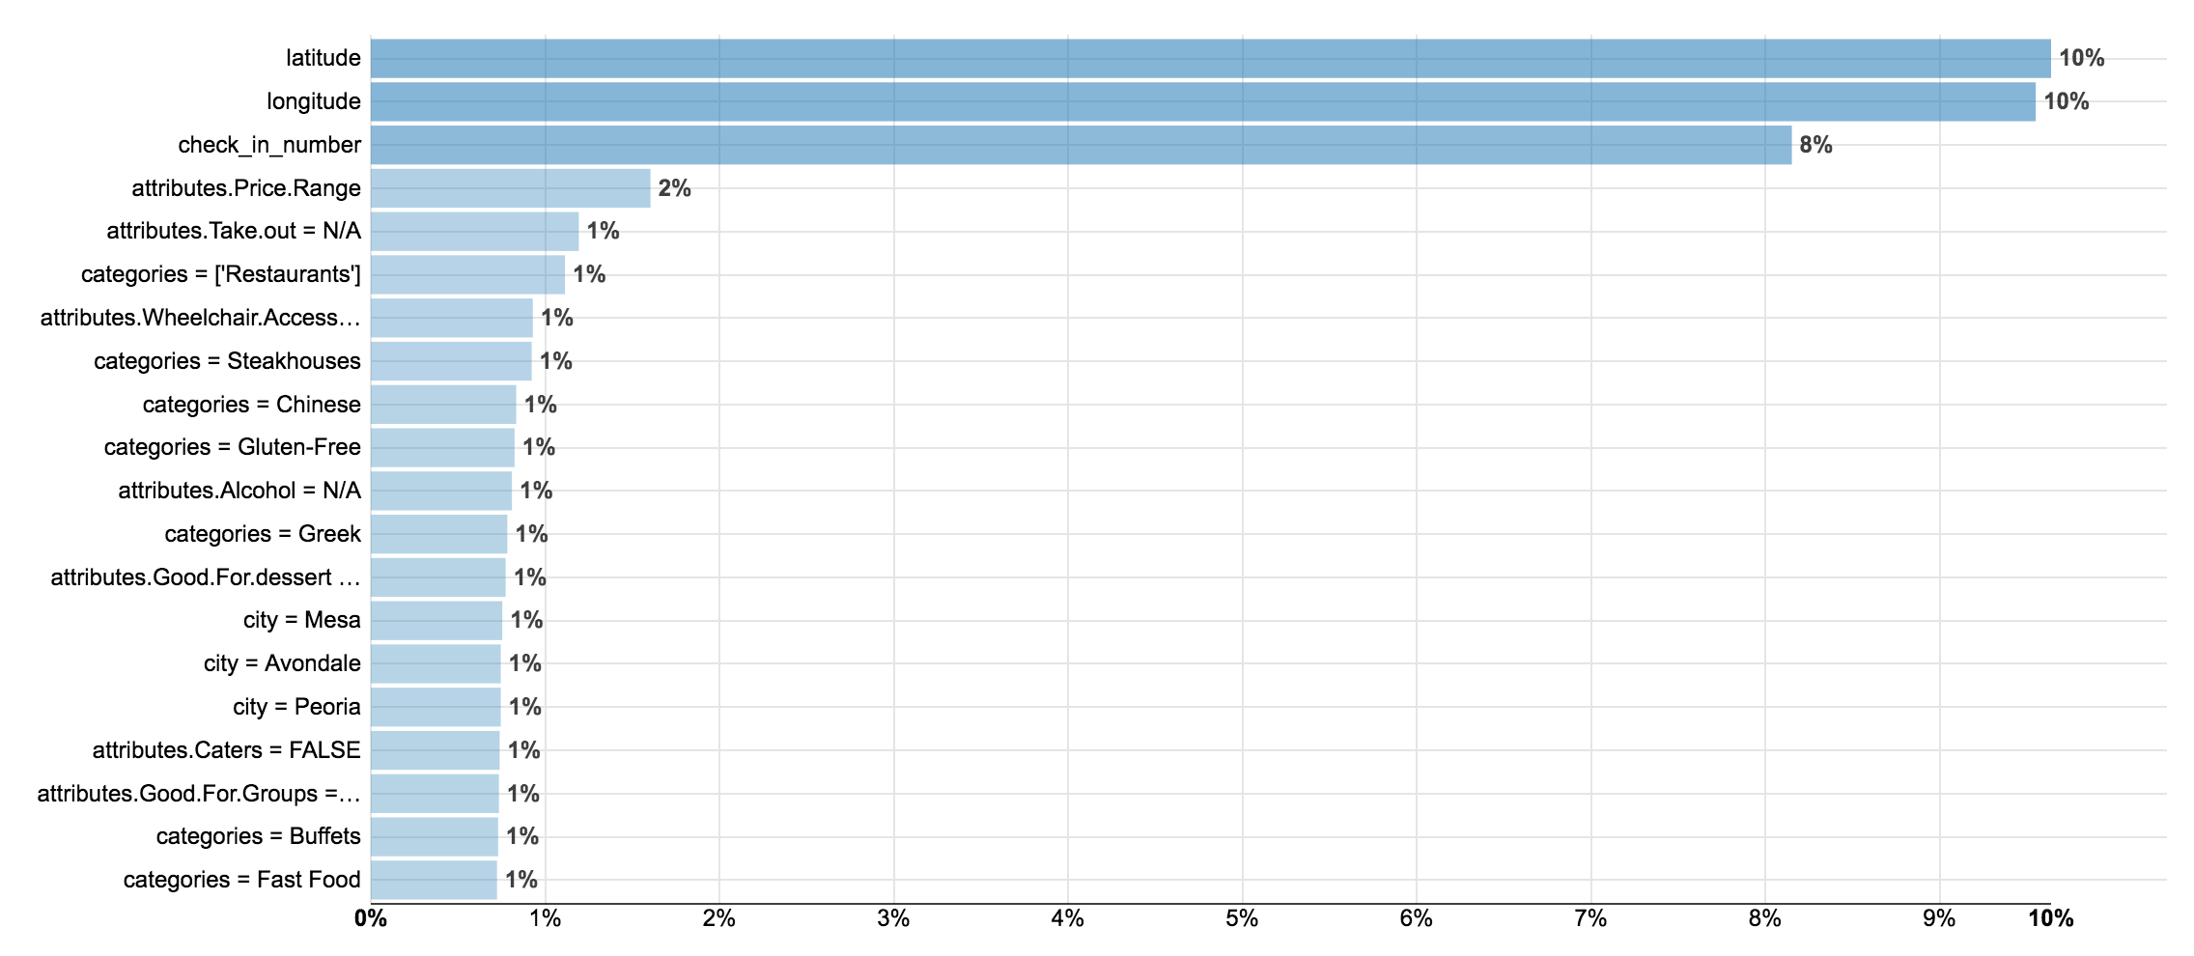
Second Try - Low Accuracy without review information
- PREDICTIVE MODELING
XGBoost:
Regression
Target variable: Stars of business
All features except all vars from review table
70/30 Train/Test
5-folds Cross Validation
500 trees; Max Tree Depth:3; Eta: 0.1
Metrics:
R square: 0.318
MSE: 0.388
Insights:
Model performance dropped drastically
Sometimes it is simply impossible to get an accurate model with available data, because the variables do not have enough predictive power
Variables Importance Plots of XGBoost_all_vars
However among all the variables that are not related to reviews, location, check-in number and price range manifest themselves to be decent predictors
Of other variables shown on this chart, we see many categories
We need to consider them as secondary keys to restaurant success (at least the success on Yelp) and inform the business owners with the data available

Slide 17
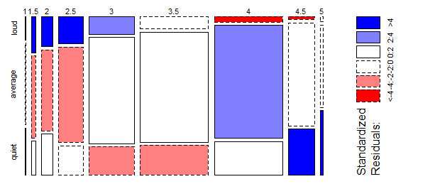
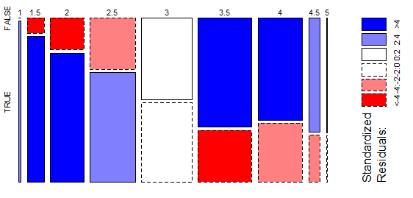
Various attributes influence Star Rating
- Exploratory Data Analyses
Attributes: Noise Level
Attributes: Drive-thru
Business Stars
Business Stars
Noise Level
Has Drive-Thru

Slide 18
Predictive Modeling - Conclusions
- PREDICTIVE MODELING
REVIEWS are so important that we believe they worth specific inspection
LOCATION and CHECK-IN information are decent predictors that can be useful for business owners.
PRICE RANGE and CATEGORY may affect business rating, but these can be used as filters rather than predictors.
NLP: Text Mining
App visualization
App filters

Slide 19
Review Text Pre-Processing
- TEXT MINING
Remove stopwords, e.g., ‘the’, ‘and’, ‘but’...
Remove punctuations, escape non-characters
Strip whitespace
Lowercase
Tokenize text
Lemmatize text

Slide 20
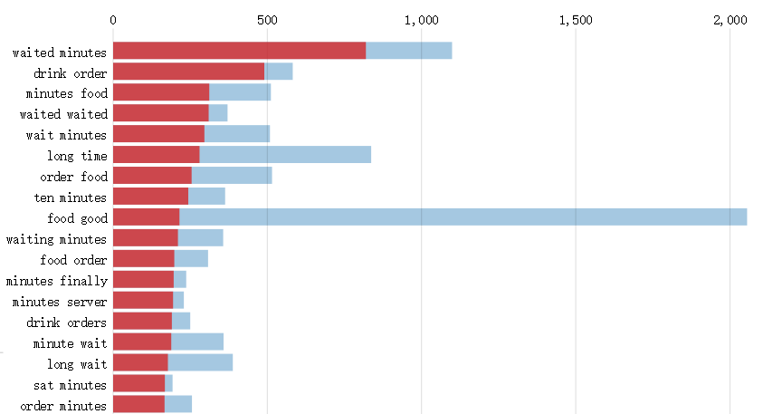
Topic Modeling
- TEXT MINING
Top Terms in Negative Reviews in Largest Topic
Latent Dirichlet Allocation (LDA):
Review texts by Business ID
Bigrams, Trigrams only
Unigrams have less meaning, e.g., the words ‘not’ ‘good’ have the opposite meaning when put together
Objective:
Identify topics discussed in reviews between different restaurant categories, and star ratings
Comparison of Topics find:
Negative Reviews concerned with time, sanitation
Term Frequency
Overall Frequency
Saliency (Frequency Within Topic)

Slide 21
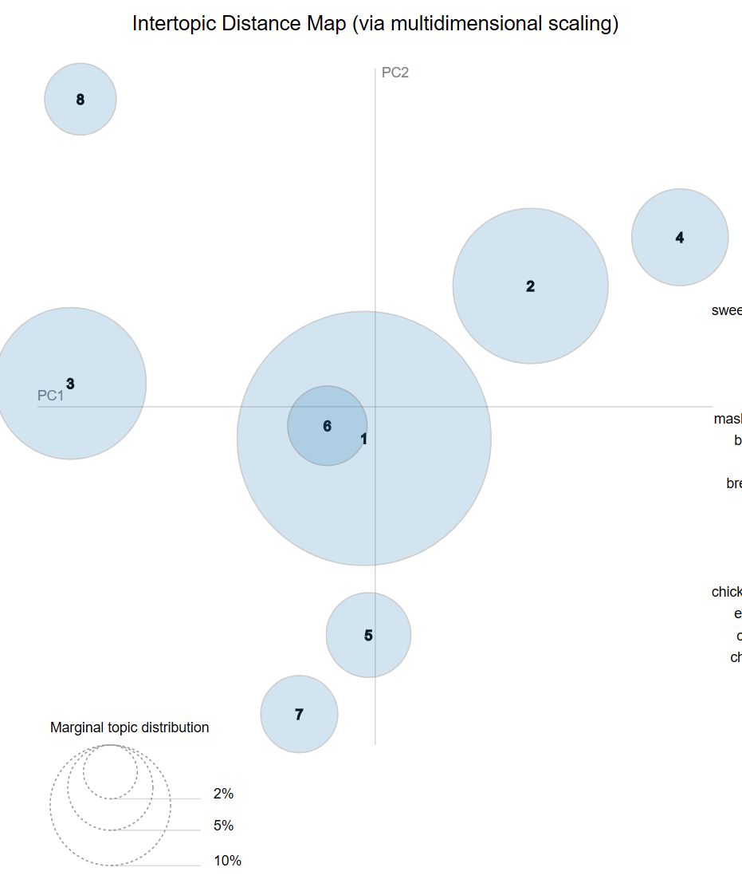
Topic Modeling
- TEXT MINING
Intertopic Distance Map:
Shows distance represented by unidentified principal components
The larger the topic circle, the large the distribution within the reviews corpus
Each topic has unique terms

Slide 22
Agenda
1
CHALLENGE OVERVIEW
2
BUSINESS PERSPECTIVE
3
DATA PREPARATION
4
MODELING
5
KEY FINDINGS

Slide 23

Features determined important:
- KEY FINDINGS
Using important variables from Predictive models:
Location
Price Range
Category
Check-in Time
We built the application that would take the above variables as inputs to customize to each business owner’s restaurant
YelpQuest provides these utilities:
Map: Geolocation analysis of restaurant success
Topic Modeling: Understanding of negative reviews within market of specified category
Cuisine Gallery: For the positive reviews, the user can find the most hype dishes - and maybe take advantage of it
Click to Pay YelpQuest

Slide 24
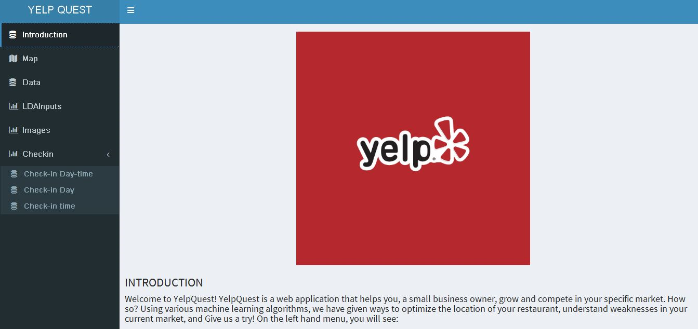
Application Demonstration & Use Case

