Slide 1








Visualizing Predictability of European Soccer Leagues Connecting Betting Odds with Predictability

Slide 2
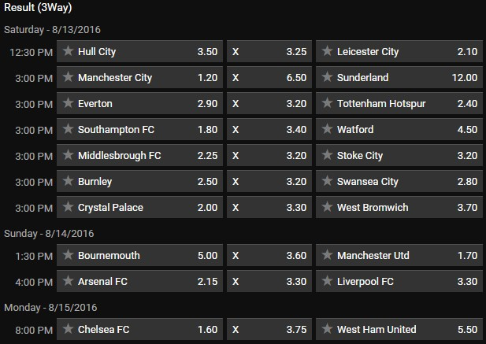
Betting Odds vs Probability
Arsenal vs Liverpool
Home Win (HW) | Draw (D) | Away Win (AW)
2.15 | 3.30 | 3.30
46.51% | 30.30% | 30.30%
46.51% + 30.30% + 30.30% = 107.11%
107.11% - 100% = 7.11% (overround)
Chelsea vs West Ham Utd.
Home Win (HW) | Draw (D) | Away Win (AW)
1.60 | 3.75 | 5.50
60.25% | 26.67% | 18.18%
60.25% + 26.67% + 18.18% = 105.10%
105.10% - 100% = 5.10% (overround)

Slide 3
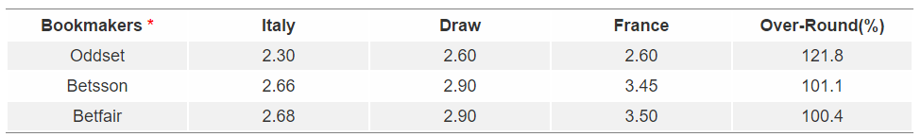
Bookmakers might have different overround.

Slide 4
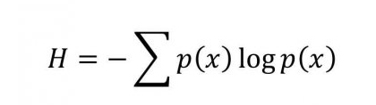
Probability
- Entropy -
Predictability
Normalizing Probability
P₁ = P_{HW} /(P_{HW} + P_{D} + P_{AW} ) , P₂=P_{D} /(P_{HW} + P_{D} + P_{AW} ) , P₃=P_{AW} /(P_{HW} + P_{D} + P_{AW} )
Calculating Entropy
H = - (P₁ *log₂P₁ + P₂ *log₂P₂ + P₃ *log₂P₃)
Entropy and Predictability
Bigger Entropy Less Predictability
Home Win (HW) | Draw (D) | Away Win (AW)
1.0 | 10.0 | 20.0
86.96% | 8.70% | 4.35%
0.5482(most predictable)
Home Win (HW) | Draw (D) | Away Win (AW)
3.1 | 3.1 | 3.1
33.33% | 33.33% | 33.33%
1.5850(least predictable)

Slide 5
the Shiny app

