Slide 1
Biomarker Measurement in a Phase I Clinical Trial

Slide 2
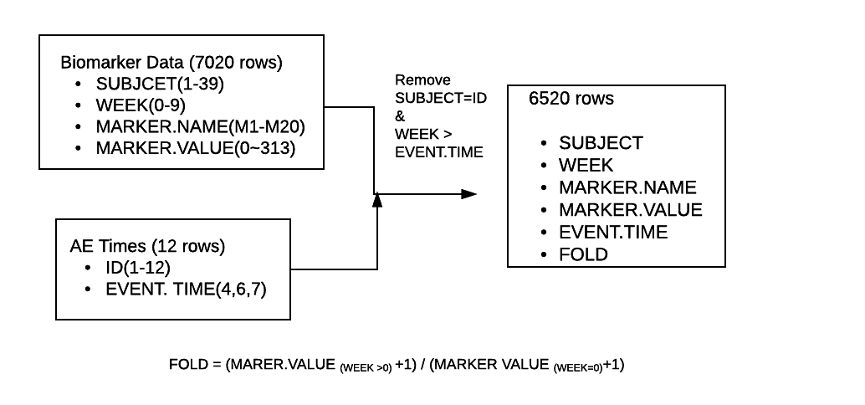
Data Preprocessing

Slide 3
Analysis by Data Visualization
Q1: What biomarkers are changing as a result of treatment?
Q2: The change in which markers is related to the adverse event?

Slide 4
Q1. What biomarkers are changing as a result of treatment?

Slide 5
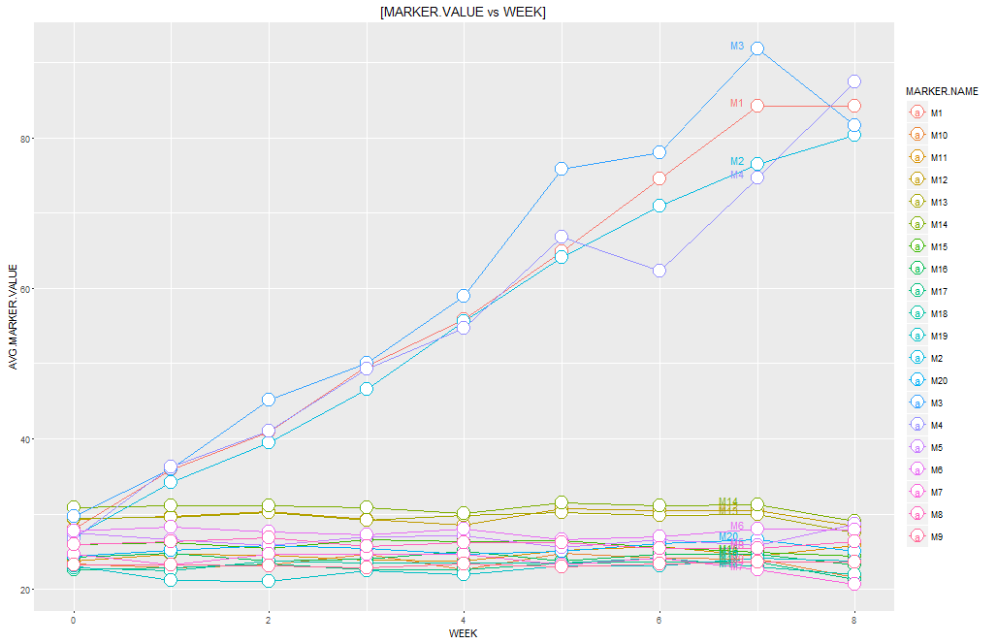
Marker value of M1,M2,M3,M4 might change as a result of treatment

Slide 6
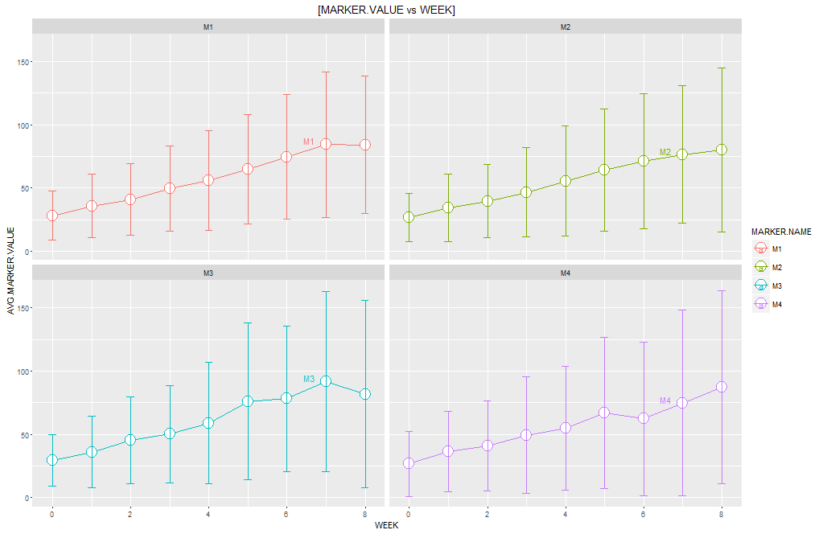
Marker value has large standard deviation

Slide 7
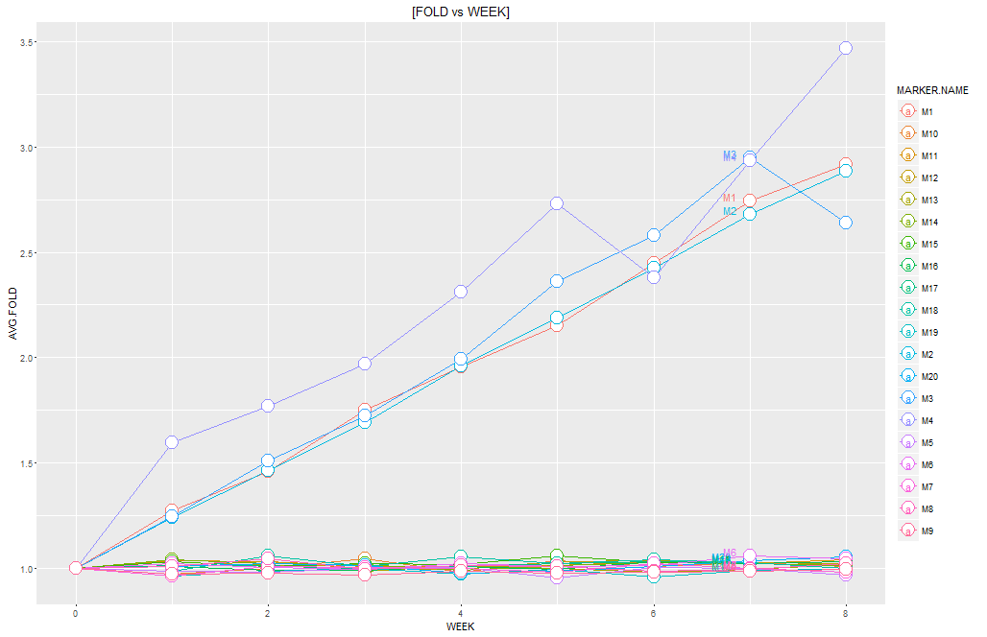
Fold change of M1,M2,M3,M4 might change as a result of treatment

Slide 8
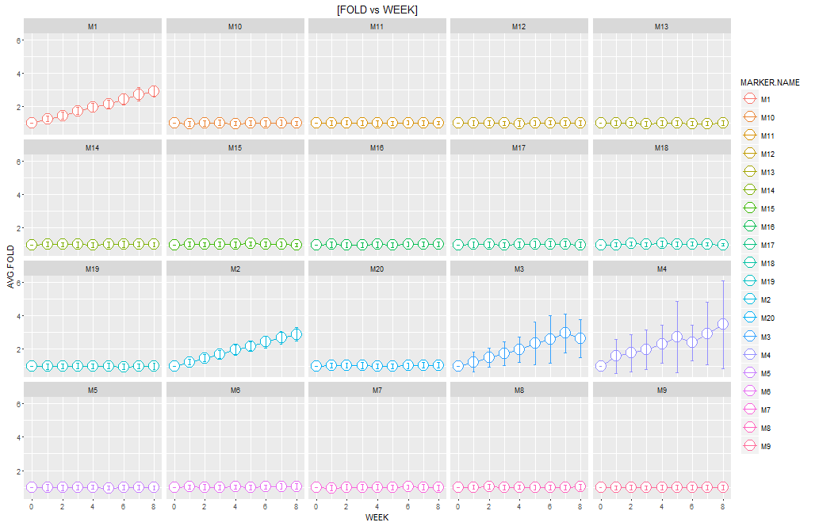
M1 and M2 appear to be better biomarkers to test treatment

Slide 9
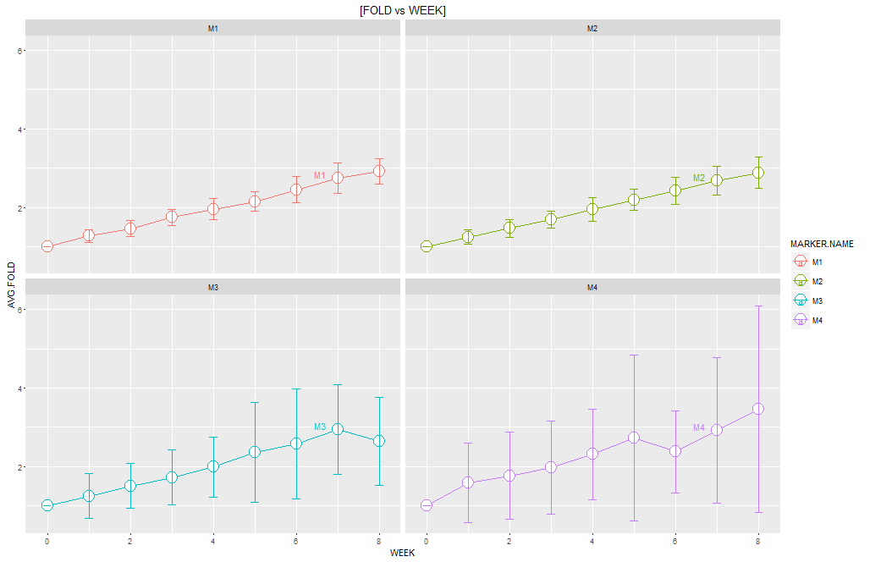
M1 and M2 appear to be better biomarkers to test treatment

Slide 10
Q2: The change in which markers is related to the adverse event?

Slide 11
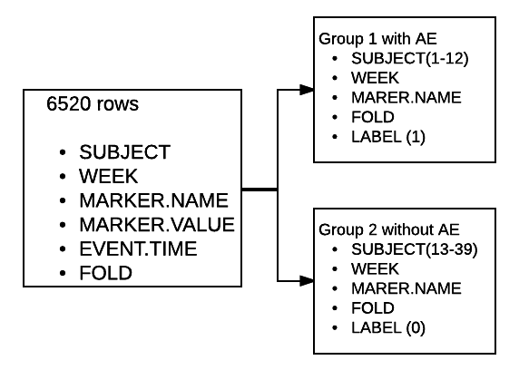
Data Preprocessing

Slide 12
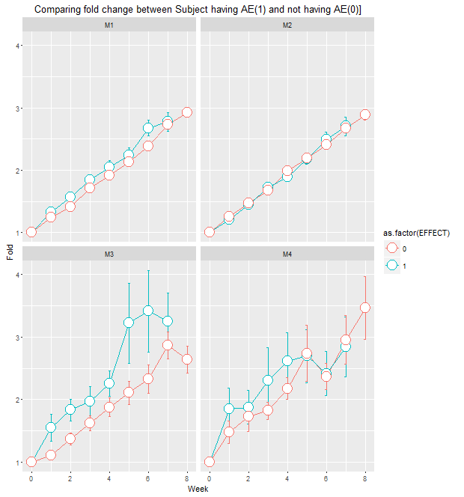
The difference of fold change in M3,M4 appear to be related to the adverse event.

Slide 13
Q3: Can come up with an algorithm to predict adverse event based on biomarker collected at least a week prior to the actual event?

Slide 14
There seem to be large difference between group with AE and group without AE at Week =5,6 for M3, and Week =3 for M4.
Event time: 4 ,4 ,4 ,4, 6,7,7,7,7,7,7,7
The fold change of M3 and M4 one week before the event seem to be a good indicator of AE.

Slide 15
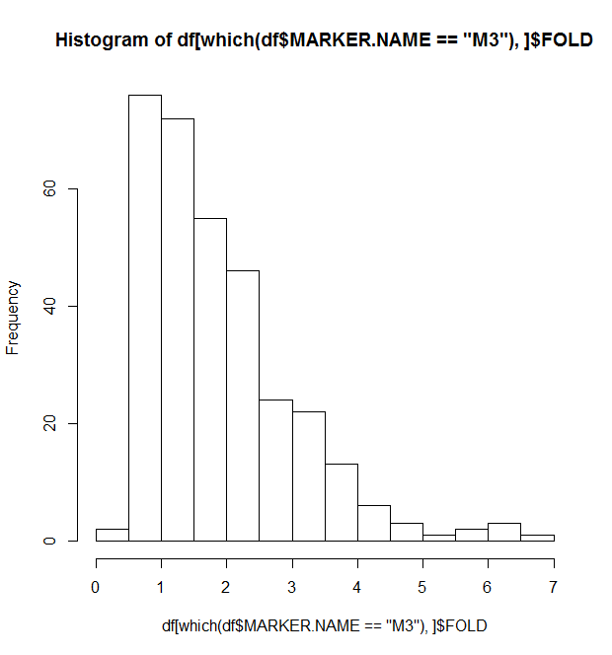
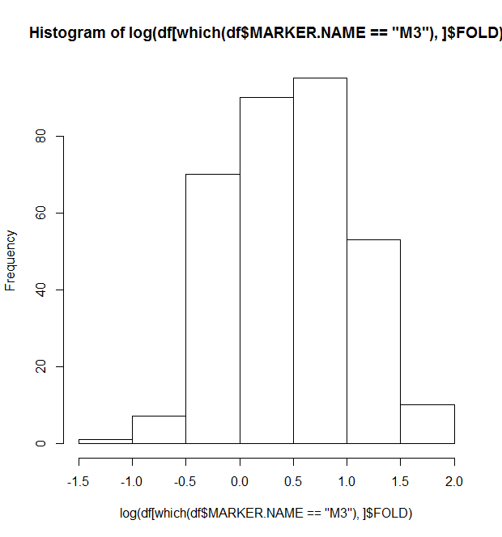
Distribution of M3 fold
log transformation

Slide 16
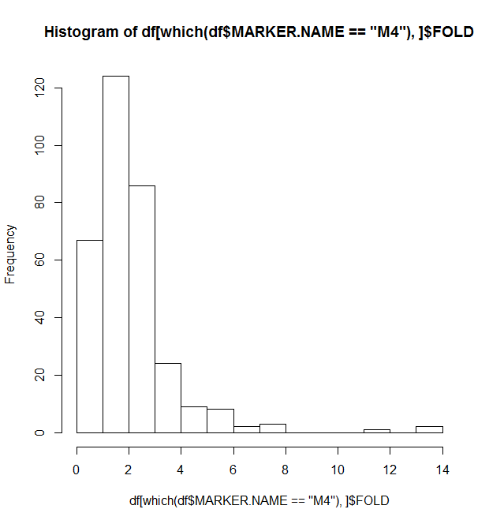
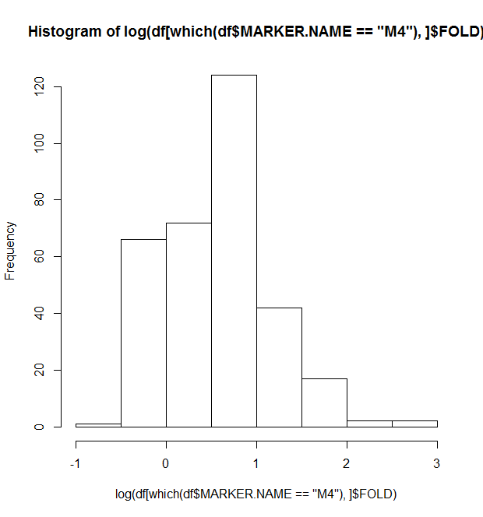
Distribution of M4 fold
log transformation

Slide 17
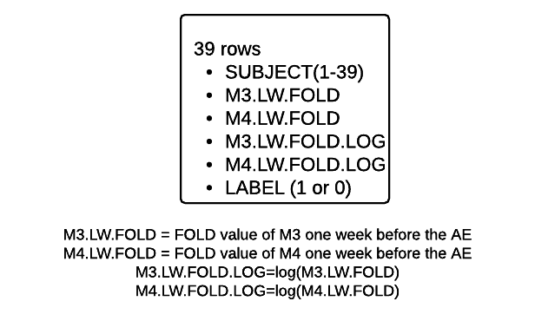
Data Preprocessing
SUBJECT(1- 12), Label = 1
EVENT TIME = c(4 ,4 ,4 ,4, 6,7,7,7,7,7,7,7)
SUBJECT(13-39), Label =0
EVENT TIME = sample(c(4,6,7),1,prob=c(4/12,1/12,7/12))
Training Data Set: SUBJECT(1-24)
Test Data Set : SUBJECT(25-39)

Slide 18
Exploration of Predictive Models
Logistic Regression
With log transformation
With square root transformation
Support Vector Machine
Naïve Bayes

Slide 19
Logistic regression modeling with log transformation
LABEL~ M3.LW.FOLD.LOG + M4.LW.FOLD.LOG,
Coefficients:
Estimate Std. Error z value Pr(>|z|)
(Intercept) -1.2520 1.1209 -1.117 0.264
M3.LW.FOLD.LOG 1.2289 0.8534 1.440 0.150
M4.LW.FOLD.LOG 0.3637 0.9025 0.403 0.687
(Dispersion parameter for binomial family taken to be 1)
Null deviance: 33.271 on 23 degrees of freedom
Residual deviance: 30.680 on 21 degrees of freedom
AIC: 36.68

Slide 20
Logistic regression modeling with square root transformation
LABEL~ SQRT(M3.LW.FOLD) + SQRT(M4.LW.FOLD),
Coefficients:
Estimate Std. Error z value Pr(>|z|)
(Intercept) -4.9765 2.9292 -1.699 0.0893 .
sqrt(df_model[1:24, 2]) 2.6065 1.3292 1.961 0.0499 *
sqrt(df_model[1:24, 3]) 0.8259 1.3875 0.595 0.5517
---
Signif. codes: 0 ‘***’ 0.001 ‘**’ 0.01 ‘*’ 0.05 ‘.’ 0.1 ‘ ’ 1
(Dispersion parameter for binomial family taken to be 1)
Null deviance: 33.271 on 23 degrees of freedom
Residual deviance: 27.700 on 21 degrees of freedom
AIC: 33.7

Slide 21
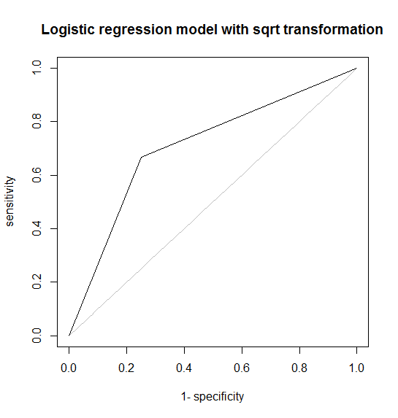
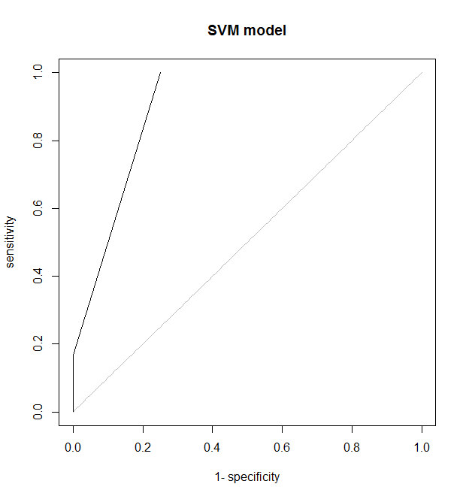
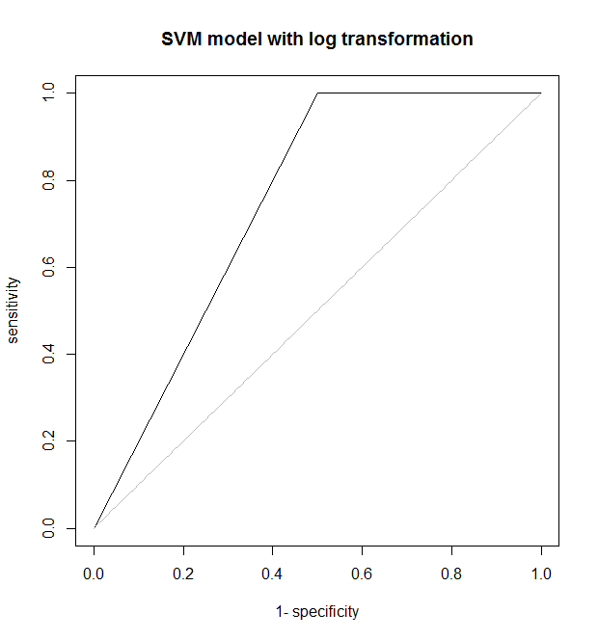
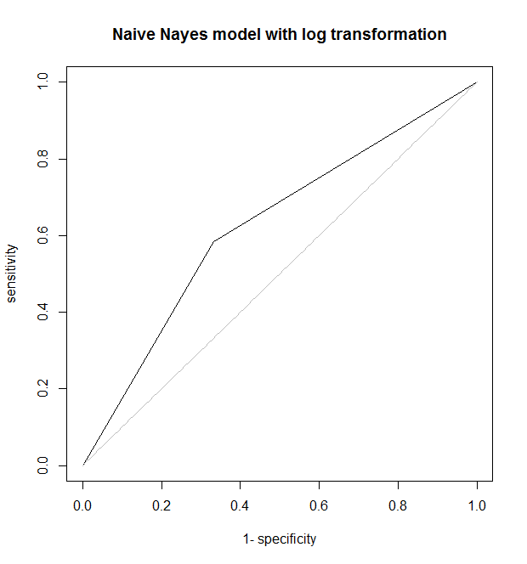
Comparison of different models based on ROC
AUC = 0.71
AUC = 0.79
AUC = 0.75
AUC = 0.63

Slide 22
Confusion matrix from SVM modeling
Training
Test
AE | Predicted: YES | Predicted: NO
Actual: YES | 7 | 5
Actual: NO | 0 | 12
AE | Predicted: YES | Predicted: NO
Actual: YES | 0 | 0
Actual: NO | 2 | 13

Slide 23
Thanks! Questions?

