Slide 1
Web Scraping Project
By Anne Song

Slide 2
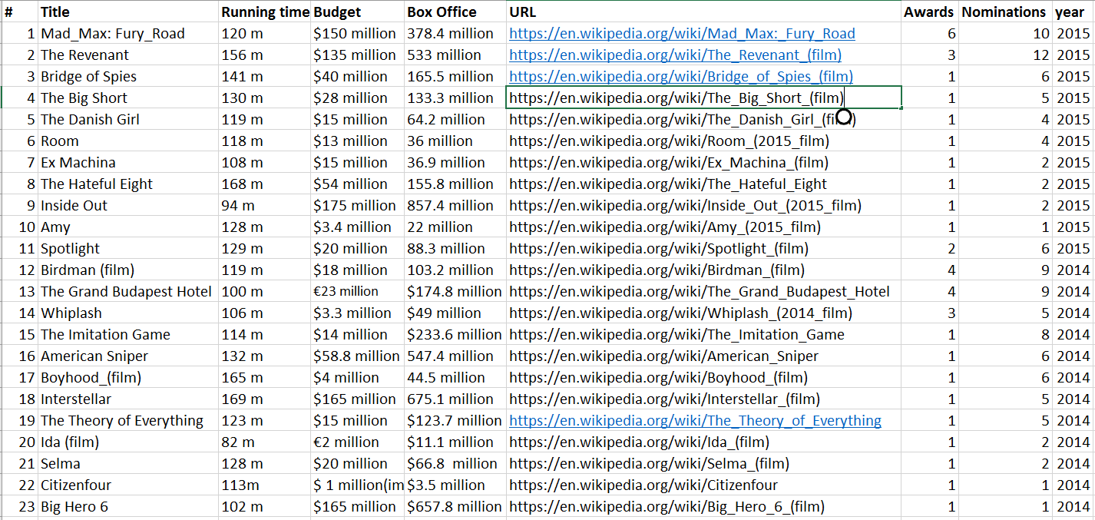
Featured Academy Award Movies (2014 -2015)

Slide 3
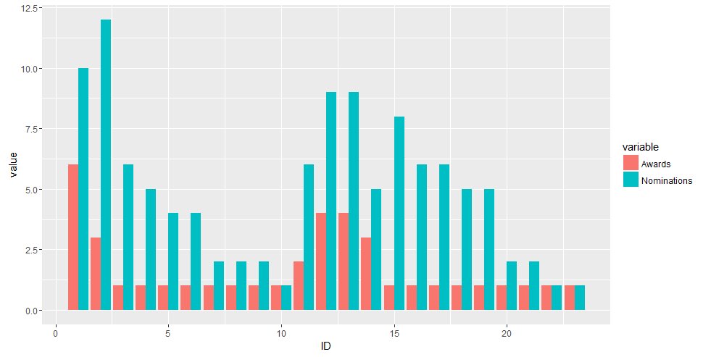
Awards vs Nominations
# | Title
1 | Mad_Max: Fury_Road
2 | The Revenant
3 | Bridge of Spies
4 | The Big Short
5 | The Danish Girl
6 | Room
7 | Ex Machina
8 | The Hateful Eight
9 | Inside Out
10 | Amy
11 | Spotlight
12 | Birdman (film)
13 | The Grand Budapest Hotel
14 | Whiplash
15 | The Imitation Game
16 | American Sniper
17 | Boyhood_(film)
18 | Interstellar
19 | The Theory of Everything
20 | Ida (film)
21 | Selma
22 | Citizenfour
23 | Big Hero 6

Slide 4
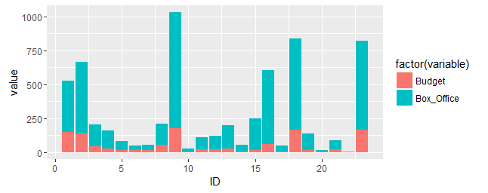
Budget vs Box Office Earning
# | Title
1 | Mad_Max: Fury_Road
2 | The Revenant
3 | Bridge of Spies
4 | The Big Short
5 | The Danish Girl
6 | Room
7 | Ex Machina
8 | The Hateful Eight
9 | Inside Out
10 | Amy
11 | Spotlight
12 | Birdman (film)
13 | The Grand Budapest Hotel
14 | Whiplash
15 | The Imitation Game
16 | American Sniper
17 | Boyhood_(film)
18 | Interstellar
19 | The Theory of Everything
20 | Ida (film)
21 | Selma
22 | Citizenfour
23 | Big Hero 6

Slide 5
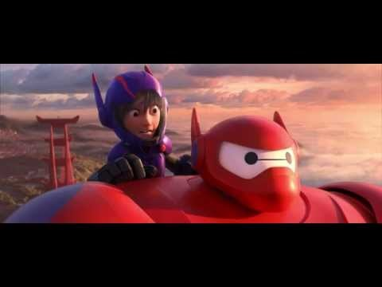
Big Hero 6: First Flight Scene

Slide 6
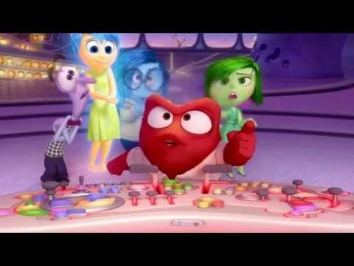
Inside Out: Disgust and Anger

