Slide 1
American Time Use Exploration
- An Exploration of the Recreational Activities Americans spent most time on across past 5 years.

Slide 2
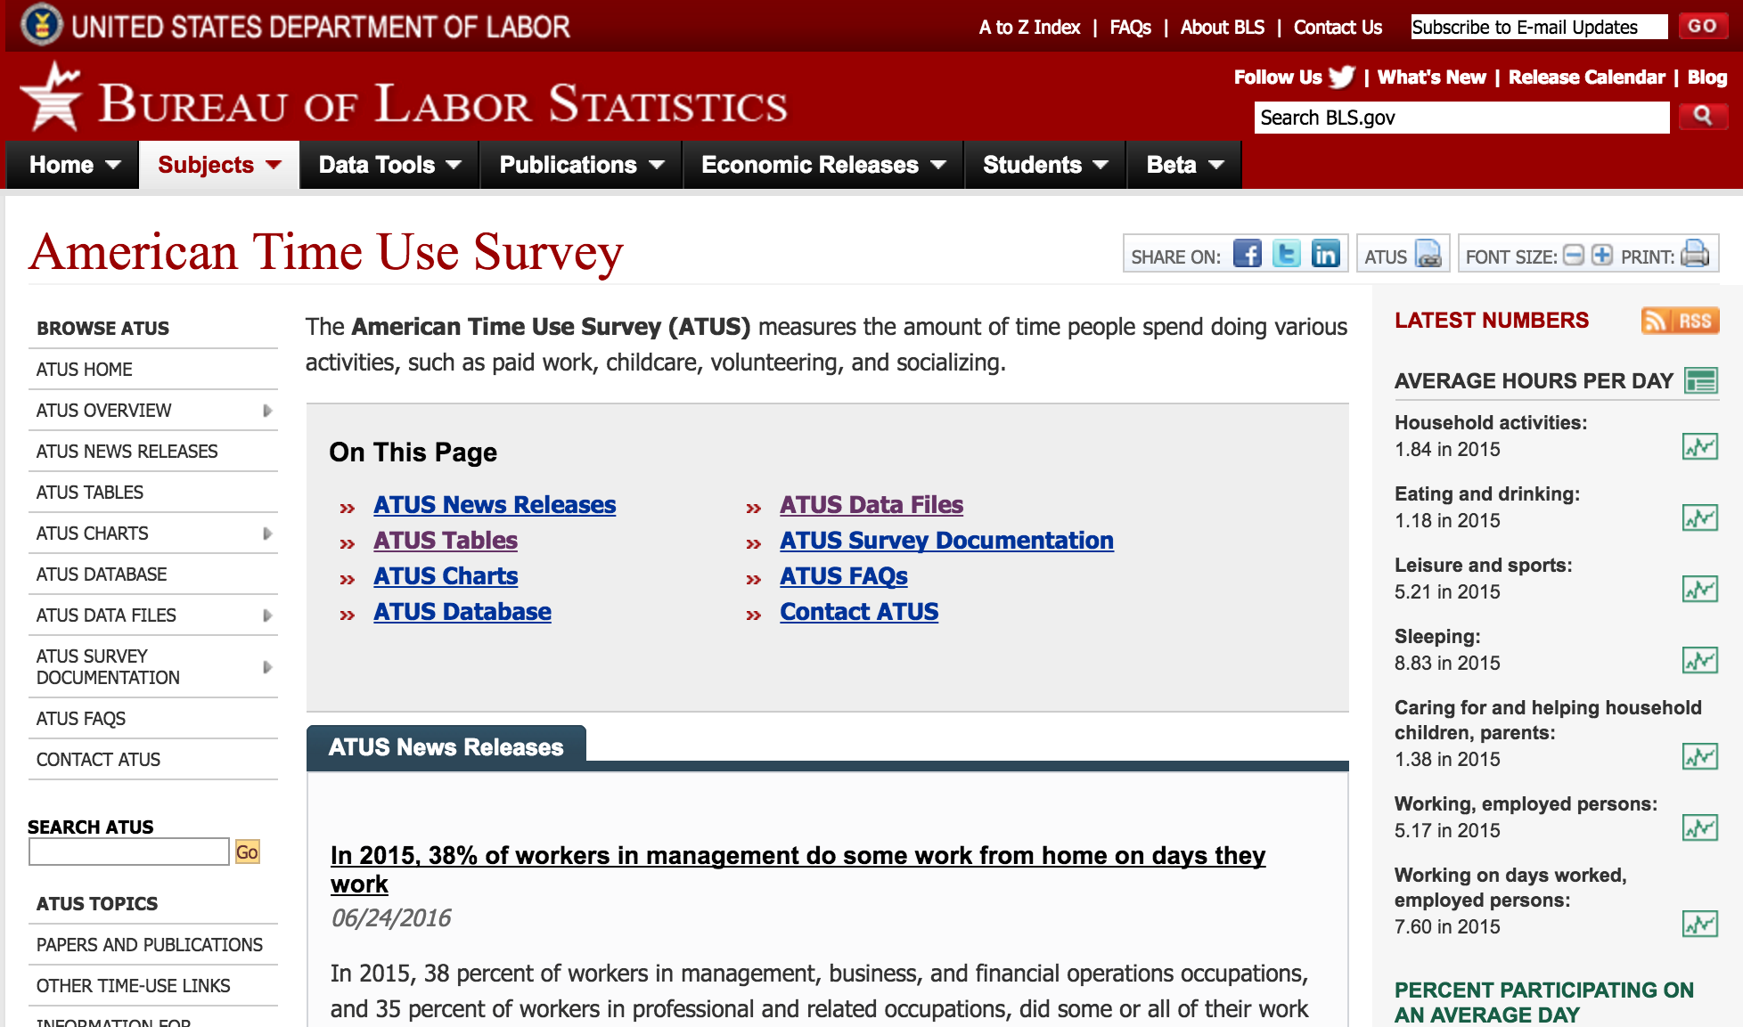
About Data
The American Time Use Survey (ATUS)
2003 – 2015 Over 170,000 interviews
Can be linked to CPS (Current Population Survey)
Link of the data: http://www.bls.gov/tus/#data
Notes:
measures the amount of time people spend doing various activities, such as paid work, childcare, volunteering, and socializing.
ATUS data files are used by researchers to study a broad range of issues; the data files include information collected from over 170,000 interviews conducted from 2003 to 2015.

Slide 3
Data Prep
Activity File
Respondent File
Roster File
The Who File
Activity Sum File
ATUS CPS File
Activity Info:
Activity ID & Duration & Location
Respondent:
Demographics & Geographical Info
Education:
Edu Level
Job Related:
Industry & Position & Income & Working Hours
Family Related:
Marital Status & Family Type & Family Income
Joining
Final dataset: 1118532 obs. of 33 variables

Slide 4
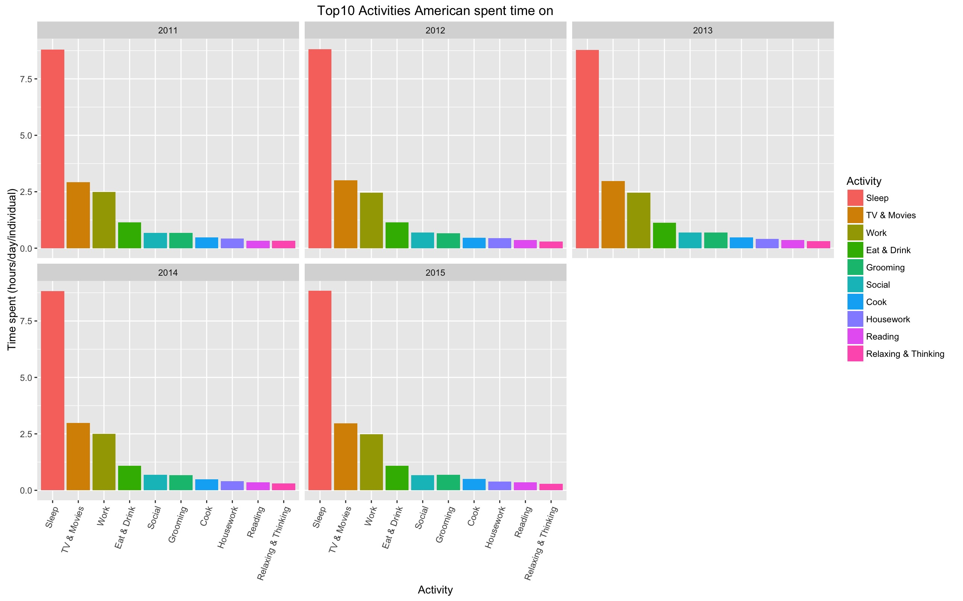
Exploration Plot

Slide 5
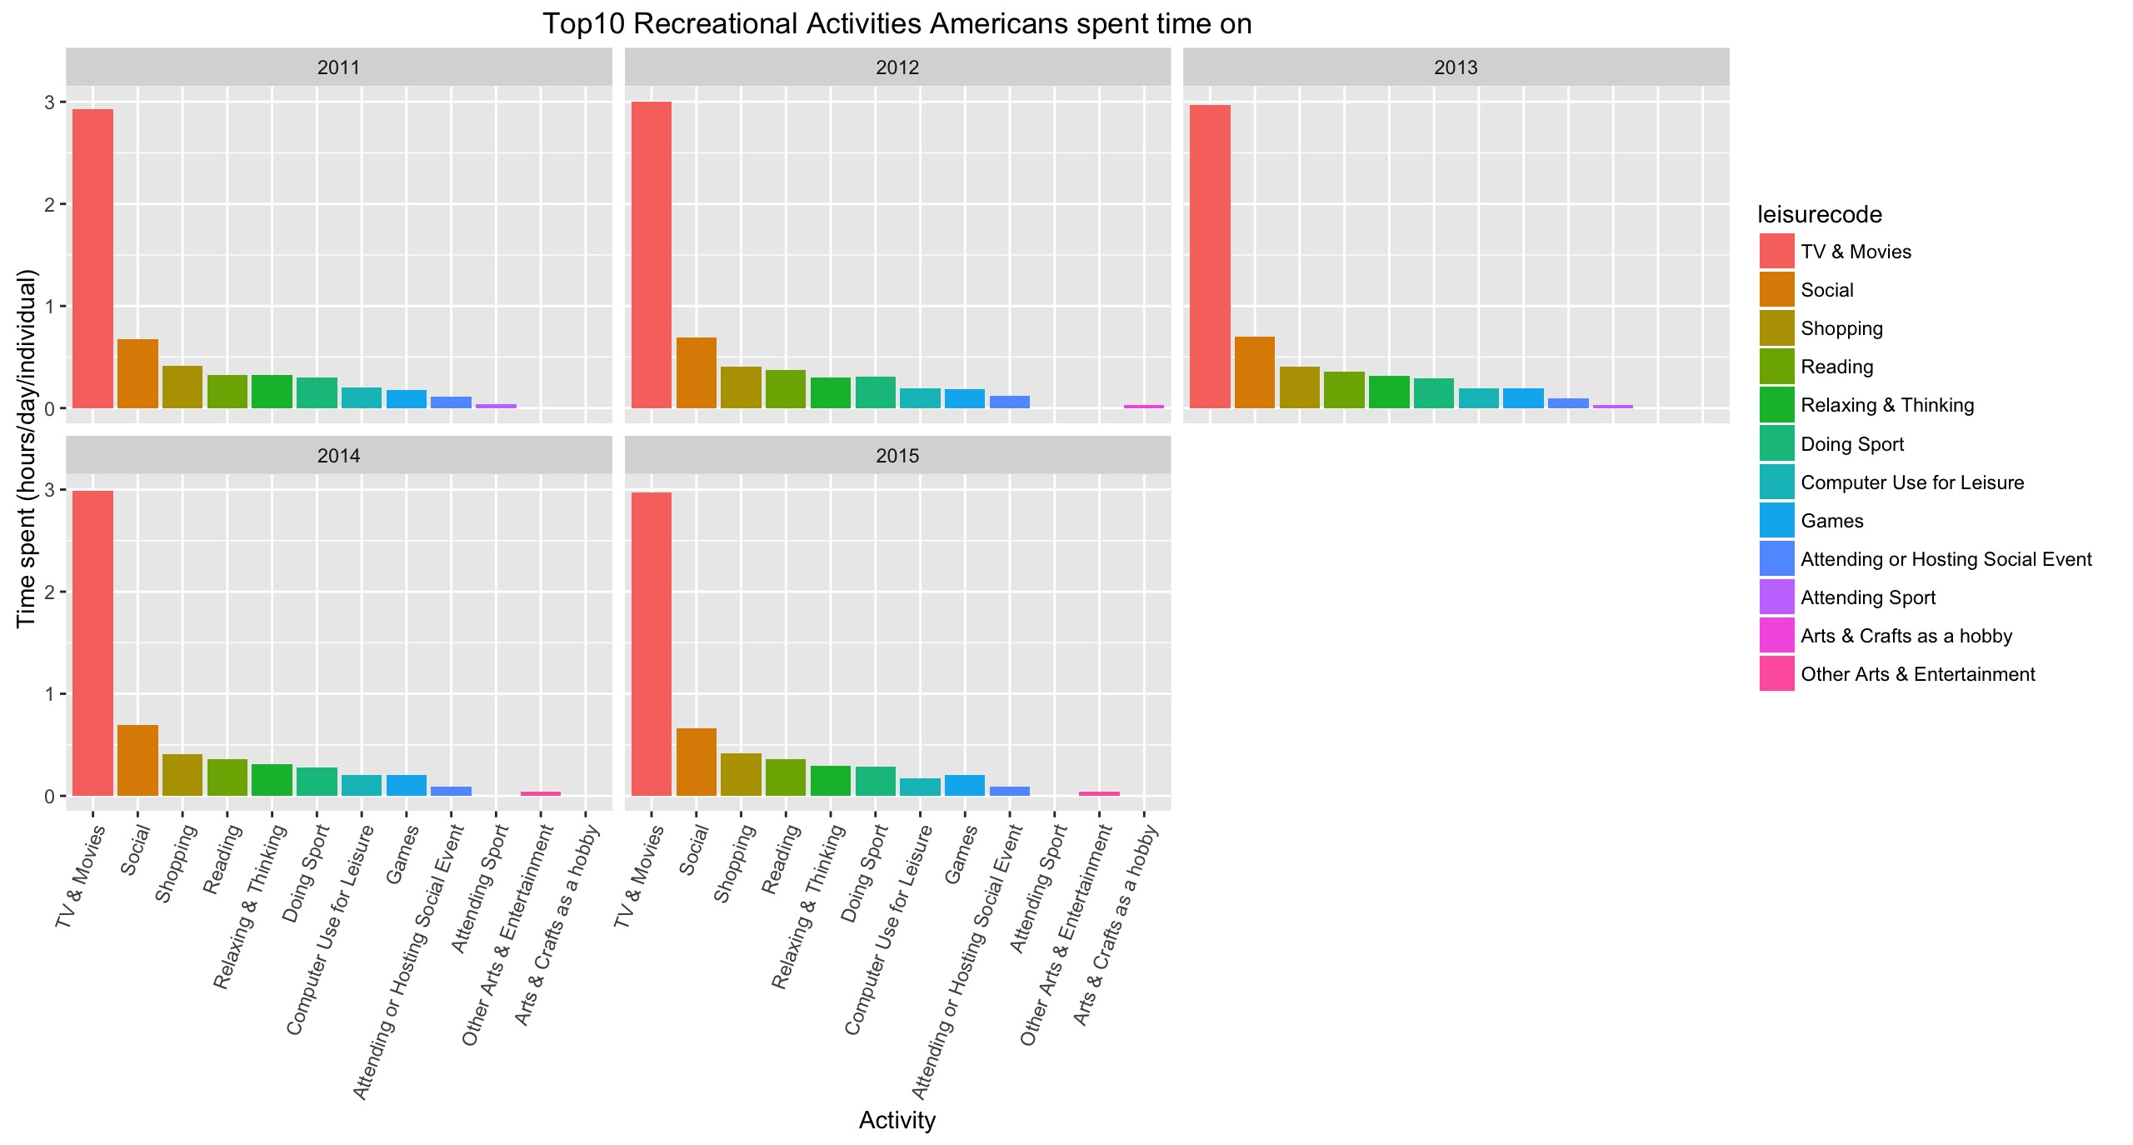
American’s Top 10 Leisure Act.

Slide 6
Good or Bad?
Beneficial | Non Beneficial
Social | TV & Movies
Reading | Shopping
Relaxing & Thinking | Computer Use for Leisure
Doing Sports | Games
Attending or Hosting Social Events
Attending Sports
Arts & Crafts as Hobby
Other Arts & Entertainment

Slide 7
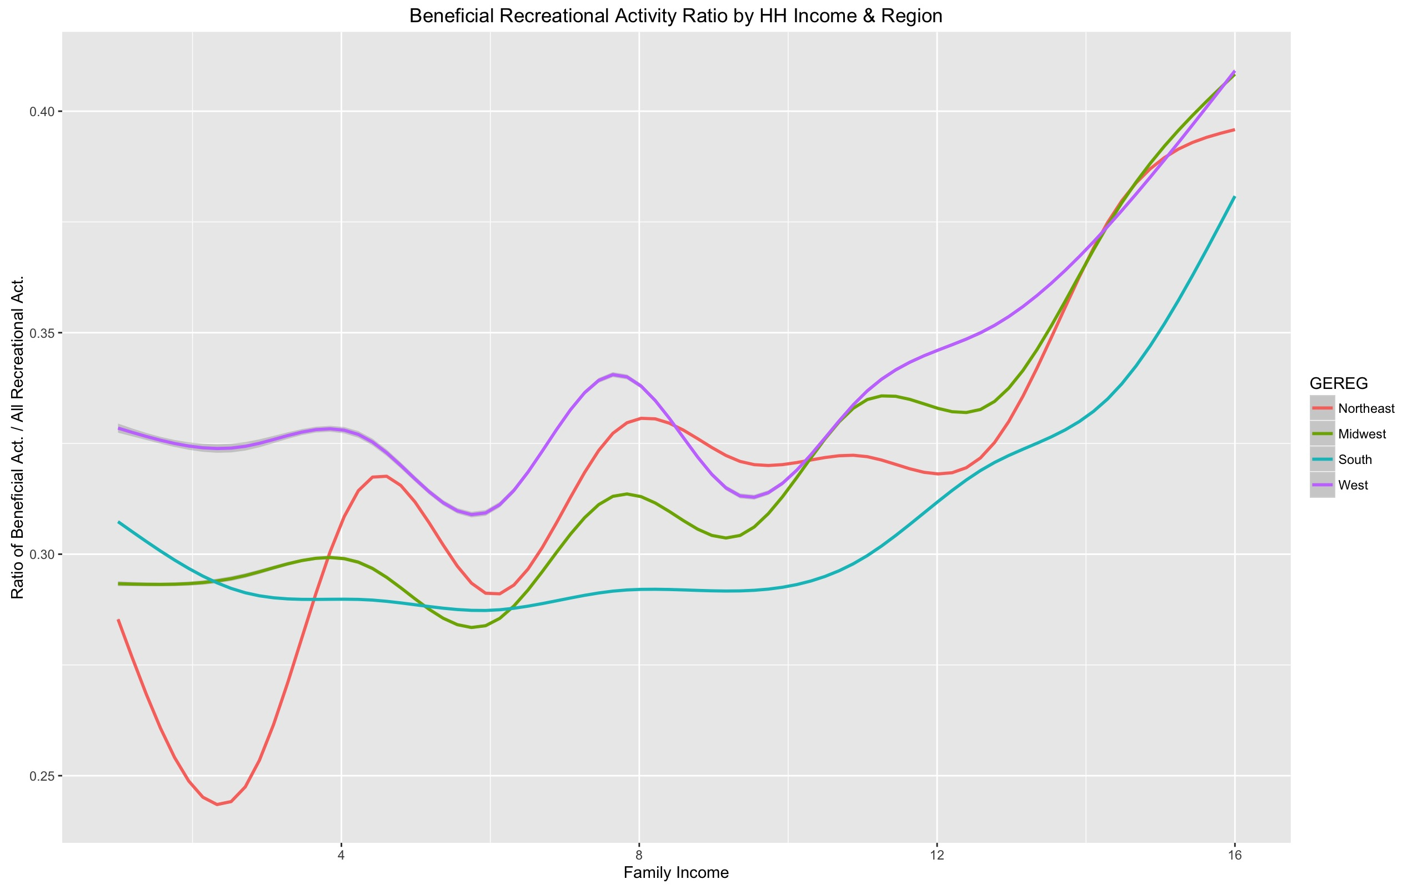
Region, Family Income & Leisure Act.

Slide 8
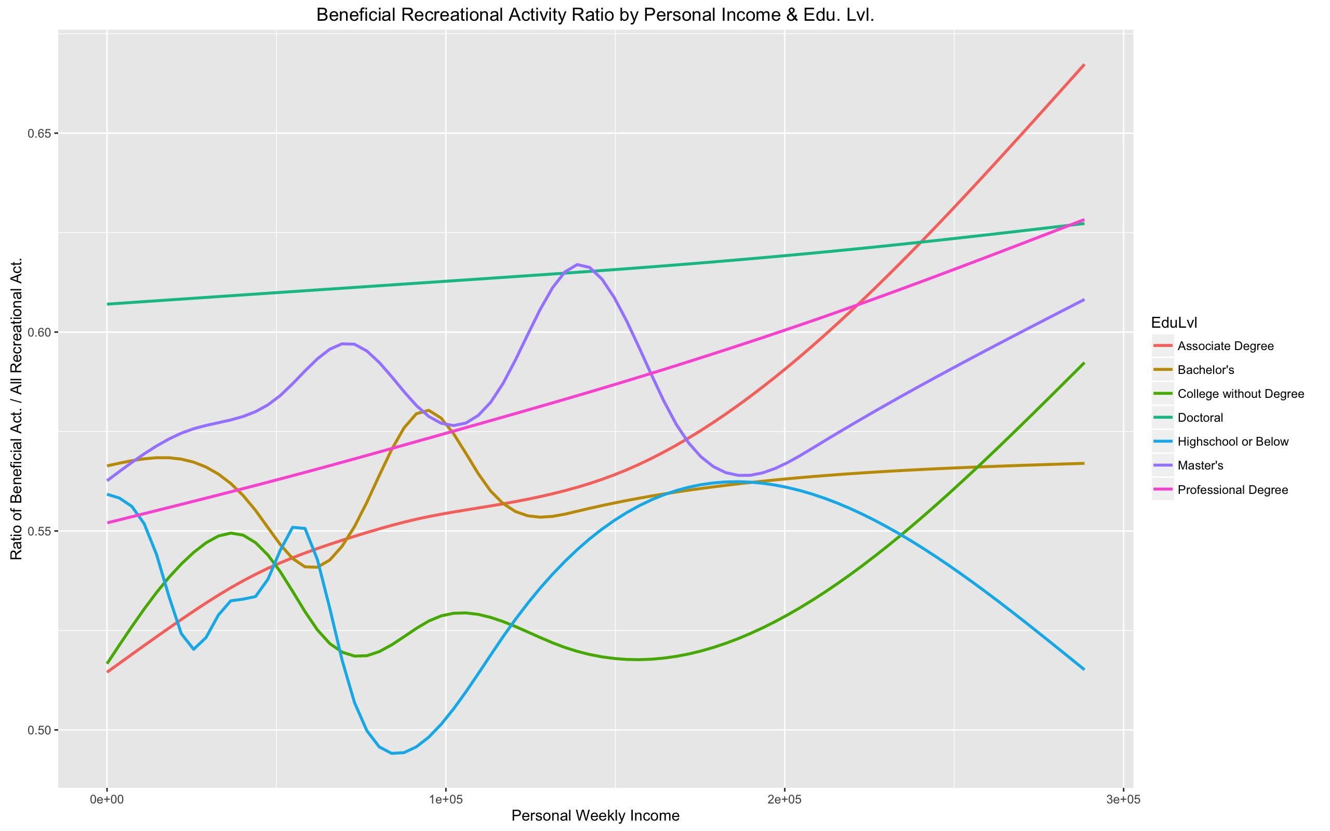
Education, Personal Income & Leisure Act.

Slide 9
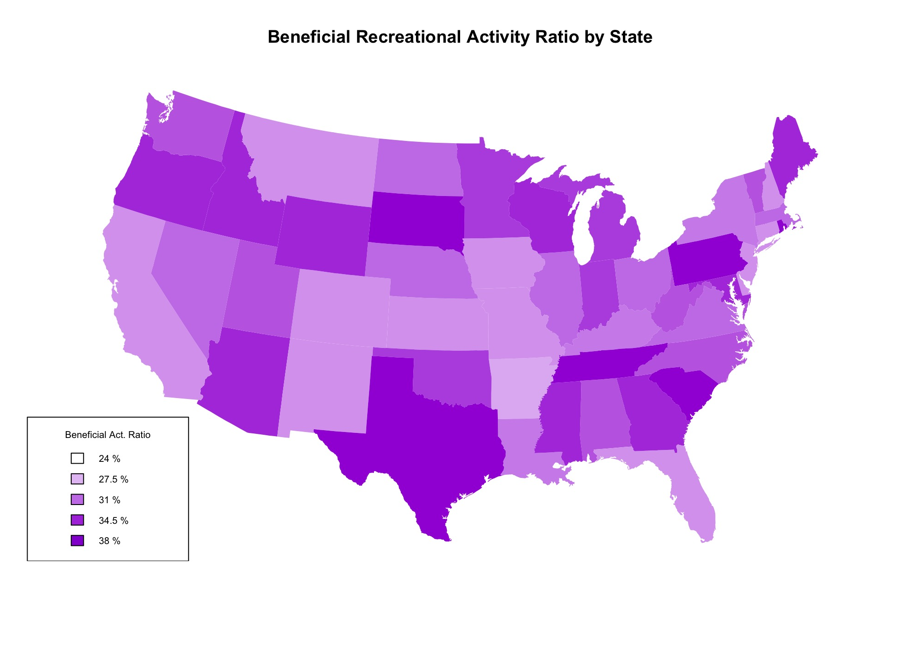
Leisure Act. By States

Slide 10

The End

