Slide 1

Higgs Boson Machine Learning Challenge
Team DataUniversalis

Slide 2
Outline
Flowchart
Exploratory Data Analysis
Models
Random Forests
Generalized Boosted Model
Neural Networks
XGBoost
Lesson Learned

Slide 3
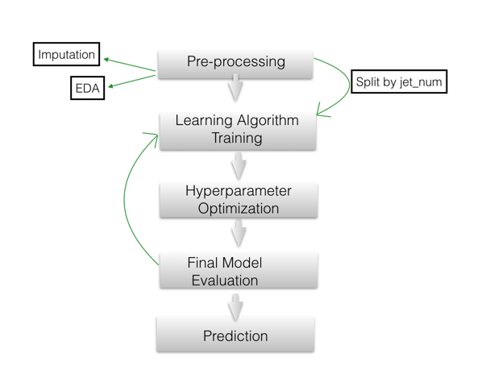
Flowchart

Slide 4
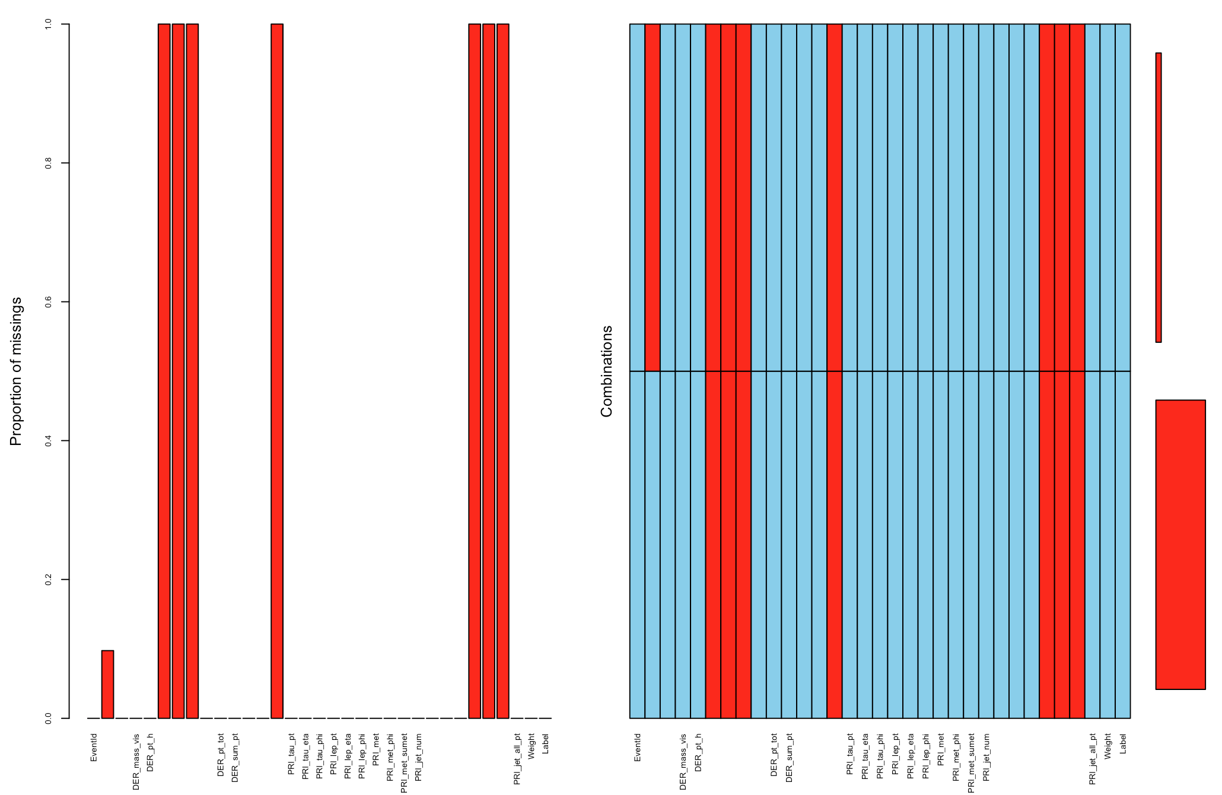
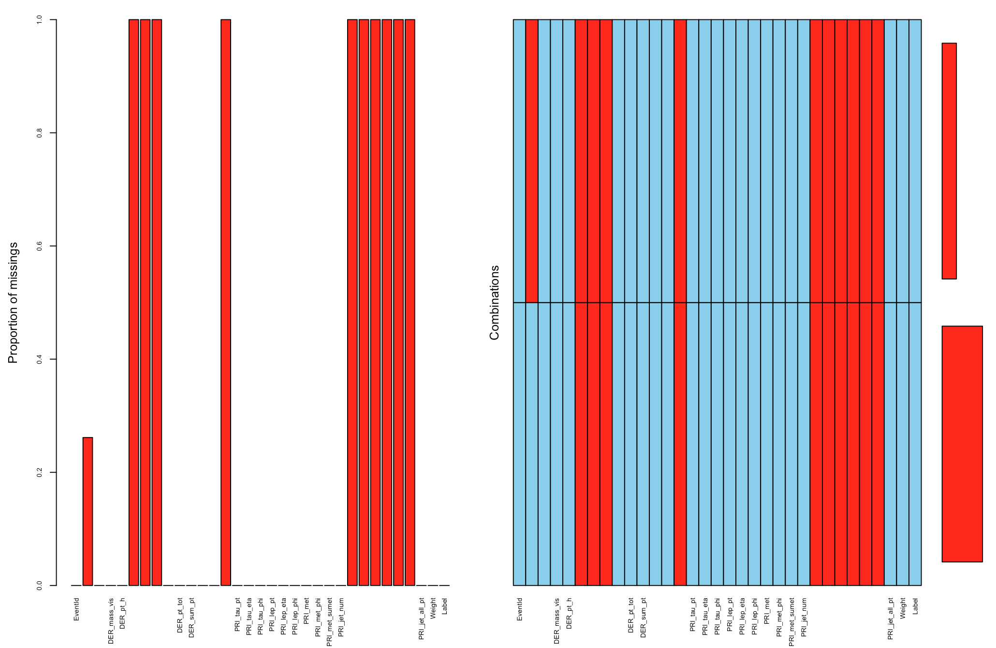
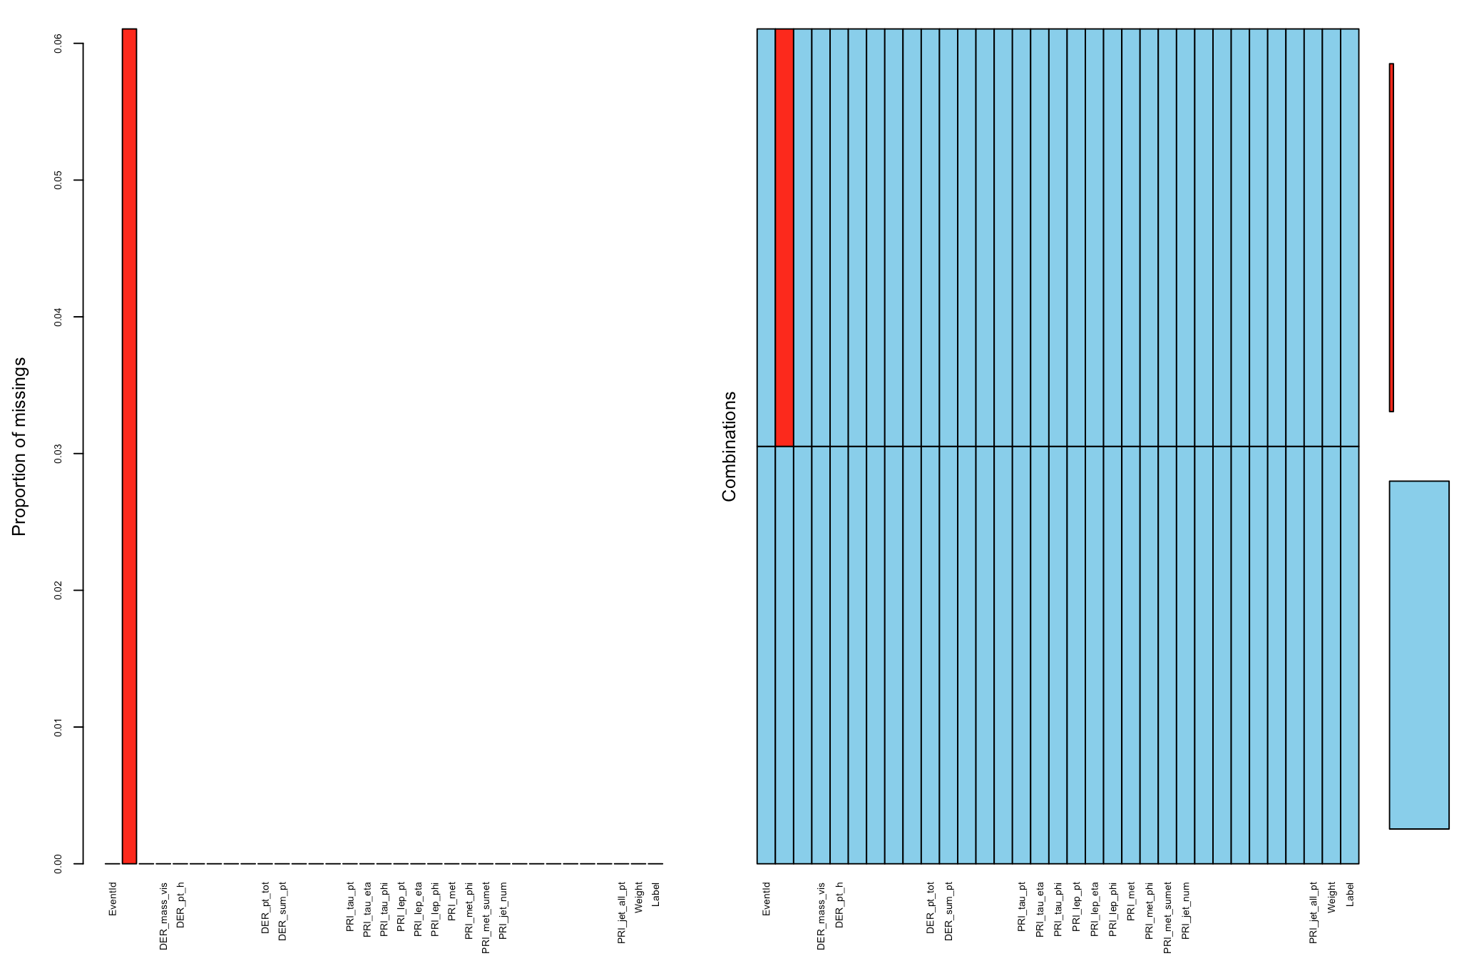
EDA -- Missingness Imputation by kNN
PRI_jet_num = 0
PRI_jet_num = 1
PRI_jet_num = 2 or 3

Slide 5
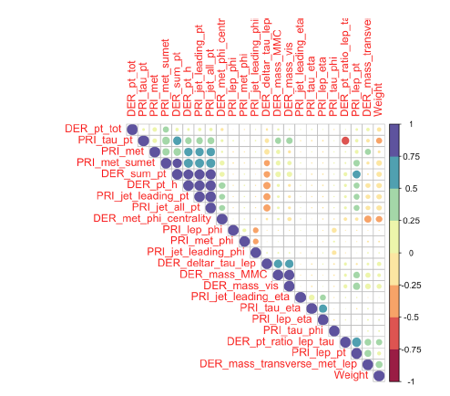
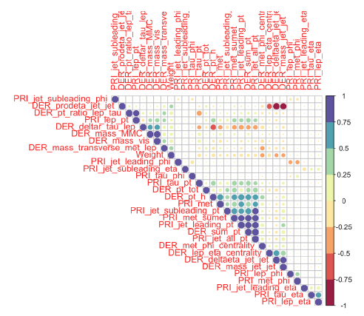
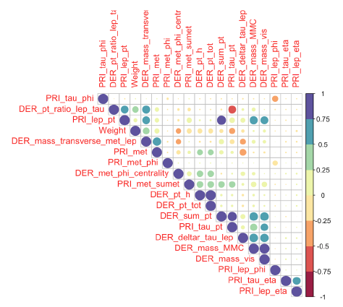
EDA -- Correlation
PRI_jet_num = 0
PRI_jet_num = 1
PRI_jet_num = 2 or 3
Variables of same prefix (with some uppercase letters) have high positive or negative correlation.

Slide 6
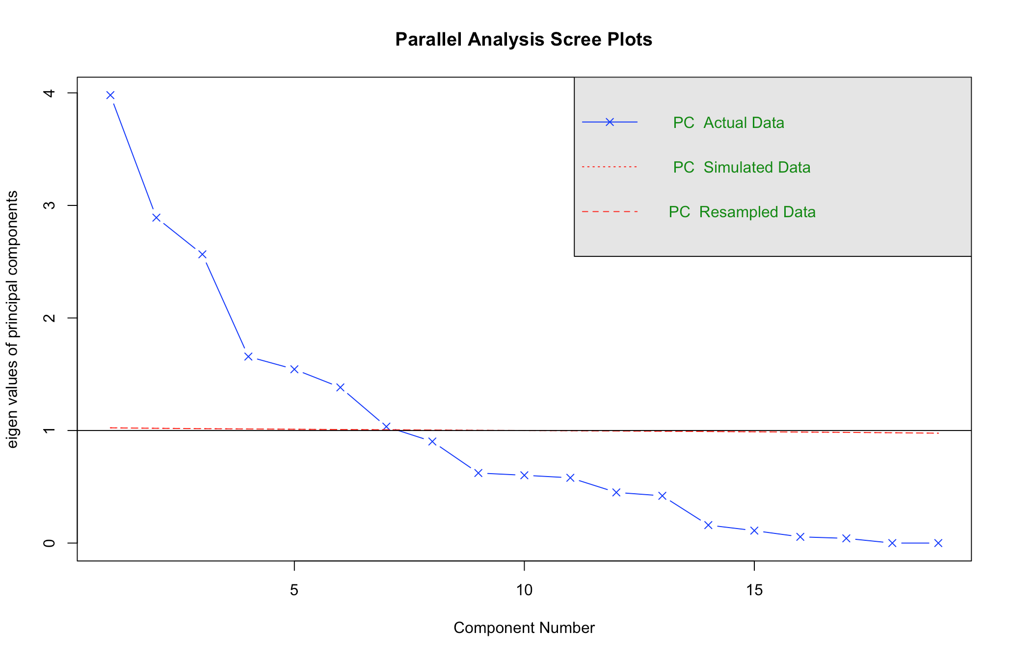
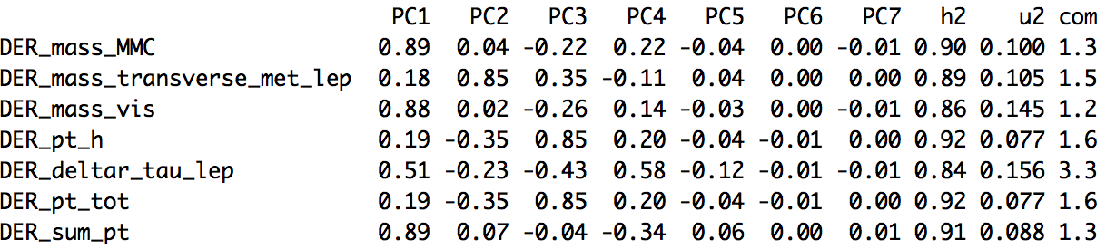
EDA -- Principal Component Analysis
Importance: mass-related variables.
Impute missing values: DER_mass_MMC
PRI_jet_num=0
Notes:
Principal component analysis was conducted in each category.
Rotations(or loading) results, which are the coefficients of the linear combinations of the continuous as shown above.

Slide 7
Outline
Flowchart
Exploratory Data Analysis
Models
Random Forests
Generalized Boosted Model
Neural Networks
XGBoost
Lesson Learned

Slide 8
Random Forests
Two parameters: ntree and mtry.
1st tuning: ntree = c(2000,5000,8000) mtry = c(3,4,5,6)
However, R crushed due to large ntree
2nd tuning: ntree = c(500,800,1000) mtry = c(3,4,5)

Slide 9
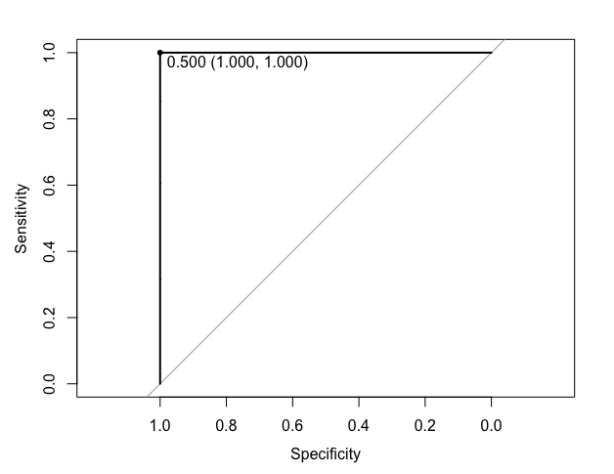
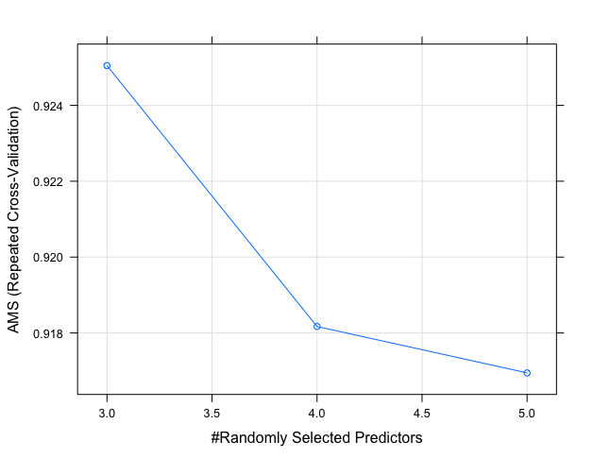
Random Forests(DF:PRI_jet_num=0)

Slide 10
Random Forests(DF:PRI_jet_num=1)
TBD

Slide 11

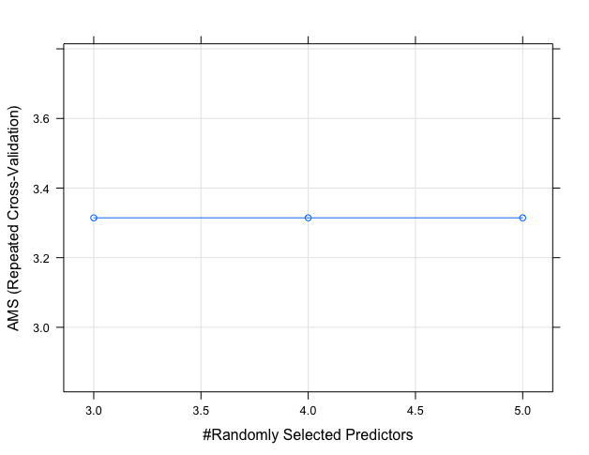
Random Forests(DF:PRI_jet_num=2&3)

Slide 12
Random Forests---Summary
Pros:
It can never go overfitting!
Good with very large data set
Robust against outliers
Cons:
Not a fast algorithm. Very time and memory space consuming
Less accurate than boosted tree models
Cannot handle NAs

Slide 13
Outline
Flowchart
Exploratory Data Analysis
Models
Random Forests
Generalized Boosted Model
Neural Networks
XGBoost
Lesson Learned

Slide 14
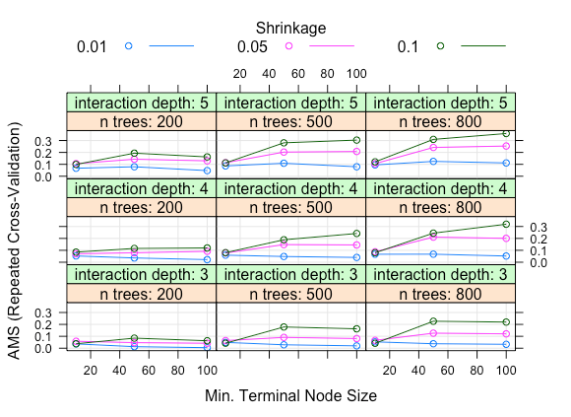
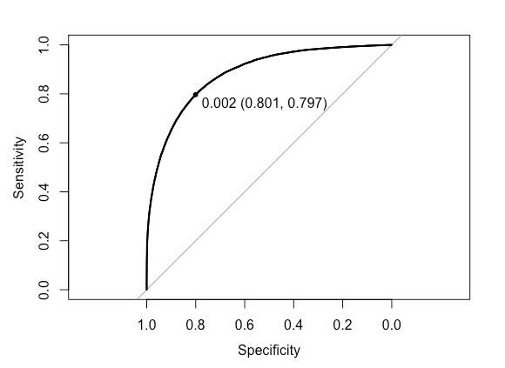
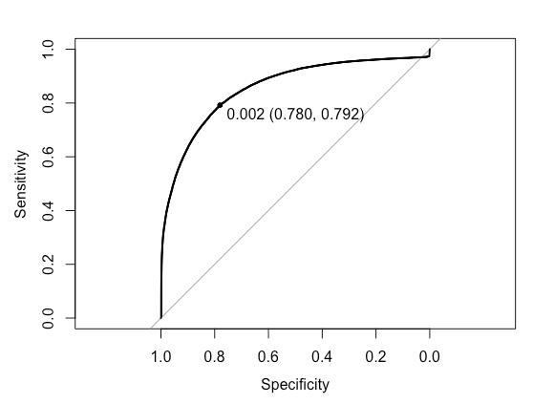
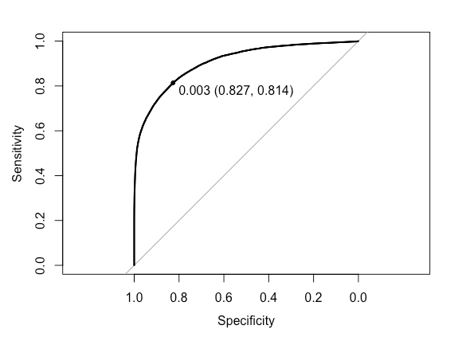
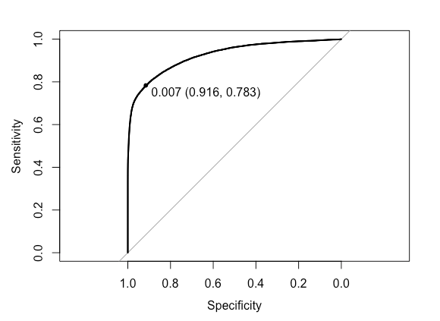
Gradient Boosting Model (DF:PRI_jet_num=1)
1
2
Tuning four parameters, 5-fold validation
1st tuning: interaction.depth =c(3, 4, 5), n.trees =c(200, 500, 800), shrinkage = c(0.1, 0.05, 0.01), n.minobsinnode = c(10, 50, 100)
2nd tuning: 800 trees and interaction.depth (5,7,10)
3rd tuning: 5 interaction.depth and large trees(800, 2000, 5000),
4th tuning: 5 interaction.depth and larger trees(5000, 7500, 10000)
3
4

Slide 15
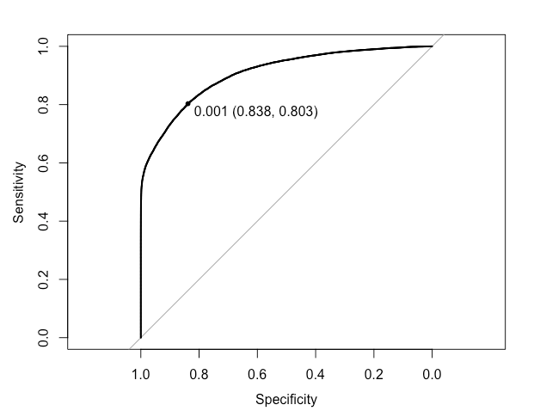
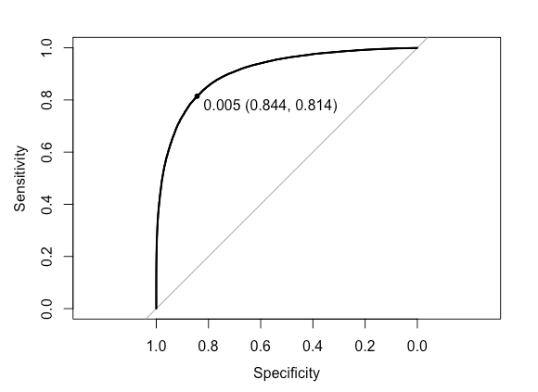
Parameter tuning for the other 2 subsets
jet_num=0
interaction.depth = 5, n.trees =10000, shrinkage = 0.1, n.minobsinnode = 100
jet_num=c(2,3)
interaction.depth = 5, n.trees =800, shrinkage = 0.05, n.minobsinnode = 100

Slide 16
Summary of Gradient Boosting Model
Interaction.depth: big trees: sqr(number of variables); smaller trees: 10
N.trees: 10000, reduce overfitting by smaller learning rate and cross-validation
Shrinkage: big trees: 0.001; small trees: 0.1
N.minobsinnode: 100: reduce variance in predictions at leaves
Pros:
Use all features
Higher accuracy and lower possibility of overfitting with more trees
Cons:
Susceptible to outliers
Lack of interpretability and higher complexity
Harder to tune hyperparameters than other models
Slow to train

Slide 17
Outline
Flowchart
Exploratory Data Analysis
Models
Random Forests
Generalized Boosted Model
Neural Networks
XGBoost
Lesson Learned

Slide 18
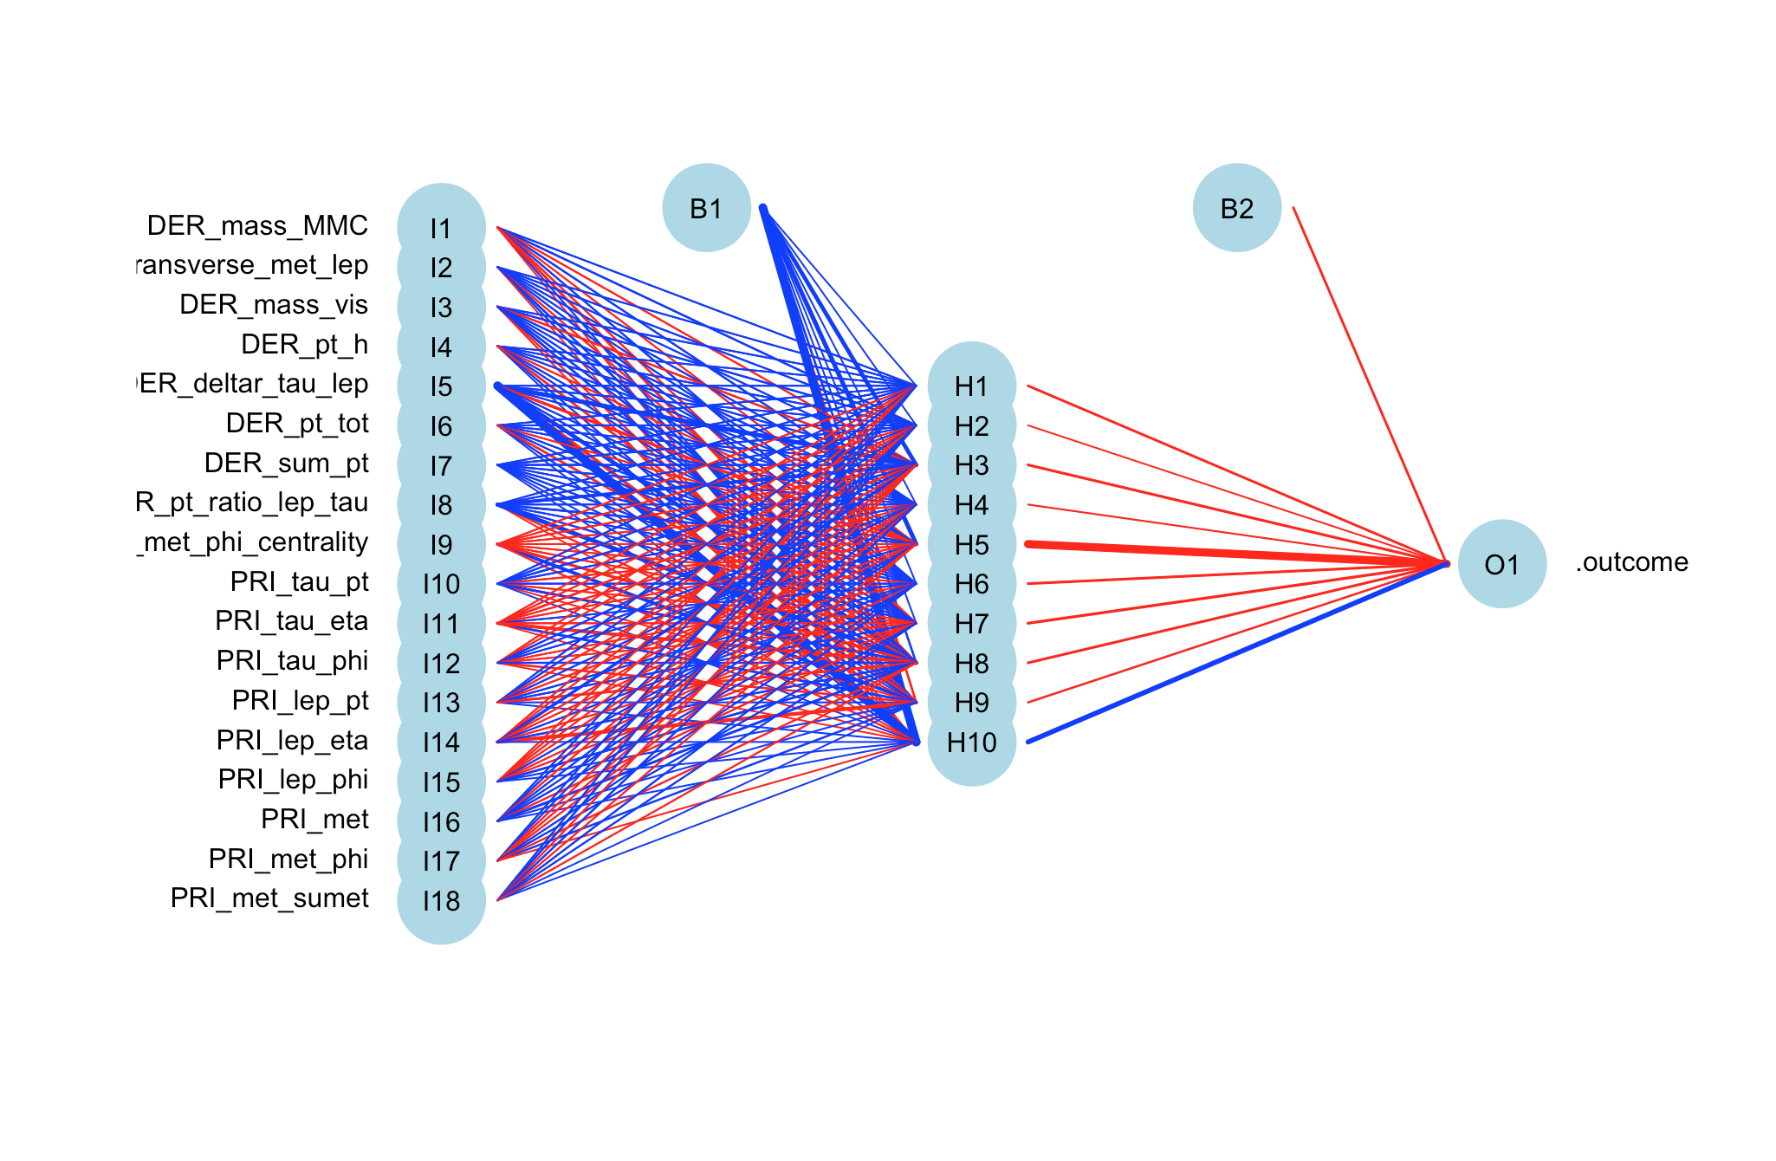
Neural Networks
We chose “nnet” under “Caret” library.
Two tuning parameters: number of hidden units and weight decay.
Firstly selected combination of different numbers of hidden units ranging between 6-20, as well different number of decay weights between 0-0.5.

Slide 19
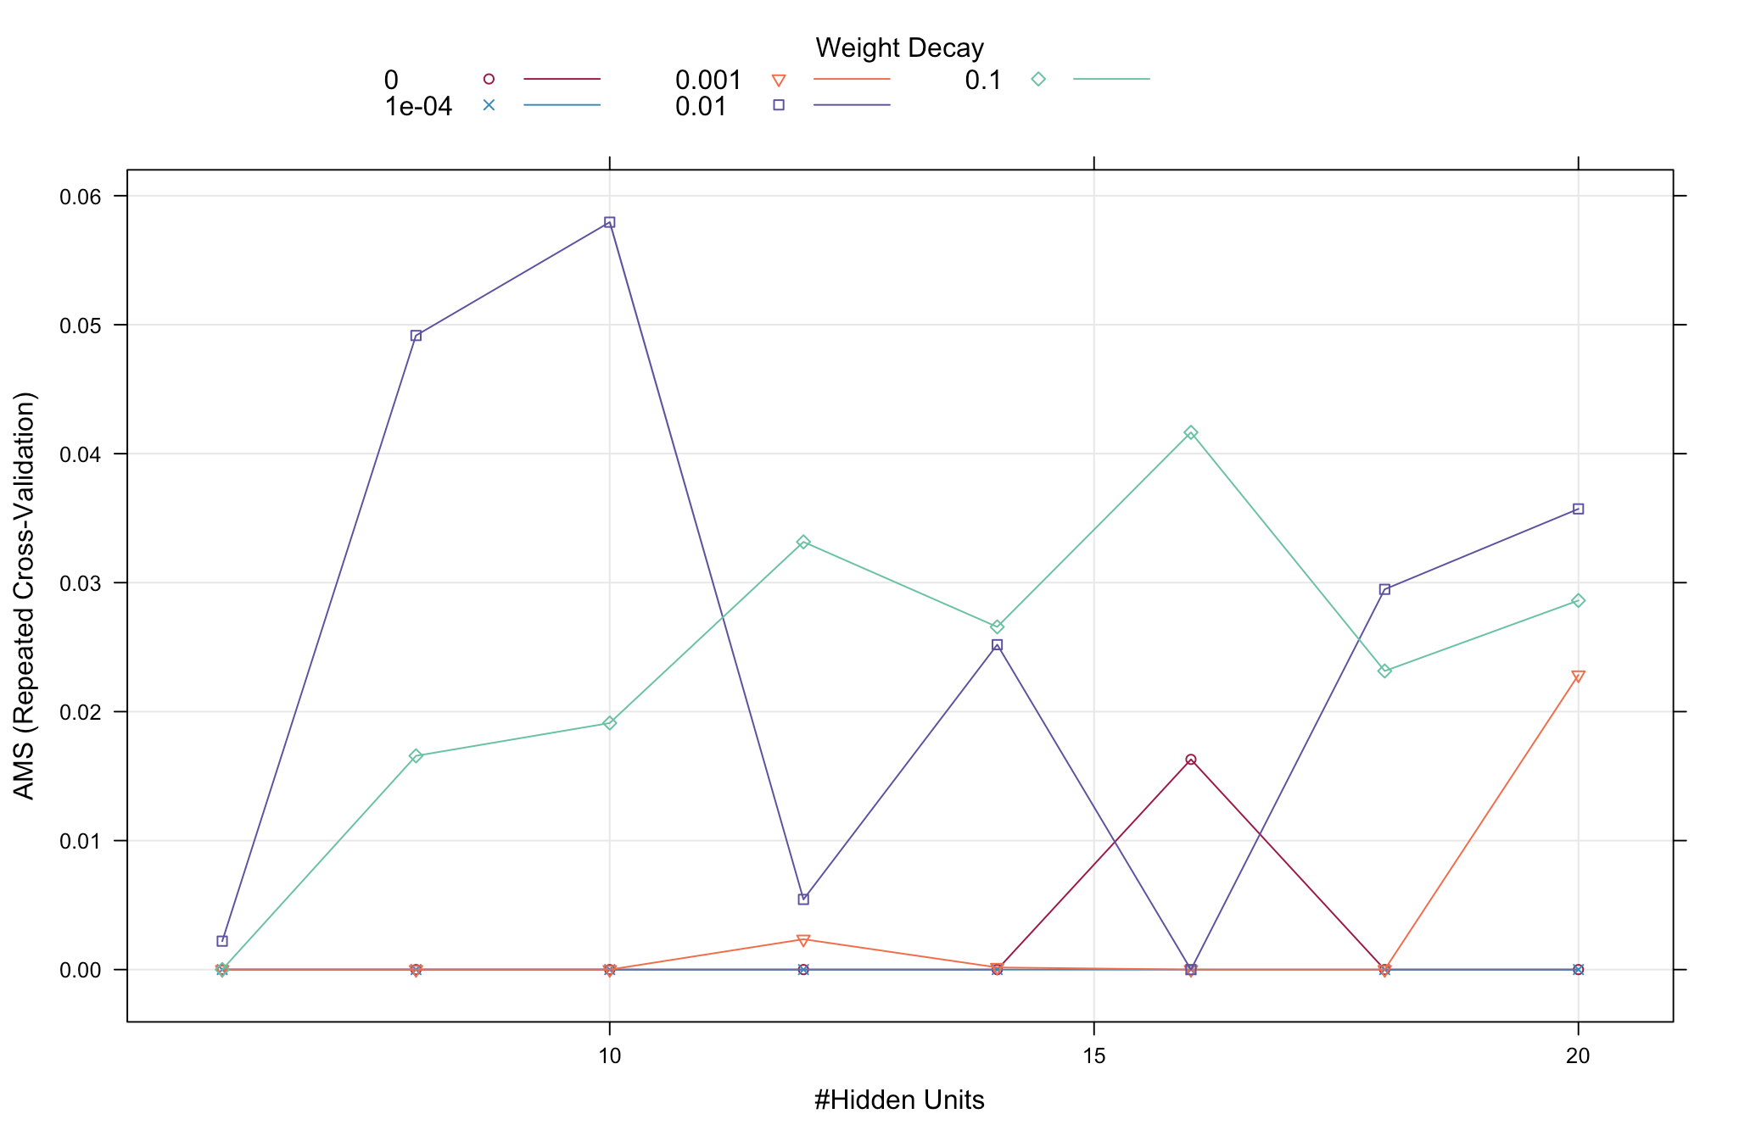
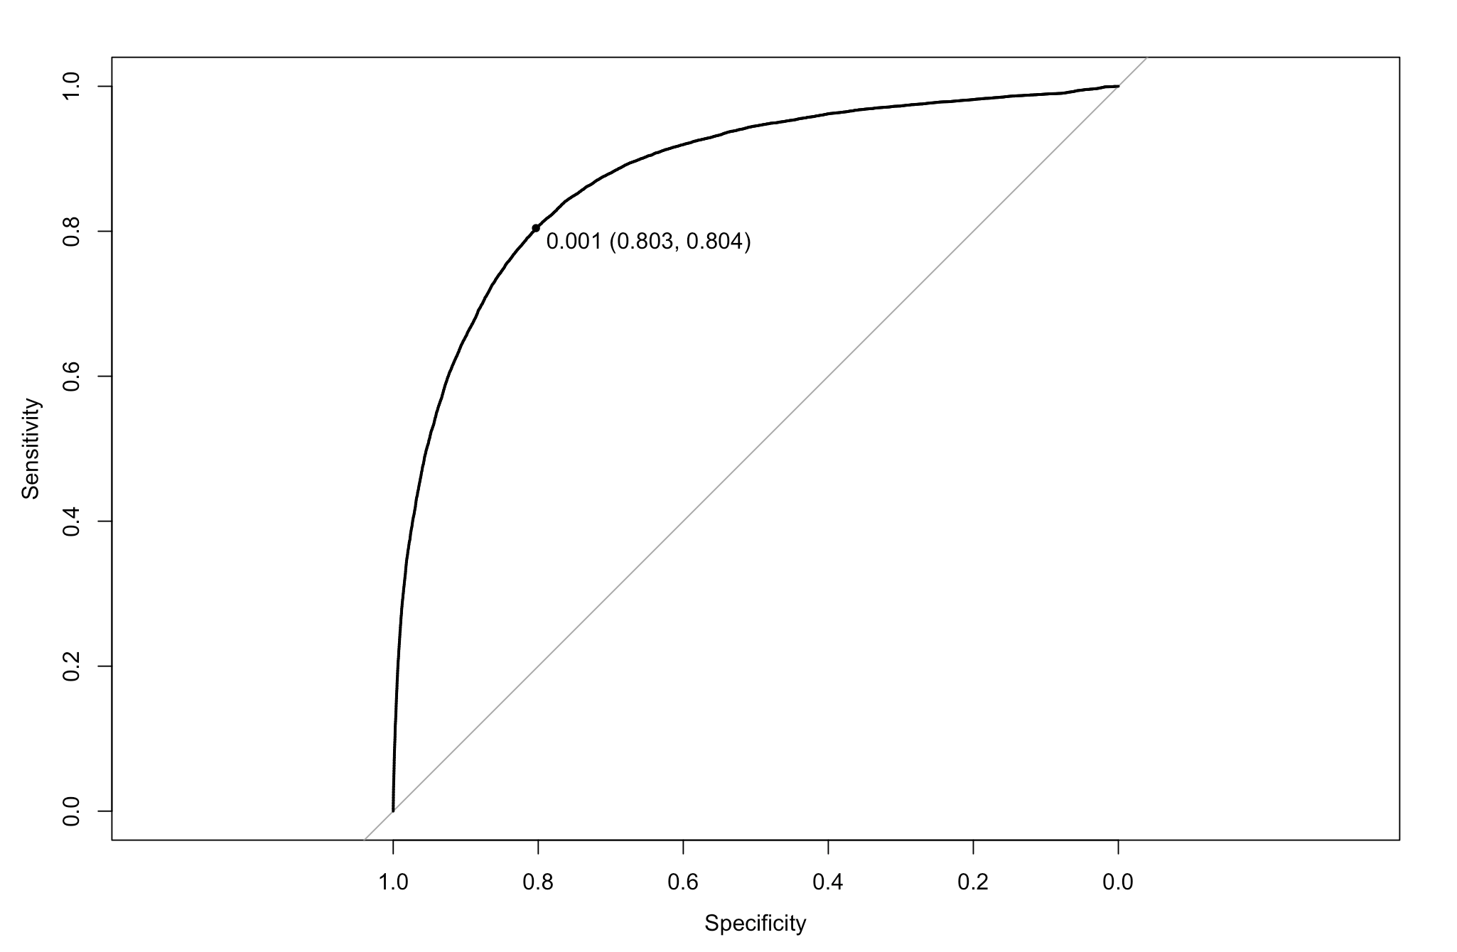
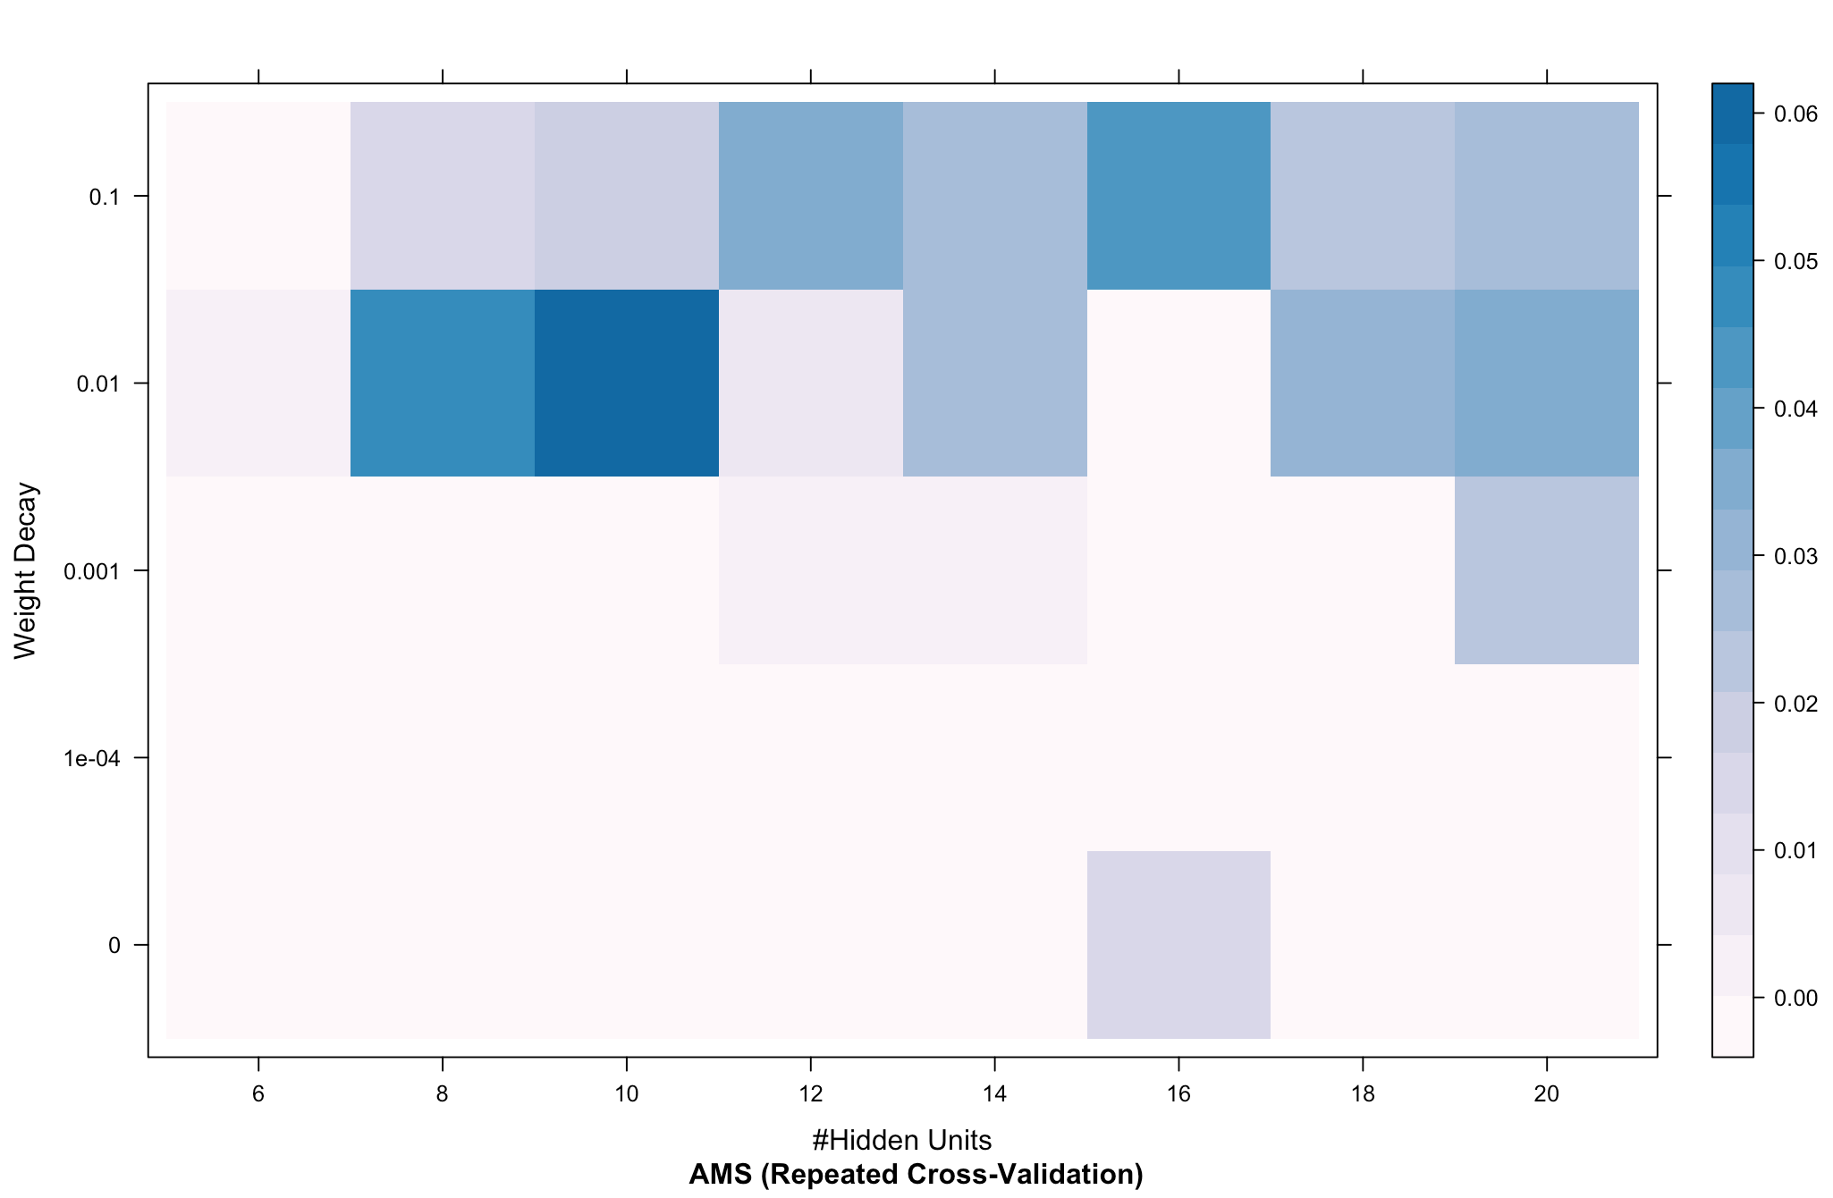
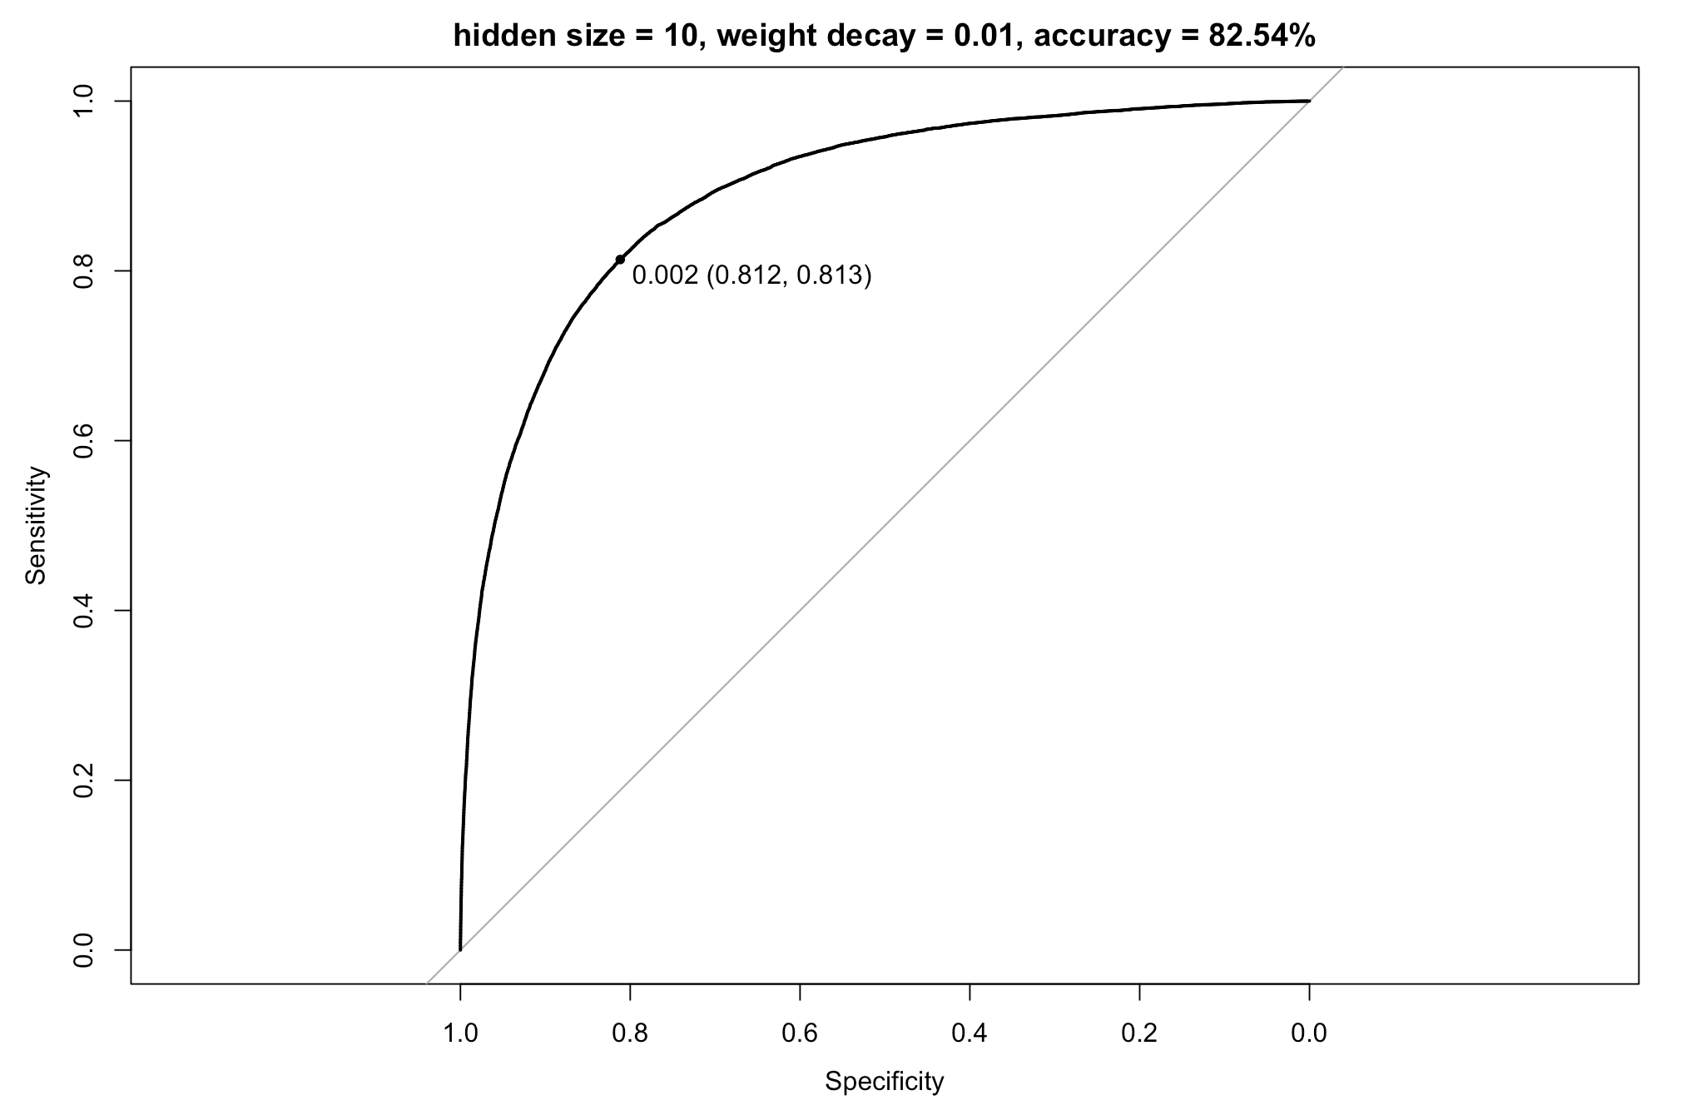
Neural Networks -- jet_number = 0
Hidden units: 6-20; Weight decay: 0.0001-0.
Fluctuation trend noticed as hidden unit increases.

Slide 20
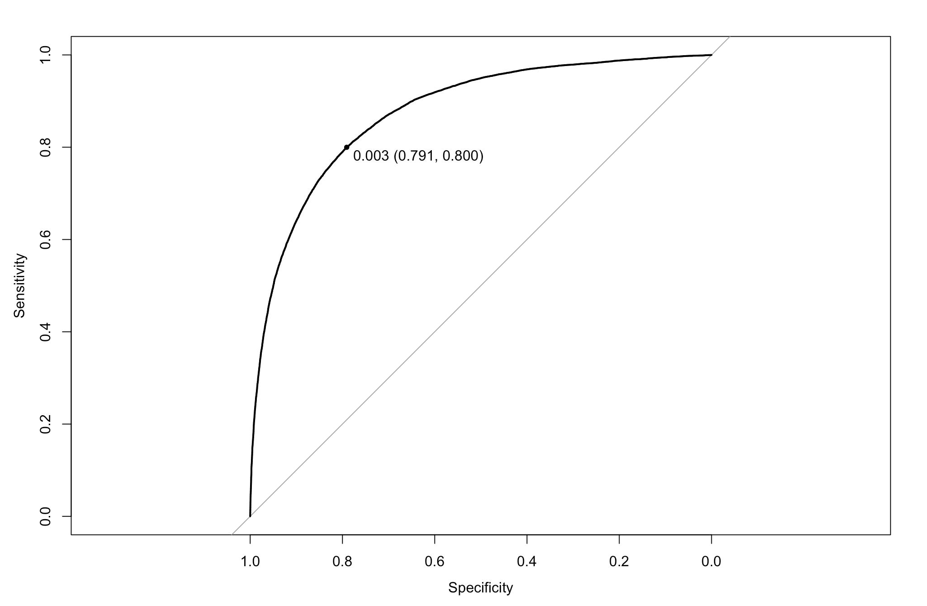
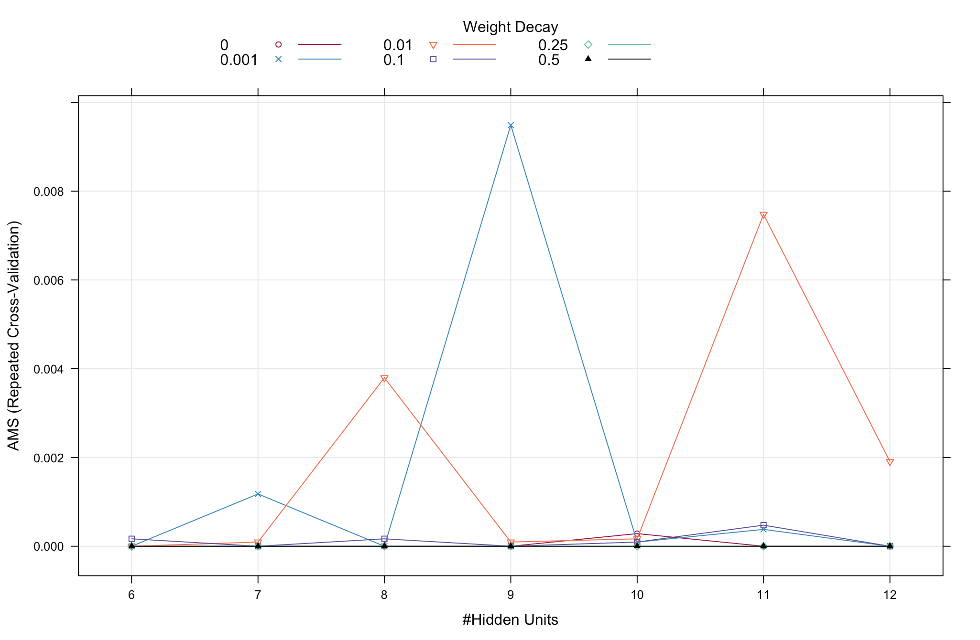
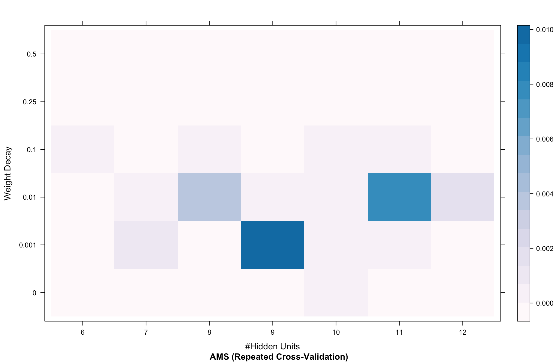
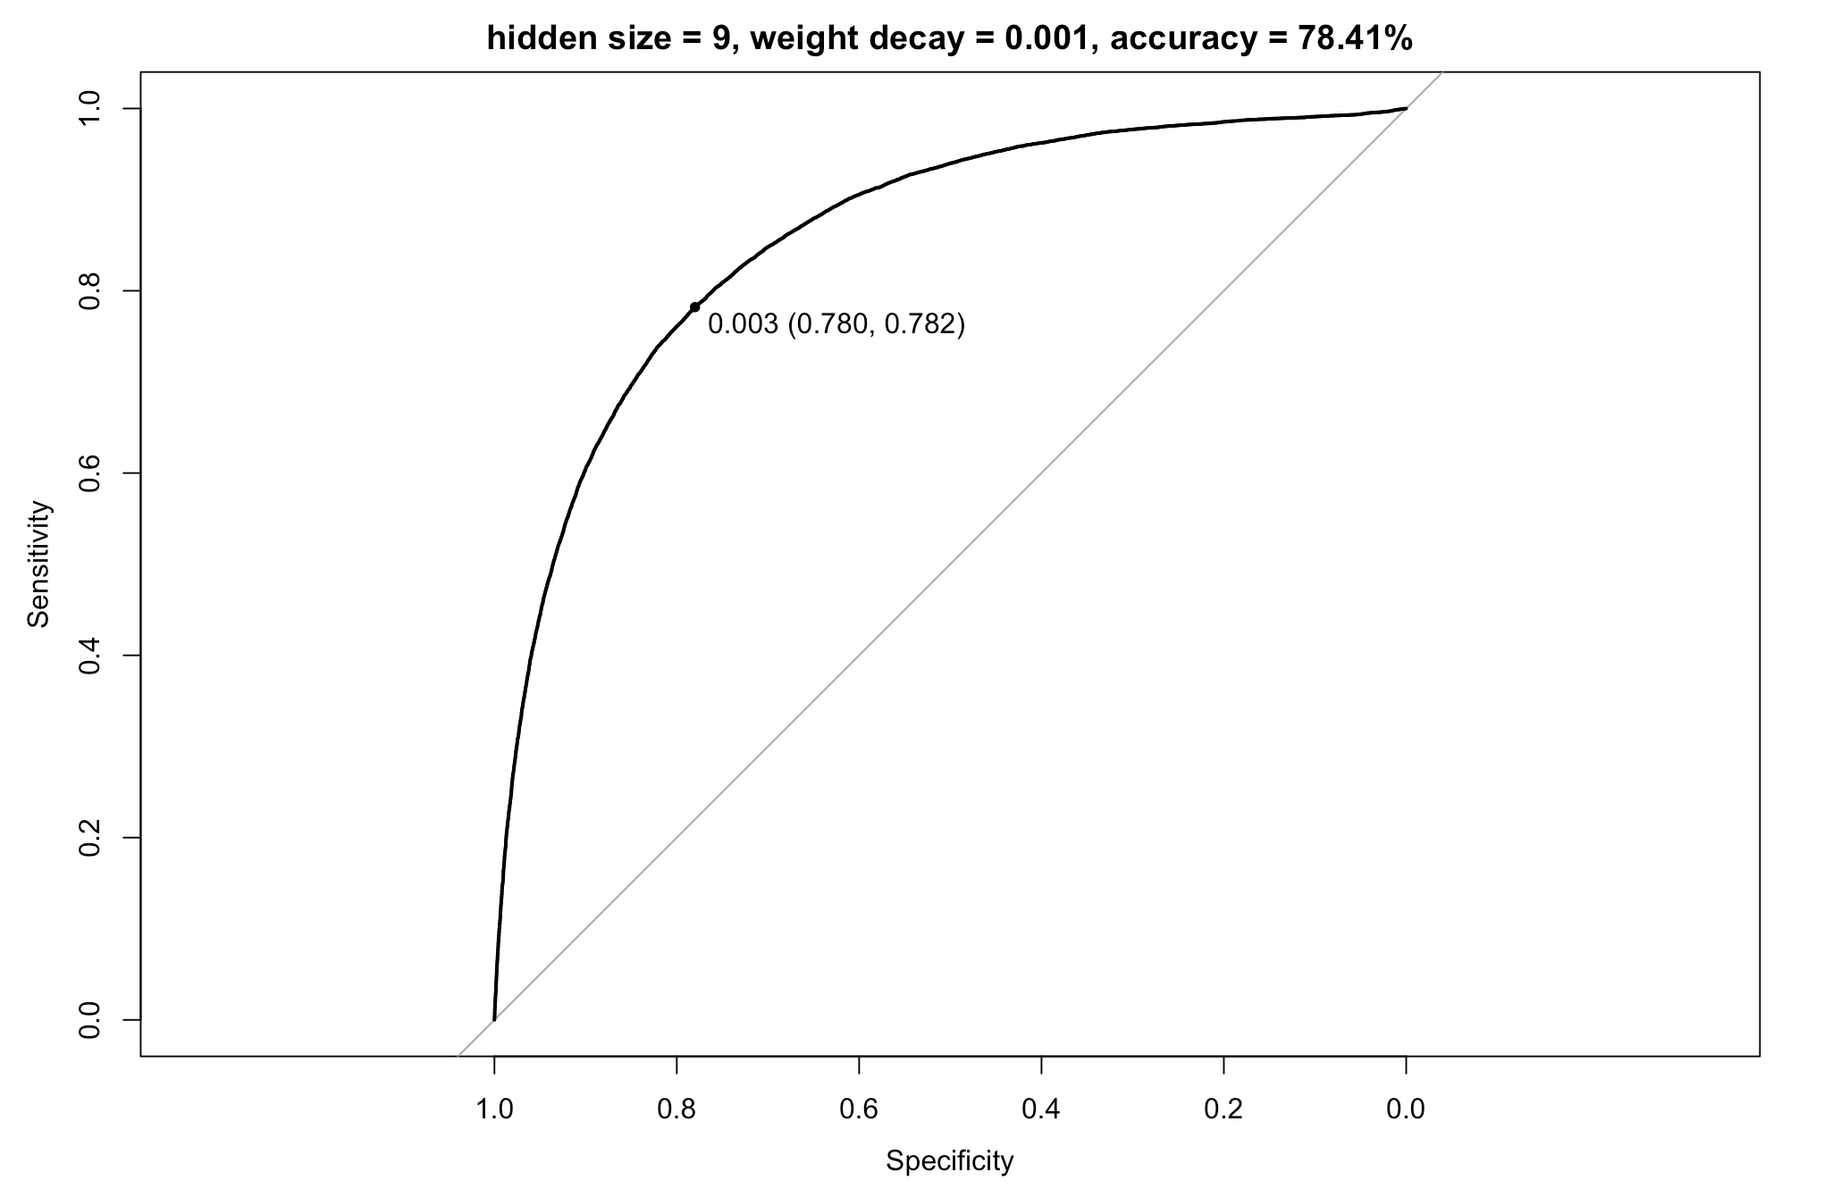
Neural Networks -- jet_number = 1
Hidden units: 6-12; Weight decay: 0.001-0.5.

Slide 21
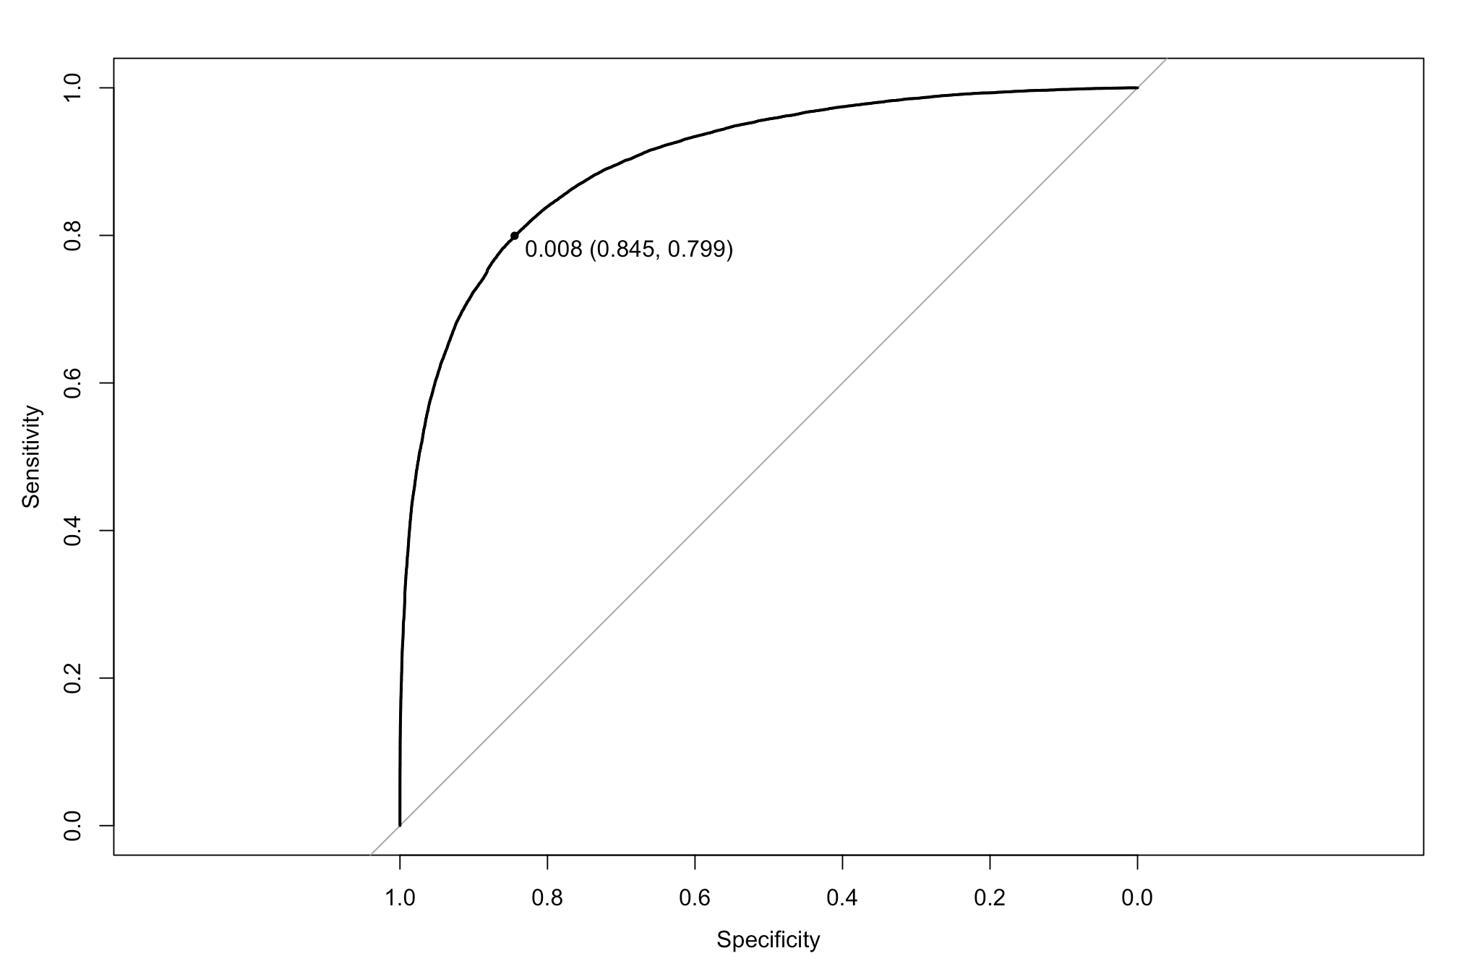
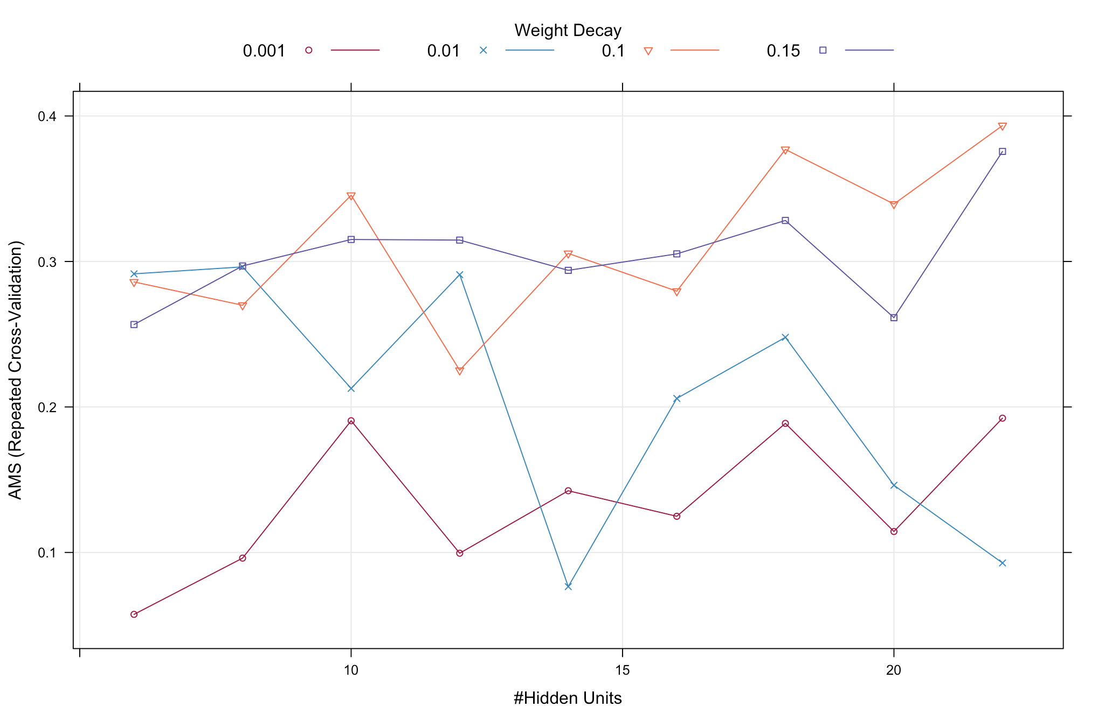
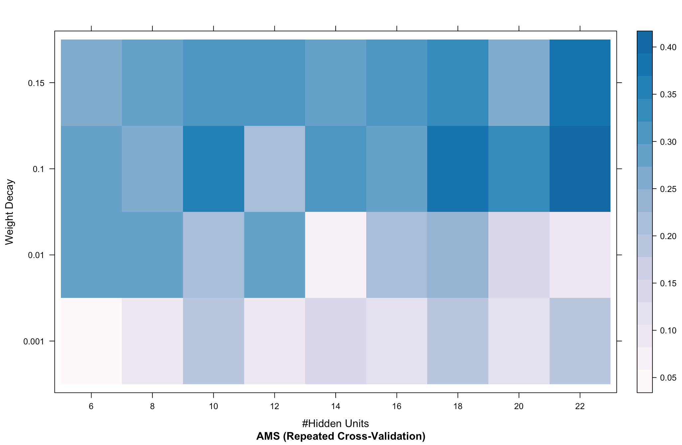
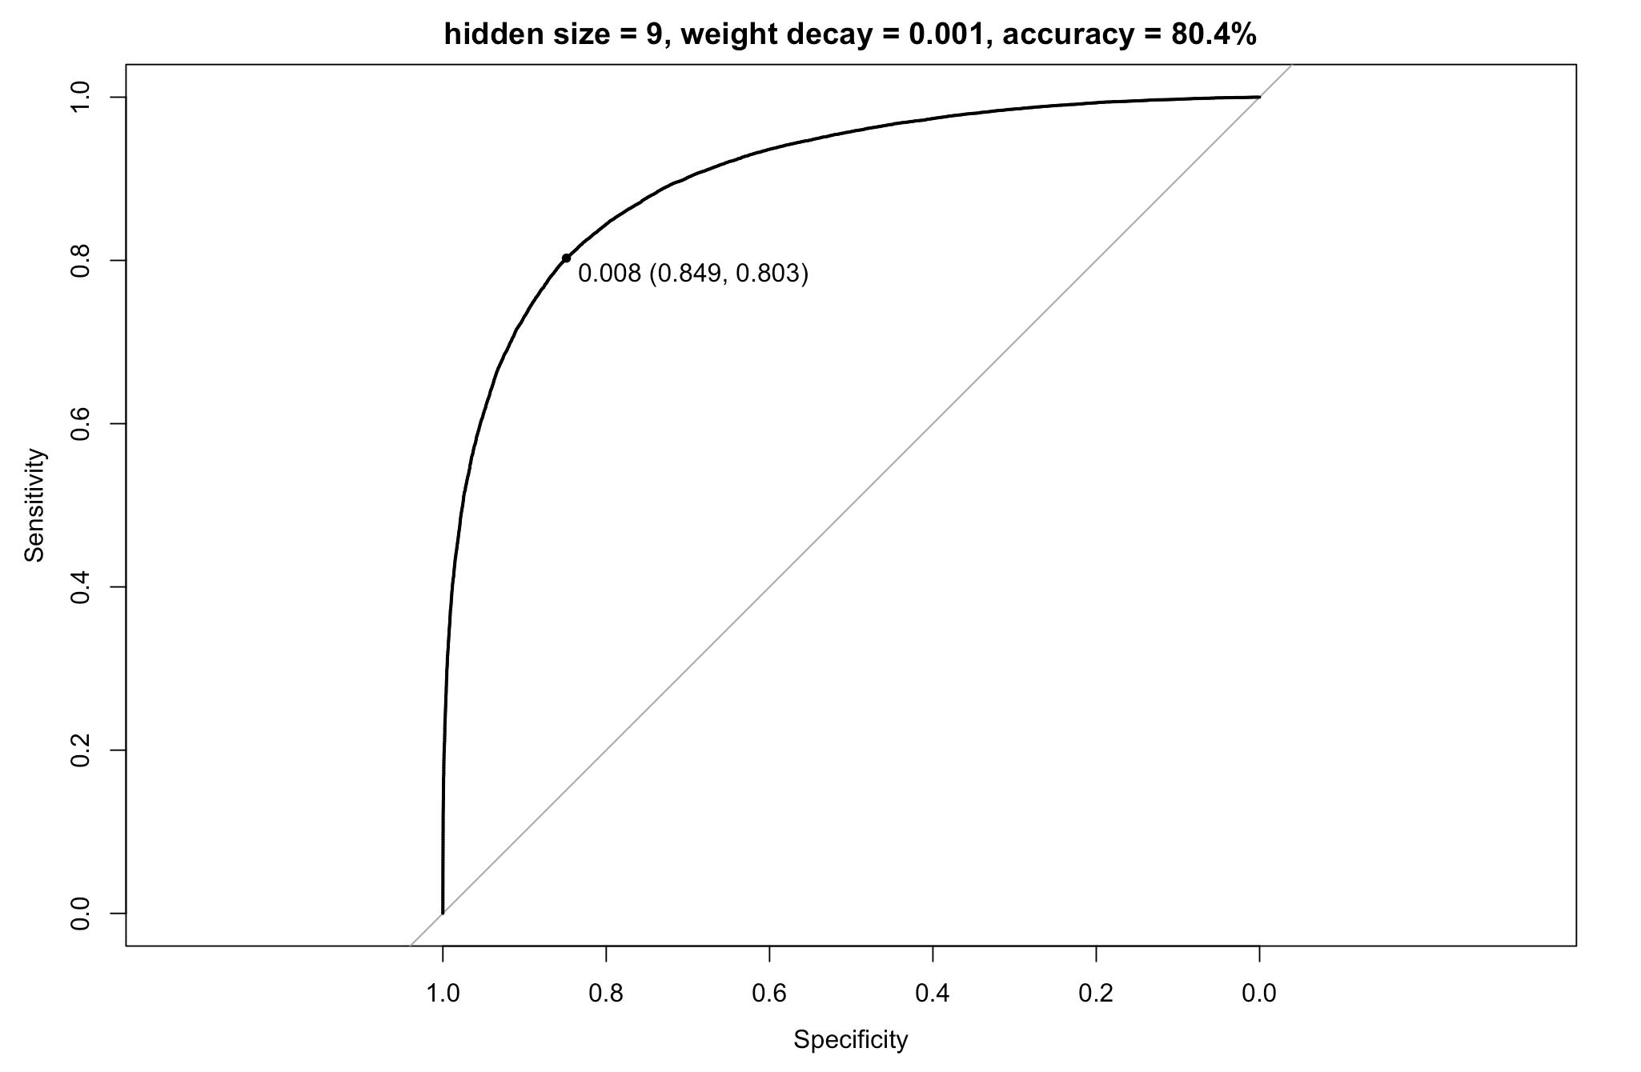
Neural Networks -- jet_number = 2/3
Hidden units: 6-22
Weight decay: 0.001-0.15

Slide 22
Neural Networks -- Summary
Insight
Pros & Cons
Can directly train hundreds or thousands of input variables.
Do not require accurate procedures of confidence on other

Slide 23
Outline
Flowchart
Exploratory Data Analysis
Models
Random Forests
Generalized Boosted Model
Neural Networks
XGBoost
Lesson Learned

Slide 24
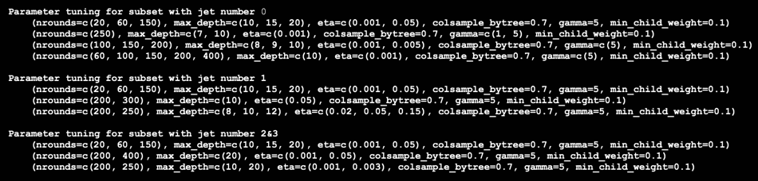
XGboost
5 parameters to tune
nrounds
max_depth
eta
colsample_bytree
gamma
min_child_weight
Guidelines
Begin with rough grid, gradually fine tuning
Prefer slow learners (small eta, eg. 0.005)
Tune max_depth (9 or 10)
Fixed colsample_bytree (0.7)
Fixed gamma (5)
Fixed min_child_weight (0.1)

Slide 25
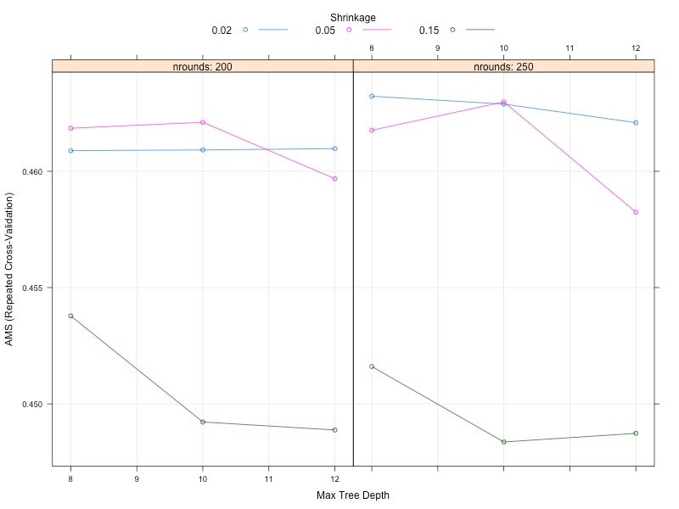
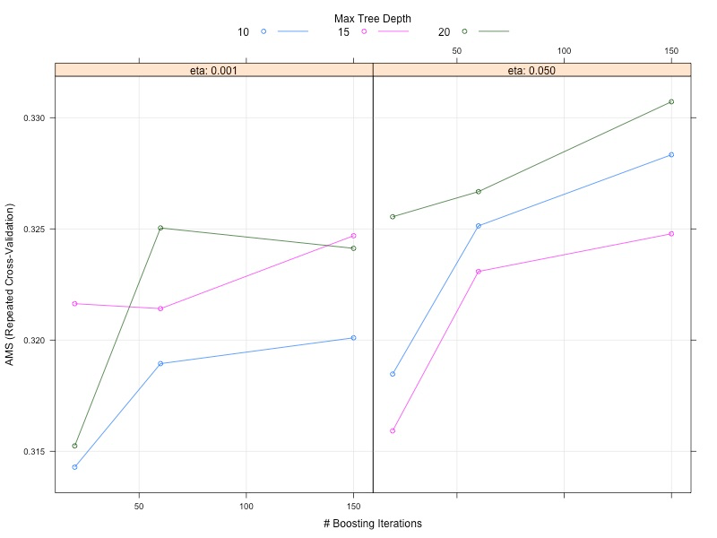
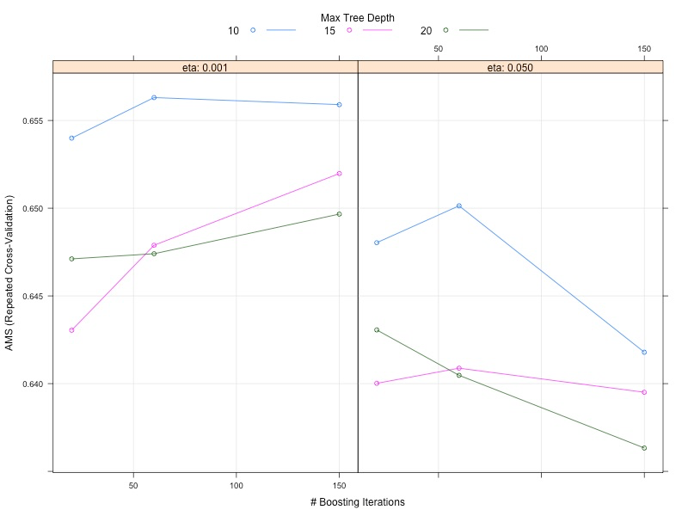
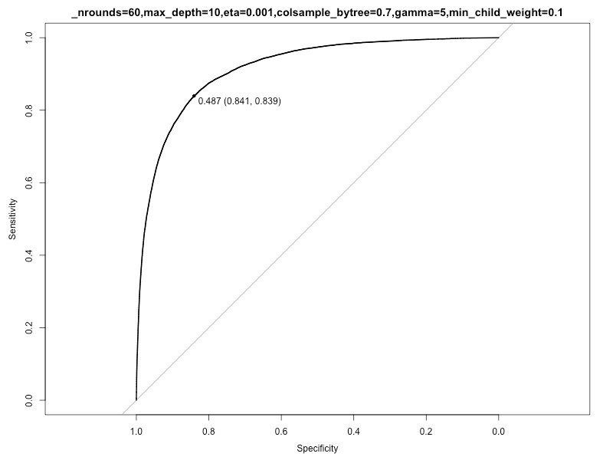
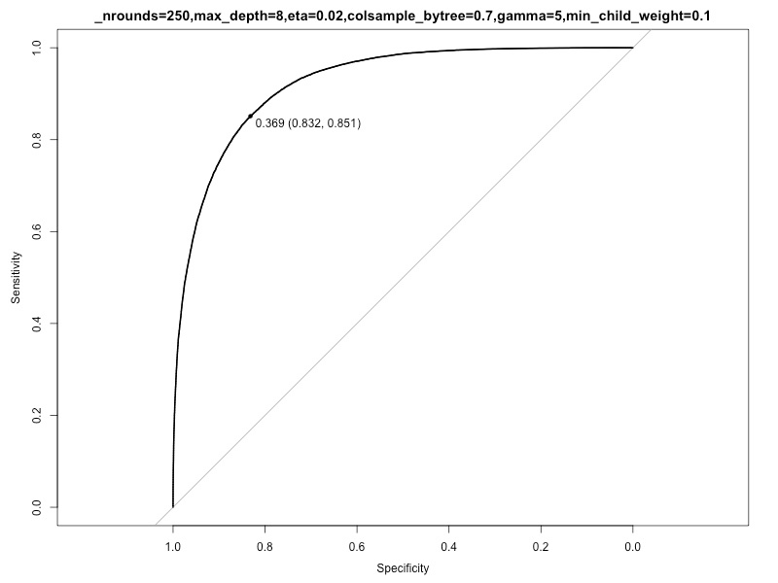
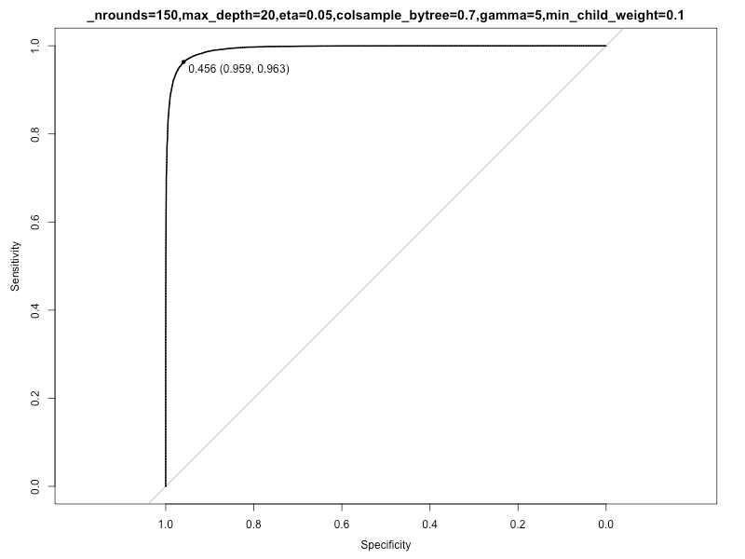
Parameter tuning for all 3 subsets

Slide 26
Outline
Flowchart
Exploratory Data Analysis
Models
Random Forests
Generalized Boosted Model
Neural Networks
XGBoost
Lesson Learned

Slide 27
Lesson learned
Prioritize team's overall strategy
Imputation turns out to be necessary for us (for EDA, feature importance, NN, RF)
Use cloud computing for all team members not their own laptops (avoid crashing and uncertainties)
Try larger grids if possible (our grids are still too sparse)
All team members focus on one model VS each work on their own

Slide 28
Thanks!

