Slide 1

Global Trade
Chia-An Chen

Slide 2
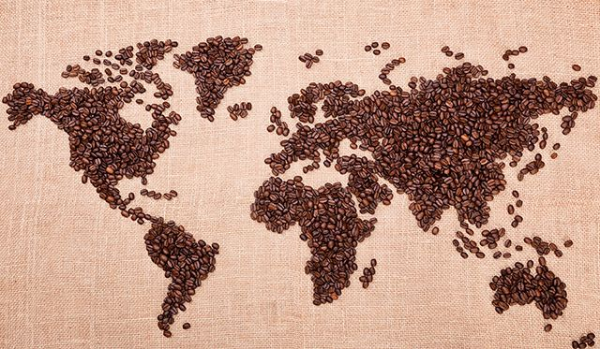
?

Slide 3

Dataset Intro
Production, supply, and distribution of coffee from United States Department of Agriculture
Total population from World Databank
GDP from World Databank
Annual working hour from OECD

Slide 4
Demo Time!
Coffee global trade app

Slide 5
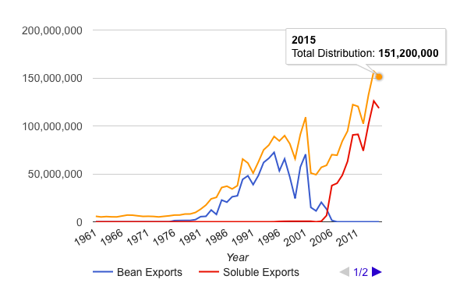
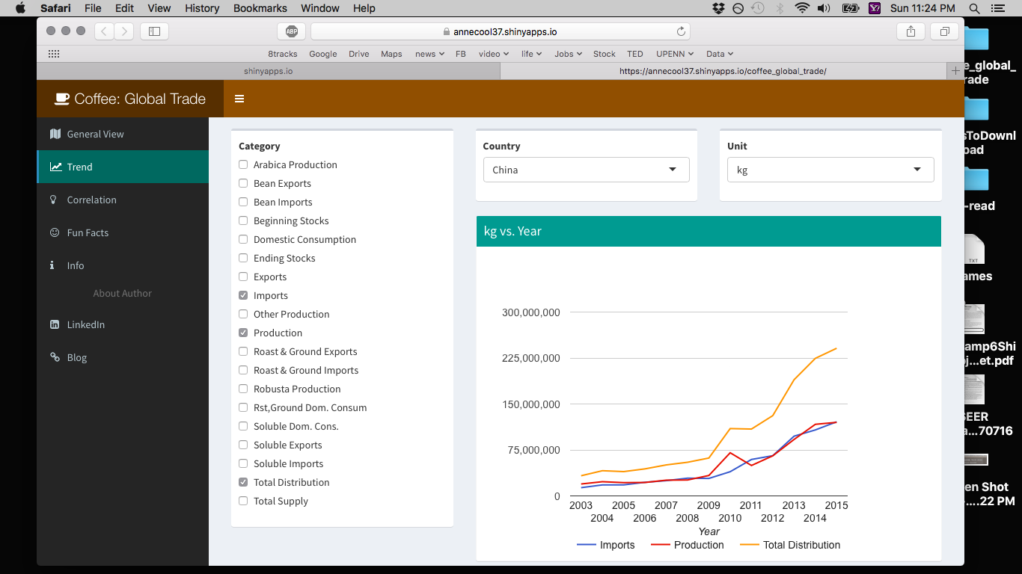
How Bean Exports and Soluble Exports Shape Total Distribution
Thailand
China

Slide 6
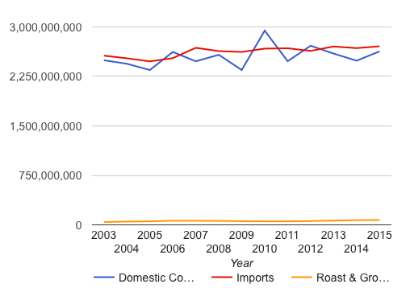
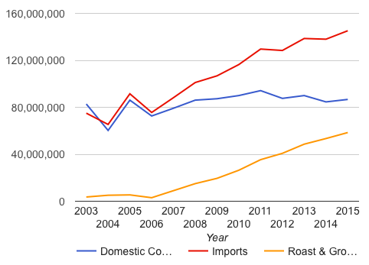
Does Import Always Correlate with Domestic Consumption?
European Union
Switzerland
kg

Slide 7
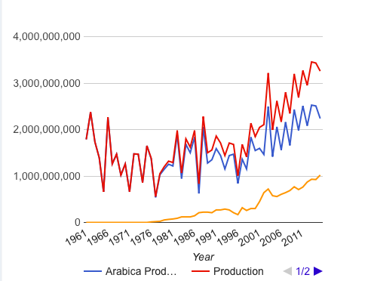
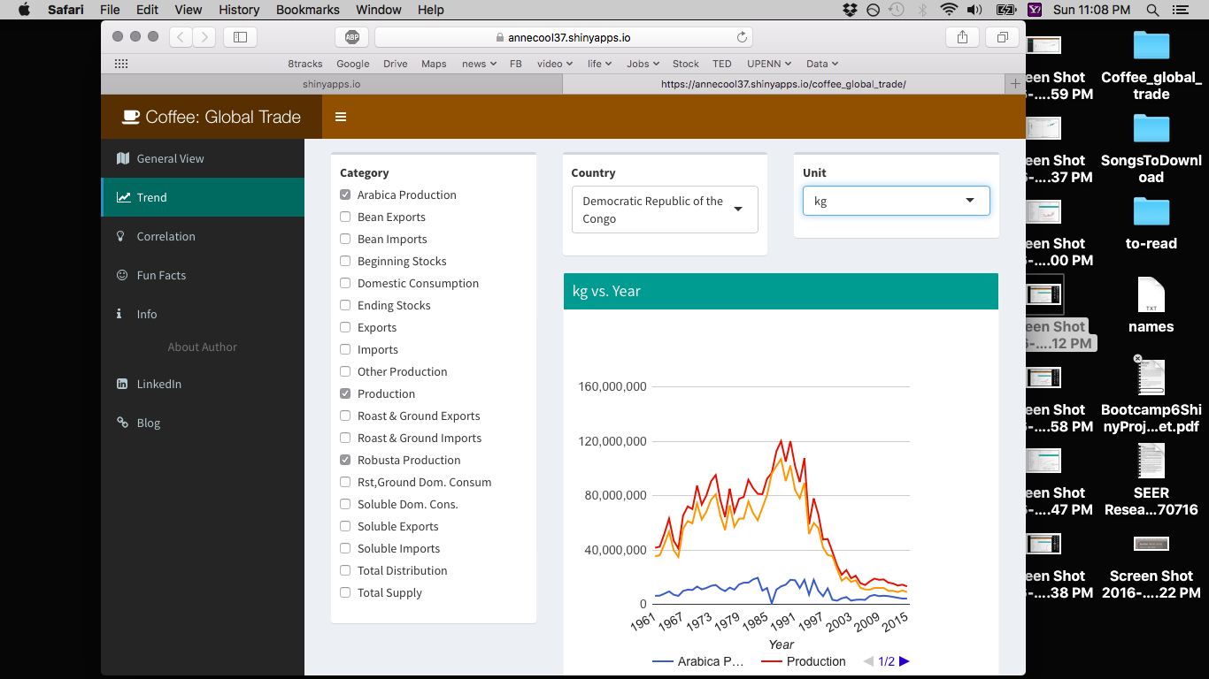
Production Type: Arabica and Robusta
Brazil
Democratic Republic of the Congo

Slide 8
If I got more time…
Integrate another dataset, price paid to coffee beans’ grower, to my app
Conduct cluster analysis based on the plot shown in correlation tab

Slide 9

Questions?

Slide 10
Appendix

Slide 11
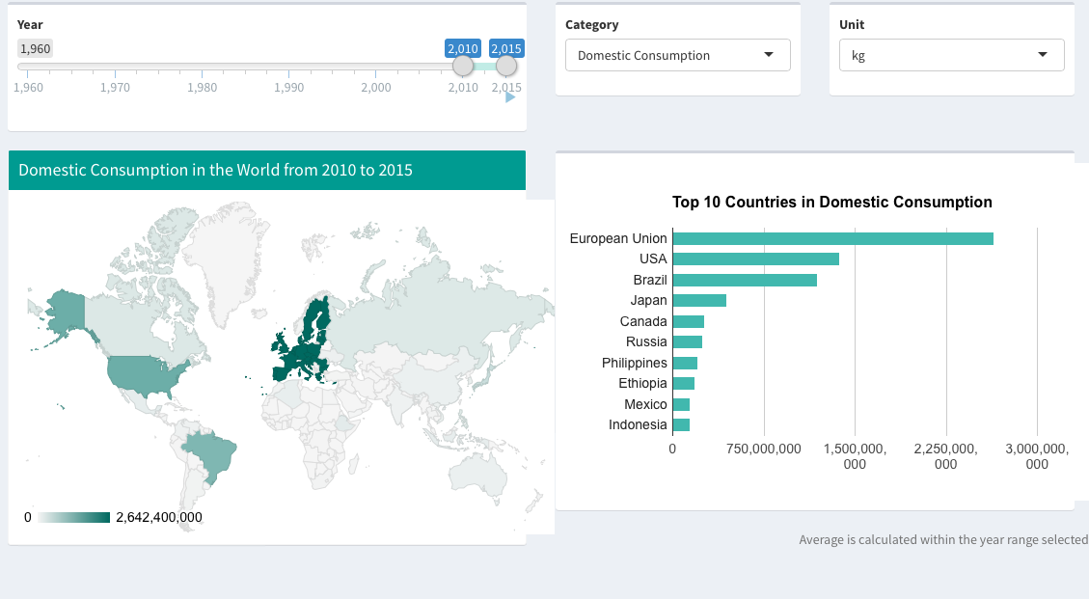
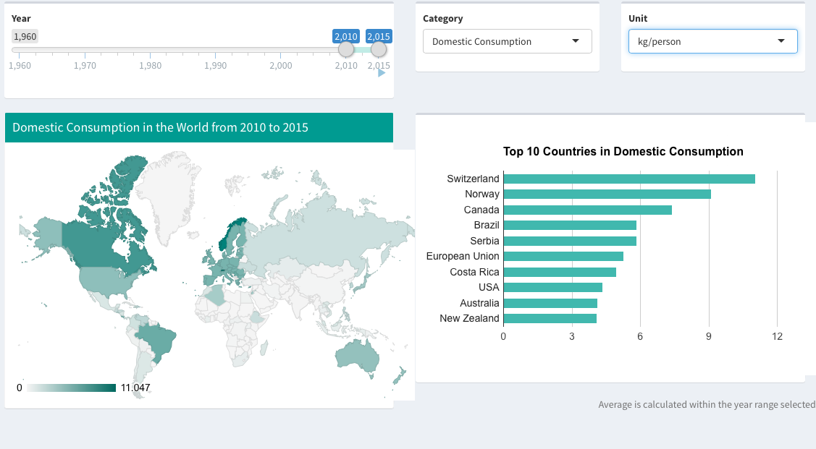
Domestic consumption
kg
kg/person

