Slide 1
SOFTWARE PROJECT MANAGEMENT PROJECT SCHEDULING –
Gantt chart
PERT diagram
CPM
‹#›
Notes:
‹#›
*
Maria Petridou
University of Nottingham

Slide 2
PROJECT WORK PLAN (/SCHEDULING)
It is a dynamic document that defines the list of tasks and important information about each task.
A project plan includes: start date, completion date, estimated duration, actual duration, precedence information, deliverables, completion status, required resources, key milestones, staffing plan, etc.
Common Tools to produce a Workplan
Gantt Chart - is a type of bar chart that illustrates a project schedule.
PERT Diagrams - useful tool to identify critical tasks.
‹#›
Notes:
‹#›
*
Maria Petridou
University of Nottingham

Slide 3
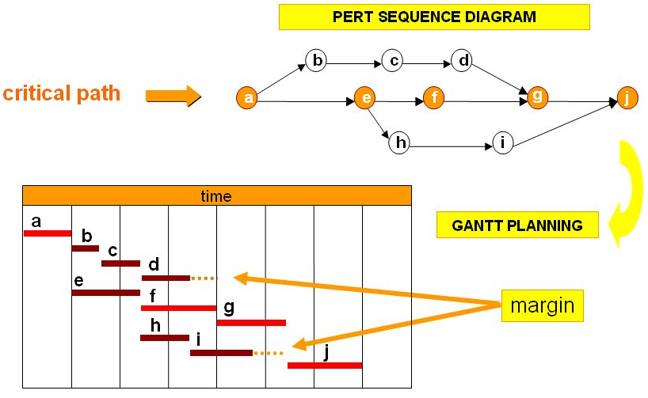
GANTT CHART & PERT DIAGRAMS EXAMPLES
Reading: (Kendall&Kendall, chapter 3), (Dennis&Wixom, chapters 2,3)
‹#›
Notes:
‹#›
*
Maria Petridou
University of Nottingham

Slide 4
LECTURE – PERT DIAGRAMS & CPM
Project Scheduling
Project Scheduling Objectives
Phases of Project Scheduling
PERT Diagrams & Dummy Activities
CPM – Critical Path Method
‹#›

Slide 5

PROJECT SCHEDULING
It is part of project management within the Planning phase of the Systems Development Life Cycle.
Project Scheduling: Allocate resources to execute all activities in the project.
Project: Set of activities or tasks with a clear beginning and ending points. The amount of available resources (time, personnel and budget) to carry out the activities is usually limited.
‹#›
Notes:
‹#›
*
Maria Petridou
University of Nottingham

Slide 6
PROJECT SCHEDULING
Objectives:
Establish beginning, ending and duration of each activity in the project.
Calculate overall completion time of the project given the amount of usually limited resources.
Determine the critical path and its duration.
Determine the slack time for all non-critical activities and the whole project.
Guide the allocation of resources other than time such as staff and budget.
‹#›
Notes:
‹#›
*
Maria Petridou
University of Nottingham

Slide 7
PROJECT SCHEDULING
Phases:
Define activities or tasks according to the project objectives.
A task is an individual unit of work with a clear beginning and a clear end.
Identify precedence relationships or dependencies
Estimate time required to complete each task.
Draw an activity-on-arrow PERT diagram inserting dummy activities if required.
Apply CPM to calculate earliest and latest starting times, earliest and latest completion times, slack times, critical path etc.
Construct a GANTT chart.
Reallocate resources and resolve if necessary.
Continuously monitor/revise the time estimates along the project duration.
‹#›
Notes:
‹#›
*
Maria Petridou
University of Nottingham

Slide 8
PERT DIAGRAMS
Program Evaluation and Review Technique
It is a network model that allows for randomness in activity completion times.
Tool used to control the length of projects.
PERT was developed in the late 1950’s for the US Navy’s Polaris Project.
First used as a management tool for military projects
Adapted as an educational tool for business managers
It has the potential to reduce both the time and cost required to complete a project.
‹#›
Notes:
‹#›
*
Maria Petridou
University of Nottingham

Slide 9
PERT DIAGRAMS
3
B
D
1
A
2
5
F
6
C
E
4
Single start
node
Single finish
node
‹#›
Notes:
‹#›
*
Maria Petridou
University of Nottingham

Slide 10
PERT DIAGRAMS
Activity-on-node diagrams:
Maybe more than one single start and end node
Nodes represent activities
Arrows indicate precedence
Activity-on-arrow diagrams:
One single start and one single end node
Arrows represent activities
Nodes indicate beginning/end of activities
‹#›
Notes:
‹#›
*
Maria Petridou
University of Nottingham

Slide 11
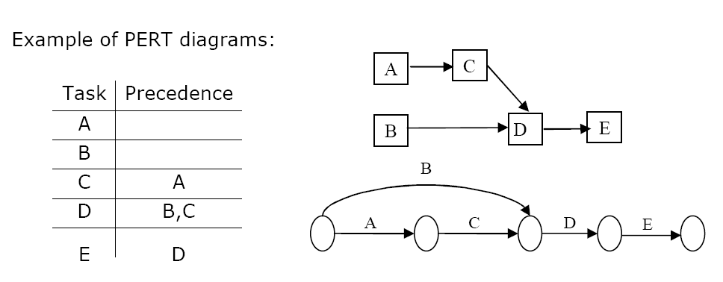
PERT DIAGRAMS
Activity-on-node
Activity-on-arrow
‹#›
Notes:
‹#›
*
Maria Petridou
University of Nottingham

Slide 12
PERT DIAGRAMS
Some basic rules for Activity –on-arrow:
Tasks are represented as arrows
Nodes represent the start and finish points of tasks
There is only one overall start node
There is only one overall finish node
Two tasks cannot share the same start and end node.
B
A
D
2
3
C
Tasks B & C share the same start and end node
‹#›
Notes:
‹#›
*
Maria Petridou
University of Nottingham

Slide 13
DUMMY ACTIVITIES
Sometimes it is necessary to insert dummy activities (duration zero) in order to maintain the clarity of the diagram and the precedence relationships between activities.
In activity-on-arrow PERT diagrams, each activity must be uniquely identifiable by its start and end nodes.
However, sometimes multiple tasks have the same predecessors and successors.
‹#›
Notes:
‹#›
*
Maria Petridou
University of Nottingham

Slide 14
DUMMY ACTIVITIES
Case One
A task should be uniquely identifiable from its start node and finish node
This means that two or more tasks cannot share the same start and finish nodes
B
1
A
2
3
D
4
Task D has immediate predecessors of B and C
C
Tasks B and C have the same start and finish nodes
‹#›
Notes:
‹#›
*
Maria Petridou
University of Nottingham

Slide 15
DUMMY ACTIVITIES
Inserting a dummy activity can ensure that multiple tasks have different successors.
A
B
D
1
2
3
5
C
A new node is inserted to give C a different finish node to B
A dummy task is inserted to preserve the immediate predecessors of D
4
‹#›
Notes:
‹#›
*
Maria Petridou
University of Nottingham

Slide 16
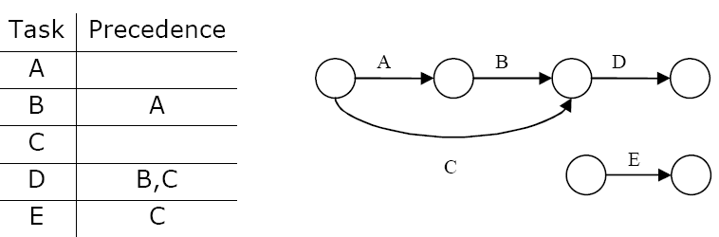
DUMMY ACTIVITIES
Case Two
A task should be uniquely identifiable from its start node and finish node
This also means that a task cannot have more than one start node and one finish node
In other words… two different arrows cannot represent the same task.
‹#›
Notes:
‹#›
*
Maria Petridou
University of Nottingham

Slide 17
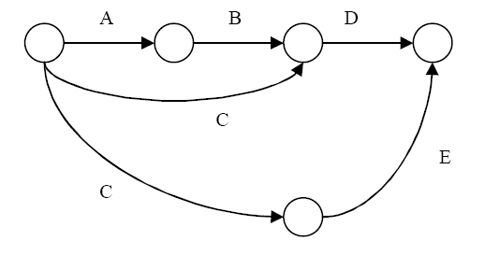
DUMMY ACTIVITIES
Possible Solution Two
Another option would be to insert activity E as shown below, but this provokes C to have two different end nodes.
Two ending nodes for Task C
‹#›
Notes:
‹#›
*
Maria Petridou
University of Nottingham

Slide 18
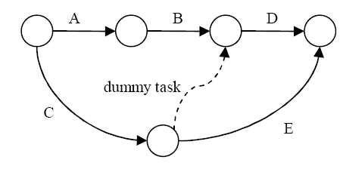
DUMMY ACTIVITIES
Correct Solution!
The solution is to insert a dummy task so that the precedence of E is preserved and activity C remains uniquely identifiable.
‹#›
Notes:
‹#›
*
Maria Petridou
University of Nottingham

Slide 19
CPM – CRITICAL PATH METHOD
It is determined by adding the times for the activities in each sequence.
CPM determines the total calendar time required for the project.
If activities outside the critical path speed up or slow down (within limits), the total project time does not change.
The amount of time that a non-critical activity can be delayed without delaying the project is called slack-time.
‹#›
Notes:
‹#›
*
Maria Petridou
University of Nottingham

Slide 20
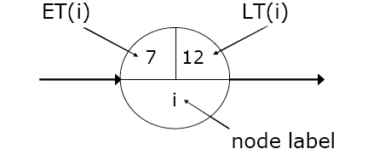
CPM – CRITICAL PATH METHOD
ET – Earliest node time for given activity duration and precedence relationships
LT – Latest node time assuming no delays
ES – Activity earliest start time
LS – Activity latest start time
EF – Activity earliest finishing time
LF – Activity latest finishing time
Slack Time – Maximum activity delay time
‹#›
Notes:
‹#›
*
Maria Petridou
University of Nottingham

Slide 21
CPM – CRITICAL PATH METHOD
Step 1. Calculate ET for each node.
For each node i for which predecessors j are labelled with ET(j), ET(i) is given
by:
ET(i)= maxj [ET(j)+ t(j,i)]
where t(j,i) is the duration of task between nodes (j,i).
Step 2. Calculate LT for each node.
For each node i for which successors j are labelled with LT(j), LT(i) is given by:
LT(i)= minj [LT(j) – t(i,j)]
where t(j,i) is the duration of task between nodes (i,j).
‹#›
Notes:
‹#›
*
Maria Petridou
University of Nottingham

Slide 22
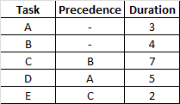
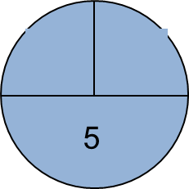
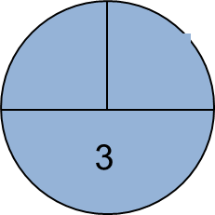
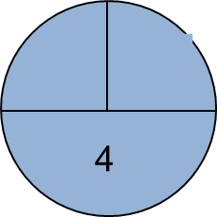
CPM – CRITICAL PATH METHOD
A ( 3 )
2
D ( 5 )
1
B ( 4 )
E ( 2 )
C ( 7 )
‹#›
Notes:
‹#›
*
Maria Petridou
University of Nottingham

Slide 23
CPM – CRITICAL PATH METHOD
A ( 3 )
2
D ( 5 )
0
1
B ( 4 )
E ( 2 )
C ( 7 )
‹#›
Notes:
‹#›
*
Maria Petridou
University of Nottingham

Slide 24
CPM – CRITICAL PATH METHOD
3
A ( 3 )
2
D ( 5 )
0
1
B ( 4 )
E ( 2 )
4
C ( 7 )
‹#›
Notes:
‹#›
*
Maria Petridou
University of Nottingham

Slide 25
CPM – CRITICAL PATH METHOD
3
A ( 3 )
2
D ( 5 )
0
1
B ( 4 )
E ( 2 )
4
C ( 7 )
11
‹#›
Notes:
‹#›
*
Maria Petridou
University of Nottingham

Slide 26
CPM – CRITICAL PATH METHOD
3
13
A ( 3 )
2
D ( 5 )
0
1
B ( 4 )
E ( 2 )
4
C ( 7 )
11
‹#›
‹#›
Notes:
‹#›
*
Maria Petridou
University of Nottingham

Slide 27
CPM – CRITICAL PATH METHOD
3
13
A ( 3 )
2
D ( 5 )
8
0
1
B ( 4 )
E ( 2 )
4
C ( 7 )
11
‹#›
‹#›
Notes:
‹#›
*
Maria Petridou
University of Nottingham

Slide 28
CPM – CRITICAL PATH METHOD
3
13
A ( 3 )
8
max
2
D ( 5 )
0
1
B ( 4 )
E ( 2 )
4
C ( 7 )
11
‹#›
‹#›
Notes:
‹#›
*
Maria Petridou
University of Nottingham

Slide 29
CPM – CRITICAL PATH METHOD
3
A ( 3 )
2
D ( 5 )
0
13
1
B ( 4 )
E ( 2 )
4
C ( 7 )
11
‹#›
Notes:
‹#›
*
Maria Petridou
University of Nottingham

Slide 30
CPM – CRITICAL PATH METHOD
3
A ( 3 )
2
D ( 5 )
0
13
13
1
B ( 4 )
E ( 2 )
4
C ( 7 )
11
‹#›
Notes:
‹#›
*
Maria Petridou
University of Nottingham

Slide 31
CPM – CRITICAL PATH METHOD
3
A ( 3 )
2
D ( 5 )
0
13
13
1
B ( 4 )
E ( 2 )
4
C ( 7 )
11
11
‹#›
Notes:
‹#›
*
Maria Petridou
University of Nottingham

Slide 32
CPM – CRITICAL PATH METHOD
3
8
A ( 3 )
2
D ( 5 )
0
13
13
1
B ( 4 )
E ( 2 )
4
C ( 7 )
11
11
‹#›
Notes:
‹#›
*
Maria Petridou
University of Nottingham

Slide 33
CPM – CRITICAL PATH METHOD
3
8
A ( 3 )
2
D ( 5 )
0
13
13
1
B ( 4 )
E ( 2 )
4
4
C ( 7 )
11
11
‹#›
Notes:
‹#›
*
Maria Petridou
University of Nottingham

Slide 34
CPM – CRITICAL PATH METHOD
5
3
8
A ( 3 )
2
D ( 5 )
0
13
13
1
B ( 4 )
E ( 2 )
4
4
C ( 7 )
11
11
‹#›
‹#›
Notes:
‹#›
*
Maria Petridou
University of Nottingham

Slide 35
CPM – CRITICAL PATH METHOD
5
3
8
0
A ( 3 )
2
D ( 5 )
0
13
13
1
B ( 4 )
E ( 2 )
4
4
C ( 7 )
11
11
‹#›
‹#›
Notes:
‹#›
*
Maria Petridou
University of Nottingham

Slide 36
CPM – CRITICAL PATH METHOD
5
3
8
min
0
A ( 3 )
2
D ( 5 )
0
13
13
1
B ( 4 )
E ( 2 )
4
4
C ( 7 )
11
11
‹#›
‹#›
Notes:
‹#›
*
Maria Petridou
University of Nottingham

Slide 37
CPM – CRITICAL PATH METHOD
3
8
A ( 3 )
2
D ( 5 )
0
0
13
13
1
B ( 4 )
E ( 2 )
4
4
C ( 7 )
11
11
‹#›
Notes:
‹#›
*
Maria Petridou
University of Nottingham

Slide 38
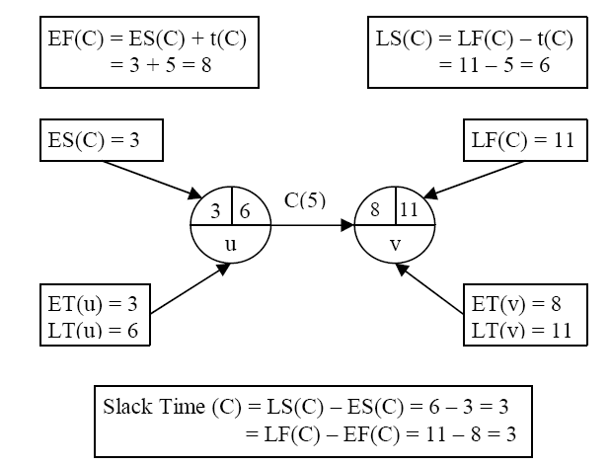
CPM – CRITICAL PATH METHOD
An activity with zero slack time is a critical activity and cannot be delayed without causing a delay in the whole project.
‹#›
Notes:
‹#›
*
Maria Petridou
University of Nottingham

Slide 39
CPM – CRITICAL PATH METHOD
Step 3. Calculate processing times for each activity.
For each activity X with start node i and end node j:
ES(X) = ET(i)
EF(X) = ES(X) + t(X)
LF(X) = LT(j)
LS(X) = LF(X) – t(X)
Slack Time (X) = LS(X) – ES(X) = LF(X) – EF(X)
Where t(X) is the duration of activity X.
An activity with zero slack time is a critical activity and cannot be delayed without causing a delay in the whole project.
‹#›
Notes:
‹#›
*
Maria Petridou
University of Nottingham

Slide 40
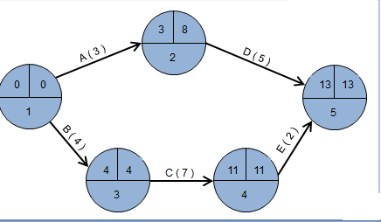
CPM – CRITICAL PATH METHOD
Step 3. Calculate processing times for each activity.
Task | Duration | ES | EF | LS | LF | Slack | Critical Task
A | 3 | 0 | 3 | 5 | 8 | 5 | No
B | 4 | 0 | 4 | 0 | 4 | 0 | Yes
C | 7 | 4 | 11 | 4 | 11 | 0 | Yes
D | 5 | 3 | 8 | 8 | 13 | 5 | No
E | 2 | 11 | 13 | 11 | 13 | 0 | Yes
Reading: (Kendall&Kendall, chapter 3), (Dennis &Wixom, chapter 3)
Notes:
‹#›
*
Maria Petridou
University of Nottingham

Slide 41
CPM – CRITICAL PATH METHOD
3
8
A ( 3 )
2
D ( 5 )
0
0
13
13
1
B ( 4 )
E ( 2 )
4
4
C ( 7 )
11
11
‹#›
Notes:
‹#›
*
Maria Petridou
University of Nottingham

Slide 42
LECTURE – GANTT CHART
GANTT Charts
Constructing GANTT Charts
Staffing and Re-scheduling
Project Management Software
‹#›

Slide 43
GANTT CHART
A GANTT chart is a type of bar chart that illustrates a project schedule.
After the PERT/CPM analysis is completed, the following phase is to construct the GANTT chart and then to re-allocate resources and re-schedule if necessary.
GANTT charts have become a common technique for representing the phases and activities of a project work breakdown structure.
It was introduced by Henry Gantt around 1910 – 1915.
‹#›
Notes:
‹#›
*
Maria Petridou
University of Nottingham

Slide 44
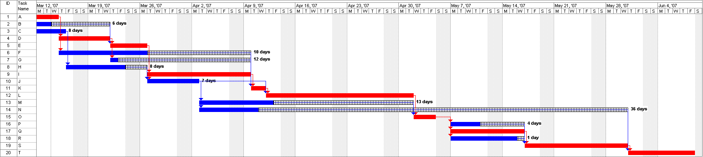
GANTT CHART
‹#›
Notes:
‹#›
*
Maria Petridou
University of Nottingham

Slide 45
GANTT CHART
Characteristics:
The bar in each row identifies the corresponding task
The horizontal position of the bar identifies start and end times of the task
Bar length represents the duration of the task
Task durations can be compared easily
Good for allocating resources and re-scheduling
Precedence relationships can be represented using arrows
Critical activities are usually highlighted
Slack times are represented using bars with doted lines
The bar of each activity begins at the activity earliest start time (ES)
The bar of each activity ends at the activity latest finish time (LF).
‹#›
Notes:
‹#›
*
Maria Petridou
University of Nottingham

Slide 46
GANTT CHART
Advantages
Simple
Good visual communication to others
Task durations can be compared easily
Good for scheduling resources
Disadvantages
Dependencies are more difficult to visualise
Minor changes in data can cause major changes in the chart
‹#›
Notes:
‹#›
*
Maria Petridou
University of Nottingham

Slide 47
CONSTRUCTING GANTT CHART
The steps to construct a GANTT chart from the information obtained by PERT/CPM are:
Schedule the critical tasks in the correct position.
Place the time windows in which the non-critical tasks can be scheduled.
Schedule the non-critical tasks according to their earliest starting times.
Indicate precedence relationships between tasks.
‹#›
Notes:
‹#›
*
Maria Petridou
University of Nottingham

Slide 48
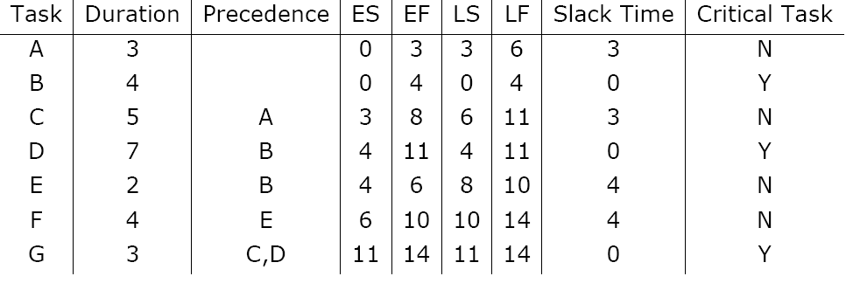
CONSTRUCTING GANTT CHART
Example of an early GANTT chart construction:
‹#›
Notes:
‹#›
*
Maria Petridou
University of Nottingham

Slide 49
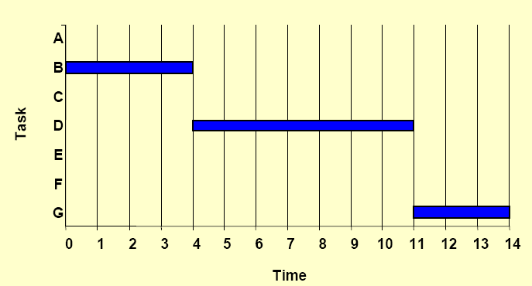
CONSTRUCTING GANTT CHART
Step 1. Schedule critical tasks:
‹#›
Notes:
‹#›
*
Maria Petridou
University of Nottingham

Slide 50
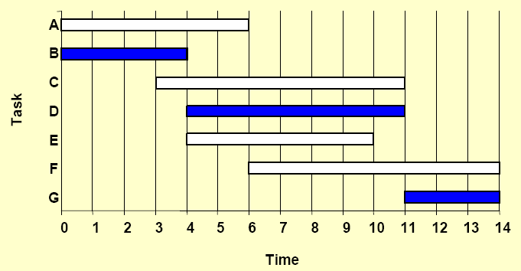
CONSTRUCTING GANTT CHART
Step 2. Place time windows for non-critical tasks:
‹#›
Notes:
‹#›
*
Maria Petridou
University of Nottingham

Slide 51
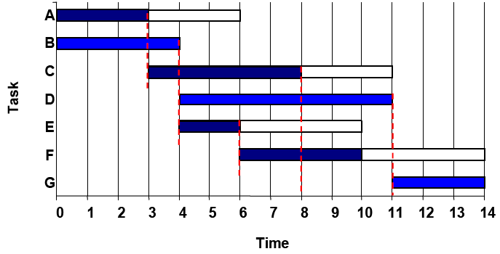
CONSTRUCTING GANTT CHART
Step 3. Schedule non-critical tasks
Step 4. Indicate precedence relationships:
‹#›
Notes:
‹#›
*
Maria Petridou
University of Nottingham

Slide 52
STAFFING & RE-SCHEDULING
Once the project schedule, (e.g. GANTT chart), has been constructed, take into account
available staff hours
slack times and
the project schedule
Assign staff and other resources to each activity in the project
‹#›
Notes:
‹#›
*
Maria Petridou
University of Nottingham

Slide 53
STAFFING & RE-SCHEDULING
Resource Smoothing is a technique used to re-allocate resources and re-schedule activities.
In resource smoothing, non-critical tasks are re-scheduled within their time window.
Staff Utilization:(duration of activity x staff required for each activity, all added together) / (maximum staff required x duration of project)
‹#›
Notes:
‹#›
*
Maria Petridou
University of Nottingham

Slide 54
STAFFING & RE-SCHEDULING
Example1
‹#›
Notes:
‹#›
*
Maria Petridou
University of Nottingham

Slide 55
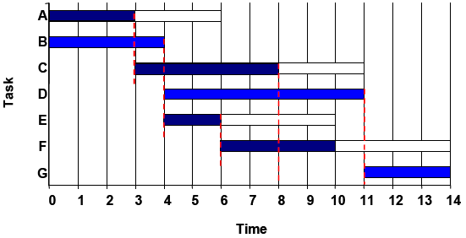
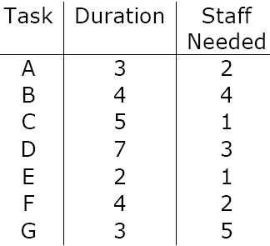
STAFFING & RE-SCHEDULING
The original schedule (constructed above) for this project is as shown below.
1. Staff utilisation = (3x2+4x4+5x1+7x3+2x1+4x2+3x5)/(14x6) = 0.857 = 85.5%
‹#›
Notes:
‹#›
*
Maria Petridou
University of Nottingham

Slide 56
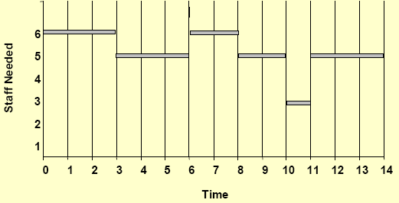
STAFFING & RE-SCHEDULING
2. Work out the Staff Profile
‹#›
Notes:
‹#›
*
Maria Petridou
University of Nottingham

Slide 57
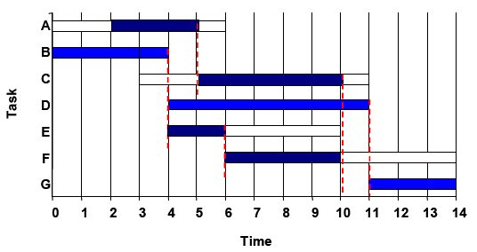
STAFFING & RE-SCHEDULING
Now, assume that there are 6 people available for working in this project but one of them returns from holidays at time=2.
So re-scheduling is needed because activities A and B cannot be carried out in parallel until time=2.
‹#›
Notes:
‹#›
*
Maria Petridou
University of Nottingham

Slide 58
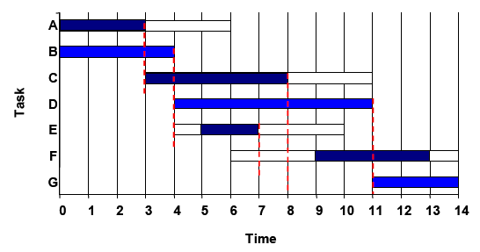
STAFFING & RE-SCHEDULING
Suppose another scenario in which equipment and materials needed to carry out activities E and F are available at time=5 and time=9 respectively instead of being available at the activities ES time. Then, rescheduling is needed but the overall duration of the project is not affected.
‹#›
Notes:
‹#›
*
Maria Petridou
University of Nottingham

Slide 59
STAFFING & RE-SCHEDULING
The obvious way to reduce the overall project duration, it is by reducing the duration of the critical activities.
Crashing Critical Activities refers to reducing the duration of a critical activity by allocating more resources to it.
The risk is that crashing activities may actually reduce productivity and increase costs.
‹#›
Notes:
‹#›
*
Maria Petridou
University of Nottingham

Slide 60
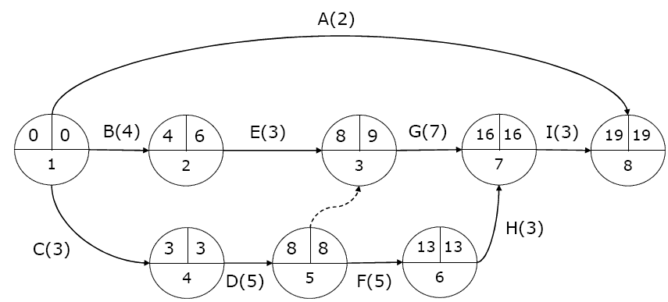
STAFFING & RE-SCHEDULING
Example 2
Apply the PERT/CPM method and construct a GANTT chart for the following list of activities with precedence and duration.
‹#›
Notes:
‹#›
*
Maria Petridou
University of Nottingham

Slide 61
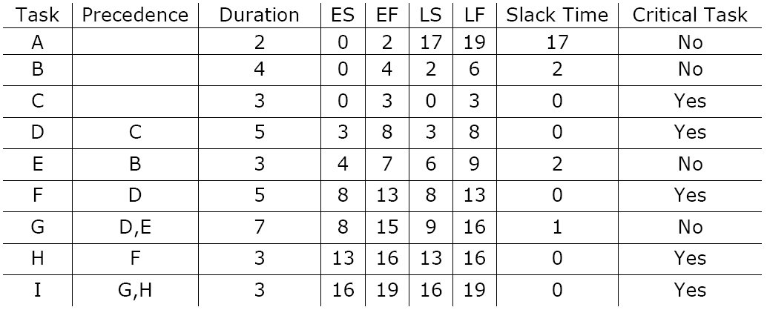
STAFFING & RE-SCHEDULING
‹#›
Notes:
‹#›
*
Maria Petridou
University of Nottingham

Slide 62
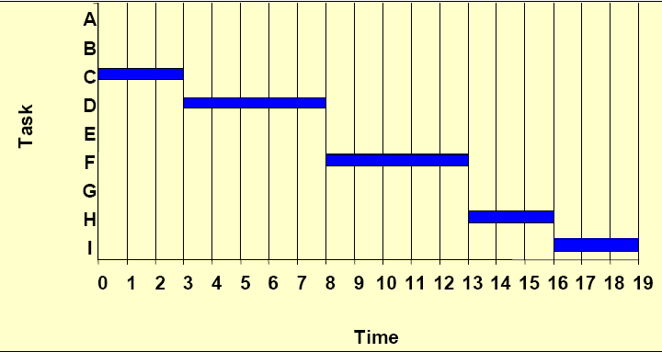
STAFFING & RE-SCHEDULING
Step 1. Schedule critical tasks.
‹#›
Notes:
‹#›
*
Maria Petridou
University of Nottingham

Slide 63
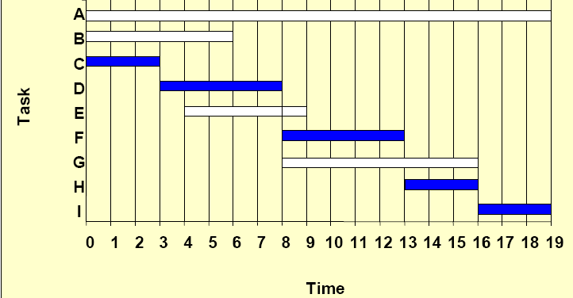
STAFFING & RE-SCHEDULING
Step 2. Place time windows for non-critical tasks:
‹#›
Notes:
‹#›
*
Maria Petridou
University of Nottingham

Slide 64
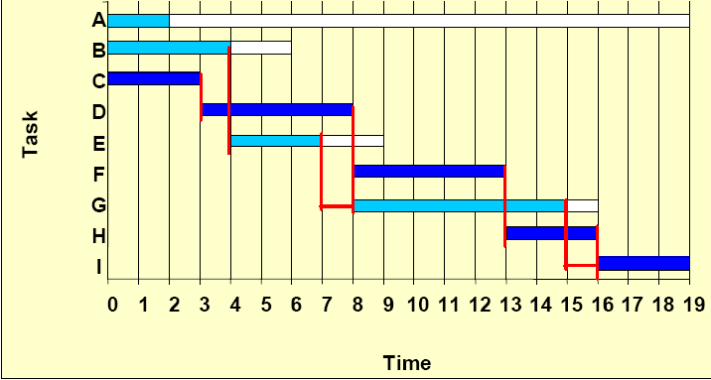
STAFFING & RE-SCHEDULING
Step 3. Schedule non-critical tasks:
Step 4. Indicate precedence relationships:
‹#›
Notes:
‹#›
*
Maria Petridou
University of Nottingham

Slide 65
PROJECT MANAGEMENT SOFTWARE
There are a number of project management software tools available to help in the planning and control of large software development projects.
E.g. MS Project is a CASE software tool for Project Management
Most tools include functions to plan, schedule and control, but decision-making still has to be done by the project manager.
‹#›
Notes:
‹#›
*
Maria Petridou
University of Nottingham

Slide 66
PROJECT MANAGEMENT SOFTWARE
Benefits of project management software:
Calculate project schedule
Resource smoothing
Automatic generation of reports and charts
Limitations of project management software
Allocation of resources to tasks
Estimation of tasks durations
Make decisions
Reading: (Kendall&Kendall, chapter 3), (Dennis &Wixom, chapter 3).
‹#›
Notes:
‹#›
*
Maria Petridou
University of Nottingham

Slide 67
Other
‹#›

Slide 68
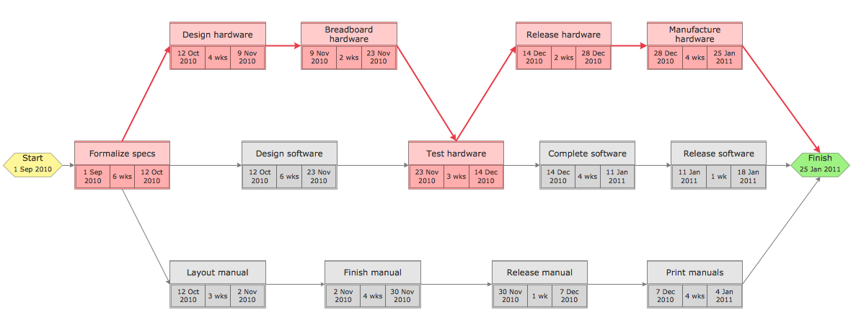
‹#›

Slide 69
EFFORT ALLOCATION
“front end” activities
customer communication
analysis
design
review and modification
construction activities
coding or code generation
testing and installation
unit, integration
white-box, black box
regression
40-50%
15-20%
30-40%
‹#›

Slide 70
TASK SET REFINEMENT
‹#›
1.1 Concept scoping determines the overall scope of the project.
Task definition: Task 1.1 Concept Scoping
1.1.1 Identify need, benefits and potential customers;
1.1.2 Define desired output/control and input events that drive the application;
Begin Task 1.1.2
1.1.2.1 FTR: Review written description of need
FTR indicates that a formal technical review (Chapter 26) is to be conducted.
1.1.2.2 Derive a list of customer visible outputs/inputs
1.1.2.3 FTR: Review outputs/inputs with customer and revise as required;
endtask Task 1.1.2
1.1.3 Define the functionality/behavior for each major function;
Begin Task 1.1.3
1.1.3.1 FTR: Review output and input data objects derived in task 1.1.2;
1.1.3.2 Derive a model of functions/behaviors;
1.1.3.3 FTR: Review functions/behaviors with customer and revise as required;
endtask Task 1.1.3
1.1.4 Isolate those elements of the technology to be implemented in software;
1.1.5 Research availability of existing software;
1.1.6 Define technical feasibility;
1.1.7 Make quick estimate of size;
1.1.8 Create a Scope Definition;
endTask definition: Task 1.1
is refined to

Slide 71
PROGRESS ON AN OO PROJECT-I
Technical milestone: OO analysis completed
All classes and the class hierarchy have been defined and reviewed.
Class attributes and operations associated with a class have been defined and reviewed.
Class relationships (Chapter 8) have been established and reviewed.
A behavioral model (Chapter 8) has been created and reviewed.
Reusable classes have been noted.
Technical milestone: OO design completed
The set of subsystems (Chapter 9) has been defined and reviewed.
Classes are allocated to subsystems and reviewed.
Task allocation has been established and reviewed.
Responsibilities and collaborations (Chapter 9) have been identified.
Attributes and operations have been designed and reviewed.
The communication model has been created and reviewed.
‹#›

Slide 72
PROGRESS ON AN OO PROJECT-II
Technical milestone: OO programming completed
Each new class has been implemented in code from the design model.
Extracted classes (from a reuse library) have been implemented.
Prototype or increment has been built.
Technical milestone: OO testing
The correctness and completeness of OO analysis and design models has been reviewed.
A class-responsibility-collaboration network (Chapter 6) has been developed and reviewed.
Test cases are designed and class-level tests (Chapter 19) have been conducted for each class.
Test cases are designed and cluster testing (Chapter 19) is completed and the classes are integrated.
System level tests have been completed.
‹#›

Slide 73
COMPUTING EARNED VALUE-I
‹#›
The budgeted cost of work scheduled (BCWS) is determined for each work task represented in the schedule.
BCWS_{i} is the effort planned for work task i.
To determine progress at a given point along the project schedule, the value of BCWS is the sum of the BCWS_{i} values for all work tasks that should have been completed by that point in time on the project schedule.
The BCWS values for all work tasks are summed to derive the budget at completion, BAC. Hence,
BAC = ∑ (BCWS_{k}) for all tasks k

Slide 74
COMPUTING EARNED VALUE-II
‹#›
Next, the value for budgeted cost of work performed (BCWP) is computed.
The value for BCWP is the sum of the BCWS values for all work tasks that have actually been completed by a point in time on the project schedule.
“the distinction between the BCWS and the BCWP is that the former represents the budget of the activities that were planned to be completed and the latter represents the budget of the activities that actually were completed.” [Wil99]
Given values for BCWS, BAC, and BCWP, important progress indicators can be computed:
Schedule performance index, SPI = BCWP/BCWS
Schedule variance, SV = BCWP – BCWS
SPI is an indication of the efficiency with which the project is utilizing scheduled resources.

Slide 75
COMPUTING EARNED VALUE-III
‹#›
Percent scheduled for completion = BCWS/BAC
provides an indication of the percentage of work that should have been completed by time t.
Percent complete = BCWP/BAC
provides a quantitative indication of the percent of completeness of the project at a given point in time, t.
Actual cost of work performed, ACWP, is the sum of the effort actually expended on work tasks that have been completed by a point in time on the project schedule. It is then possible to compute
Cost performance index, CPI = BCWP/ACWP
Cost variance, CV = BCWP – ACWP

